Slide 1
Edward’s Aquifer Potentiometric Map
Daria Akhbari
Fall 2014

Slide 2
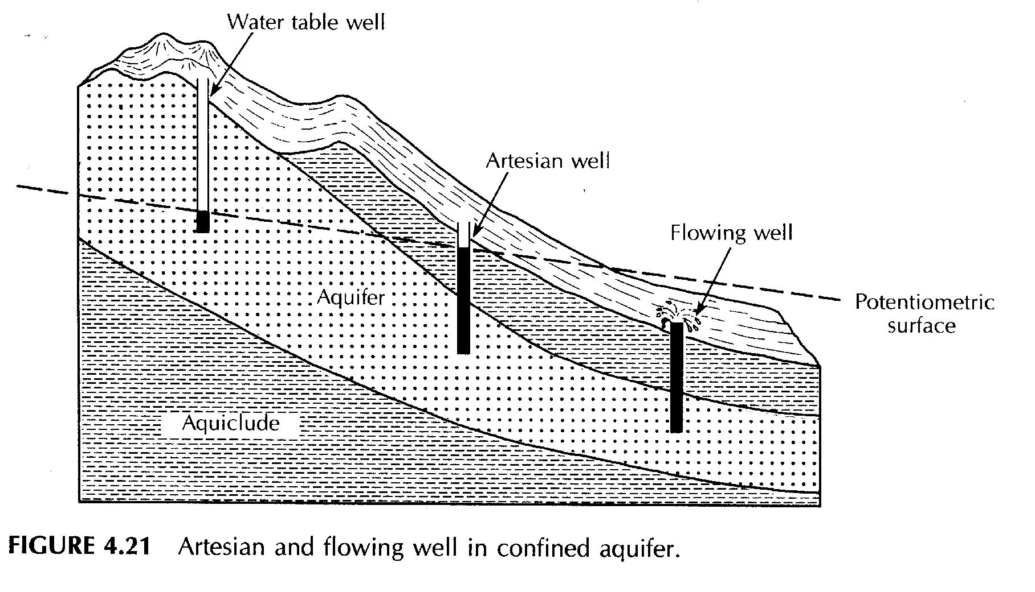
Objective
Construct potentiometric maps for Edward’s aquifer at different periods.

Slide 3
Motivation
To:
Recognize the flow paths in Edwards Aquifer
Observe the spatial and temporal trends in water level changes.
Correlate these changes to hydraulic/hydrologic features of this region.

Slide 4
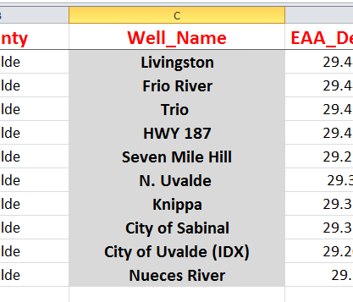
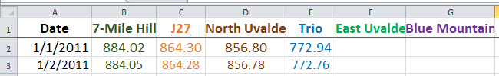
Challenges
How to work with Arc Hydro GW?
Non-organized datasets.

Slide 5
Edwards Aquifer

Slide 6
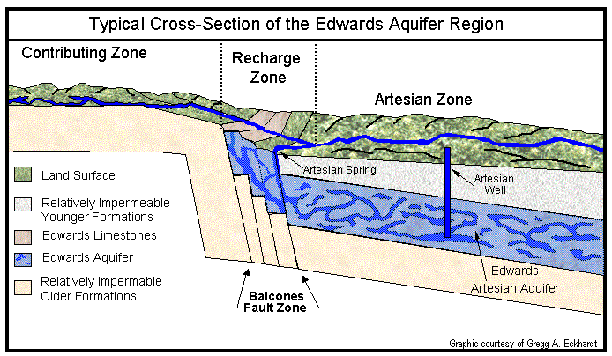
Edwards Aquifer

Slide 7
Digital Elevation Model (DEM)

Slide 8
monitoring wells
Water Levels in Uvalde
Water Levels in Comal
2012
2013
2014
2012
2013
2014

Slide 9
Annual Potentiometric Surfaces
Piezometric Head (ft)
2011
2013

Slide 10
2011-2013
Water Level increase (Ft)
Water Level increase (ft)

Slide 11
Flow path direction

Slide 12
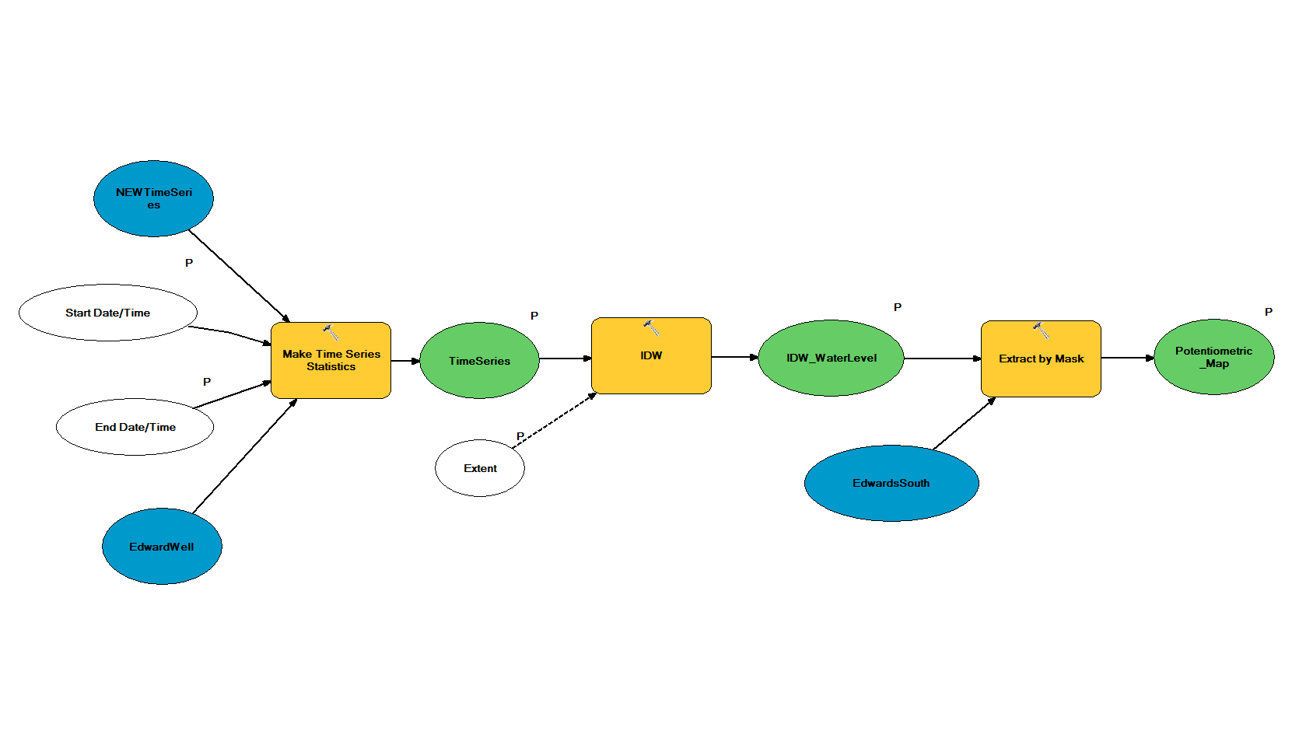
Geo-processing Model

Slide 13
Next Step:
Meaningful Seasonal Changes?
January 2011
August 2011
August 2014
January 2014

Slide 14
Conclusions
A geodatabase consist of water level monitoring was created.
Geo-proccesing model was built to calculate potentiometric surface for different periods.
Water levels in Edwards Aquifer were raised up in the period of 2011 to 2013.
Flow path directions were created for Edwards Aquifer.

Slide 15
Acknowledgments
Dr. Maidment
Dr. Gary for providing me with the water level data.

Slide 16
Thank you!

