Slide 1
Characteristics of Lake Ralph Hall, Upper Trinity Basin, Texas
Mosaed AlraSHIDI
11/18/2014
GIS in Water Resources Fall/2014

Slide 2
Background
Upper Trinity.
Existing water.
Water needs in future.
Source: City of Ladonia Website

Slide 3
Lake Ralph Hall
Reservoir Specifications:
Volume = 180,000 acre-ft
Surface Area = 7,605 acres
Time to Fill Reservoir = 3 years
Source: City of Ladonia Website

Slide 4
Project Objectives
Create Maps in ArcGIS.
Construct a Relationship Between Reservoir Characteristics.
Estimate Time to Fill Reservoir.
Compare Between Proposed Reservoir and ArcGIS Results.
Perform a Flood Frequency Analysis.

Slide 5
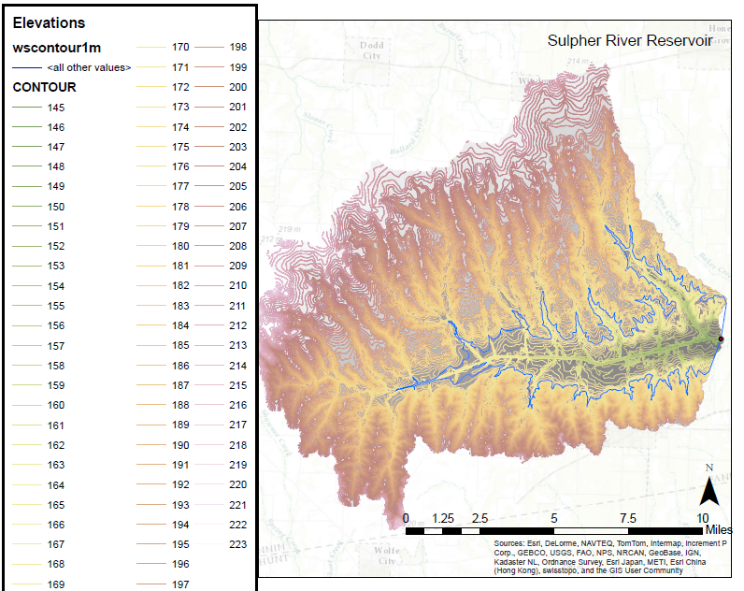
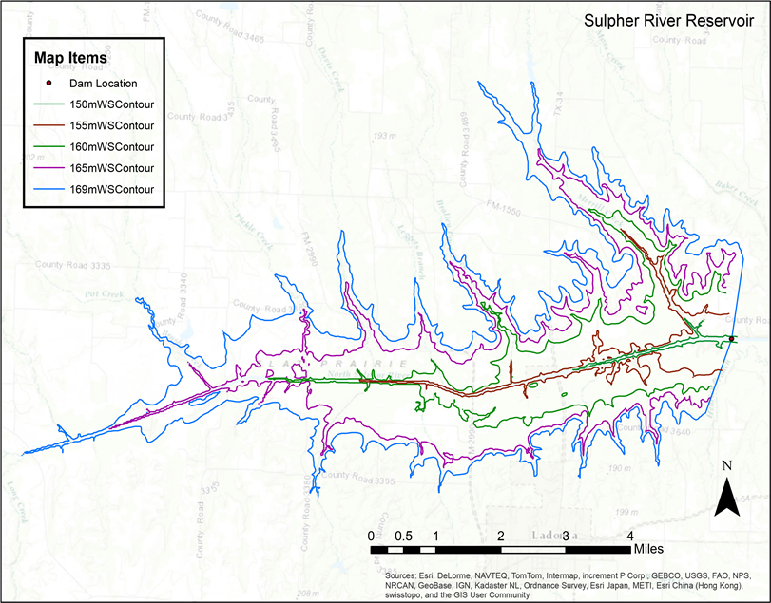
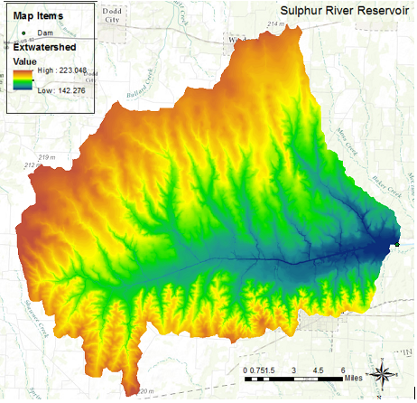
Mapping
Dam Location.
DEM 30m / Watershed.
Contours 1m.
Extracting Specific Elev.

Slide 6
Comparison_Visually
Proposed Layout
Map Created by ArcGIS

Slide 7
Comparison_Volume
Our estimation:
Volume= 178,000 acre-ft
Proposed:
Volume= 180,000 acre-ft
Elev. above sea level= 555 (ft)
Bare earth elev. = 473 (ft)
Dam height = 82 (ft)

Slide 8
Comparison_Surface Area
Our estimation:
Surface Area = 8,000 acres
Proposed:
Surface Area = 7,605 acres
Difference = 5.2% due to different DEM resolutions

Slide 9
Reservoir Filling
$S_{t+1}$= $S_{t}$+ $Q_{t}−R_{t}− L_{t}…(eq.1)$
$S_{t+1}$= $S_{t}$+ $Q_{t}−0.5 Q_{t}…(eq.2)$

Slide 10
Comparison_Time
Our Estimated Time:
Time to Fill Reservoir = 31 months
Proposed:
Time to Fill Reservoir = 36 months
Difference = 13.8% due to different starting time (Wet/Dry season)

Slide 11
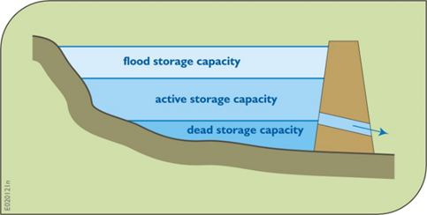
Flood Frequency Analysis
Data Source: USGS website
Separated storage capacities of reservoirs (Loucks& Beek book)
http://nwis.waterdata.usgs.gov/tx/nwis/peak?site_no=07343000&agency_cd=USGS&format=gif

Slide 12
Flood Frequency Analysis
Comparison Between Models (T= 100 years):
Distribution | EV1 |  | LP3
Method | MOM | ML | MOM
x_{T=100} | 90,674 | 97,788 | 76,722
S(x_{T}) | 8,873 | 8,611 | 13,076
x_{T=100}^{L} | 76,079 | 83,625 | 55,214
x_{T=100}^{U} | 105,270 | 111,952 | 98,230
LP3_MOM with different return periods:
T(years) | X_{T}(cfs) | X_{T}^{L}(cfs) | X_{T}^{U}(cfs)
100 | 76,722 | 55,214 | 98,230
50 | 73,122 | 56,878 | 89,366
10 | 60,634 | 54,564 | 66,703
5 | 52,424 | 47,579 | 57,270
2 | 36,186 | 31,156 | 41,215

Slide 13
Flood Frequency Analysis
LP3 with MOM: Flood Water Volume/day
T(years) | X_{T}(cfs) | Volume (acre-ft)
100 | 76,722 | 152,196
50 | 73,122 | 145,055
10 | 60,634 | 120,282
5 | 52,424 | 103,996
2 | 36,186 | 71,783
New Reservoir Volume included flood zone
Returm Period | Volume
T=100 | 180,000 + 152,196 = 332,196
T=50 | 180,000 + 145,055 = 325,055
T=10 | 180,000 +120,282 = 300,282
T=5 | 180,000 + 103,996 = 283,996
T=2 | 180,000 + 71,783 = 251,783

Slide 14
New Reservoir Map
Components | Original | New
Visually | Blue Line | Red Line
Elevation (ft) | 555 | 570
Dam Height (ft) | 82 | 97
Volume (acre-ft) | 180,000 | 332,196
Surface Area (acres) | 7,605 | 12,000

Slide 15
Future Work
Water Balance of the Reservoir (NASA Land Data Assimilation System).
Time Series Analysis(AR(1), AR(2), ARMA(1,1)) for the N. Sulphur River.
* To generate synthetic data from 2015 to 2018.
* Data Source: http://waterdata.usgs.gov/tx/nwis/dv/?site_no=07343000&agency_cd=USGS&amp;referred_module=sw

Slide 16
Acknowledgements
Drs. David Maidment & Paola Passalacqua.
TA: Gonzalo Espinoza

Slide 17
References
Dr. Maidment Website: http://www.caee.utexas.edu/prof/maidment/giswr2013/giswr2013.htm
Dr. Paola Class: Stochastic Hydrology
Helsel D.R., and R.M. Hirsch, Statistical Methods in Water Resources, Techniques of Water Resources Investigations Book 4, Chapter A3, September 2002, available free of charge at: http://pubs.usgs.gov/twri/twri4a3/html/pdf_new.html
Kite, G.W., Frequency and Risk Analyses in Hydrology, Water Resources Publications, Fort Collins, CO, 1977.
Loucks, Daniel P. and Eelco van Beek, Water Resources Systems Planning and Management: An Introduction to Methods, Models and Applications, UNESCO, Paris, 2005

Slide 18
Thank you! Questions?

