Slide 1
Channel Identification in the Guadalupe Delta and Bayou System
Richard Carothers
11 November, 2014

Slide 2
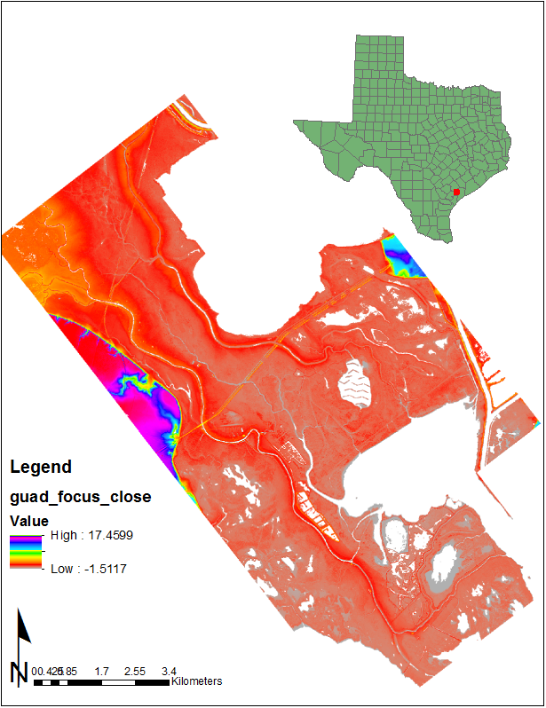
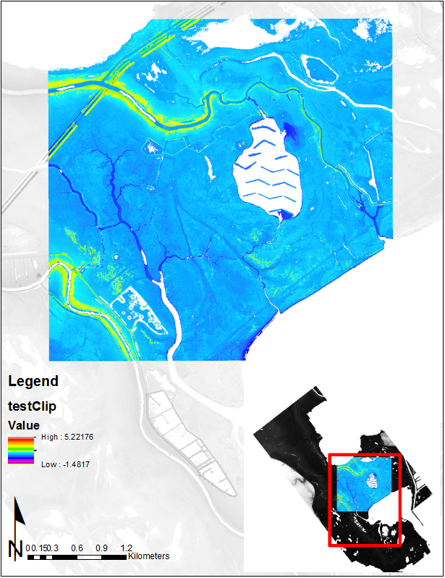
Study Area
General Purpose
Identify water surfaces channels with an automated or semi-automated process
Lower Guadalupe basin emptying into Mission Lake in SE TX in Calhoun, Refugio, Victoria counties.
1 m resolution Lidar dataset approximately 15 km by 25 km though the actual study area likely smaller

Slide 3
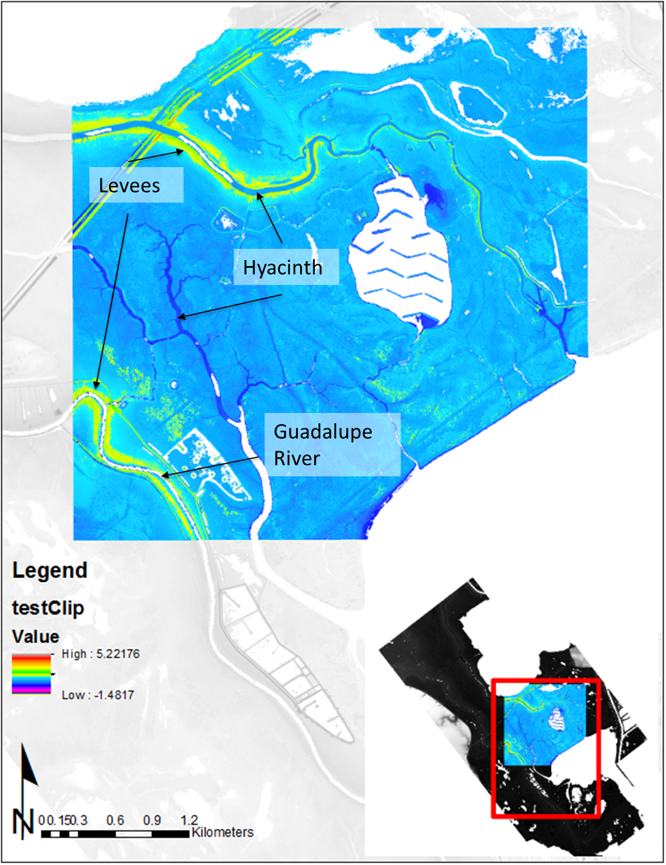
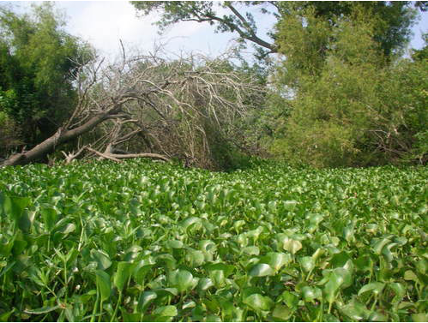
Problem
Normal Method
Water surface inhibits the reflection of laser waves providing “no return” or no elevation data
Water hyacinth sits atop water and return signal as land

Slide 4
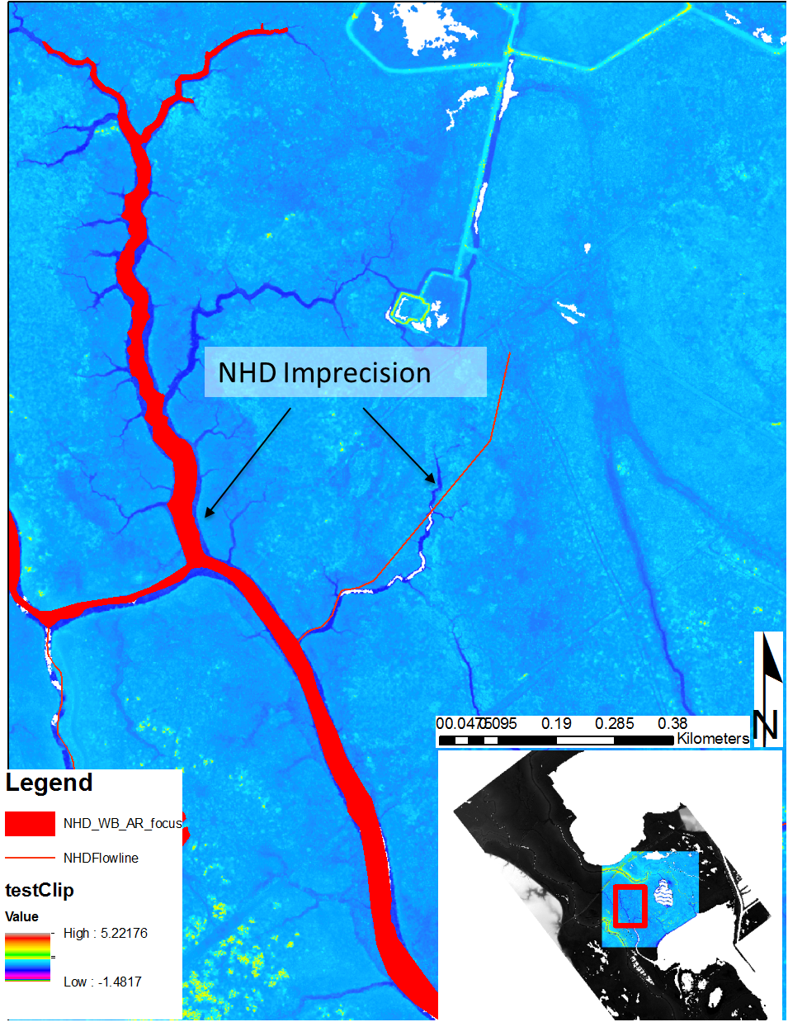
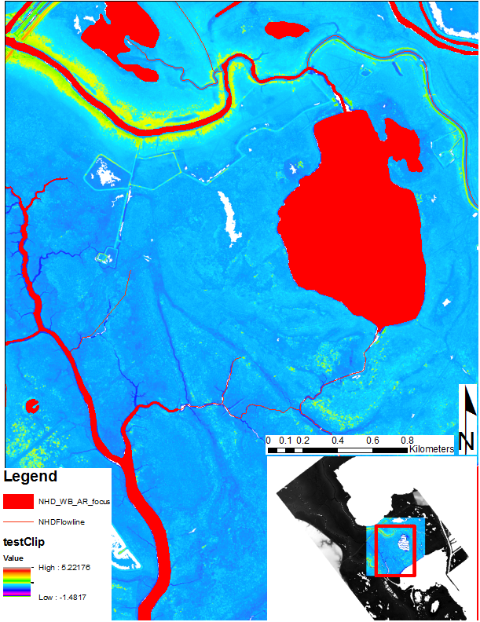
NHD Dataset
Original NHD dataset provides features of water bodies, water “areas”, and flow lines
… But the dataset can be imprecise and even inaccurate

Slide 5
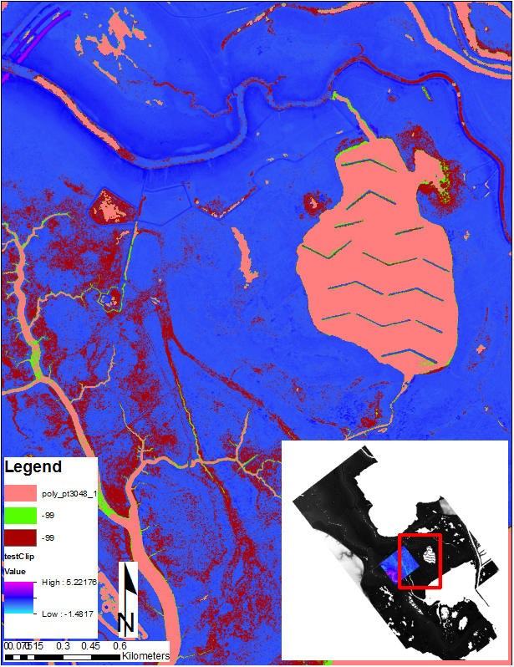
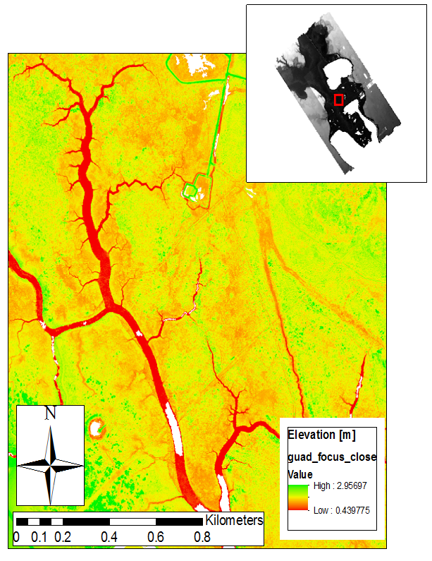
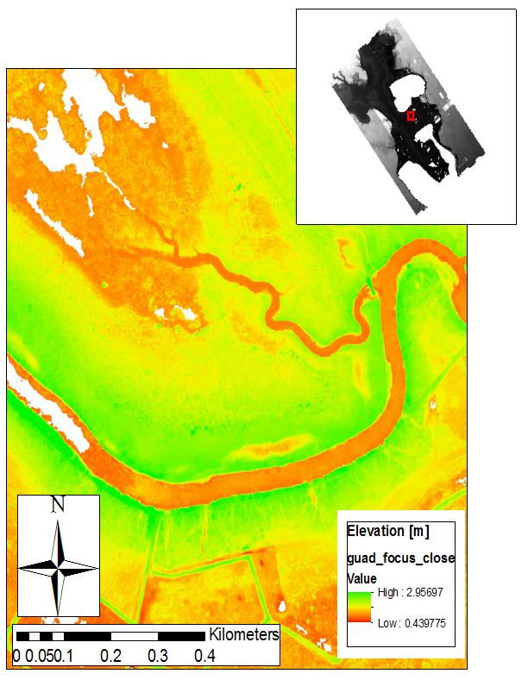
Thresholding
Set elevation and/or slope thresholds to extract likely water surface locations.
This works well in some areas.
Marsh
(land/aquatic veg)
Aquatic Vegetation
No Data
(water surface)
No Data
(water surface)
However, it works quite poorly in others.
Aquatic Vegetation

Slide 6
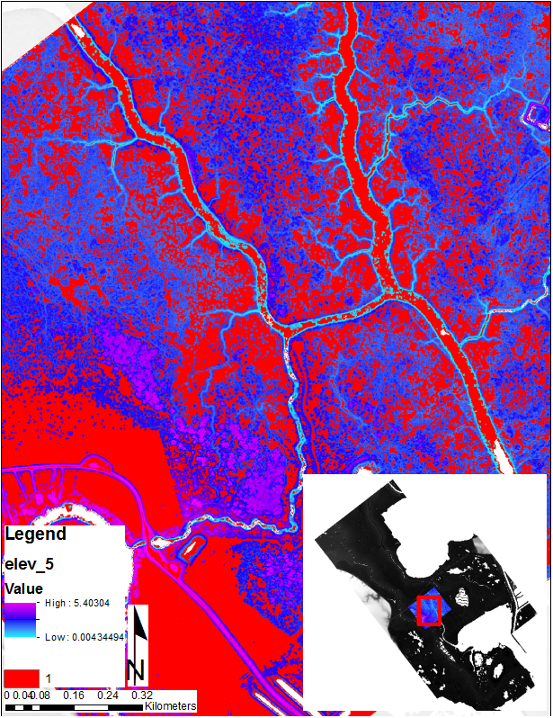
Other methods
TerEX toolbox
Developed by Patrick Belmont et al at Utah State
(http://www.cnr.usu.edu/htm/facstaff/belmont-hydrology-and-fine-sediment-lab/belmont-lab-resources)
Image Processing toolbox
Provides a variety of filters to enhance feature contrast
Filter example taken from ESRI:
http://help.arcgis.com/en/arcgisdesktop/10.0/help/index.html#/Convolution_function/009t0000004s000000/

Slide 7
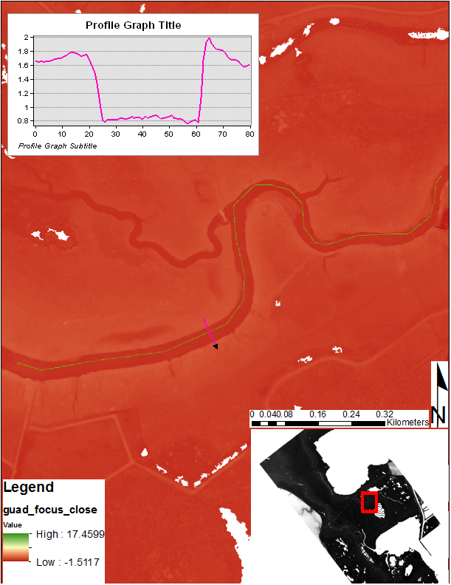
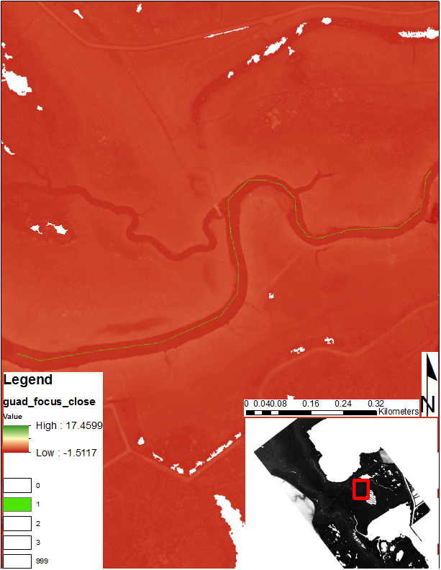
Current Work
Bank identification by semi-automated cross section analysis
Develop custom flow lines based on NHD edits
Import into MATLAB and extract banks using feature of GeoNet2.0
Import bank locations back into GIS
Connect points to make polygons

Slide 8
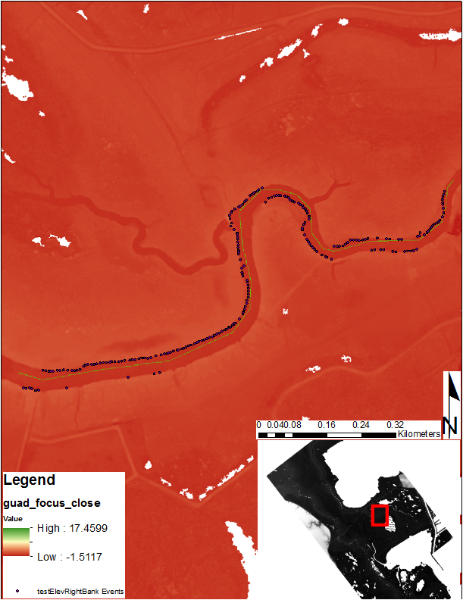
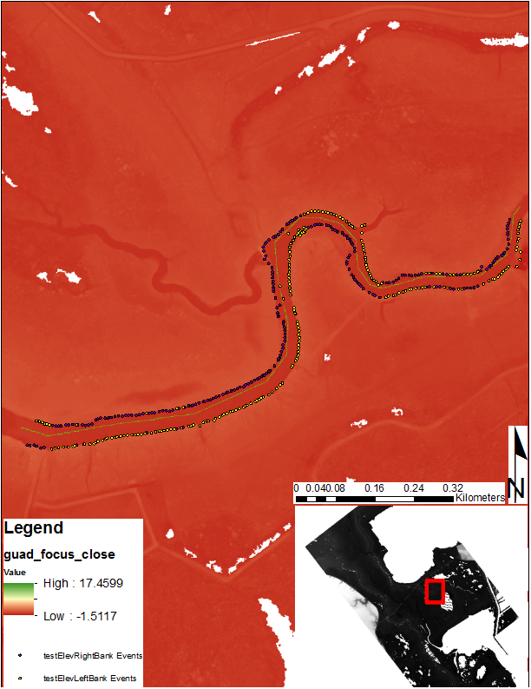
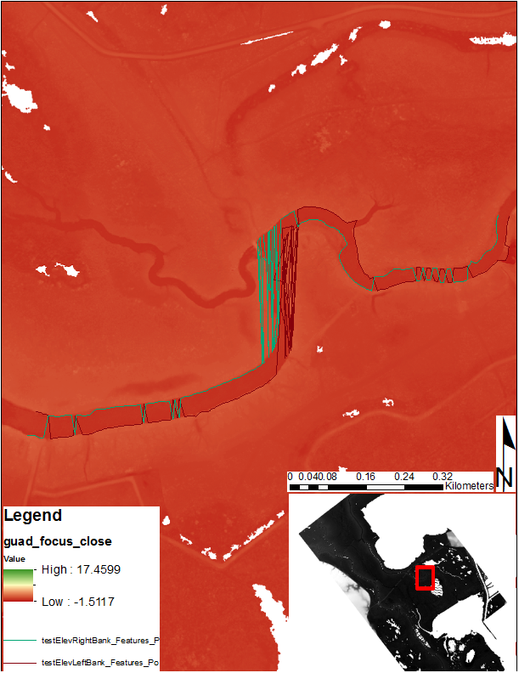
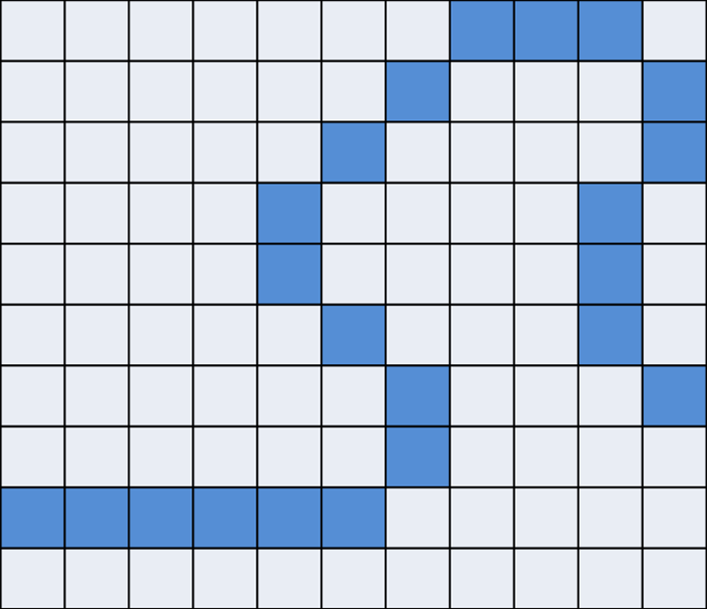
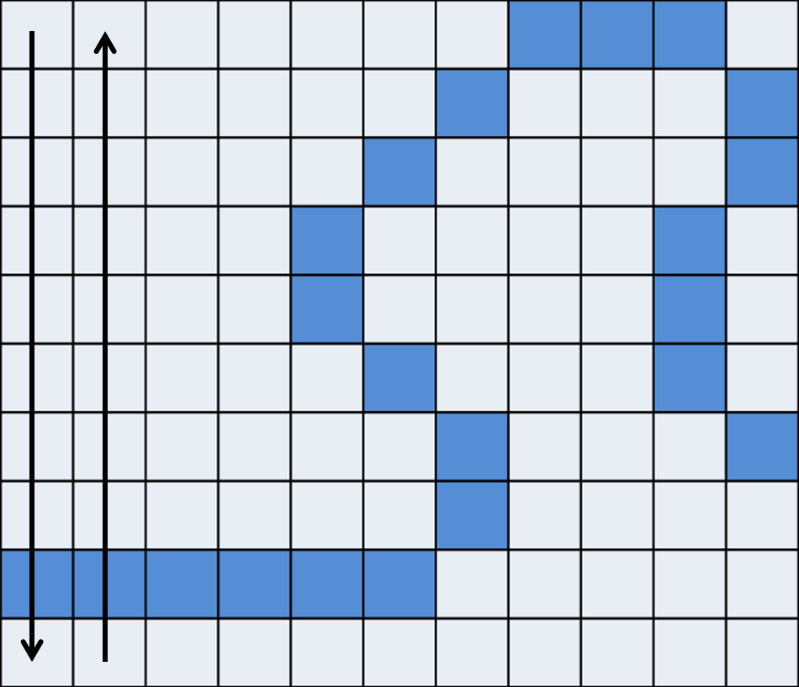
Problems
Cross sections work OK
Bank extraction works pretty well
Major problems with connections
Issue has to do with vector vs raster analysis

Slide 9
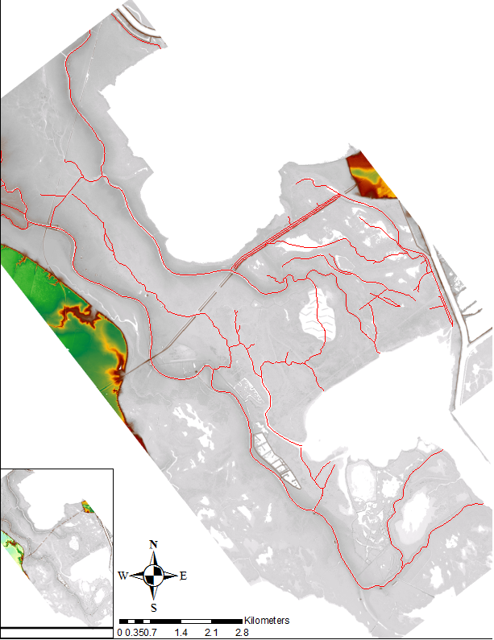
Future Work
Either recode GeoNet2.0 or try HEC-RAS/GeoRas for bank extraction
Interpolate water surface elevations for area
Bathtub inundation model to establish connectivities

