Slide 1
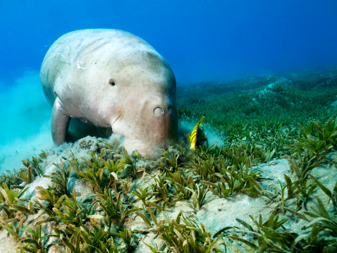
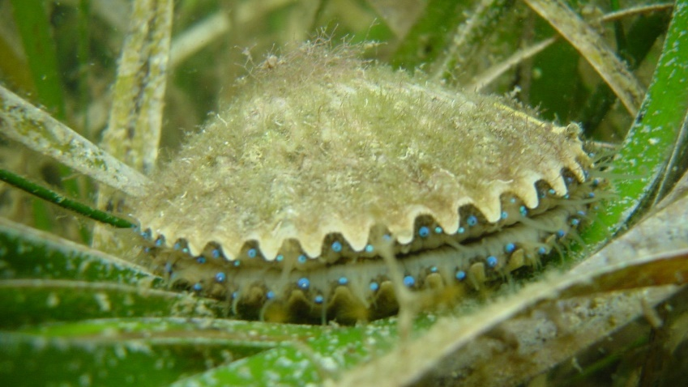
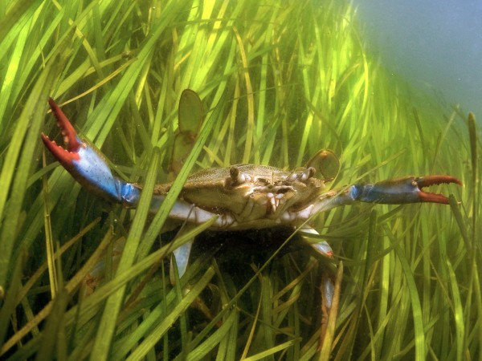
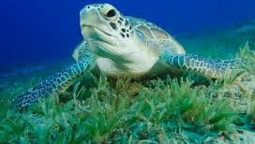
Characterization of seagrass on the Texas coast by Victoria Congdon

Slide 2
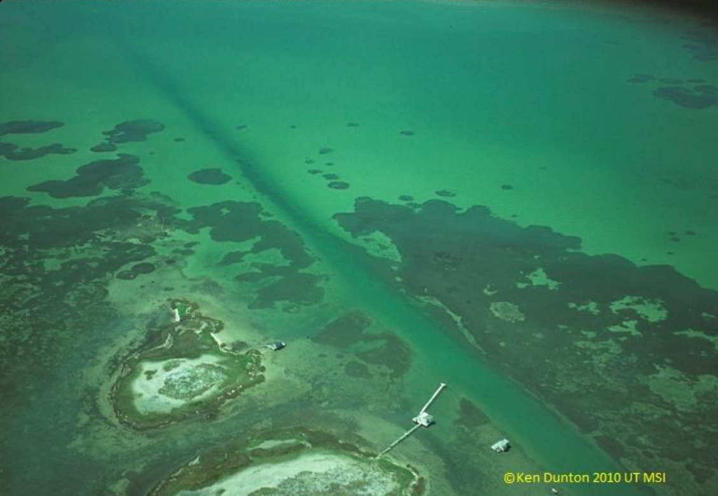
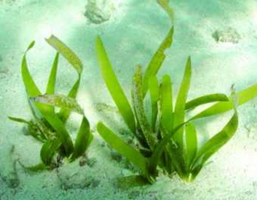
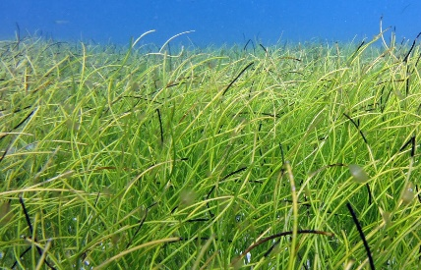
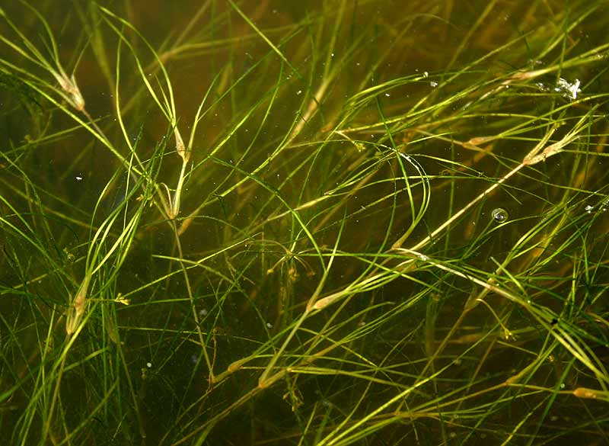
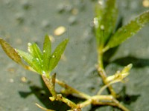
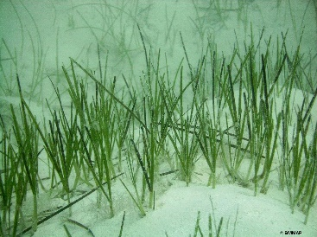
Introduction
Goal
Determine seagrass distribution using light attenuation as a proxy
How?
Use of GIS to:
Acquire data
Spatial analyses
Interpret results
Predict spatial variation

Slide 3
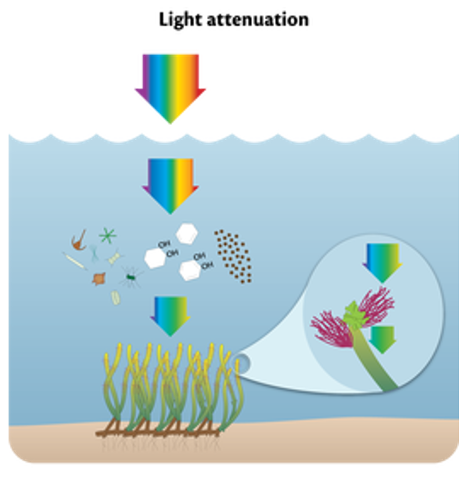
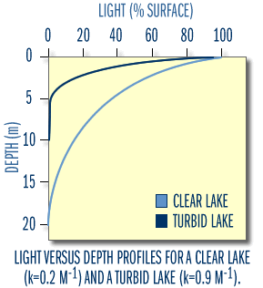
Background
Light Attenuation
Rate at which light is absorbed or scattered
Can limit photosynthesis
Increased attenuation = potential negative effects on seagrass

Slide 4
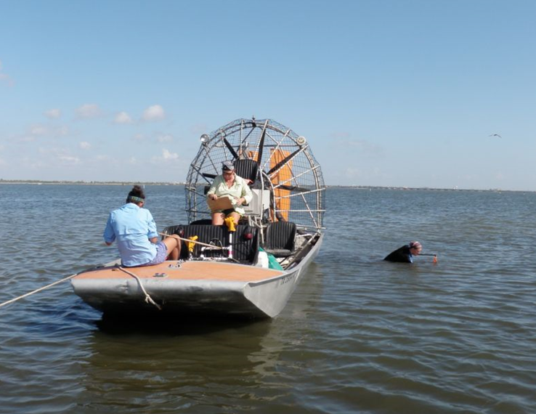
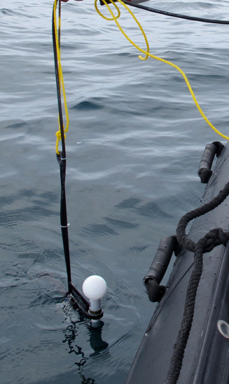
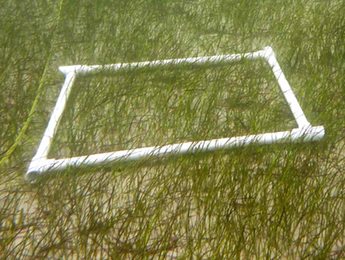
Data Acquisition
TX Seagrass Monitoring Program
2011-present
Four systems along TX coast (567 sites)
NERR: 57
CCBAY: 81
ULM: 144
LLM: 285
Light attenuation
Seagrass percent cover

Slide 5
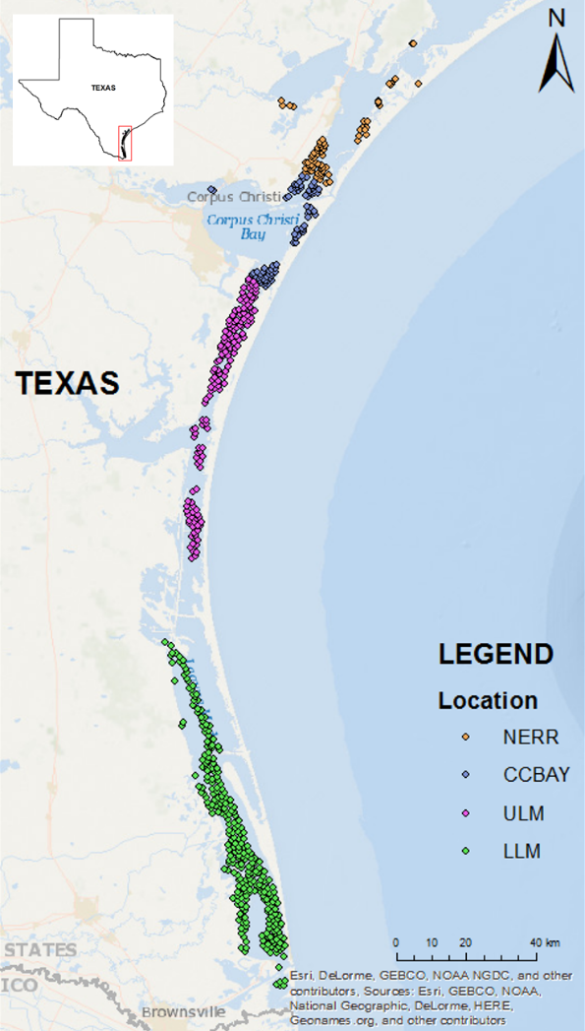
Study Location
Import Excel Table
Export Data
Create:
Geodatabase
Feature dataset
Characterize Layer Properties
Feature class

Slide 6
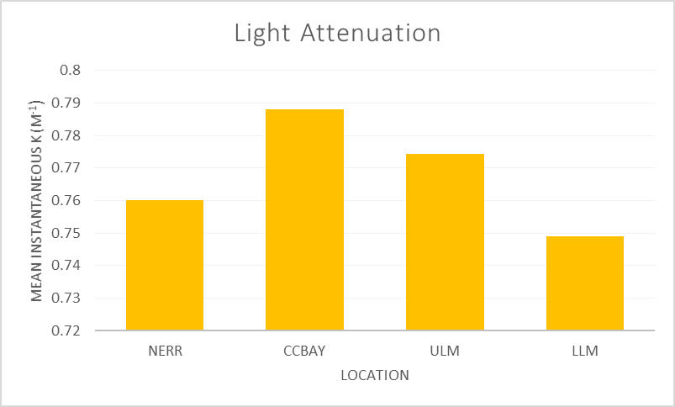
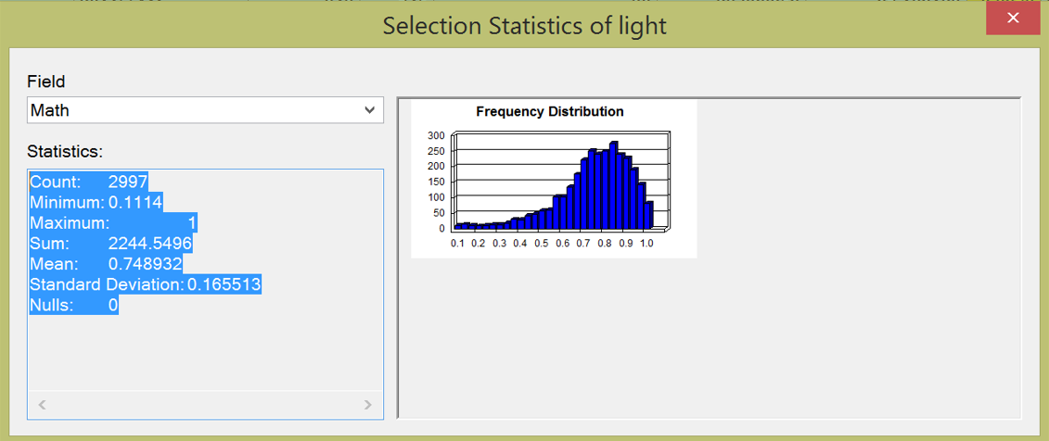
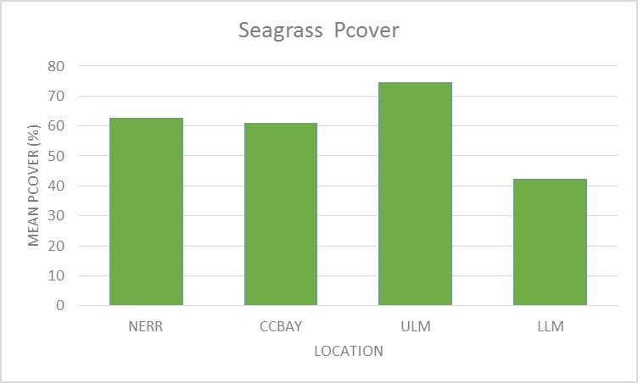
Data Analyses
Select by Attribute
Definition Query
Predict: low light attenuation = greater Pcover
Do we see this?

Slide 7
NERR
Is there a relationship?

Slide 8
CCBAY
Is there a relationship?

Slide 9
ULM
Is there a relationship?

Slide 10
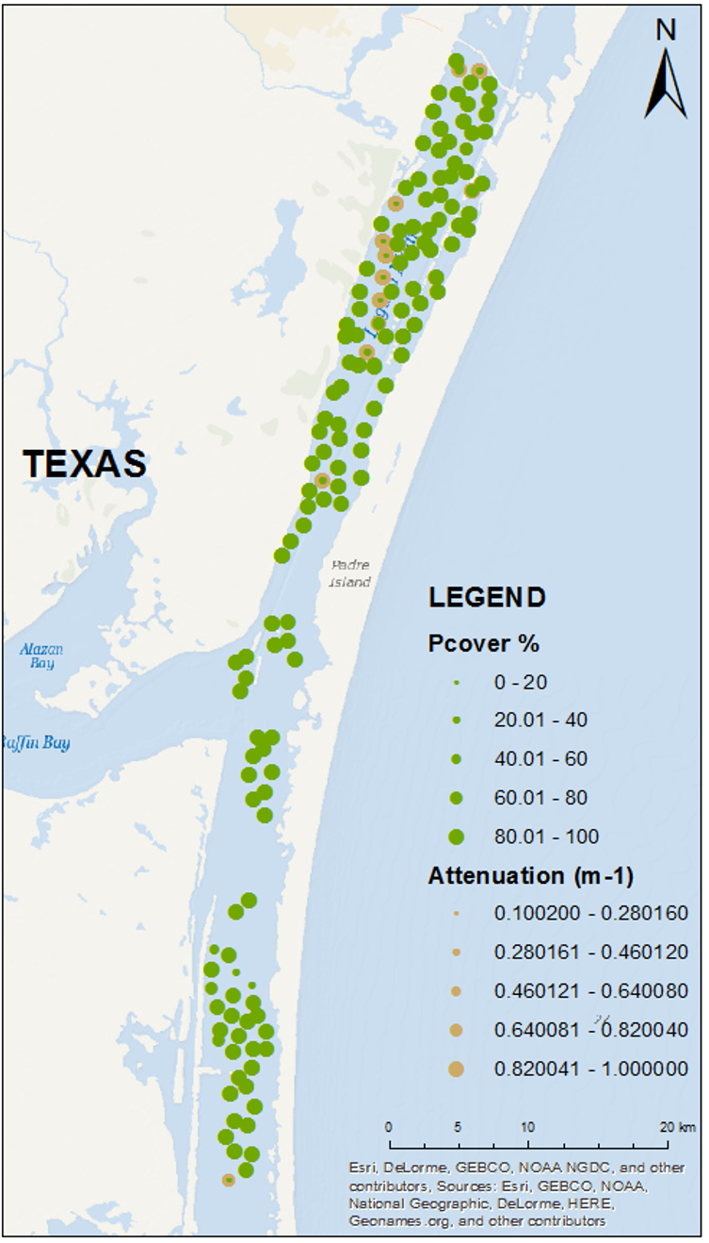
NERR
CCBAY
ULM

Slide 11
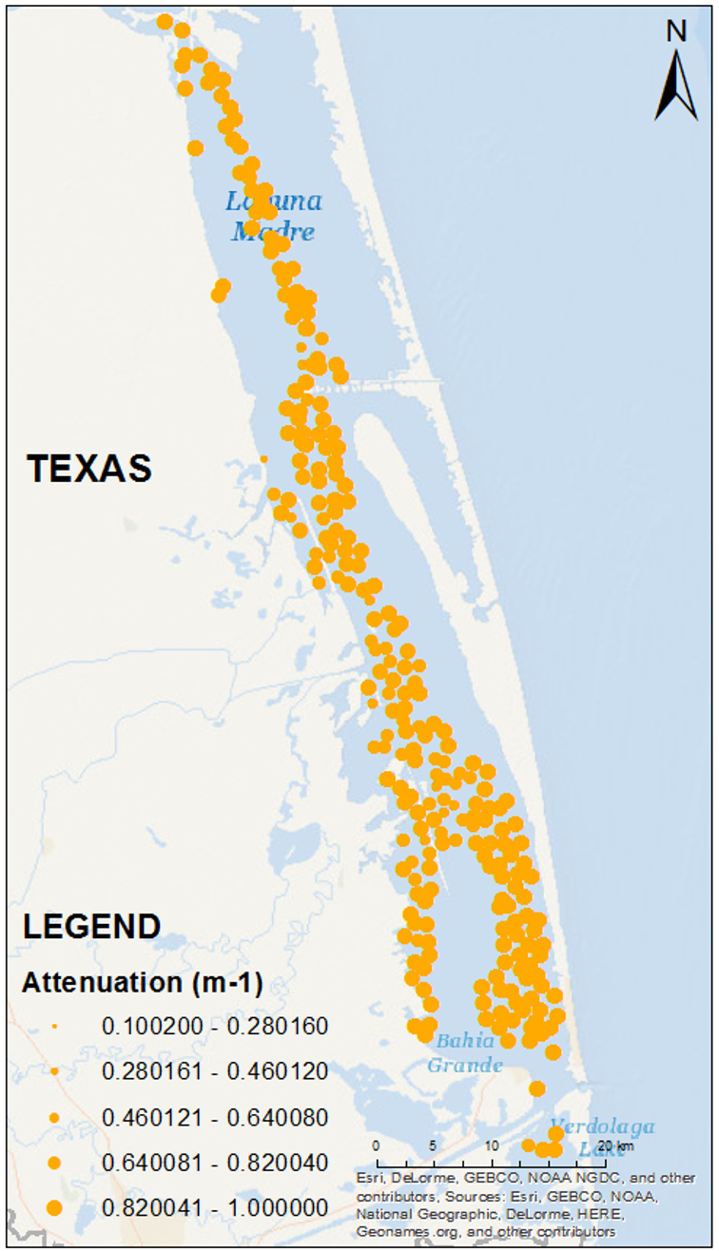
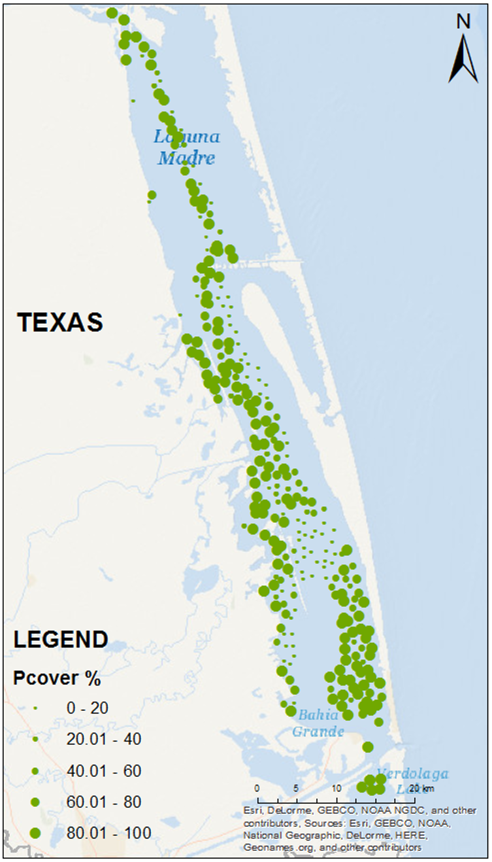
LLM
Should we see greater Pcover based on the relationship with attenuation?
It appears not, let’s take a closer look…..

Slide 12
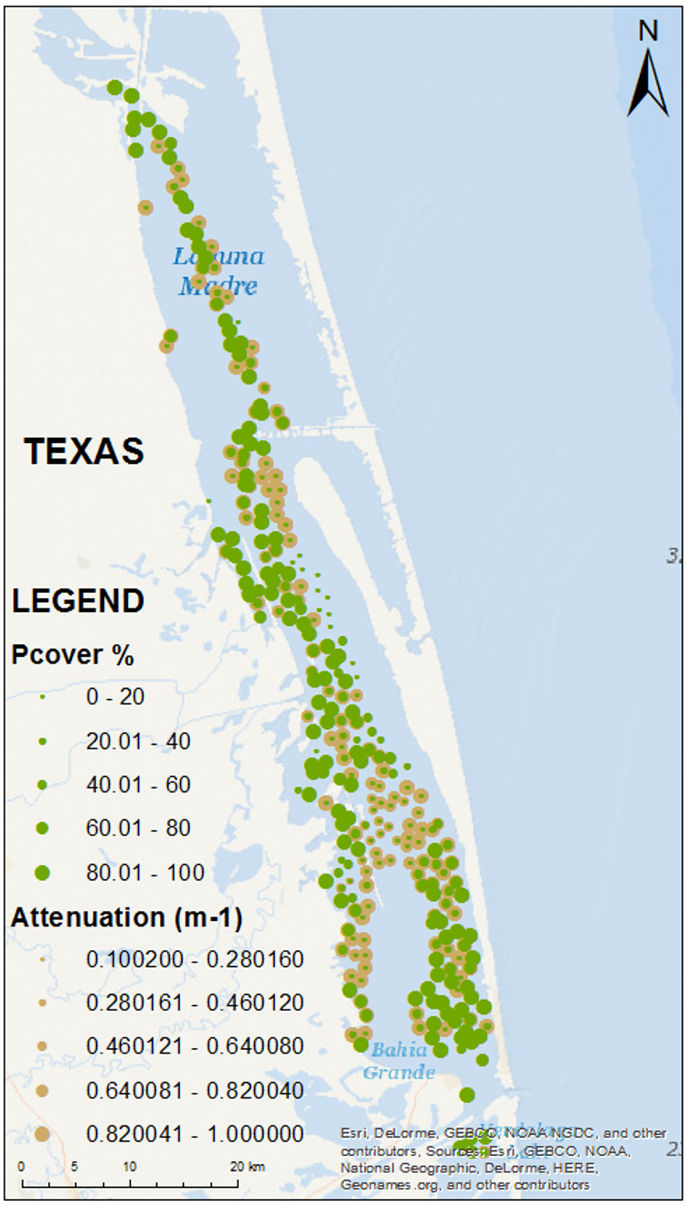
LLM
Greater light attenuation reduces Pcover
Site had lowest light attenuation but lowest Pcover
Does this make sense?
What might be driving this “pattern” in the LLM?

Slide 13
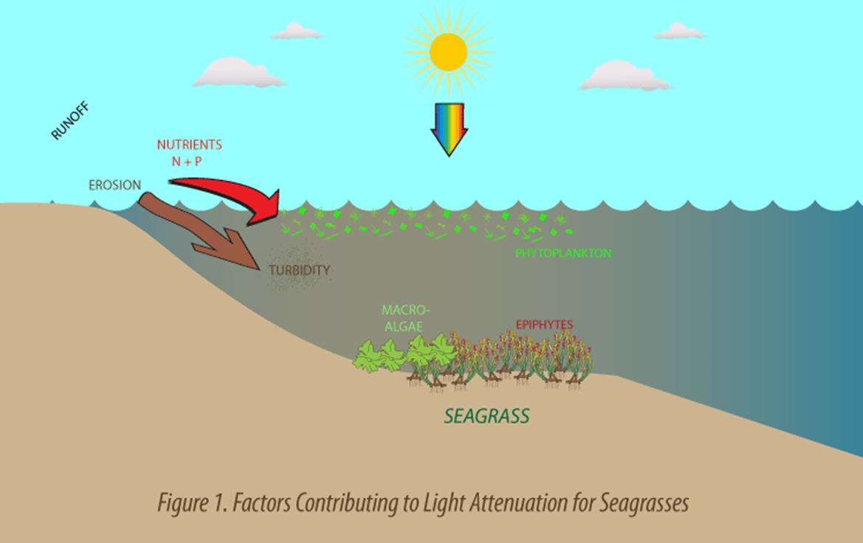
Conclusions
It’s complicated…
Potential factors controlling light attenuation:
Nutrient influx
TSS
Phytoplankton biomass
NEXT:
Display these variables using GIS
Interpolate

Slide 14
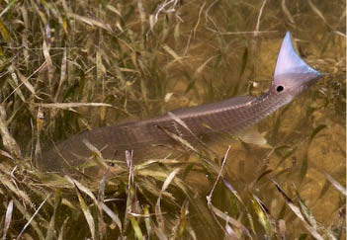
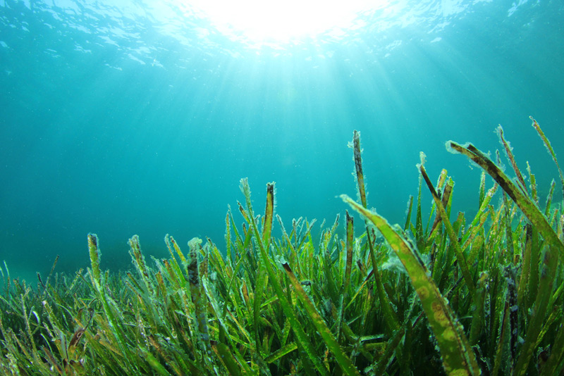
Fin
Questions?
Special thanks to Dr. Maidment and Gonzalo Espinoza
UTMSI Dunton Lab

