Slide 1
Nueces River Basin
By Jason Jenkins

Slide 2
Basin Overview
11 HUC8
71 HUC10
432 HUC12
Approx 43,325.55 km²

Slide 3
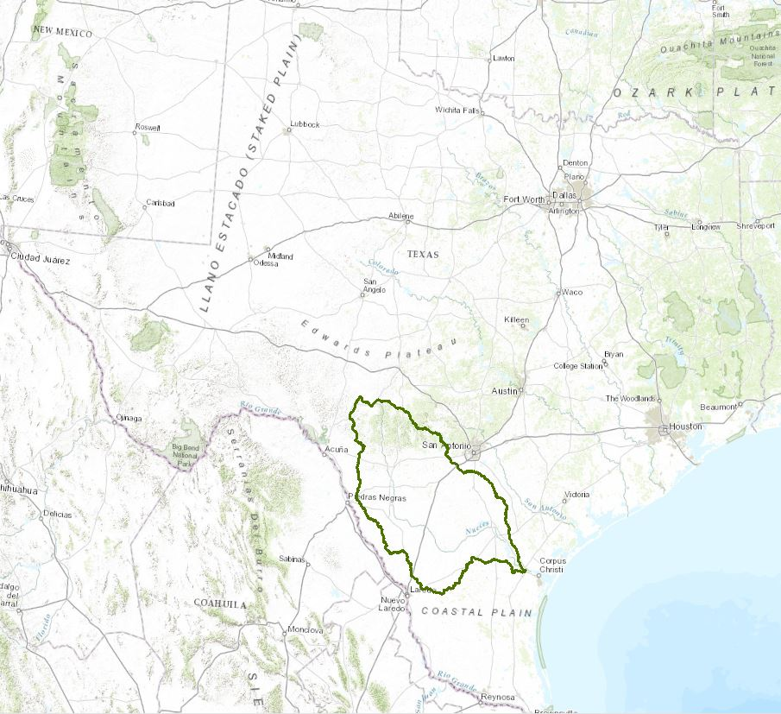
Why Important?
Provides water to reservoirs which support Corpus Christi and 18 other cities in region
Flows into important salt marsh and estuarine systems
Exceptionally vulnerable to droughts
Covers a large area of southwest Texas 43,325.55 km²

Slide 4
From Texas Water Development Board Website (TXWB) http://waterdatafortexas.org/reservoirs/municipal/corpus-christi

Slide 5
Growing Population = Growing Demand
Over 500,000 residents and businesses and growing
Annual consumption of the region for 2013 was 39,907,000,000 gallons (122,469 acre feet)*
*From Corpus Christi Chamber of Commerce
From Texas Water Development Board Website (TXWB) http://waterdatafortexas.org/reservoirs/municipal/corpus-christi

Slide 6
Available Soil Water Storage in Top 1m
Area
Mean | 14.3%
Max | 27%
Min | 1%
Std Dev | 8.3%
Nueces River Basin Available Soil Water Storage
Darker blue represents higher percent storage in top meter of soil

Slide 7
Mean Annual Precipitation 1.25026E+12 ft³
Mean Annual Stream Flow 1.96598E+10 ft³
Runoff Ratio very low 0.0157
Vulnerability to Droughts

Slide 8
Future Plans
Calculate freshwater input by waste water treatment plant
Calculate runoff ratio for each HUC 8 in basin

