Slide 1
Salinity Distribution of Nueces Delta
Zhi Li
11/18/2014

Slide 2
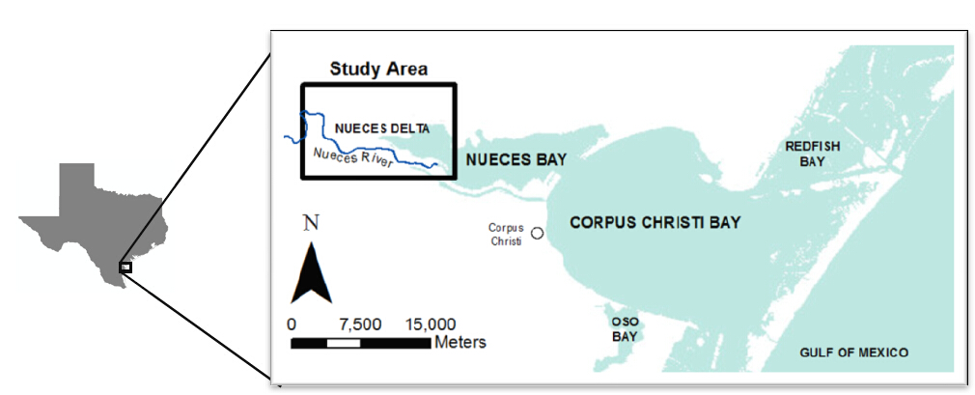
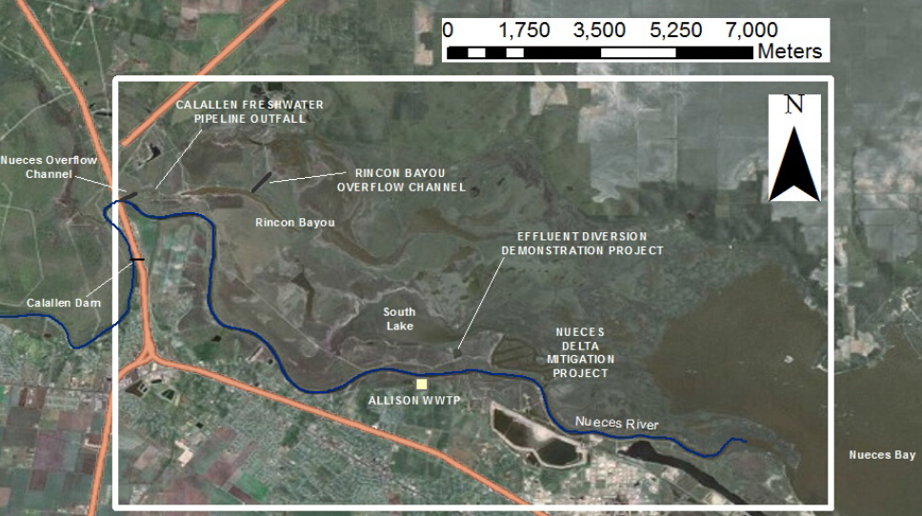
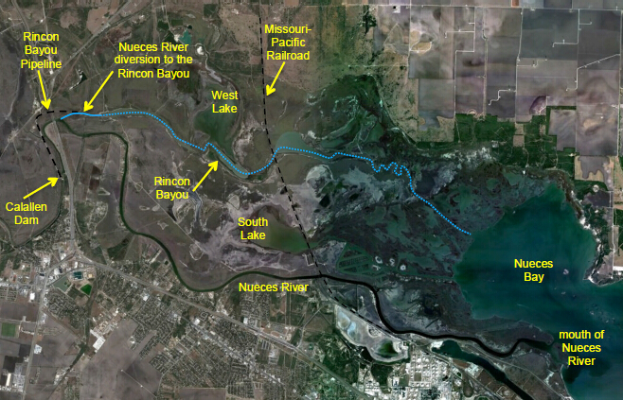
Problem Definition
Conclusion
Future Work
Result
Study Method
Nueces Delta
Notes:
Nueces Delta is the place where Nueces River meet Nueces Bay. Fresh water flows into the Nueces Delta is provided by the Nueces Overflow Channel, which was built in 2000. The Rincon Bayou Pipeline was built in 2007, which provided controllable fresh water into the delta.

Slide 3
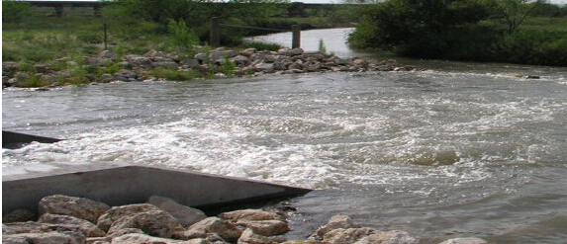
Problem Definition
Conclusion
Future Work
Result
Study Method
Current Problems:
Reduced inflow
High salinity
Loss of various species
Current Action:
Pumping fresh water
But,
When/Where is fresh water needed?
How much fresh water is needed?
http://www.nueces-ra.org/CP/CITY/rincon/
Notes:
The upstream dam reduced fresh water flows into Nueces Delta, which caused high salinity and loss of species. Currently fresh water is being pumped from upstream into Nueces Delta, but the open and close of the pump is random. We would like to know when and where is fresh water needed? How much fresh water is needed so that we can operate the pump more efficient.

Slide 4
Problem Definition
Conclusion
Future Work
Result
Study Method
Goal of term project:
Study spatial/temporal distribution of salinity
Investigate the effect of pumping and other factors (e.g. wind, tide, rain, evaporation…) on salinity
Long term goal:
Hydrodynamic model of Nueces Delta
Ultimate goal:
Restoration of Nueces Delta ecosystem
Notes:
The goal of this project is to study the spatial and temporal distribution of salinity, investigate the effect of pumping and other factors on salinity so that we know how salinity changes in Nueces Delta. Our long term goal is… Our ultimate goal is…

Slide 5
Problem Definition
Conclusion
Future Work
Result
Study Method
Data Sources
Salinity – Texas Water Development Board (TWDB)
Wind/Tide/Rain – Texas Coastal Ocean Observation Network (TCOON)
River inflow – USGS
Pump inflow – Rincon Pump Station under Nueces River Authority

Slide 6
Problem Definition
Conclusion
Future Work
Result
Study Method
Spatial Analysis – ArcGIS Interpolation Tool (Kriging)
Temporal Analysis – MATLAB

Slide 7
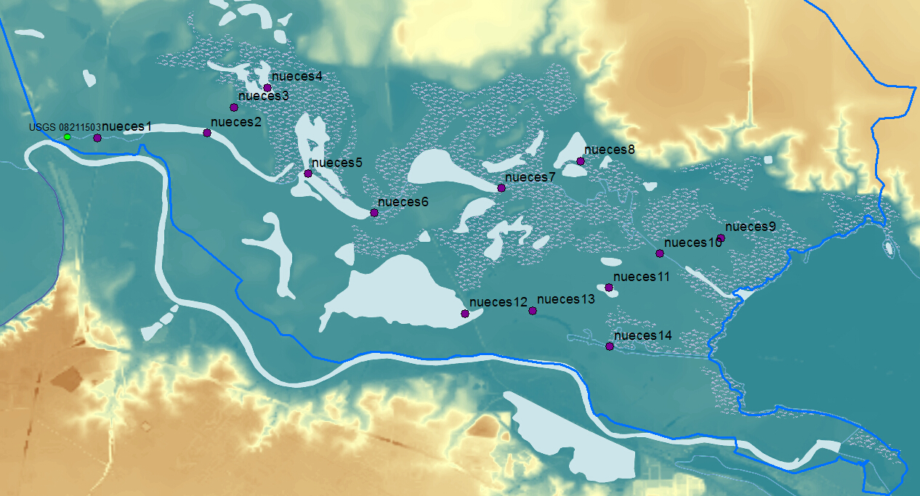
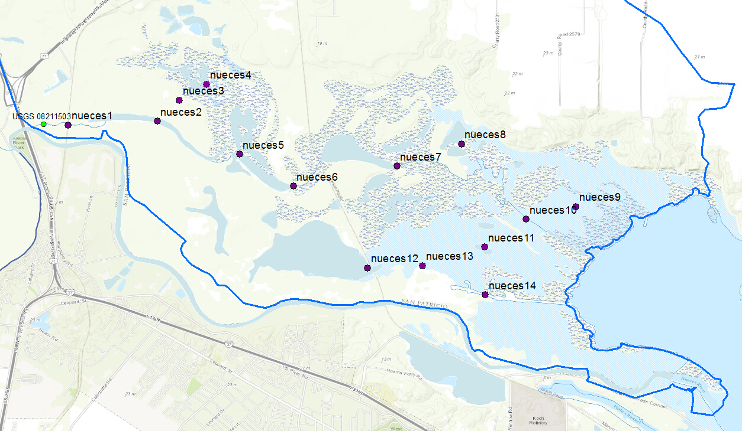
Problem Definition
Conclusion
Future Work
Result
Study Method
Notes:
This is the elevation of Nueces Delta and the 14 spots where salinity data was acquired. The interpolation is based on these spots.

Slide 8
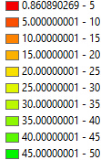
Problem Definition
Conclusion
Future Work
Result
Study Method
Salinity Distribution on Aug. 2012 (in [psu], Red = low salinity)
Notes:
This is the salinity distribution on Aug. 2012 in psu (practical salinity unit). Red means low salinity and green means high salinity.

Slide 9
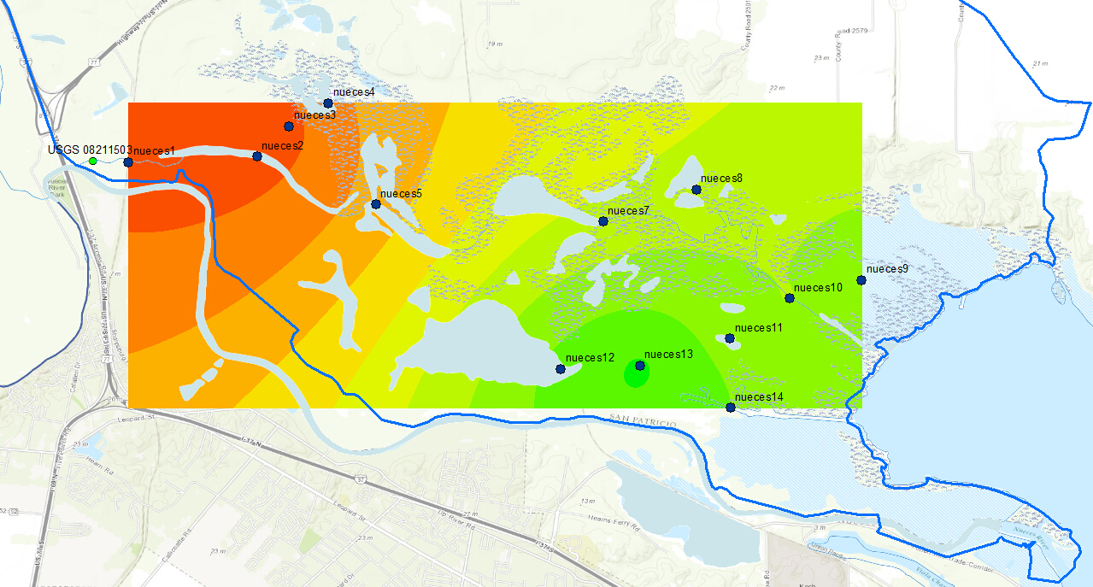
Problem Definition
Conclusion
Future Work
Result
Study Method
Salinity Distribution on Nov. 2012 (Green = high salinity)
Notes:
This is the salinity in Nov. 2012. Generally the salinity increased over the entire delta. But relatively high and low salinity regions remained the same. The highest salinity was not observed in Nueces Bay but in South Lake.

Slide 10
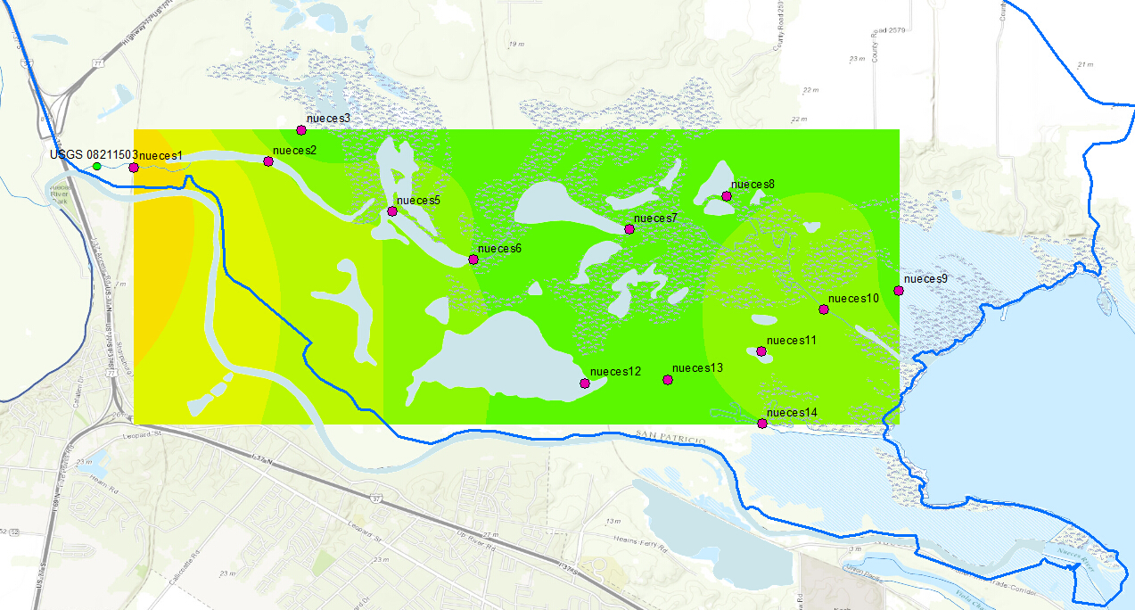
Problem Definition
Conclusion
Future Work
Result
Study Method
Salinity Distribution on May 2013 (Green = high salinity)
Notes:
When it comes to May of 2013, the salinity increased further. A big portion of Nueces Delta had a salinity higher than the ocean.

Slide 11
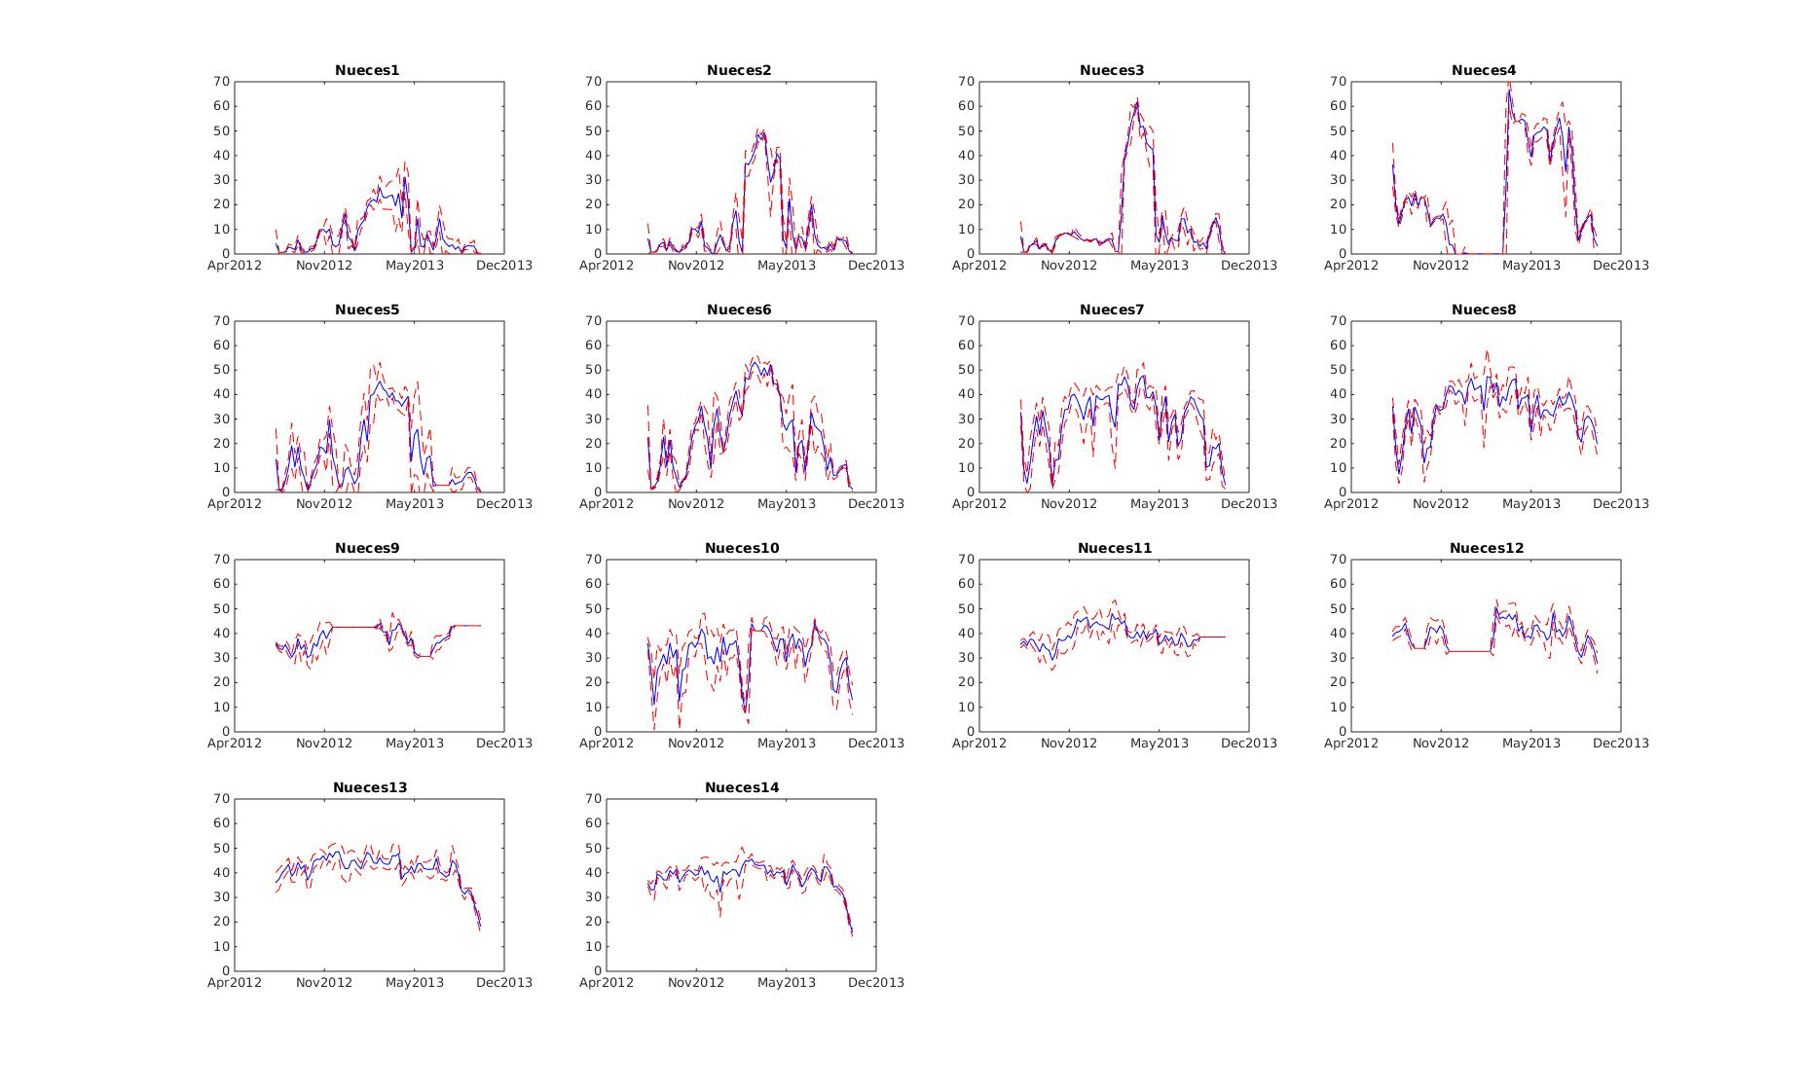
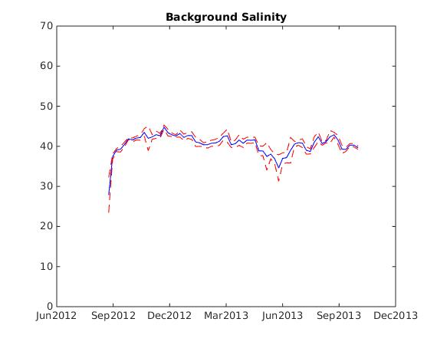
Problem Definition
Conclusion
Future Work
Result
Study Method
Notes:
This is the plot of salinity vs time at each measuring spot. At upstream spots (nueces1 through 6), salinity increased significantly in spring of 2013. At downstream spots, the salinity is relatively stable with time. But a sharp decrease can be found in the fall of 2013. The ocean salinity is similar to downstream salinity. But a decrease in ocean salinity can be found in summer.

Slide 12
Problem Definition
Conclusion
Future Work
Result
Study Method
Findings:
Increased salinity at upstream stations in spring
Stable salinity at downstream stations
Salinity at South Lake higher than ocean
Decrease of salinity on fall 2013
Decrease of ocean salinity in summer
What causes variation of salinity?

Slide 13
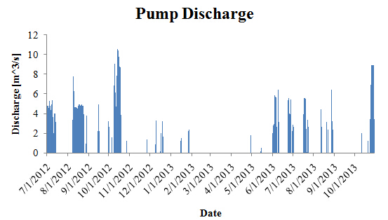
Problem Definition
Conclusion
Future Work
Result
Study Method
Pump open/close Salinity low/high
Notes:
This is the pump discharge. As we mentioned before, the pump is open randomly. It was closed for a long time during spring of 2013, which corresponded to the increase of upstream salinity.

Slide 14
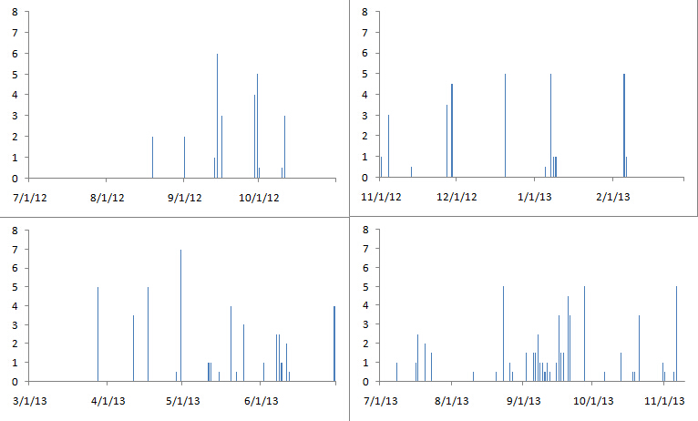
Problem Definition
Conclusion
Future Work
Result
Study Method
Precipitation [mm/hr]
Dense rainfall events lead to decreased salinity
Seasonal pattern of rainfall events remain unclear
Notes:
This is the precipitation at Nueces Delta. There are no obvious seasonal rainfall pattern. But a group of dense rainfall events can be found in the fall of 2013, which corresponds to the decrease of downstream salinity.

Slide 15
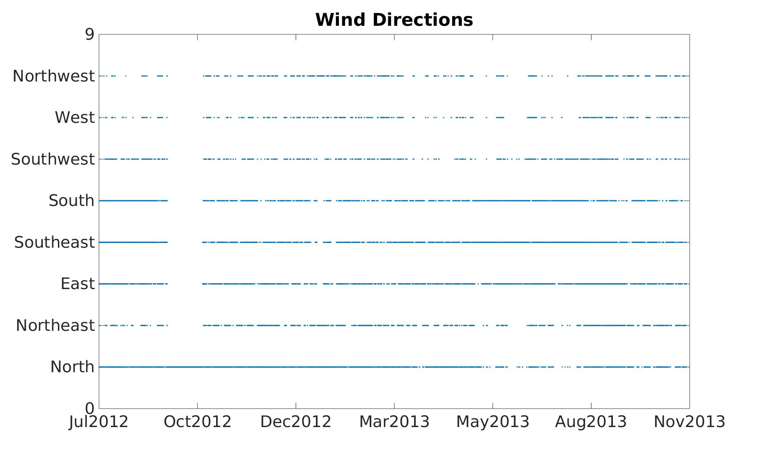
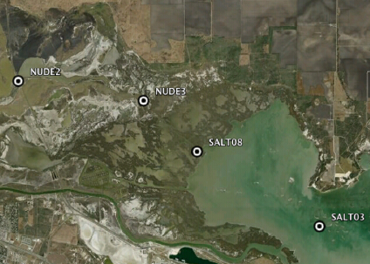
Problem Definition
Conclusion
Future Work
Result
Study Method
Wind Pattern
Southeast wind dominates in summer
North wind dominates in winter
Notes:
This is a plot of wind directions. If the line is more solid, it means that wind in this direction is more frequent. We can see southeast wind is frequent during summer and north wind is more frequent during winter. The ocean salinity was measured at SALT03. In summer, southeast wind will push the fresh water outflow from Nueces River back into the Nueces Bay, which caused the decrease of salinity.

Slide 16
Problem Definition
Conclusion
Future Work
Result
Study Method
Upstream Salinity is:
Mainly affected by pumping
Downstream Salinity is:
Mainly affected by precipitation
Highest in South Lake – no inflow + evaporation
Background Salinity is:
Affected by wind – show seasonal variation
Notes:
The upstream salinity is mainly affected by pumping. The downstream salinity is mainly affected by precipitation. The highest salinity was found in the South Lake because the lake has no freshwater inflow. Evaporation makes its salinity high. The background salinity is affected by wind.

Slide 17
Problem Definition
Conclusion
Future Work
Result
Study Method
Actual situation more complex:
Water – land boundary is subtle
Insufficient knowledge about inundation
Notes:
The analysis above is kind of ideal. The actual case is more complicated. The boundary between water and land is not as clear as the map shows. The inundation area, which changes with time, will be another important factor that affect salinity. It makes our spatial interpolation less reliable.

Slide 18
Problem Definition
Conclusion
Future Work
Result
Study Method
Hydrodynamic model of Nueces Delta
Use FREHD developed in CRWR
Quantitatively study variation of salinity
Model more natural forces (e.g. Infiltration, Evapotranspiration, Tide)
Test effect of different pump location/open time/flow rate
Notes:
In the future, we will use hydrodynamic model to quantitatively study the variation of salinity. We will include more natural forces that could affect salinity such tide, infiltration and evapotranspiration. We will also test different pump settings because it has been shown that the pump plays an important role in reducing salinity.

Slide 19
Problem Definition
Conclusion
Future Work
Result
Study Method
Thank you

