Slide 1
Characterization of the impact of Water Flow on the Organic Matter Flux in the mission-Aransas NERR
Presented by: Nick Reyna
November, 18 2014

Slide 2
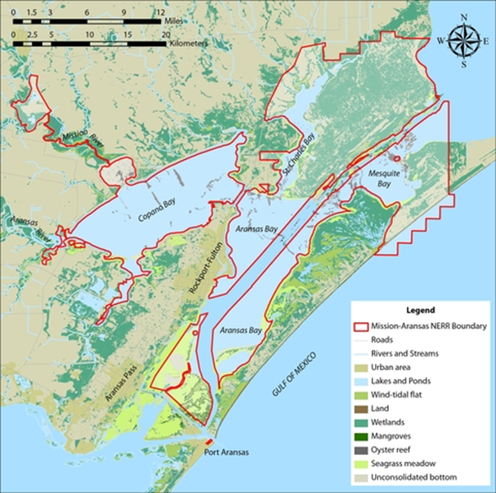
Mission-Aransas National Estuarine Research Reserve
Notes:
28 NERRs

Slide 3
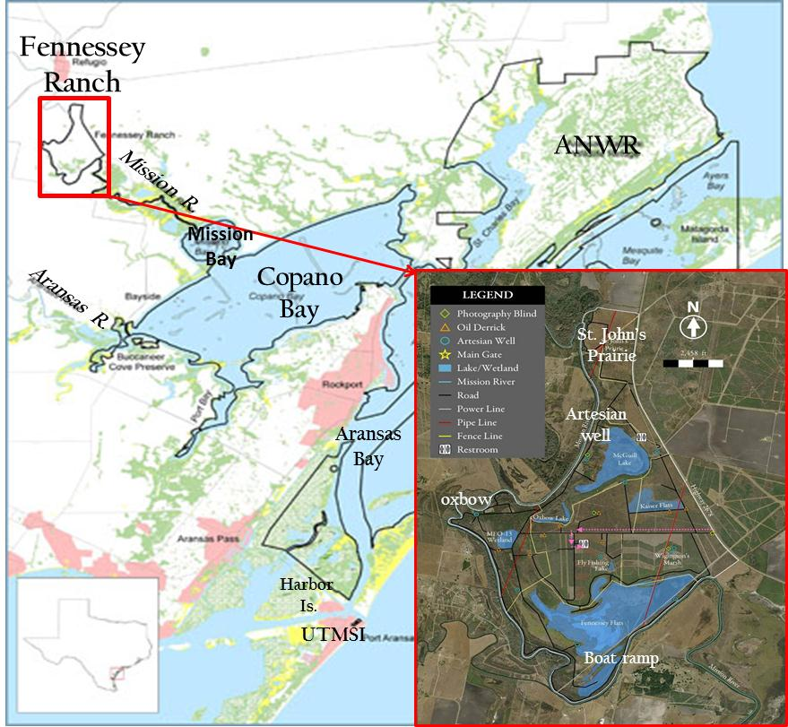

Slide 4
 | Artesian Well | St. John’s Prairie | Oxbow | Boat Ramp
Temperature (C’) | 29.42 | 16.77 | 16.49 | 17.15
pH | 8.37 | 7.41 | 8.44 | 8.11
Salinity | 1.62 | 13.87 | 17.62 | 26.83
Table 1. Physical and chemical parameter averages from one groundwater
and three river sites at The Fennessey Ranch, Bayside, TX.

Slide 5
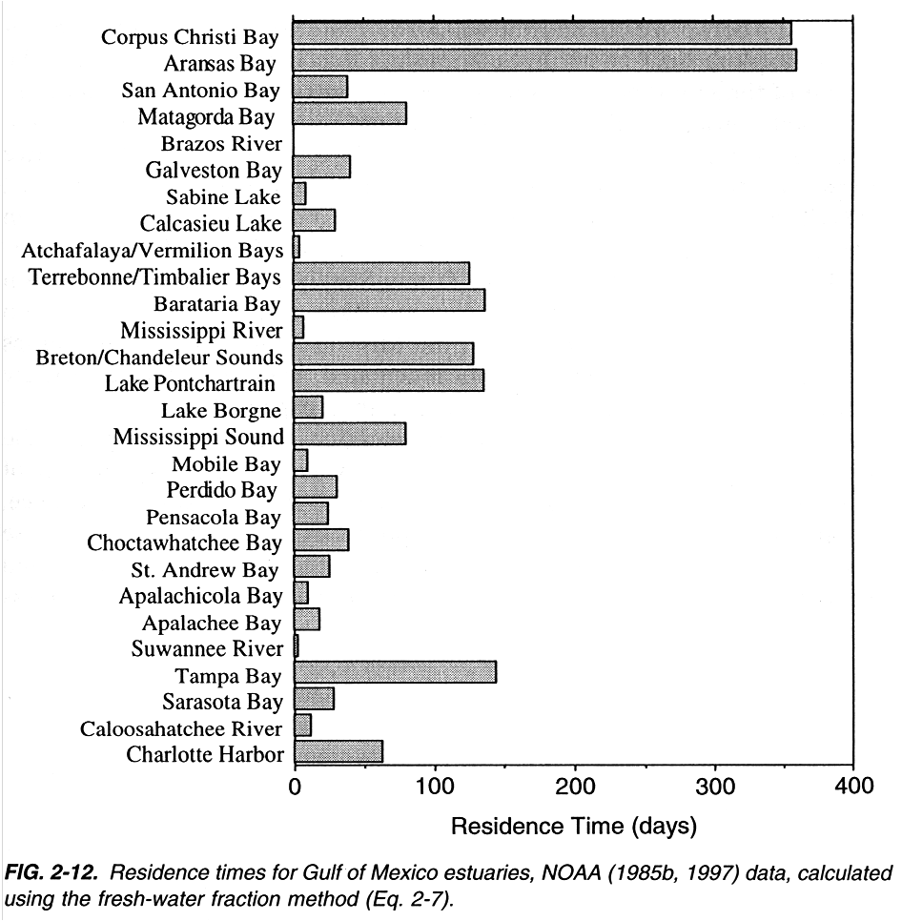
(Bianchi, Pennock and Twilley, 1999)

Slide 6
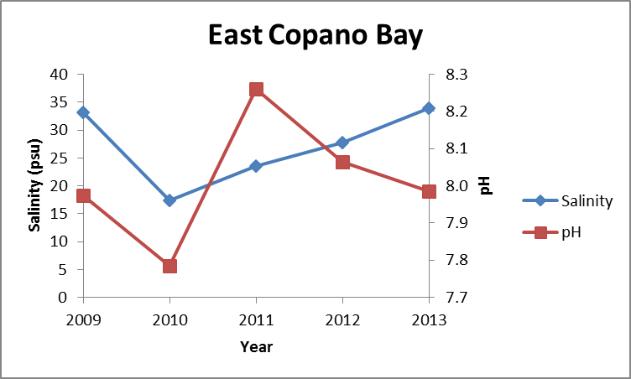
Figure 4. Yearly salinity and pH measurements extrapolated from data taken from a MANERR autonomous monitoring station located in East Copano Bay, TX on the same day of the year as that sampled during this expedition.

Slide 7
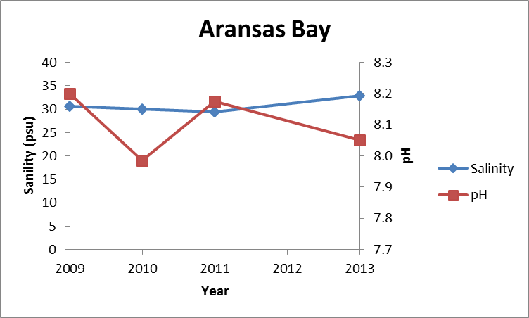
Figure 5. Yearly salinity and pH measurements extrapolated from data taken from a MANERR autonomous monitoring station located in Aransas Bay, TX on the same day of the year as that sampled during this expedition.

Slide 8
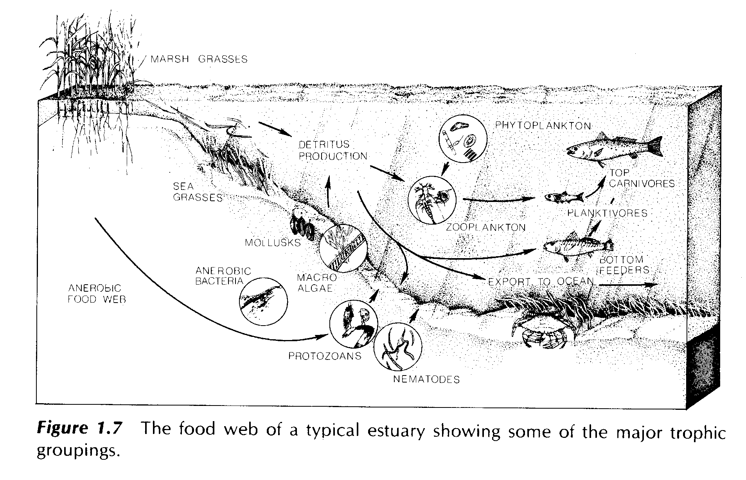
(Estuarine Ecology 2nd Edition, 2013)

Slide 9
“The U.S. Fish & Wildlife Service’s (USFWS)
2011 National Survey of Fishing, Hunting and
Wildlife-Associated Recreation identifies fishing
as one of the most popular outdoor recreational
activities in the
United States.
As many as 33 million people aged 16 or older participate in the activity, and spend $48 billion annually on equipment, licenses, trips and other fishing-related items or events.
These funds help create and support more than 828,000 jobs in the United States at a time when
many industries are still coping with a challenging
economic climate. In some rural areas, the dollars
brought in through recreational fishing help support
entire communities.”
(American Sportfishing Association)

