Slide 1
Terrain Analysis on the Arctic Coastal Plain, Northern Alaska
Chuck Abolt
November 20, 2014
GIS in Water Resources

Slide 2
Background
The Alaska North Slope is flat and marshy
Location of largest oil field in United States
Great Bear Petroleum is interested in area
UT-BEG hired to fly LiDAR survey in 2012

Slide 3
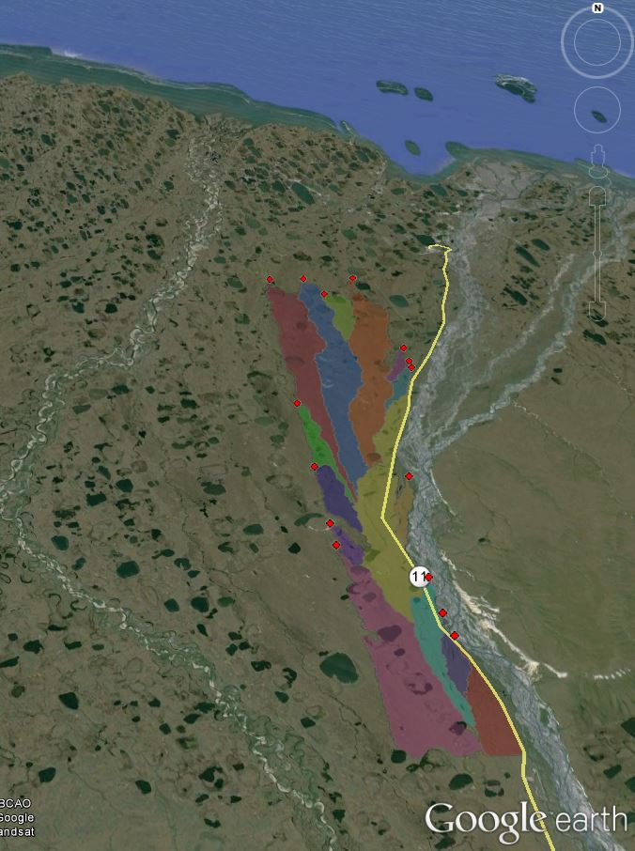
DEM and Stream Basins

Slide 4
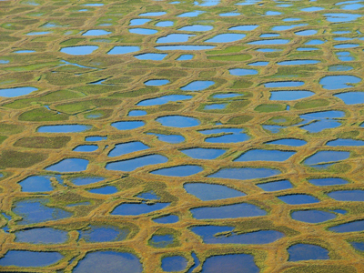
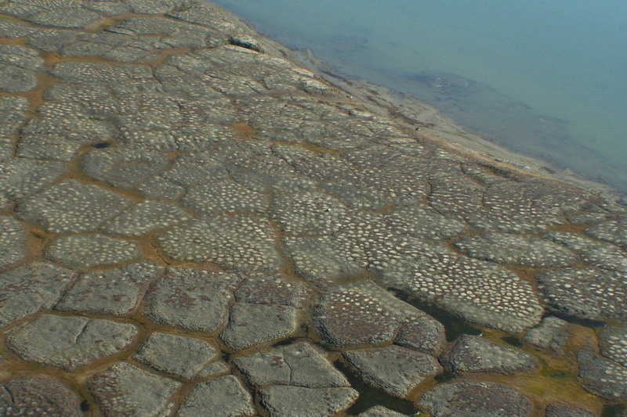
Ice Wedge Polygons
Low-Centered
http://www.awi.de/fileadmin/user_upload/News/Press_Releases/2009/4._Quartal/Eispolygone_KPiel_w.jpg
High-Centered
http://permafrost.gi.alaska.edu/photos/image/85

Slide 5
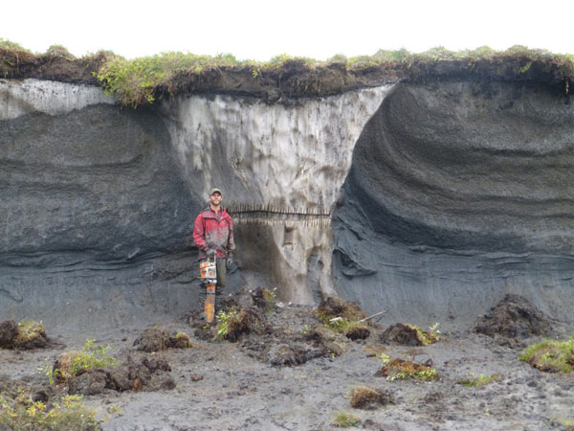
Ice Wedge Polygons
http://www.page21.eu/gallery/fieldstations2012

Slide 6
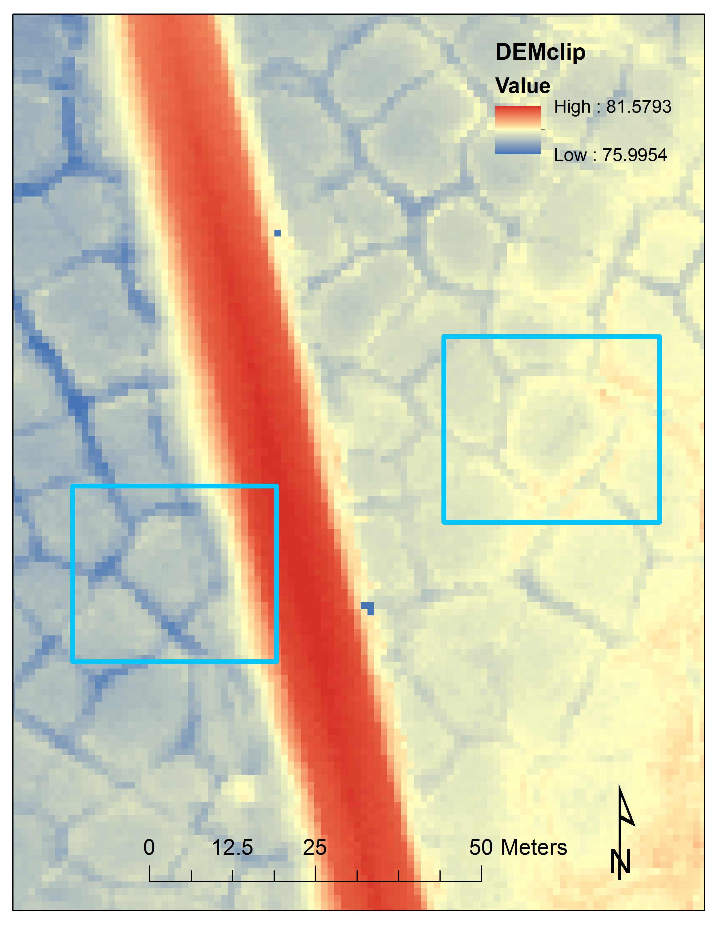
Ice Wedge Polygons
Construction of the Dalton Highway in 1978 may have triggered polygon erosion
Inverse modeling of polygon evolution:
$$\frac{∂z}{∂t}≈−D\left(\frac{∂^{2}z}{{∂x}^{2}}+\frac{∂^{2}z}{{∂y}^{2}}\right)$$

Slide 7
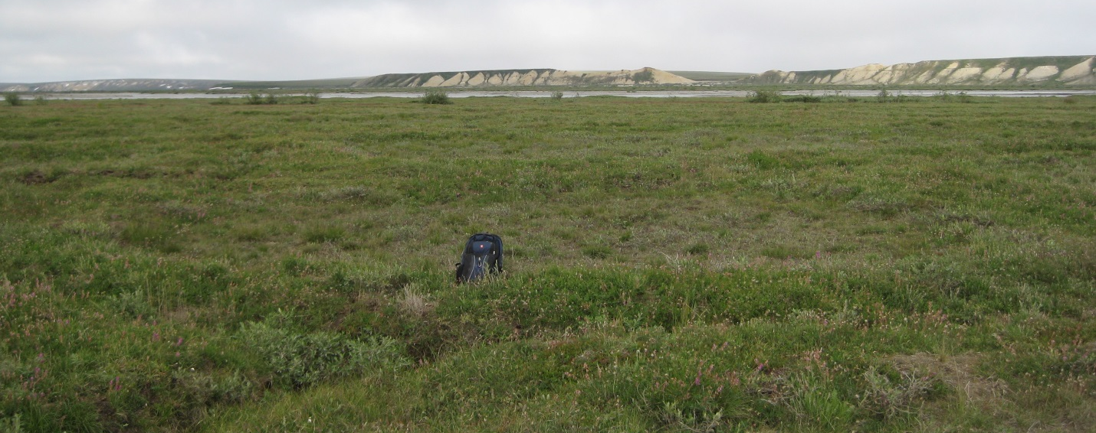
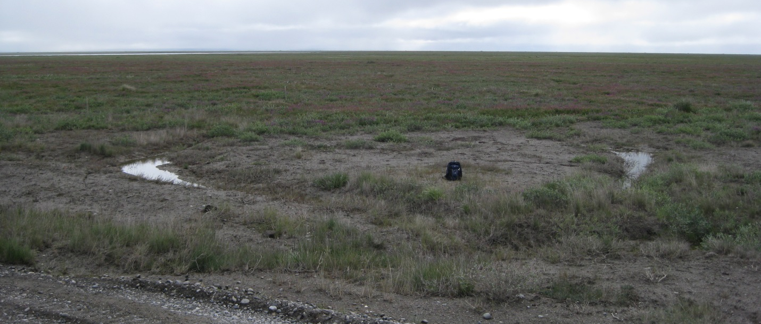
Ice Wedge Polygons

Slide 8
Generation of 50 cm DEM

Slide 9
Model of Polygon Evolution
Best fit D = 0.038 – 0.050 m²yr⁻¹
Best fit trough incision depth = 25-29 cm

Slide 10
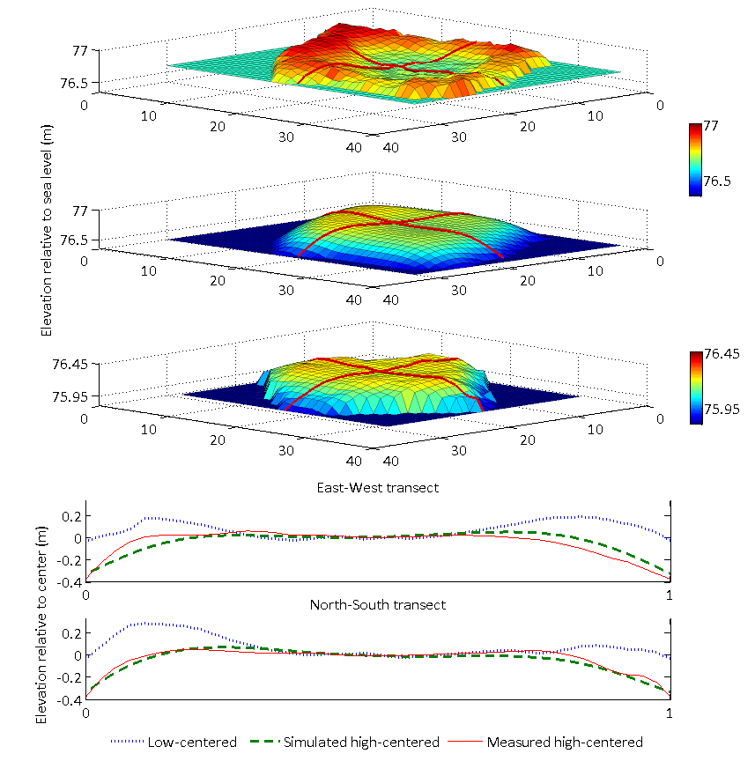
Model of Polygon Evolution

Slide 11
Changes in Pond Areas and ET
Use Fill, Raster Calculator, and Surface Volume tools to measure polygon ponds
Penman-Monteith equation:
$$λE=\frac{∆\left(R_{n}−G\right)+ρ_{a}c_{a}\left(δe\right)r_{a}}{∆+γ(1+\frac{r_{a}}{r_{s}}) }$$

Slide 12
Thank you!
David Maidment
Michael Young, Todd Caldwell, Toti Larson
Kutalmis Saylam, Jeff Paine, Aaron Averett, John Andrews
Great Bear Petroleum, LLC
Questions?

