Slide 1
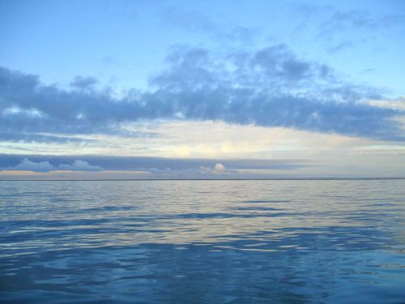
Water quality and flow into lagoons of the Eastern Alaska Beaufort Sea Coast
Craig T. Connolly

Slide 2

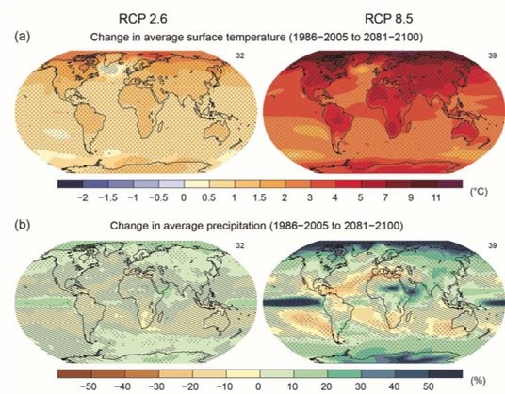
Climate Change and Arctic Warming
Predicted 7-8 ºC warming in the Arctic by the 21st century (IPCC AR5)
Will have a substantial affect on surface hydrology
Notes:
Will have increase in temperature and increase in precipitation

Slide 3
Eastern Alaska Beaufort Sea coast
Lagoons, which occur along >50% of the sea coast are hotspots for biogeochemical cycling
Watersheds deliver high quantities of organic matter and nutrients
Is there evidence for changes in quality from varying magnitudes of freshwater flow?
Notes:
Which support productive food webs
Goal for this project was to delineate watersheds of water flow into coastal zones of the Eastern Beaufort Sea

Slide 4
Study Site
.c
NED 2 Arc Sec 34m
.c
NED30m

Slide 5
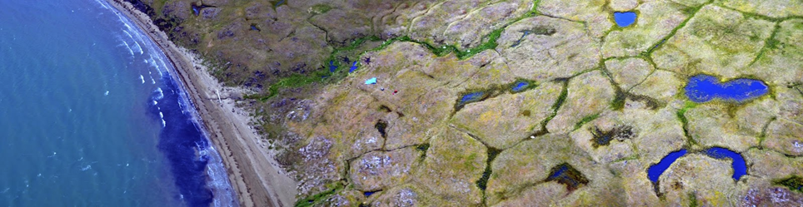
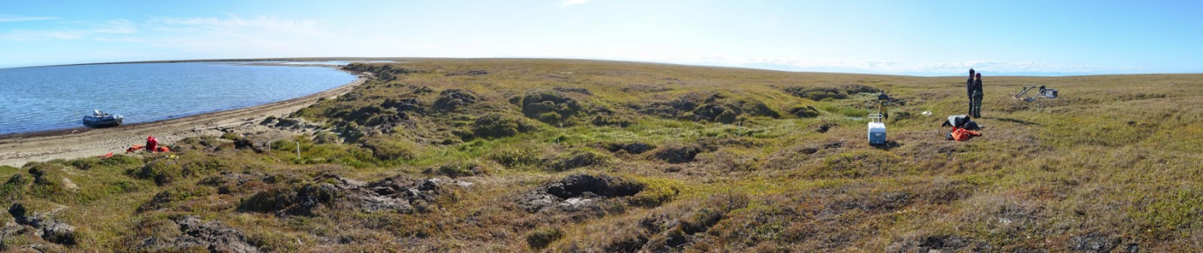
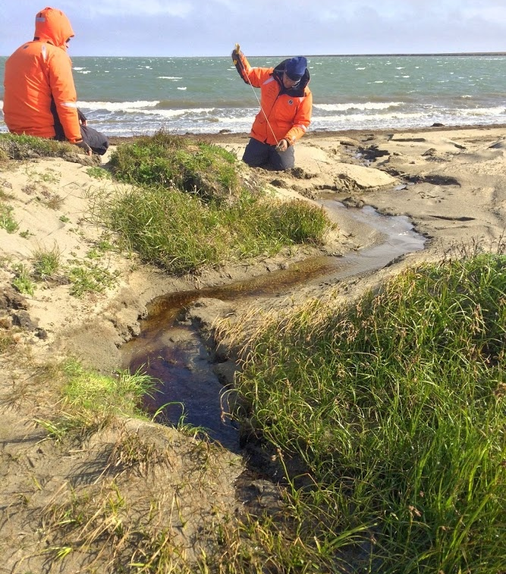
Study Site

Slide 6
Study Site

Slide 7
Selecting Drainage Points
Angun
Jago
Nuvagapak
Kaktovik

Slide 8
Watershed Delineation
Nice Agreement!
USGS
Stream Gage

Slide 9
Watershed Delineation
Jago
Kaktovik
Angun
Nuvagapak
1
2
4
3
USGS
Stream Gage

Slide 10
Watershed Delineation
Jago
Kaktovik
Angun
Nuvagapak
1
4
2
USGS
Stream Gage
3

Slide 11
Results
Jago
Kaktovik
Angun
Flow Accumulation (km²)
Watershed Area (km²)
Nuvagapak
Kaktovik 195.81
Jago 1793.31
Angun 321.14
Nuvagapak 1455.63
? ? ? ?
Kaktovik 264.49
Jago 2065.71
Angun 1929.20
Nuvagapak 987.89
? ? ? ?

Slide 12
Why the Discrepancy?
NED30m
.c
Jago
Watershed Tool “best available”: 90m resolution
DEM obtained: 34m resolution
Kaktovik
Angun
Nuvagapak
1
2
3
4

Slide 13
Why the Discrepancy?
NED30m
.c
Jago
Kaktovik
Angun
Nuvagapak

Slide 14
Water Quality and Flow
Jago
Lagoon | Temp (ºC) | Salinity (ppm) | DO (mg/L) | pH | Chlorophylla | Carbon (umol/L) | Nitrogen (umol/L) | δ ¹³C | δ ¹⁵N
Kaktovik | 10.57 | 21.91 | 8.97 | 7.95 | 0.31 | 19.39 | 2.89 | -27.99 | 6.43
Jago | 8.52 | 21.74 | 10.93 | 7.89 | 0.21 | 16.57 | 2.32 | -28.39 | 5.42
Angun | 9.07 | 22.69 | 10.47 | 7.94 | 0.42 | 18.91 | 2.69 | -28.72 | 7.47
Nuvagapak | 11.54 | 3.15 | 11.28 | 7.82 | 1.42 | 20.37 | 2.97 | -30.61 | 3.07
Kaktovik
AN
Angun
NU
Nuvagapak

Slide 15
Future Work
Delineate watersheds draining additional lagoons?
Relate to additional lagoon quality data?
USGS
Stream Gage

Slide 16
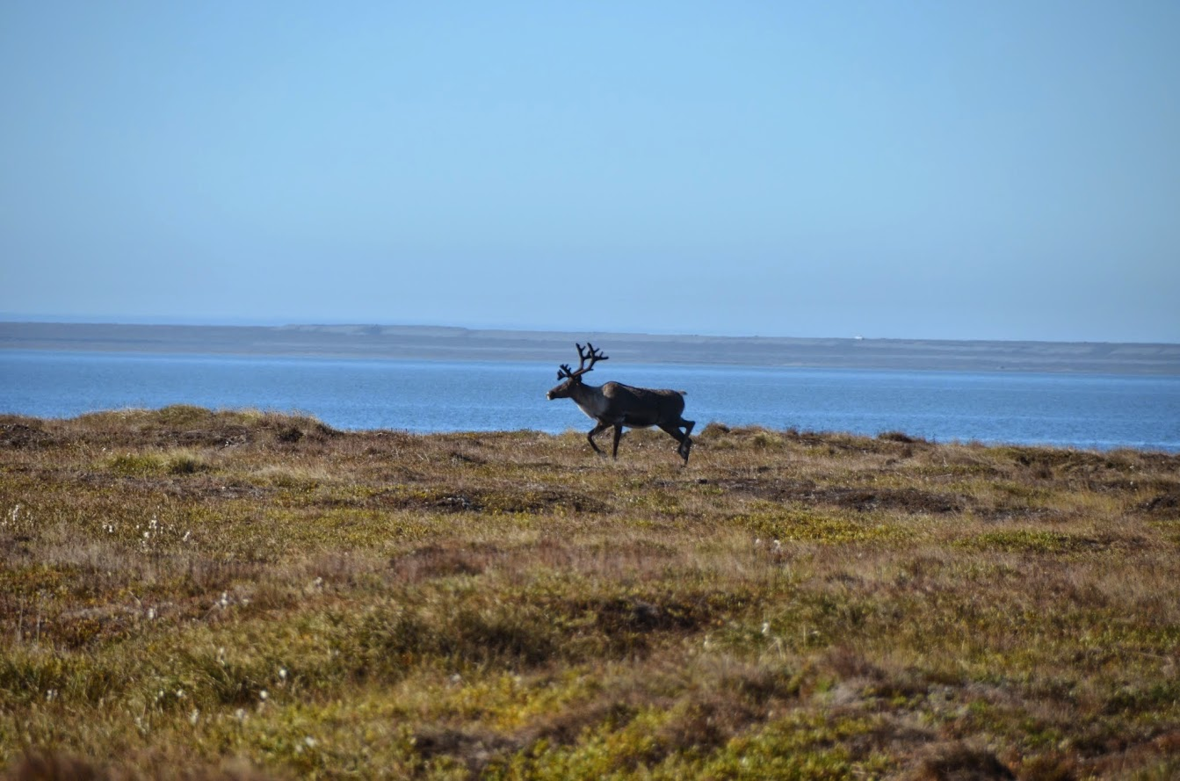
QUESTIONS ??

