Slide 1
Evaluating access to jobs via transit from disparate urban corridors
GISWR 2014 Final Presentation
Clifford Kaplan
Community and Regional Planning and Public Affairs
November 20, 2014
Cliff.Kaplan@gmail.com

Slide 2
Background:
Affordable housing preservation project called Green Corridors
Sponsored by U.S. Department for Housing and Urban Development. Principle Investigator is Dr. Elizabeth Mueller.
Currently in phase 1: Compare affordable housing stock in different parts of the city in terms of quality and quantity.
.
GISWR 2014 Final Presentation - Clifford Kaplan

Slide 3
Background:
Affordable housing preservation project called Green Corridors
Sponsored by U.S. Department for Housing and Urban Development.
Currently in phase 1: Compare affordable housing stock in different parts of the city in terms of quality and quantity.
Objective:
Develop a method to rank urban corridors according to the accessibility to low-wage jobs from each corridor provided by public transportation.
GISWR 2014 Final Presentation - Clifford Kaplan

Slide 4
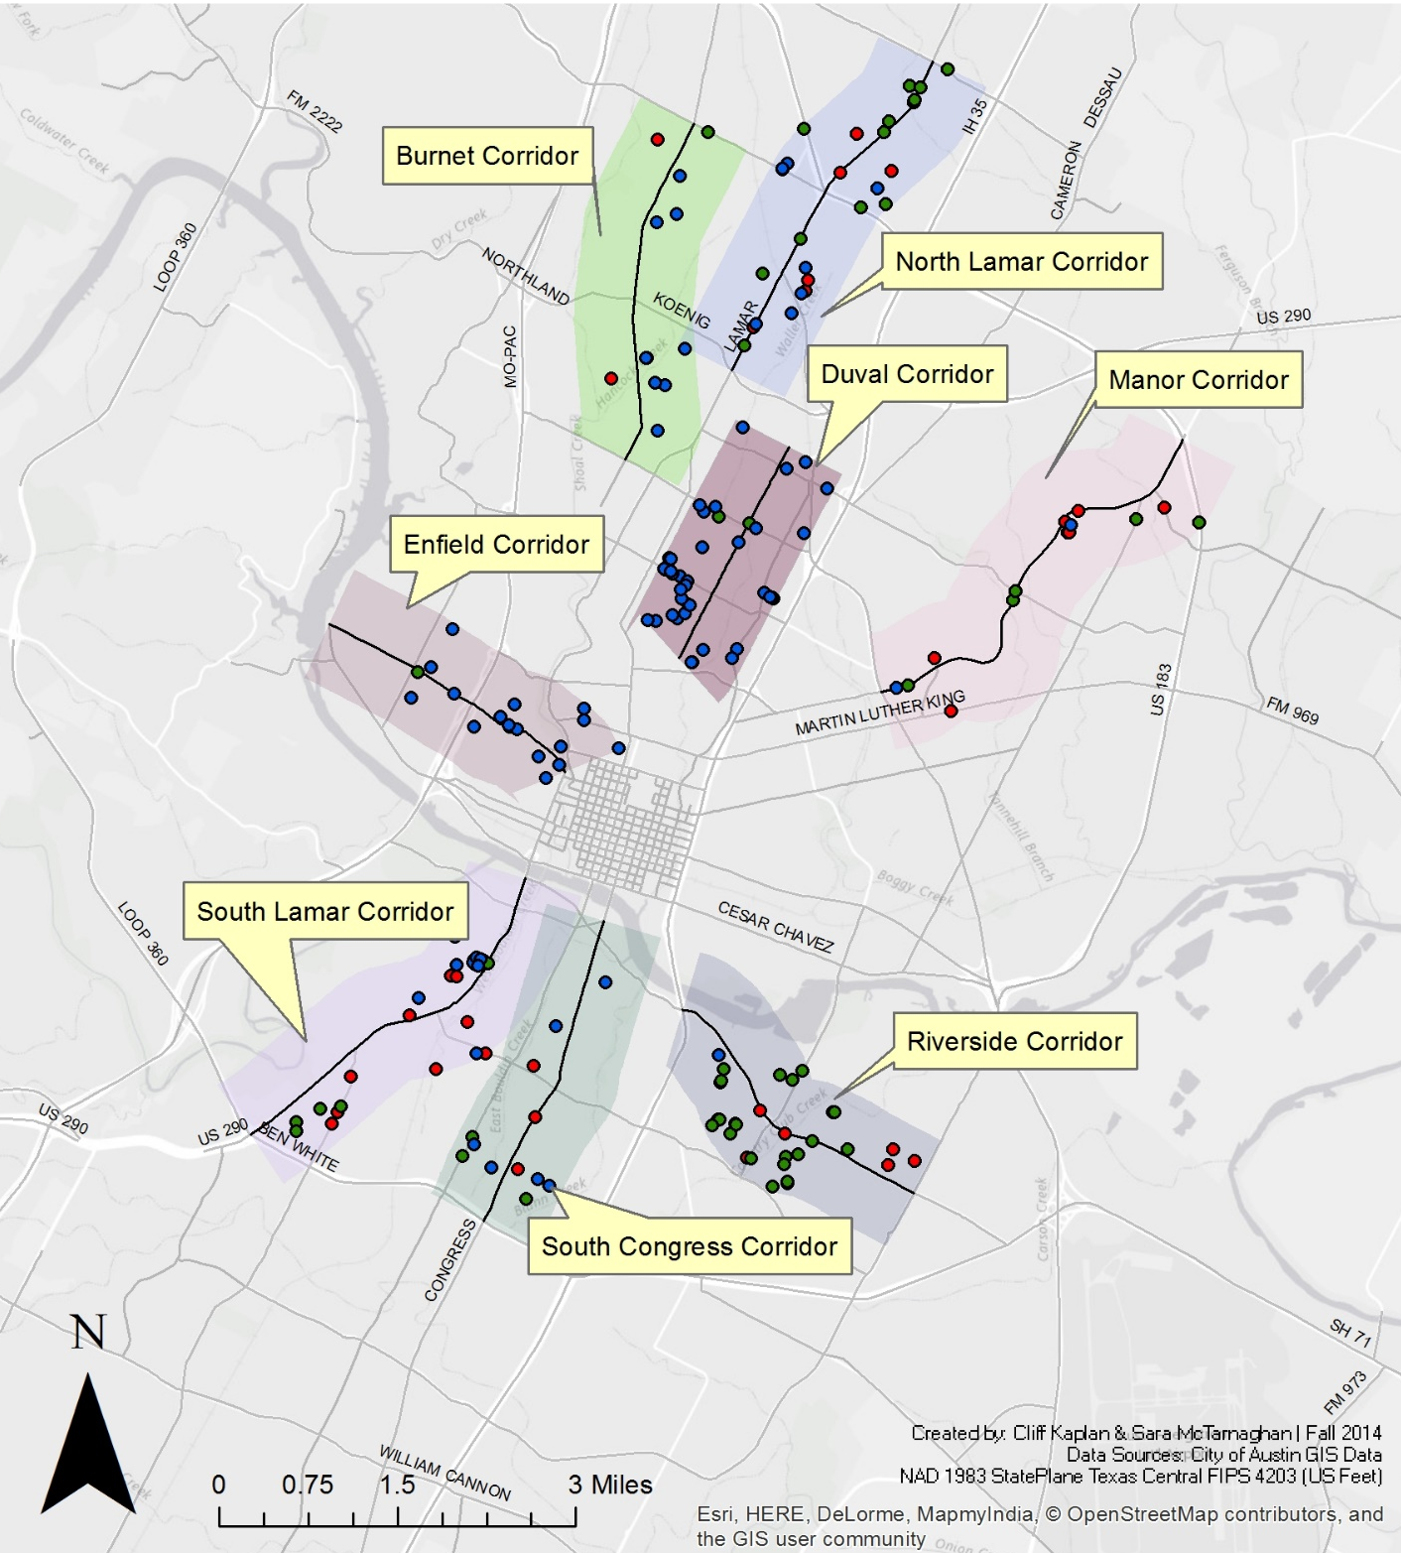
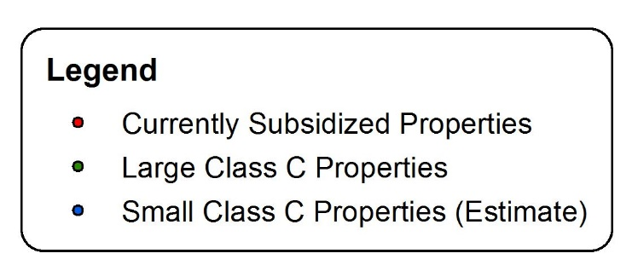
Study Areas
and their
Affordable
Housing
Stocks
GISWR 2014 Final Presentation - Clifford Kaplan

Slide 5
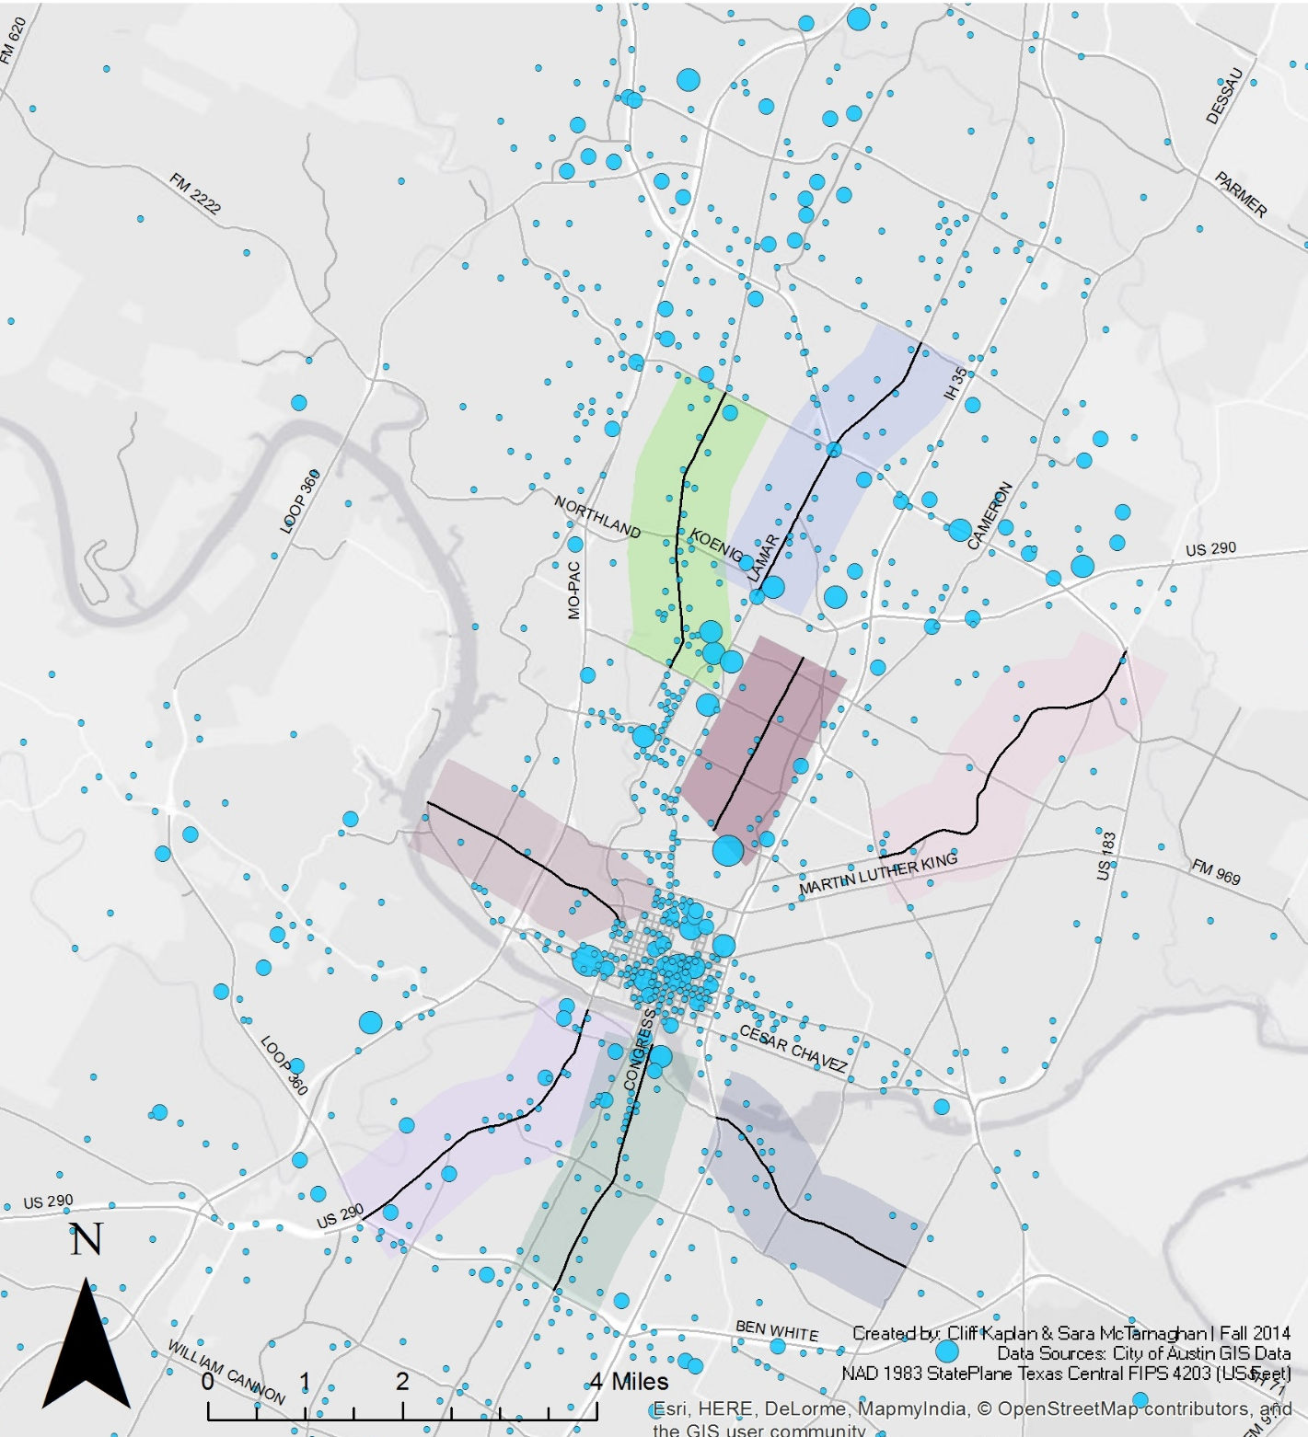
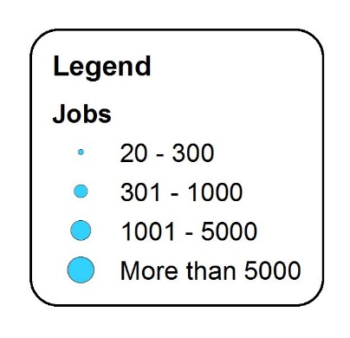
Spatial
Distribution
of Jobs
Paying
$15,000 –
$40,000
per Year
GISWR 2014 Final Presentation - Clifford Kaplan

Slide 6
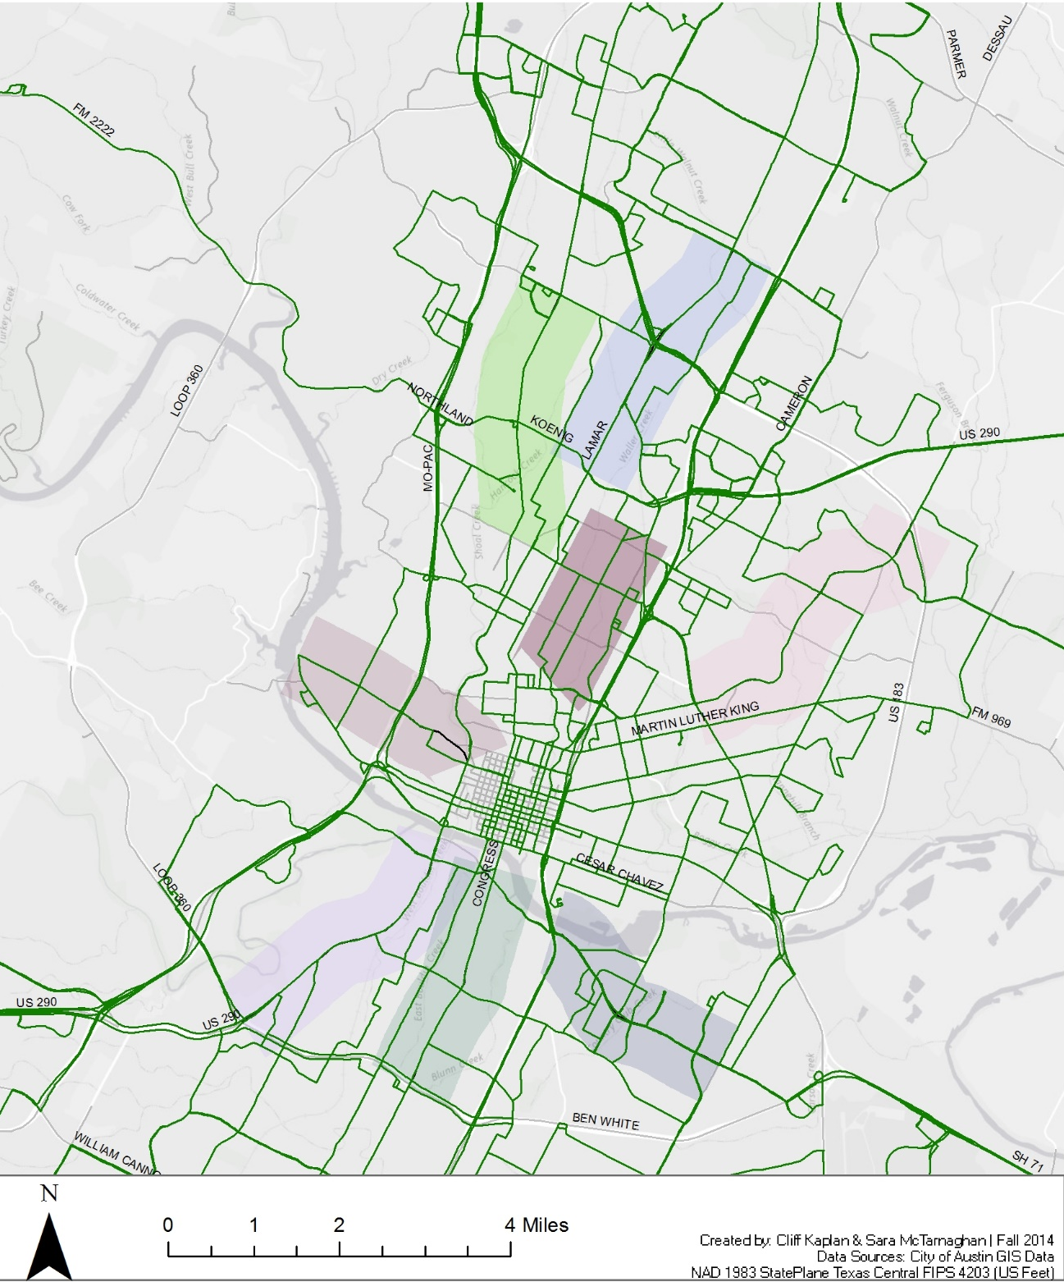
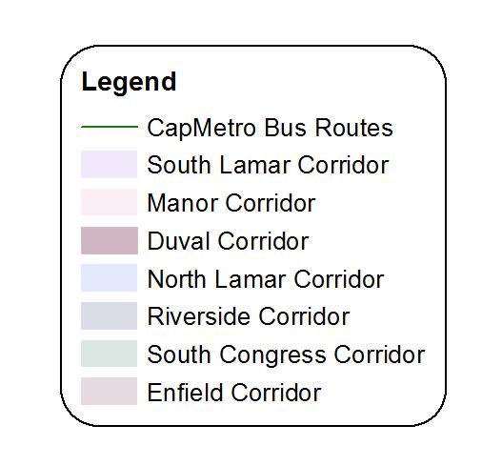
Bus Routes
GISWR 2014 Final Presentation - Clifford Kaplan

Slide 7
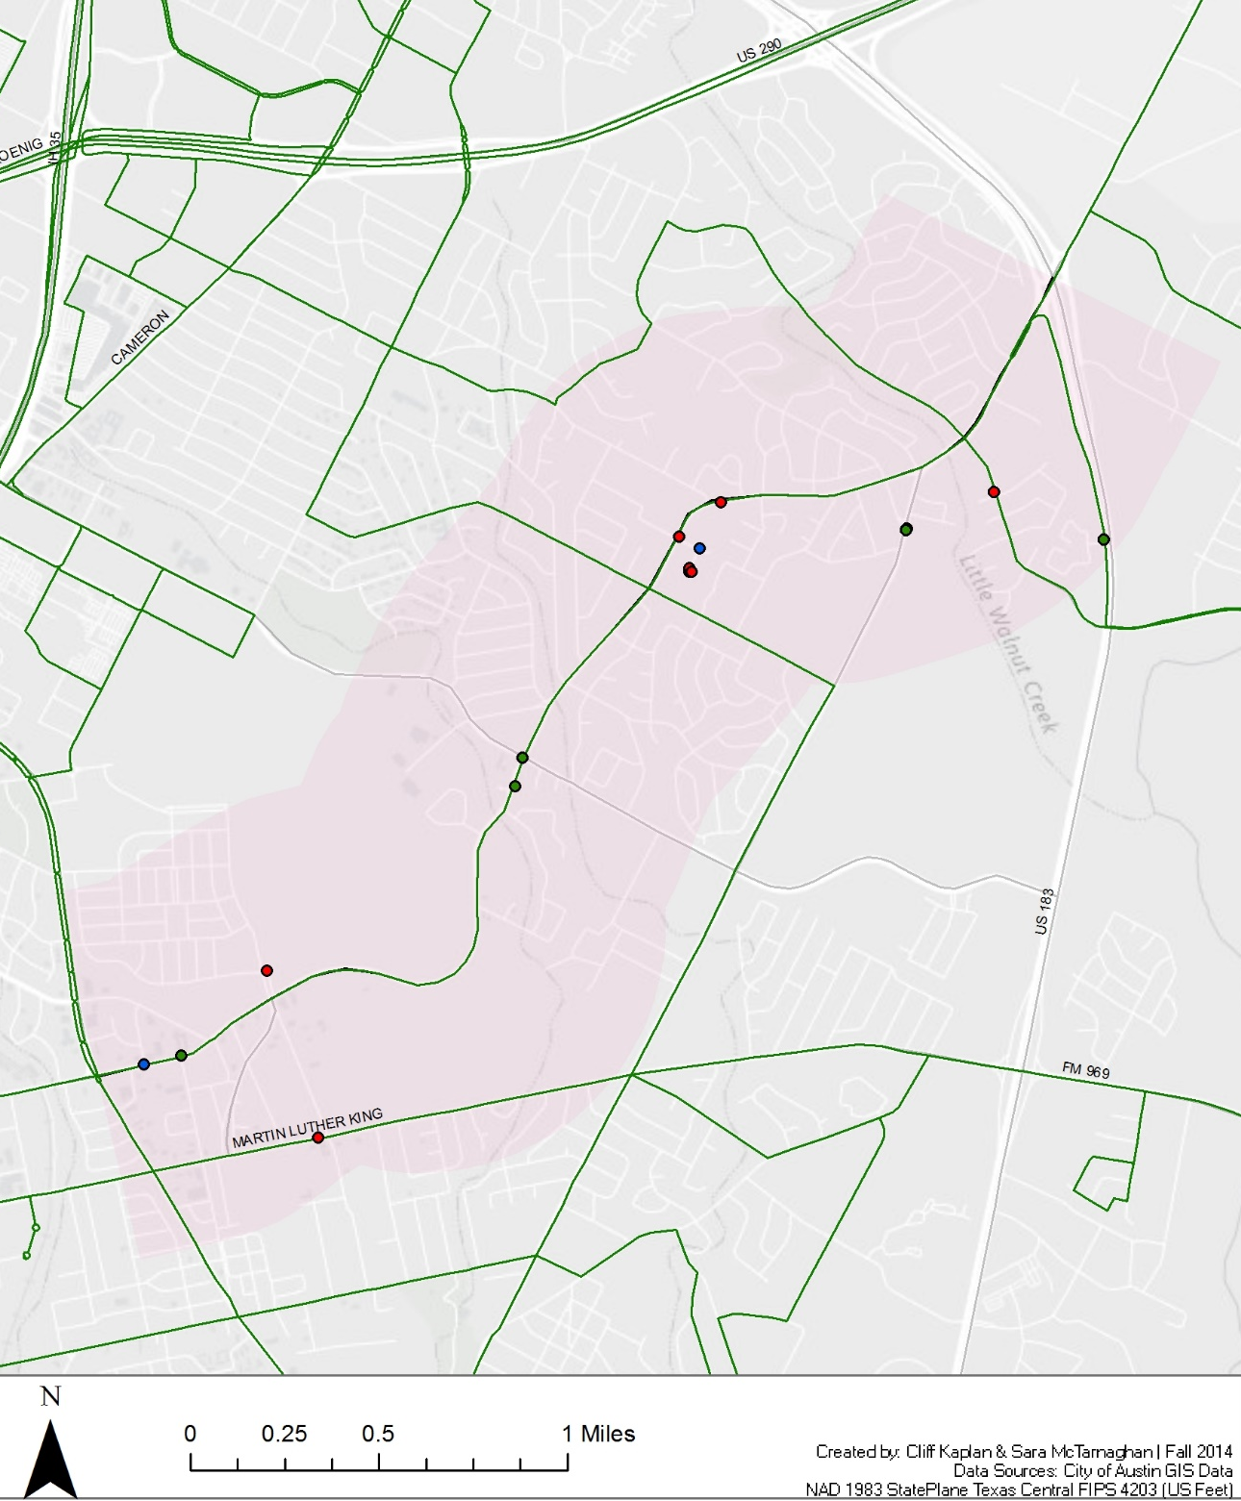
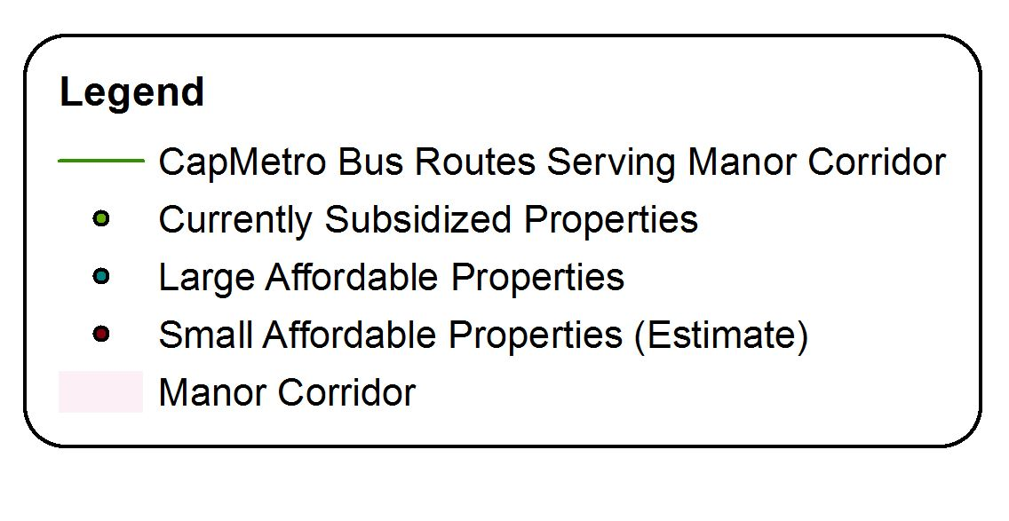
The analysis:
Focusing on
the Manor
Corridor as an
Example
GISWR 2014 Final Presentation - Clifford Kaplan

Slide 8
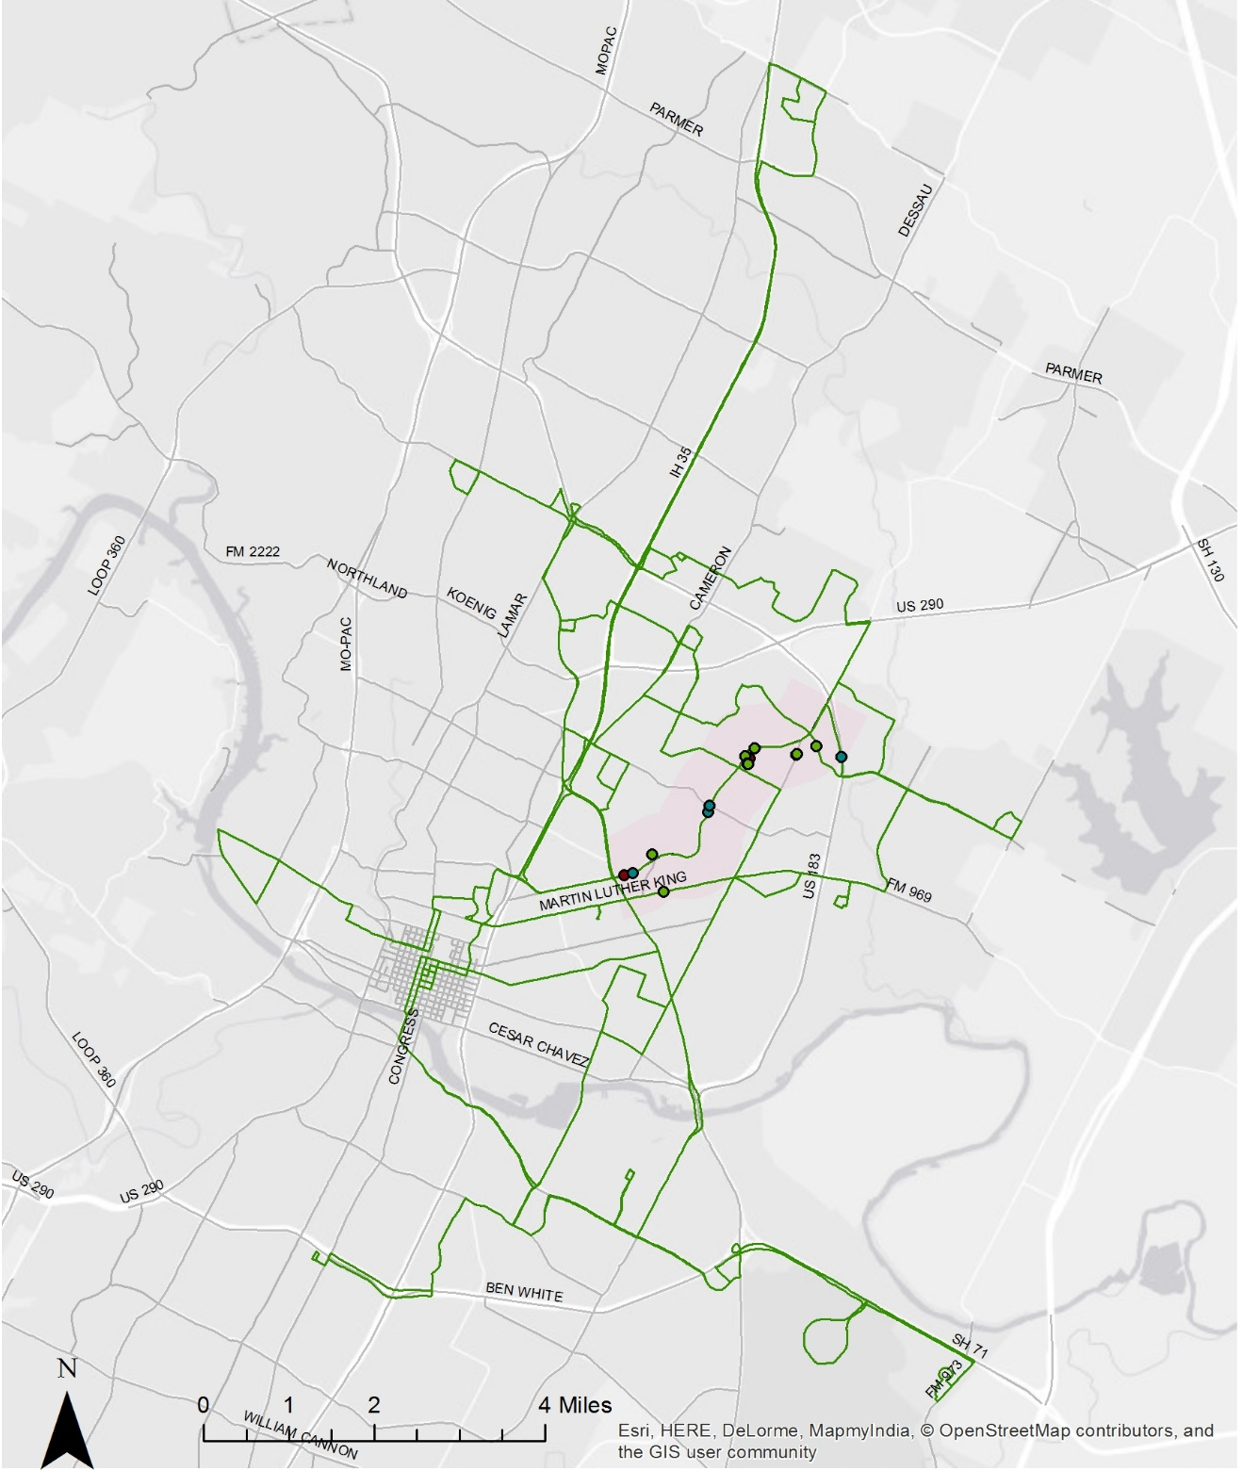
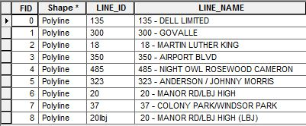
Transit Access
from the
Manor Corridor:
Nine Lines
GISWR 2014 Final Presentation - Clifford Kaplan

Slide 9
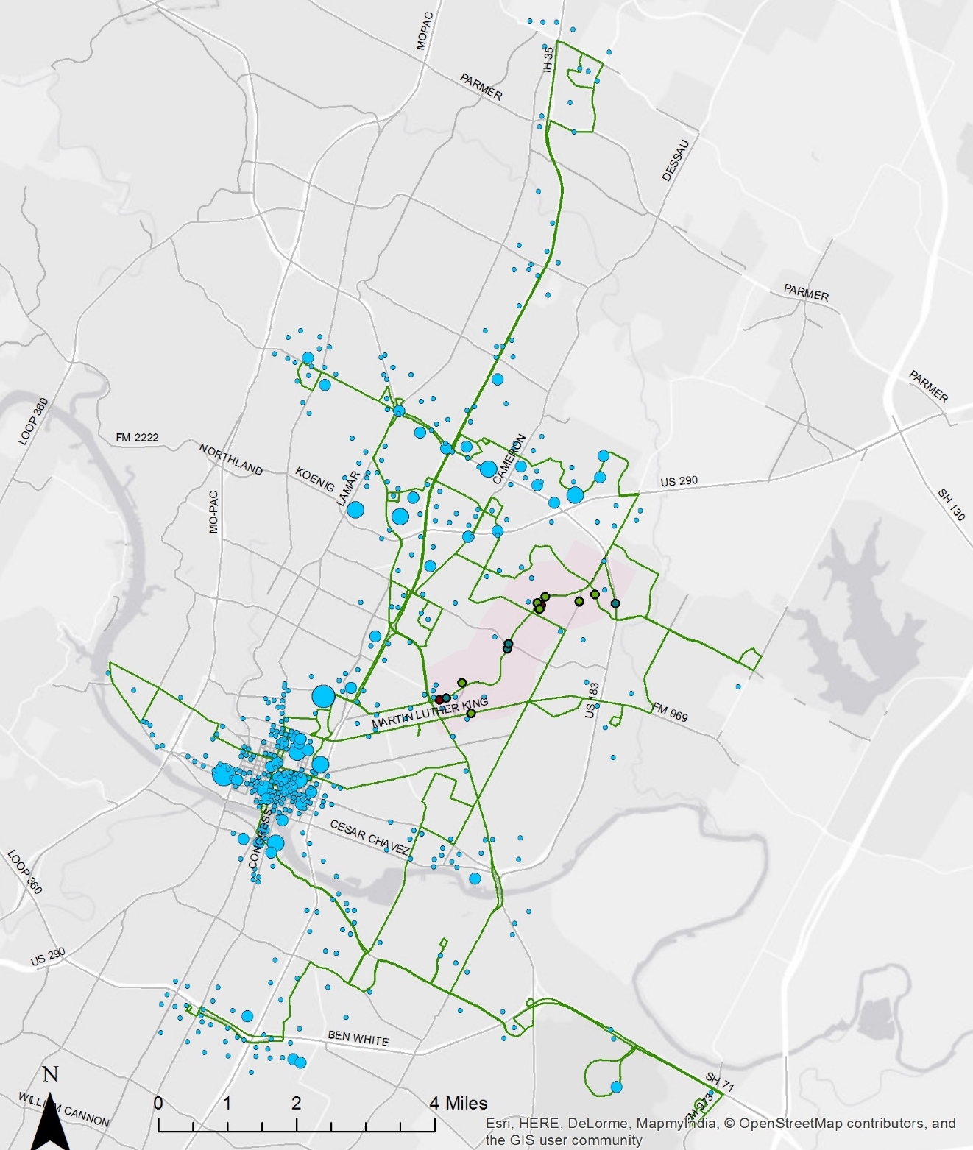
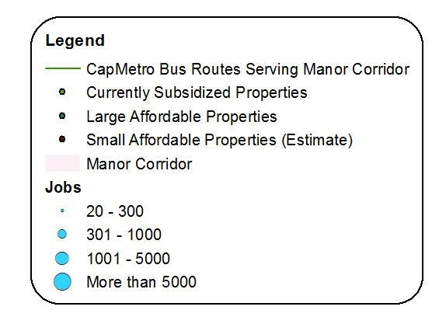
How many jobs
can be reached
from the Manor
Corridor?
55,124 jobs
GISWR 2014 Final Presentation - Clifford Kaplan

Slide 10
More nuance:
Bus Route 18 as an
example
Bus Route 18 (Martin Luther King BLVD) reaches 49,808 jobs.
It serves 4 of the 13 affordable buildings in the Manor Corridor.
Therefore, the job access it provides affordable housing residents
in the Manor Corridor is: 49,808 x 4/13 = 15,325.5385.
GISWR 2014 Final Presentation - Clifford Kaplan

Slide 11
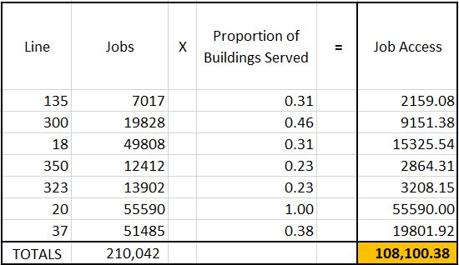
More nuance:
Total number of jobs
accessible from the Manor
Corridor via the bus
without a transfer: 55,124.
Total job accessibility from
the Manor Corridor is
108,100.38. This number
accounts for the presence
of multiple bus lines with different spatial coverage.
Further nuance could be added by using the proportion of units served,
Instead of the proportion of buildings, and by accounting for the
frequency of buses on each line.
GISWR 2014 Final Presentation - Clifford Kaplan

Slide 12
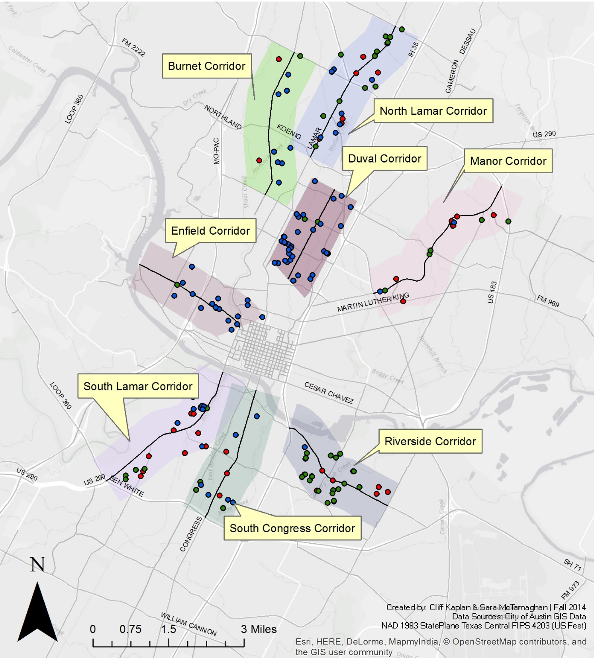
Next Steps:
Try to automate
the analysis.
Perform the analysis
on the remainder of
the corridors.
Thank you
GISWR 2014 Final Presentation - Clifford Kaplan

