Slide 1
Soil Erosion Assessment using GIS and RUSLE model
CE 394K
GIS
in Water Resources
By Yongsik Kim
Notes:
It is a pleasure to show you the results of my Term Project. I estimated the soil erosion potential using GIS and RUSLE model.

Slide 2
Contents
1
Introduction
2
Analysis
3
Conclusion
Notes:
The contents are introduction, analysis, and conclusion.
In introduction, I will talk about the motivation, objective, explanation of RUSLE model, methodology, and study area.
In analysis, I will show you the estimation of each parameter for RUSLE model using GIS.

Slide 3
1. Introduction
Motivation
Sediments
by Soil Erosion
Morphological Changes of River Beds.
- Settlement,
- Entrainment.
Decrease of Water Quality in River Systems.
- Water depth decrease,
- Turbidity increase,
- Nutrient increase.
Objective
Assessment of the Potential of Soil
Erosion Using GIS and RUSLE model.
Notes:
Sediments by soil erosion have been an important factor that affects the morphological changes of river beds and water quality in river systems.
So, for the best management of sediment particles, it is essential to estimate the potential of soil erosion accurately.

Slide 4
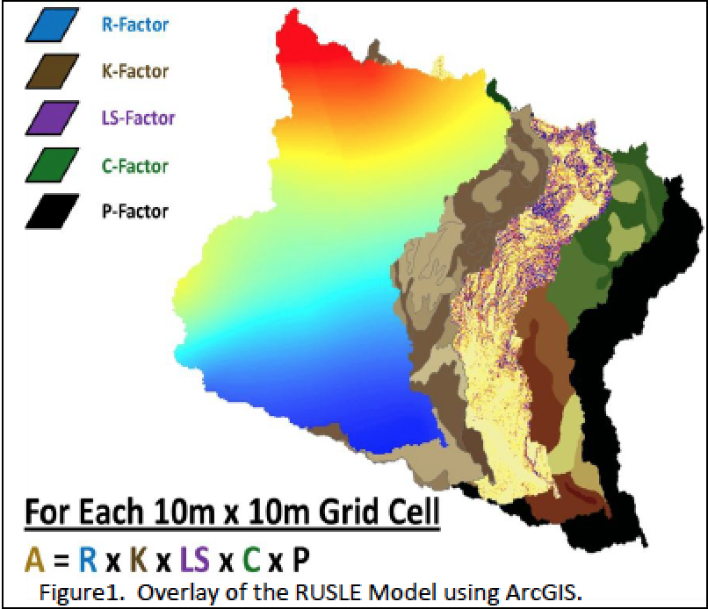
1. Introduction
RUSLE(Revised Universal Soil Loss Equation)
A = R x K x LS x C x P
A: average annual potential soil loss
(tons/acre/year),
R: rainfall-runoff erosivity factor,
K: soil erodibility factor,
LS: slope length and degree factor,
C: land-cover management factor,
P: conservation practice factor.
* The Universal Soil Loss Equation (USLE) was first developed in the 1960s by Wischmeier and Smith.
* It was later revised in 1997 in an effort to better estimate the values of the various parameters
in the USLE.
Notes:
To estimate the potential of soil erosion, I adopted RUSLE model.
The RUSLE model uses the simple equation as you see. Average annual soil loss can be calculated by multiplying 5 parameters.
R is the rainfall-runoff erosivity factor, K is the soil erodibility factor, LS is the slope length and degree factor, C is the landcover management factor, and P is the conservation practice factor.
I will explain these parameters more precisely in analysis section.

Slide 5
1. Introduction
Methodology
- Data sources: USDA, USGS, and NRCS.
- Coordinate system(Projection).
▪ North America Albers Equal Area Conic.
* Datum: D North American 1983.
- Data form and cell resolution.
▪ Raster data with a cell size of 30m x 30m.
Study Area
- San Marcos Watershed.
(Subbasin in central Texas)
Notes:
All data came from USDA, USGS, and NRCS.
And I used a constant coordinate system for all maps.
All of the shapefile form data are converted into raster data with a cell size of 30m.
Study area is San Marcos watershed which is familiar with me through the GIS class.
Although I am in an international section, my target area is San Marcos watershed.

Slide 6
2. Analysis
R factor(Rainfall erosivity parameter)
- Accounts for the energy and runoff of rainfall.
- An empirical equation to determine R factor.
(by Kurt cooper, 2011)
▪ P is mean annual precipitation(inches).
- Data: 1961~1990 precipitation (USDA/NRCS).
- GIS function:
Raster calculator.
- Raster data of
R factor: 140~160.
(uniform precipitation)
Notes:
Now, I will talk about the estimation process of each parameter.
R factor accounts for the energy and runoff of rainfall. And, I used empirical equation to calculate R factor I used precipitation data from 1961 to 1990 offered by USDA and NRCS.
Using the raster calculator in GIS, mean annual precipitation is converted into raster data of R factor.
As you see, there is not so much variation in R factor due to the uniform precipitation over the basin area.

Slide 7
2. Analysis
K factor(Soil erodibility parameter)
- Accounts for soil texture, structure, organic matter,
and even permeability.
- Data : GIS shapefiles with tabular data including the
K factor for each soil type from NRCS.
- GIS function:
Feature to raster.
- Raster data of K
factor: higher value
in south east area.
(flat topography and
alluvial accumulation)
Notes:
K factor accounts for soil texture, structure, organic matter, and even permeability.
K factor is provided by NRCS with GIS shapefiles.
Using the feature to raster function in GIS, shapefile of soil type is converted into raster data of K factor.
K factor is higher in south east area.
I think that the flat topography and alluvial accumulation in south east area caused higher K value in that area.

Slide 8
2. Analysis
LS factor(Slope length parameter)
- Represents the effects of slope length (L) and
slope steepness (S) on the erosion in the basin.
- USPED(Unit Stream Power Erosion and Deposition,
Jim Pelton et al, 2012) method: Two equations for L and S
▪ L is the slope length factor at some point on
the landscape,
▪ λA is the area of upland flow,
▪ m is an adjustable value depending on the
soil’s susceptibility to erosion,
▪ 22.1(m) is the unit plot length.
▪ θ is the slope in degrees,
▪ 0.09 is the slope gradient constant,
▪ n is an adjustable value depending on the soil’s
susceptibility to erosion
Here, m=0.4 and n=1.4, which is typical of farm and rangeland with low susceptibility .
Notes:
LS factor represents the effects of slope length and slope steepness on the erosion in the basin.
I adopted USPED method to calculate LS.
USPED method suggests two equations for L and S as you see.
Using these equations in GIS raster calculator, LS factor is calculated.

Slide 9
2. Analysis
LS factor(Slope length parameter)
- Calculation of LS.
▪ Step1: calculate flow direction from DEM(ArcGIS server),
▪ Step2: calculate flow accumulation from flow direction,
▪ Step3: calculate slope in degree from DEM,
▪ Step4: raster calculation of LS using USPED equations.
- Raster data of LS
factor: higher value
in north west area.
(steep slope)
Notes:
This is the detail steps for LS calculation.
At Step 1, flow direction is calculated from DEM.
At Step 2, from the flow direction, flow accumulation is calculated.
At Step 3, Slope is calculated in degree form DEM.
At Step 4, Using USPED equations with flow accumulation and slope data, LS is calculated.
LS factor is higher in north west area. I think it is the effect of steep slope in that area.

Slide 10
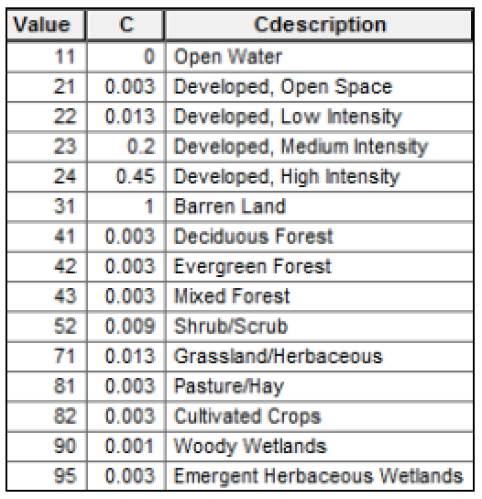
2. Analysis
C factor(Land-cover management parameter)
- A ratio comparing the soil loss from a specific type of
vegetation cover.
- Data: land-cover data of shapefile from USGS.
- C value table for land cover specification (Haan et al, 1994)
Notes:
C factor is a ratio comparing the soil loss from a specific type of vegetation cover.
Landcover data of shapefile came from USGS. And C values for specific landcovers are provided by Haan in 1994.

Slide 11
2. Analysis
C factor(Land-cover management parameter)
- GIS function: Feature to raster.
- Raster data of C factor: Not much variation over the
target area
<Land cover(shapefile)>
<C value(raster data)>
Notes:
Using GIS feature to raster function, the shapefile of landcover is converted into a raster data of C factor.
There is not much variation in C factor over the target area except some points in the middle of the area.

Slide 12
2. Analysis
P factor(Conservation practice parameter)
- Represents the ratio of soil loss by a support
practice to that of straight-row farming up and down
the slope.
- For this project the ratio is kept at 1, indicating
straight-row farming.
Notes:
P factor represents the ratio of soil loss by a support practice to that of straight-row farming up and down the slope.
For this project, the ratio is kept at 1, indicating straight-row farming.

Slide 13
2. Analysis
Soil Erosion
- Average annual soil erosion (tons/acre/year)
= R x K x LS x C x P.
- GIS function : Raster calculator.
- Soil erosion:
higher value in north
west area.
(Effects of LS rather
than R, K, and C)
Notes:
The average annual soil loss is calculated by multiplying 5 parameters using the GIS raster calculator.
The amount of soil erosion is high in the north west area because of the effect of steeper slope which is shown in the LS factor.

Slide 14
3. Conclusion
The RUSLE model combined with GIS is effective to estimate the potential of soil erosion for the target watershed.
- From basic overlays of the 5 variables and
the raster calculator, the model was
accurately depicted.
Caution is needed when interpreting the results considering the assumptions made to create each variable and errors of an empirical equation for the RUSLE model.
Notes:
The RUSLE model combined with GIS is effective to estimate the potential of soil erosion for the target watershed.
Caution is needed when interpreting the results considering the assumptions made to create the variables and errors of an empirical equation for the RUSLE model.

Slide 15
Acknowledgements
Thanks to the USGS, the USDA, and NRCS for making data accessible to the public.
Thanks to David R. Maidment, David G. Tarboton, Anthony Castronova, and Larry Band for the passionate lectures.
Thanks to TA(Gonzalo Espinoza Davalos).
Notes:
Thanks to professors and TA for the passionate lectures and helps.

Slide 16
References
USDA-NRCS <www.soils.usda.gov>
USGS <http://seamless.usgs.gov>
Haan, C.T., Barfield, B.J. and Hayes J.C. (1994). Design Hydrology and Sedimentology for Small Catchments. Academic Press, Inc, California.
Evaluation of the relationships between the RUSLE R-factor and mean annual precipitation, Kurt Cooper, 2011 <http://www.engr.colostate.edu/~pierre/ce_old/Projects/linkfiles/Cooper
%20R-factor-Final.pdf>
Calculating Slope Length Factor (LS) in the Revised Universal Soil Loss Equation (RUSLE), Jim Pelton, Eli Frazier, and Erin Pickilingis, 2012
<http://gis4geomorphology.com/wp-content/uploads/2014/05/LS-Factor
-in-RUSLE-with-ArcGIS-10.x_Pelton_Frazier_Pikcilingis_2014.docx>
Notes:
These are references.

Slide 17
CE 394K
GIS
in Water Resources
Thank You !

