Slide 1
A Characterization of the Sea of Cortez Gulf of California
By
Erin Reed

Slide 2
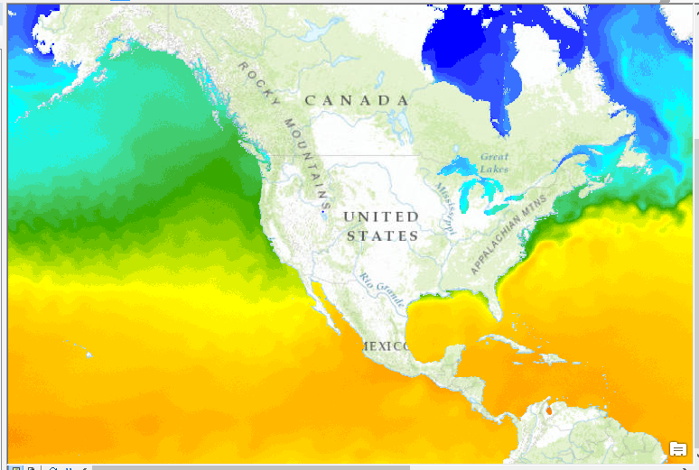
Outline for today
Background
Work done to date
Problems encountered
Future work

Slide 3
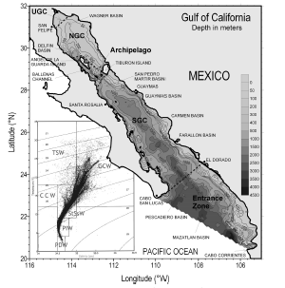
Background:
Between mainland Mexico and Baja California
150 Km wide and 1,100 Km long
Depths 200 m (N. Gulf) to 3,600 m at (S. Gulf)
Upper GOC (N.Gulf) “inverse estuary” yearly temp range 32C- 8C
Figure 1 Lavin and Marinone 1998

Slide 4
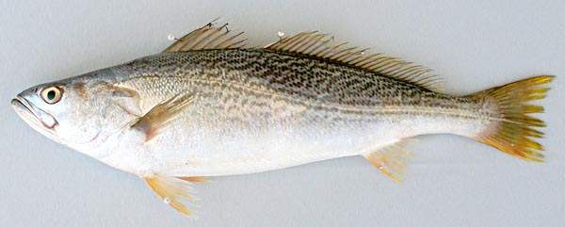
Important Habitat and Nursery Grounds
Not cool man!!
Small scale fisheries are of high economic value in GOC
Aggregate spawners, problem for fish, ideal for human
Gulf Corvina spawns with lunar cycles, primarily April

Slide 5
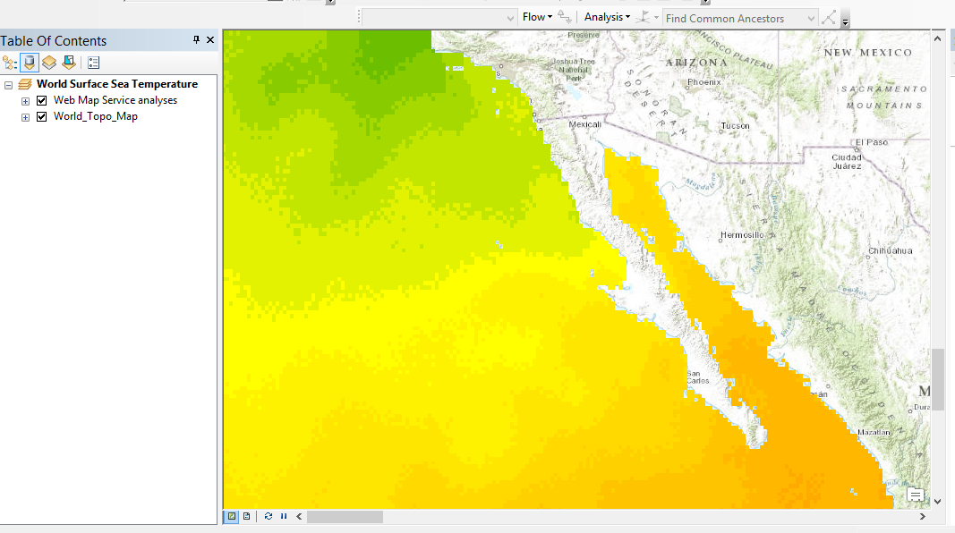
GIS Characterization
NOAA Climate Data
ESRL PSD
Variables
SST
U-wind
V-wind
Data Range 1960-2013
This project
April, 1974 only

Slide 6
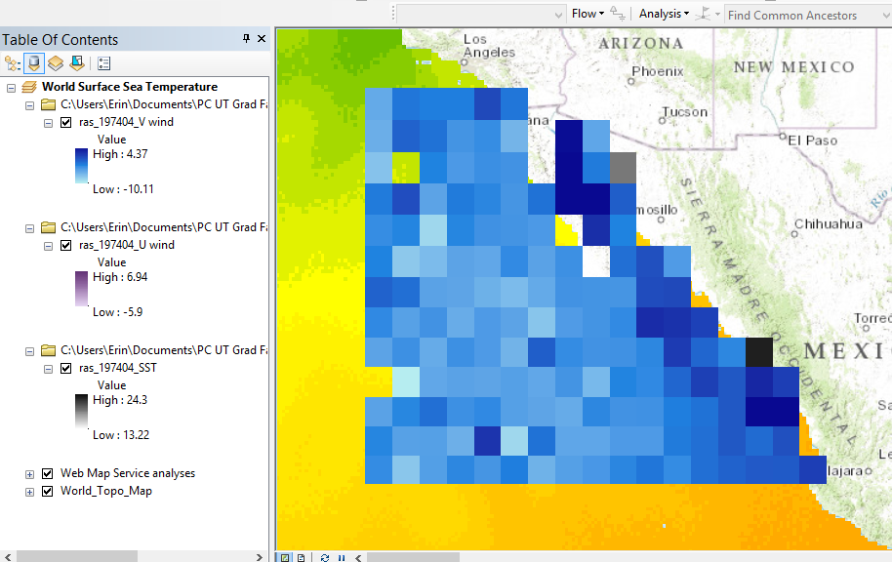
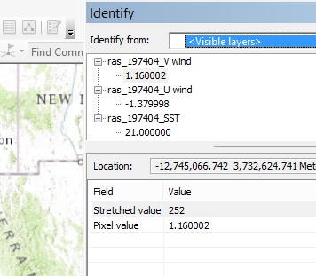
GIS Characterization: Conversion
Identify – obtain general idea of the content
Conversion Tool
Converted from Raster to point
Manipulate data easier

Slide 7
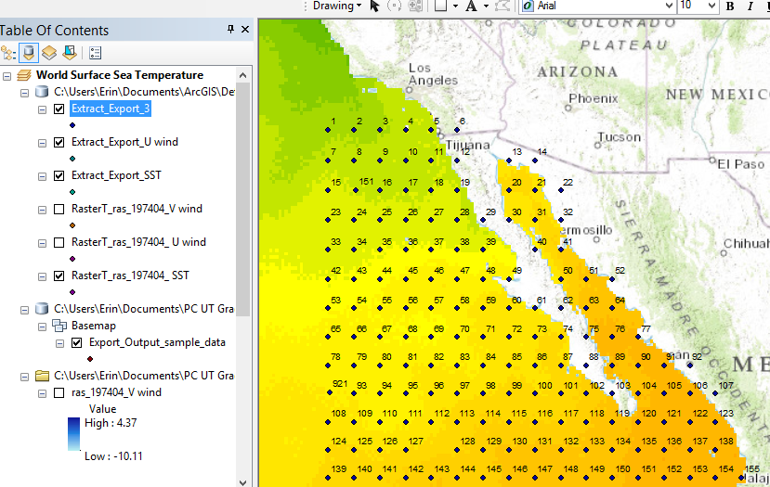
GIS Characterization: Sampling Stations
Sampling Stations 1-154
U- wind and V-wind
SST 1-155
Tool: Extract values to points
Now can compare values
Inside of Sea of Cortez
Pacific Side Baja Peninsula

Slide 8
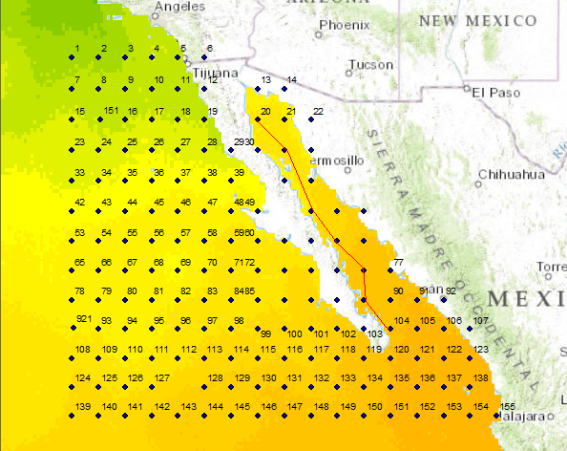
GIS Characterization: Beginnings of analysis

Slide 9
GIS Characterization: Beginnings of Analysis
Station ID | Distance (km) | SST ( C) | V-wind (N/S) | U-wind (E/W)
20 | 142.96 | 19.52 | 4.37 | 1.86
31 | 313.21 | 18.87 | 2.5 | 1.38
50 | 590.41 | 20.36 | -3.51 | 2.19
63 | 757.92 | 20.45 | -1.87 | 1.46
76 | 924.62 | 22.2 | -0.66 | -2.07
89 | 1090.55 | 21.9 | -1.11 | 1.22
104 | 1255.75 | 21.03 | -1.31 | 1.07

Slide 10
Problems Encountered
Obtaining Data
Selecting appropriate data
Month/year
Formatting three variables together
Fixing data inconsistencies (gaps)
Different numbers of sampling sites

Slide 11
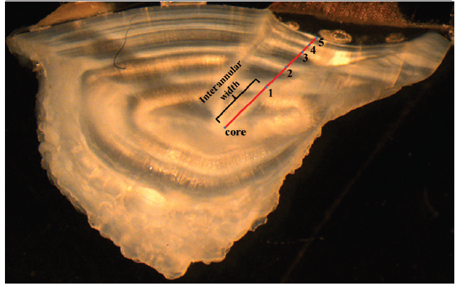
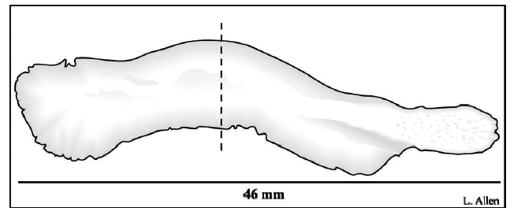
Future Work
GIS:
3 sections, North, Central, South
Contrast Pacific vs. Sea of Cortez
Hot spot tool
Environmental tracers for migrations
Salinity, SST

Slide 12
Thank you!!
Gonzalo Espinoza
Dr. Maidment
Dr. Erisman

