Slide 1
GLDAS and E2O Compared
CE 394K Term Project
Frank Schalla
November 20th, 2014

Slide 2
GLDAS & E2O
Global Land Data Assimilation System
Earth To Observe
European Centre for Medium-Range Weather Forecasts (ECMWF)
Comparing to land based data to systems
Common denominator – rainfall rate (kg / m² / sec, mm / sec)
Notes:
Introduce two systems – satellite based, one US, one European from ECMWF

Slide 3
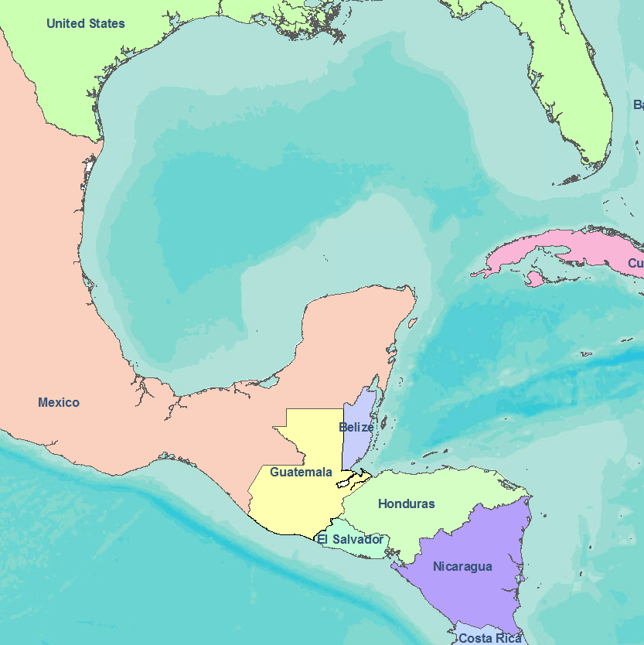
Guatemala at Large
Notes:
Comment on purpose for using Guatemala, rainwater harvesting systems
Comment on rain gauge sites, data mining

Slide 4
Land Based Data
Rainfall Rate
September 2009
Notes:
Spline with barriers
Min: 15mm, Max: 443mm (14ft)

Slide 5
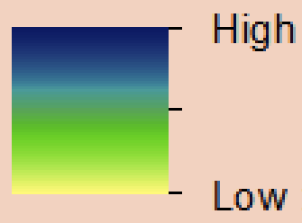
Satellite Data – September 2009
GLDAS
E2O
Notes:
Provide maps of GLDAS and E2O rasters

Slide 6
Comparison Workflow
Extract Raster Value at Point
Calculate percent error
Visualize

Slide 7
Visual Comparison
GLDAS
E2O
Percent Error
Notes:
Map showing differences between three data systems for two months – September
Pick a few points scattered across the country and compare RR and rainfall data. Have Map of selected points?
GLDAS: 30% of the points had error < 25%
E2O: 16% of guage stations had error <25%

Slide 8
Conclusions & Future Work
Significant differences in satellite data
Analyze additional months
Expand analysis to Ghana
Compare local rainfall gauge data to Global Precipitation Climatology Center (GPCC) data
Notes:
Comment on additional application: use in areas with little rainfall gauge data.

