Slide 1
Shale gas in Mexico
Darcia Datshkovsky sáenz

Slide 2
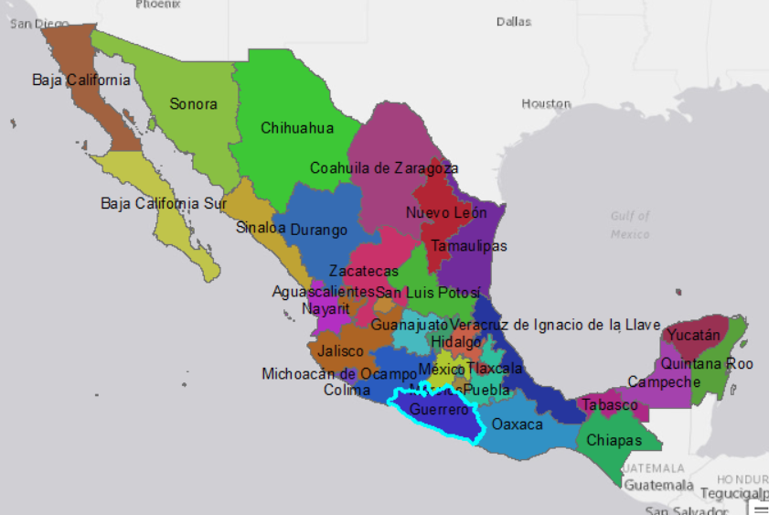
Energy reform
1938- Mexico becomes the first country to nationalize oil
Date celebrated as national holiday until this day
Closest energy market in the world
No private investment allowed anywhere in the chain
Government could only pay cash for services
Investment in new fields went down

Slide 3
Mexico´s energy production
Source: EIA

Slide 4
Mexico´s energy reform
The PRI came to power in 2012 (after 12 years ago)
President set up to pass needed reforms
Law modeled after Colombia´s and Brazil´s
Allows private investment but oil and PEMEX remains 100% Mexican
Tender process for new and mature fields
Aimed at “increasing Mexico´s energy security within a susatinable and socially conscious way”

Slide 5
Shale gas
Source: EIA

Slide 6
Shale reserves per country
Source: EIA

Slide 7
Mexico

Slide 8
US and Mexico Shale production
US shale basins
Mexico shale basins
Source: EIA and CONAGUA

Slide 9
To increase energy production and assure security…
In review
Dry gas
Wet gas
Oil
Shale formation
Source: CONAGUA

Slide 10
To increase wealth in a sustainable way…
Source: UN

Slide 11
To increase wealth in a sustainable way…
Source: UN and CONAGUA

Slide 12
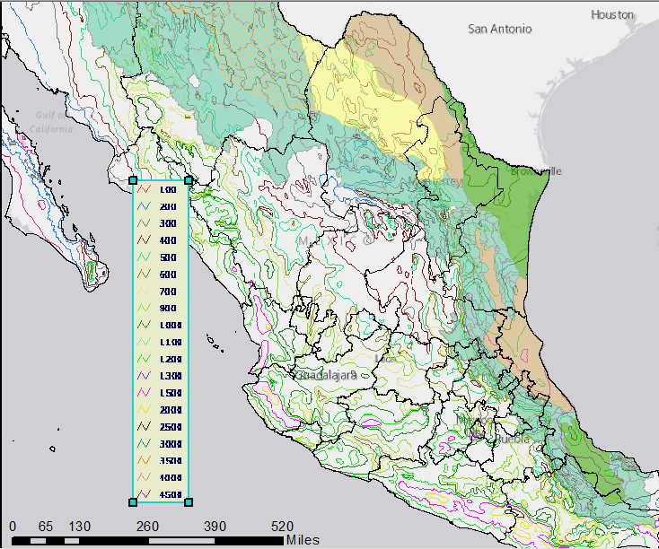
Shale producing áreas are some of the driest…
Source: CONAGUA

Slide 13
Conclusions
Mexico has important Shale gas formations that could help its energy sector develop
Yet, due to the location of these formations, other energy reform targets might not be achieved
Water issues especially pressing
Social issues (violence)

