Slide 1
Visualizing Poverty and Disability in Austin and San Antonio, Texas
Objectives:
Observe the distribution and coincidence of poverty and disability
Use a GIS in the analysis of predictors for disability, poverty, and employment
Data Source
American Community Survey 5-year estimates (2008-2012)

Slide 2
Percentage of Households Under the Poverty Line per Block Group
Austin
San Antonio

Slide 3
Percentage of Individuals Between the Ages of 16 and 64 with a Disability
Austin
San Antonio

Slide 4
Percentage of Individuals 16-64 with a Disability Working Full Time in San Antonio
FT Workers Among the Disabled, All Block Groups
Block Groups where Disability >= 20%
Work Rates in High Disability Block Groups

Slide 5
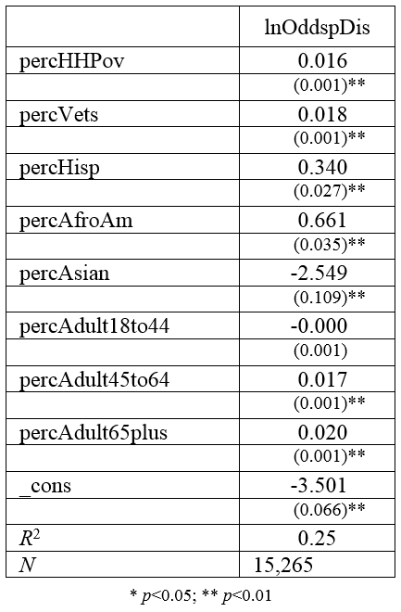
Log-Odds of Disability Rates Among Individuals Age 16 to 64 by Block Group
Covariates:
% of Households in Poverty percHHPov
% of Veterans percVets
% Hispanic percHisp
% African American percAfroAm
% Asian percAsian
% Adults 18-44 percAdults18to44
% Adults 45-64 percAdults45to64
% Adults 65+ percAdults65plus

Slide 6
Log-Odds of Full Time Work Among the Disabled Age 16 to 64 in High Disability Block Groups
Covariates:
% of Disabled age 16-64 percDis
% of Households in Poverty percHHPov
% of Veterans percVets
% Hispanic percHisp
% Asian percAsian
% Adults 18-44 percAdults18to44
% Adults 45-64 percAdults45to64
% Adults 65+ percAdults65plus

Slide 7
Evaluating the Model Spatially Percentage of Full Time Workers Among the Disabled Aged 16 to 64 in Block Groups with High Rates of Disability
Predicted Percentages
Observed Percentages

Slide 8
GIS and Post-estimation Observing the Residuals Spatially
Residual = (Observed Value) – (Estimated Value)

Slide 9
Conclusion
GIS is helpful for observing where services are needed
Output from statistical models can easily be presented in a GIS.
Observing the residuals spatially can be helpful in identifying important predictors that are not included in the model.
Possible examples:
Proximity to other sources of support that affect employment rates for this group.
Location of specialized job training programs for the disabled.
Access to public transportation.
Thank you to Prof. Maidment for providing the Block Group Geodatabase!

