Slide 1
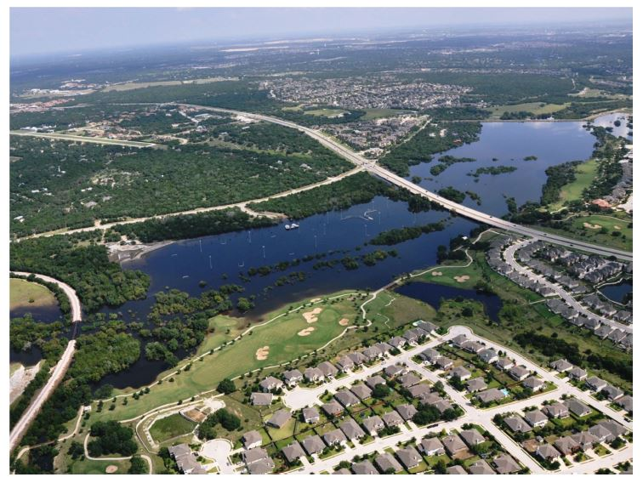
HEC & GIS Modeling of the Brushy Creek Watershed
Presented by Cassandra Fagan 25, November 2014
http://ubcwatershedstudy.ursokr.com/images/

Slide 2
Overall Goal: Raise emergency response at the local level to the national level
Create maps and tools that support local emergency response in all phases:
1) Preparedness
2) Response
3) Recovery
4)Mitigation

Slide 3
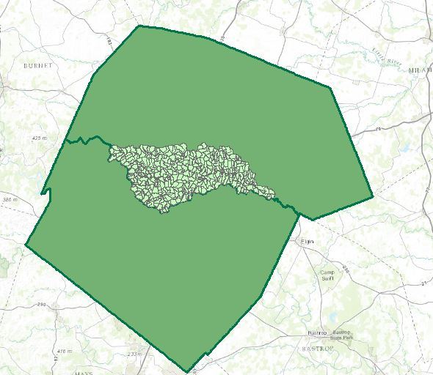
Study Area
Upper Brushy Creek Watershed located in Travis & Williamson County- 187 square miles
Flood Frequencies: 10, 25, 50, & 100 year flood events
Software used:
HEC-RAS
HEC-Geo RAS
ArcGIS
HAZUS
HEC-FIA
Williamson County
Travis County

Slide 4
Brushy Creek Watershed falls under four city jurisdictions
Study Area

Slide 5
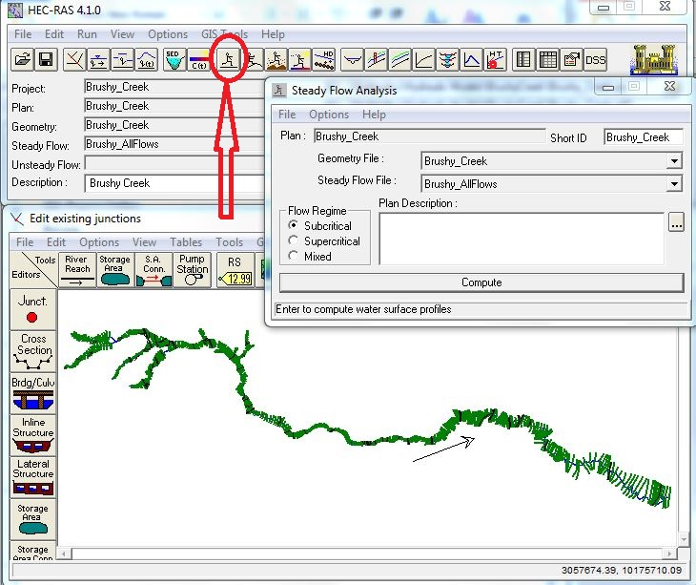
HEC-RAS
HEC-RAS model for the Brushy Creek river ran on steady-flow analysis for the 2yr, 10yr, 25 yr, 50 yr, 100 yr flood events.

Slide 6
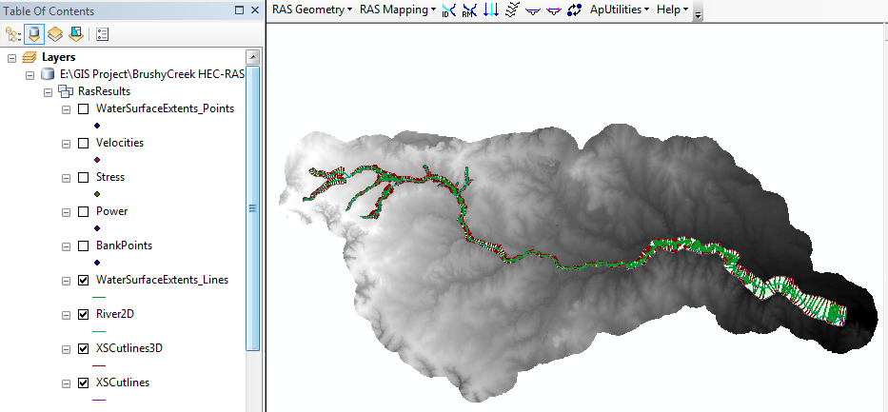
Arc-GIS 10.2.2
HEC-Geo RAS toolbox
Inundation & velocity mapping for the Brushy Creek Watershed

Slide 7
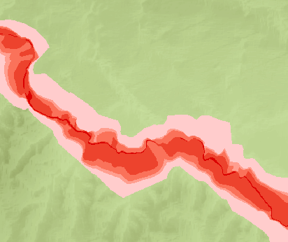
Arc-GIS 10.2.2
Velocity Mapping Using ArcGIS & HEC-Geo RAS

Slide 8
Census Data
Downloaded Census Data for Texas from https://msc.fema.gov/portal/resources/hazus

Slide 9
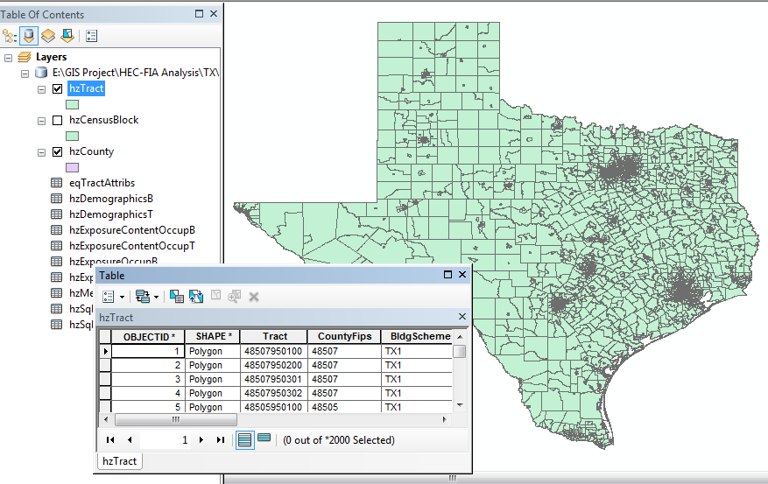
Census Data

Slide 10
Population Living the Upper Brushy Creek 100 Year Floodplain

Slide 11
Population Over 65 Living the Upper Brushy Creek 100 Year Floodplain

Slide 12
Future Work:
Perform the analysis using Bare Earth DEM from Upper Brushy Creek Control & Improvement District
Arrival Time & Evacuation route mapping using HEC-FIA
Thanks to Professor Maidment and my research group!

