Slide 1
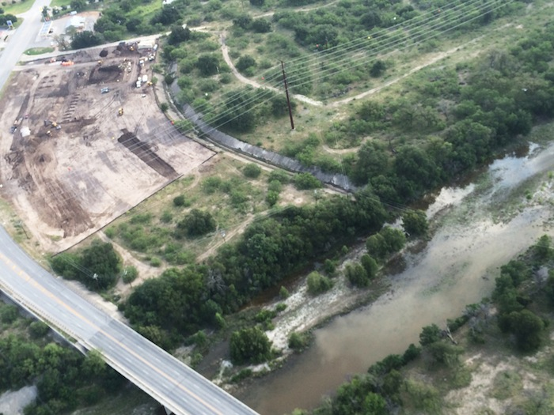
Water Quality and Development in Hill Country
Jesse Libra
CE 394K

Slide 2
Outline
Flying J Construction at Junction
Key Issue
Scope & Data
Methods
Analysis of Junction Site

Slide 3
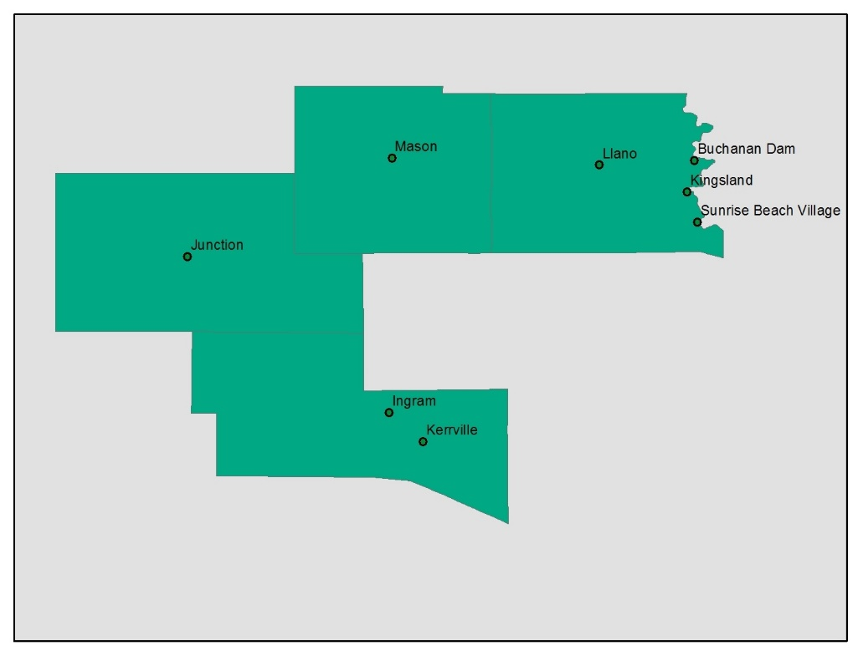
Flying J Junction Site

Slide 4
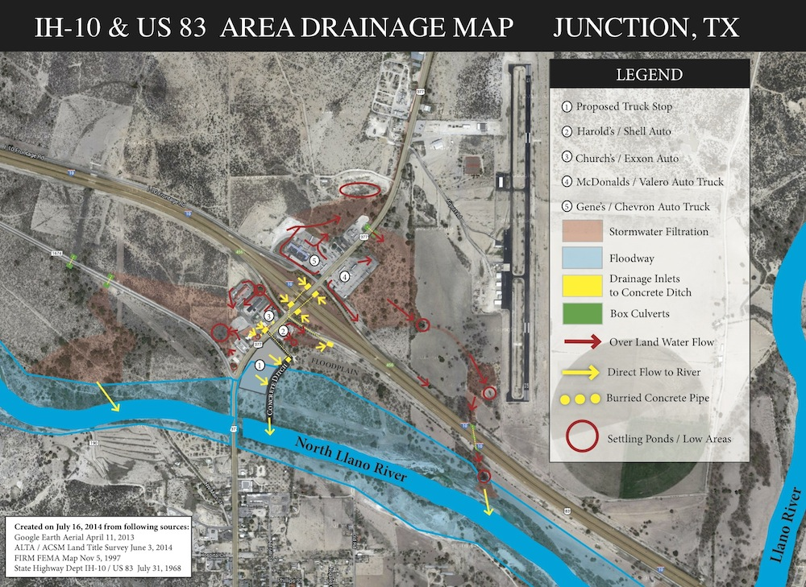
Issues with the site:
In the Floodway/Floodplain
Drains towards the North Llano River via a TxDOT drainage ditch.

Slide 5
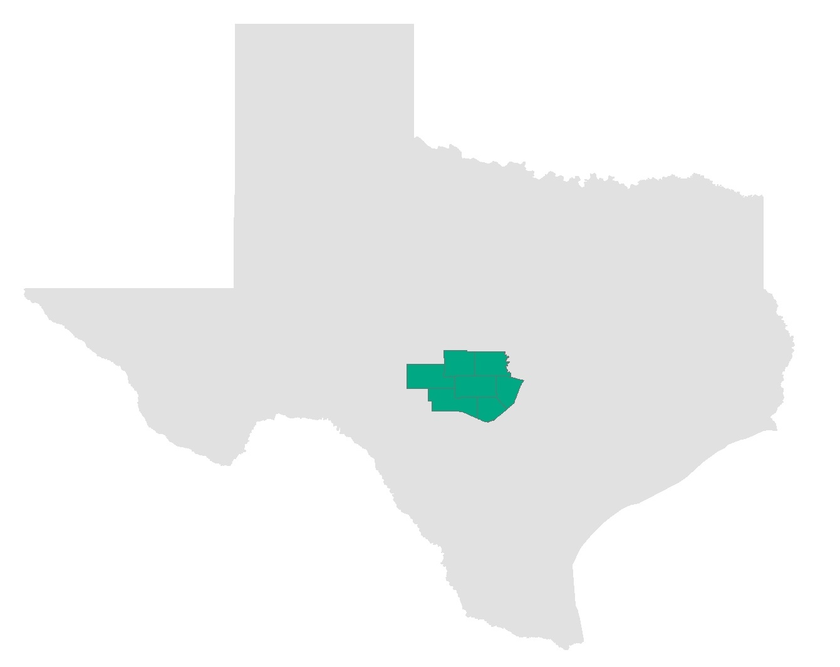
*Southeastern Hill Country: Mason, Llano, Blanco, Kimble, Gillespie, Kerr, Kendall US Census Bureau
Project Justification
Problem
Population set to double by 2050
Counties have virtually no zoning power
Most small municipalities don’t have zoning ordinances
Goal
Identify areas where:
Major Highways (ADT > 5,000) intersect waterways within municipal limits
with:
1) High runoff potential (High Curve Numbers)
2) Overland flow to water body

Slide 6
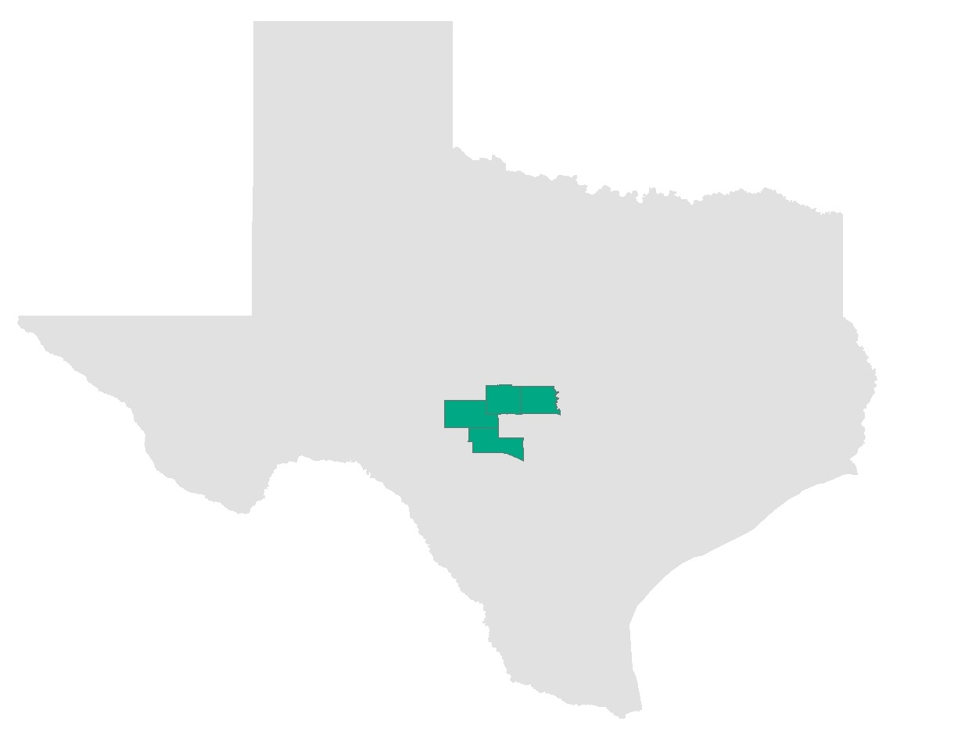
Counties: Mason, Llano, Kerr, and Kimble
Data
Identifying Potential Sites:
TxDOT ADT data (2013)
Municipal boundaries
NDH Flow Lines
Runoff potential:
DEM30m
SSURGO USDA soil Data,
2006 National Land Cover data (2011 edition)
Overland Flow:
DEM 3m

Slide 7
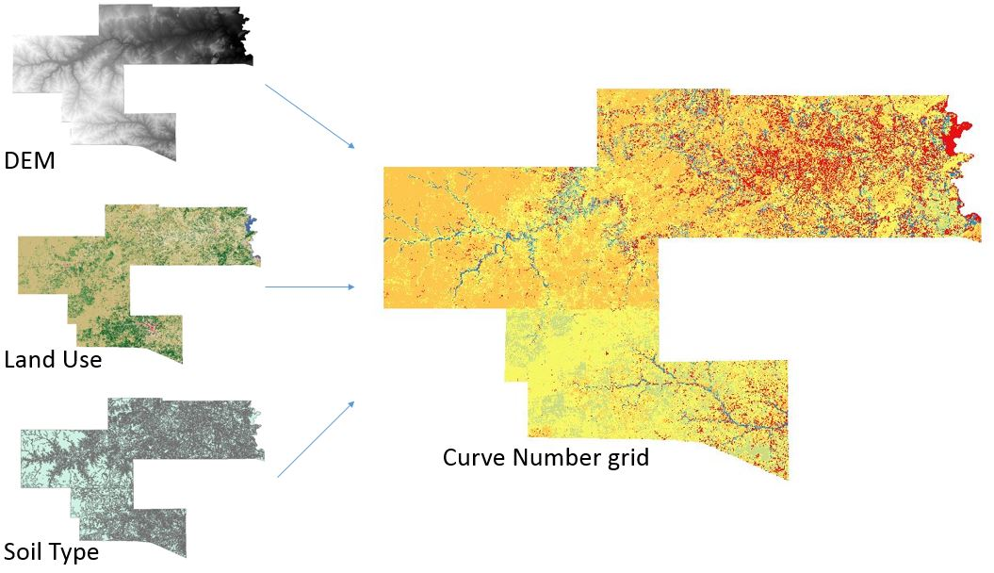
Runoff Curve Numbers using HEC-GeoHMS
Approximates runoff potential
Land use + Slope + Soil Type
10 land use categories, 4 Soil Types
 | A | B | C | D
Pasture, grassland, or range | 39 | 61 | 74 | 78
Meadow | 30 | 58 | 71 | 78
Brush | 30 | 48 | 65 | 73
Forest | 30 | 55 | 70 | 77
Row Crops | 67 | 78 | 85 | 89

Slide 8
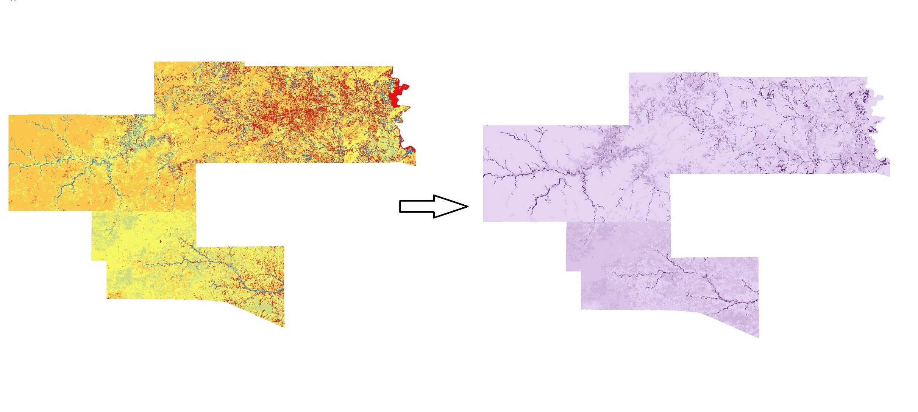
Potential Maximum Soil Moisture
Potential Maximum Soil Water Retention
Curve Number grid
S_{0.20} = ((1000/CN) – 10))
S_{.05} = 1.33 x S_{0.20}^{1.15}

Slide 9
Characterization of Junction Site

Slide 10
Characterization of Junction Site
IH 10 ADT: 10,355
US 83 ADT: 5,458
Slope: 0.2 – 0.9 percent rise

Slide 11
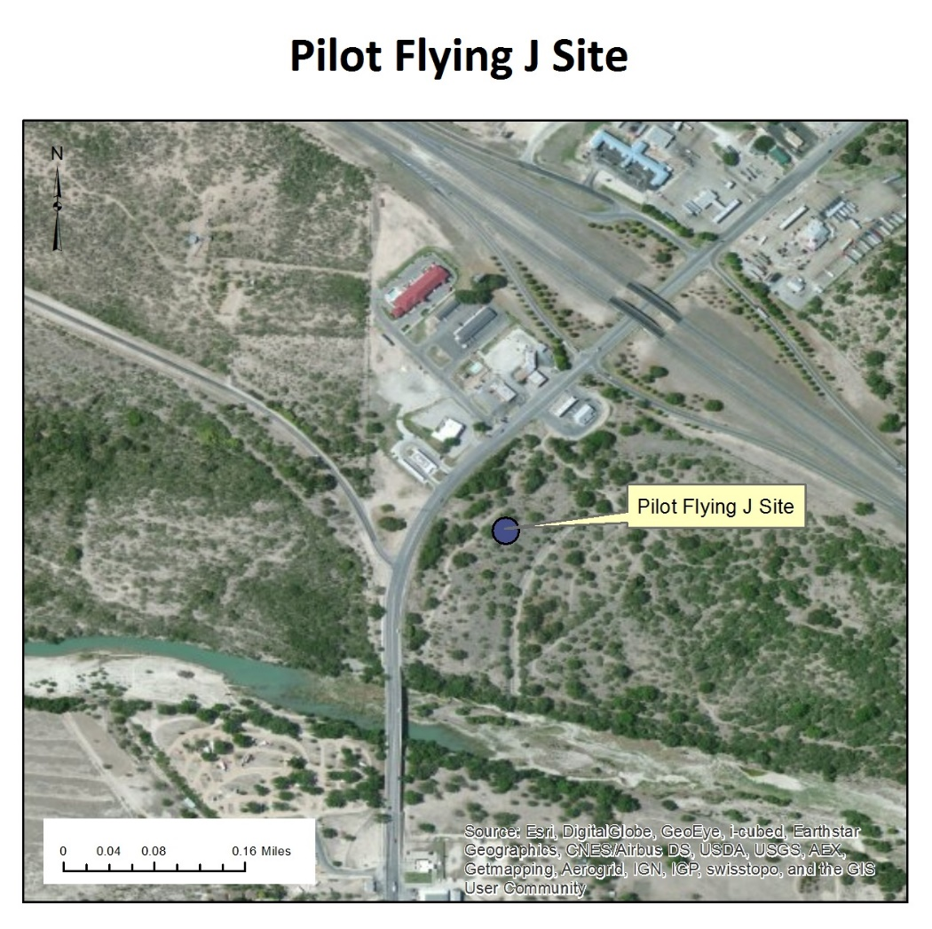
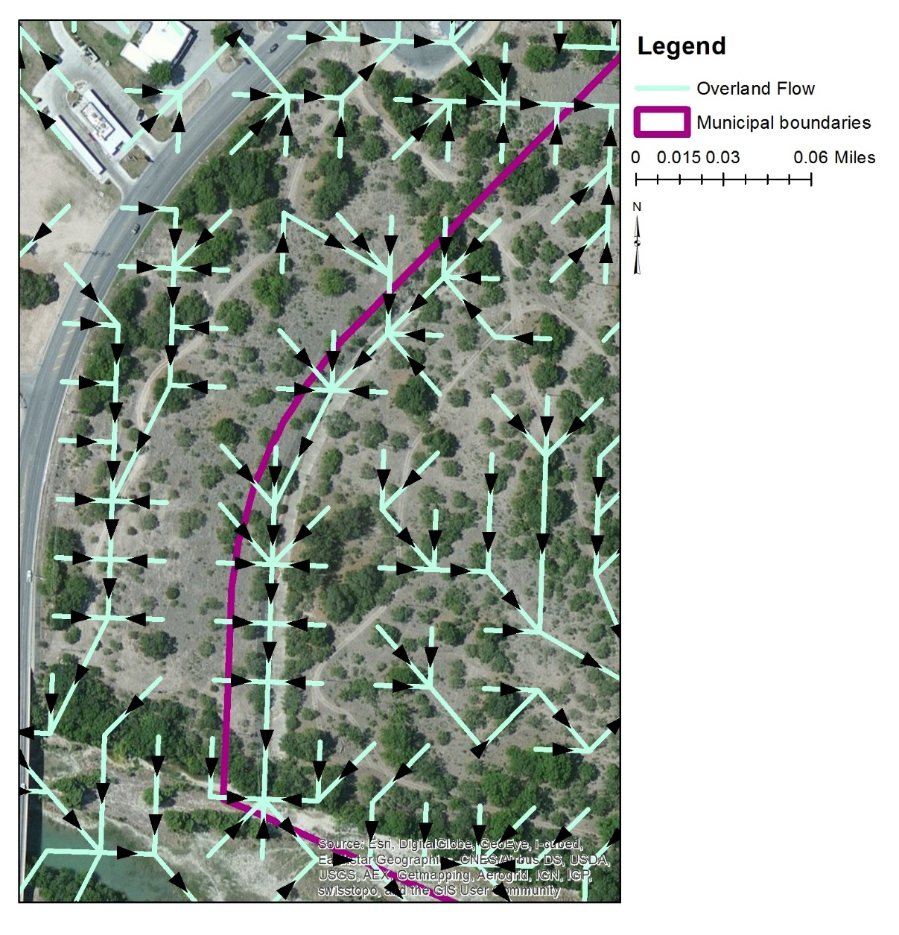
Overland flow
Overland Flow
Overland flow direction towards water body

Slide 12
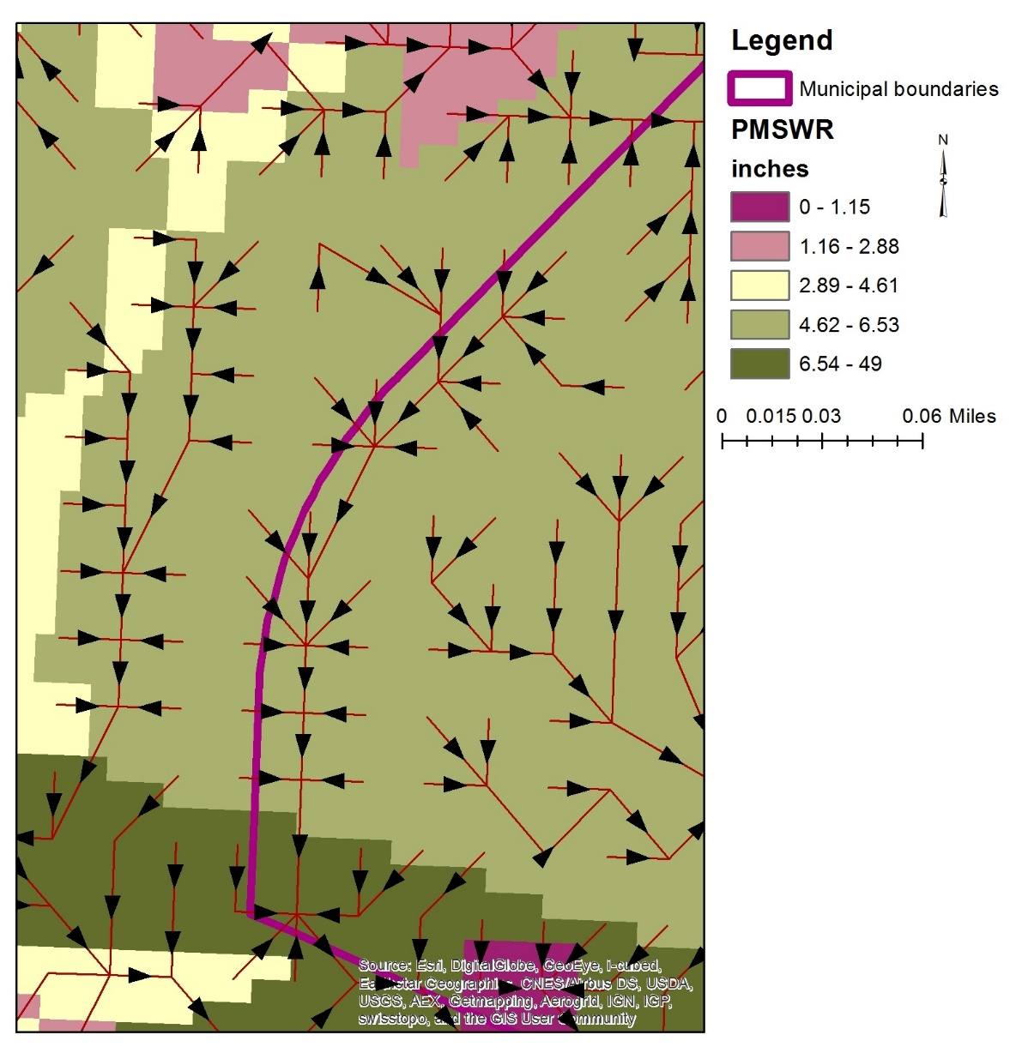
Potential Maximum Soil Moisture
Potential Maximum Soil Water Retention
PMSWR 4.62 – 6.53 inches

Slide 13
Current/Future work
Current Work
Sites based on:
> 5000 ADT
Proximity to water body
Flow direction
Runoff potential during heavy rains
Within municipal boundaries

Slide 14
Questions?

