Slide 1
Hydrologic Application of Onion Creek
Revisit of the Halloween Flood from 2013
Juhn-Yuan Su
C E 394K
Dr. D. R. Maidment
Fall 2014
Notes:
Spend 1 minute on Slide 3, 1 minute on Slides 4-5, 1 minute on Slides 6-7, 2 minutes on Slides 8-13, 2 minutes on Slides 14-15, 2 minutes on Slides 16-19

Slide 2
OBJECTIVES
Background and Motivation
Project Goal/Approach
Problems Encountered
Solution
Conclusions and Future Work

Slide 3
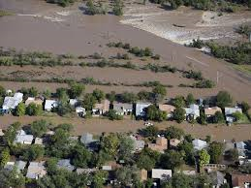
Background
October 31, 2013 (from Jervis 2013, USA Today)
Major Rainfall
At least 4 people killed (including a woman and her 8-month-old son)
1200 Homes Destroyed
Similar events that happened at Onion Creek (1869, 1921)

Slide 4
Goal of Project
Investigate the factors to this flood
Role of ArcGIS:
Incorporate Precipitation Data for 10-30-2013 and 10-31-2013
Gather Soil Data and Land Use Data
Use HEC-HMS and HEC-GeoHMS to predict streamflow
If time permits, incorporate into HEC-RAS (floodplain)
Could we have prevented this?

Slide 5
Gathering Data and Sources
DATA | SOURCE | Purpose
Precipitation (10-30-2013 to 10-31-2013) | NOAA | Streamflow Calculation
Soil Data | STATSGO and SSURGO | Infiltration (CN)
Land Use | NCLA_2006 (2011 Edition) | Infiltration (CN)
Evapotranspiration (in mm from GIS) | USGS | Excess Rainfall Deletion (not presented in these slides)
Elevation | DEM | Stream Systems and Catchments
Searching of the types of data based on referencing of Han (2010), Yeh et al. (2014), Rimmer and Salingar (2006), Liu et al. (2013), van Etten and Vellekoop (2009)

Slide 6
HUC 12 Numbers for Onion Creek

Slide 7
Precipitation (10-30-2013)

Slide 8
Precipitation (10-31-2013)
Notes:
Notice the difference with the precipitation daily averages for October 30, 2013.

Slide 9
Land Use Data (NCLD)
Notes:
Land Use Data gathered from the ArcGIS web service (NCLD_Landscape); these were raster data originally that were converted to a feature class

Slide 10
Soil Data
Slow Infiltration Rates Upstream
Notes:
Soil Data adopted from a layer file for Austin-Travis County that was retrieved from ArcGIS online; intersected with the Onion Creek Catchment Polygons (as the soil layer is a vector); notice that many parts of the Onion Creek Watershed have a soil hydrologic group D (which means infiltration rates < 0.15 inches/hour); slow infiltration rates with large rainfalls at the region = Flooding!

Slide 11
Delineating the Watershed
First, get the Digital Elevation Model (DEM) of Onion Creek
Notes:
Extracted the N30m from the ArcGIS web services over the Onion Creek Watershed; then filled the watershed, followed by flow direction and flow accumulation through HEC-GeoHMS; as shown in the flow accumulation, a stream definition must be made to avoid a complex network

Slide 12
Raster Calculator to Catchments!
Notes:
Defined the stream network as over 20,000 grids to allow a reasonable amount of catchments that could be done by hand (10,000 grids had 55 catchments total)

Slide 13
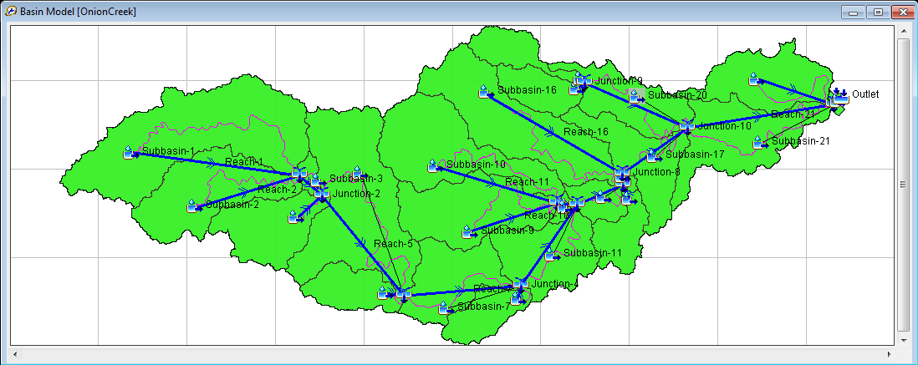
CHALLENGES
Problem with HEC-GeoHMS (Project Generation in GIS?)
Solution: Build the HMS model by hand/use ArcHydro
Notes:
All the junctions, subbasins, and downstream conditions are filled.

Slide 14
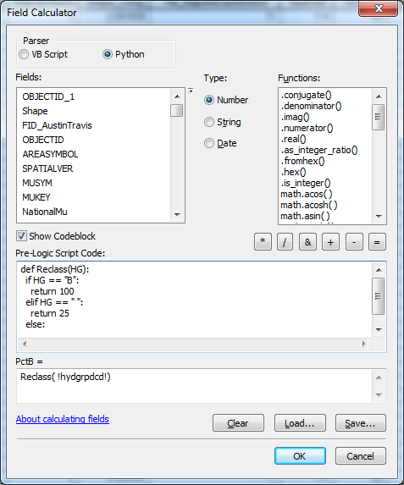
CHALLENGES
Soil Group Feature Class:
NO % A, % B, % C, % D
Hydrologic Group (HG) = “A” or “B” or “C” or “D” or “__”
I assumed:
Assign 100% for HG = A, B, C, or D and 25% for HG = blank
Solution: Computer Code in Python in Field Calculator
Notes:
Note that 2 spaces are required to start an “IF” statement while 4 spaces are required for the “return” statement. To avoid a syntax error, two equal signs are included here. The above window is an example for calculating Percent B. The % A, % B, etc. are needed for HEC-GeoHMS that required a land-use, soil-type integrated class (this feature class must have “PctA”, “PctB”, “PctC”, “PctD”, “Landuse”, and “LUValue” in it) and a CN table that defined the curve numbers for land use and hydrologic group as a dBASE file. Generating the CN grid is a long process (in terms of hours).

Slide 15
Status
Completed
Future Work
CN Grid Made using HEC-GeoHMS
Curve Numbers approximated by TR-55 (1986) and Merwade (2012)
Model built into HEC-HMS (export shapefiles)
Have all the needed data available in ArcGIS
Calculate Parameters (Streamflow) from the HMS model
Incorporate into ArcGIS for streamflow modeling with ArcHydro
Investigate why the Halloween Flood is devastating

Slide 16
Acknowledgements
Dr. Maidment
Cynthia Castro (with HEC-GeoHMS)
Xing Zheng (for guidance toward problems HEC-GeoHMS)
Parents and Siblings (UT grads…)!

Slide 17
References (for further help with project)
Etten, E. v. and Vellekoop, S. (2009). Response of Fringing Vegetation to Flooding and Discharge of Hypersaline Water at Lake Austin, Western Australia. Hydrobologia, 626(1), 67-77.
Han, J. (2010). Streamflow Analysis using ArcGIS and HEC-GeoHMS. Term Project Report for CVEN 658: Civil Engineering Applications of GIS. Zachary Department of Civil Engineering, Texas A&M University, College Station, TX.
Liu, X., Dai, X., Zhang, Y., Li, J., and Wang, P. (2013). Analysis of Changes in the Relationship between Precipitation and Streamflow in the Yiluo River, China. Theoretical & Applied Climatology, 114(1/2), 183-191.
Merwade, V. (2012). Creating SCS Curve Number Grid using HEC-GeoHMS. School of Civil Engineering, Purdue University.
Rimmer, A. and Salingar, Y. (2006). Modeling Precipitation-Streamflow Processes in Karst Basin: The Case of the Jordan River Sources, Israel. Journal of Hydrology, 331(3/4), 524-542.
Urban Hydrology for Small Watersheds: TR-55 Manual. (1986). United States Department of Agriculture, Natural Resources Conservation Service, and Conservation Engineering Division.
Yeh, H.-F., Lin, H.-I, Lee, S.-T., Chang, M.-H., Hsu, K.-C., and Lee, C.-H. (2014). GIS and SBF for Estimating Groundwater Recharge of a Mountainous Basin in the Wu River Watershed, Taiwan.

