Slide 1
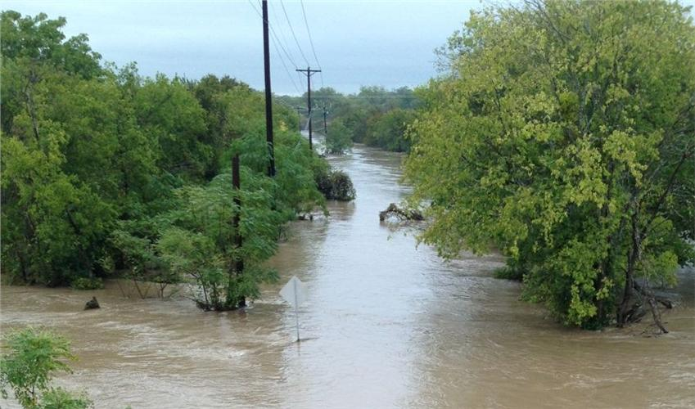
Demographics of Upper Brushy Creek

Slide 2
Layout
Why Do This Study?
UPCWCID Independent Study
Accessing and Organizing Demographic Data
Discussion of Income, Race, Age, Education
What’s Next?

Slide 3
JURISDICTIONAL BOUNDARIES

Slide 4
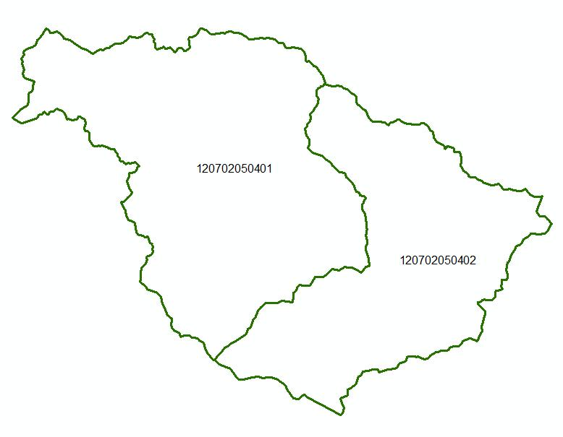
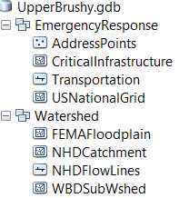
Upper Brushy Subwatersheds

Slide 5
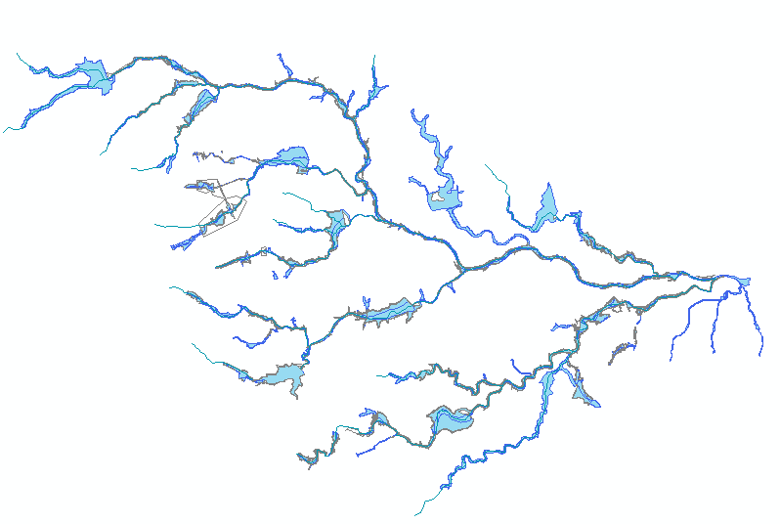
Upper Brushy Floodplain

Slide 6
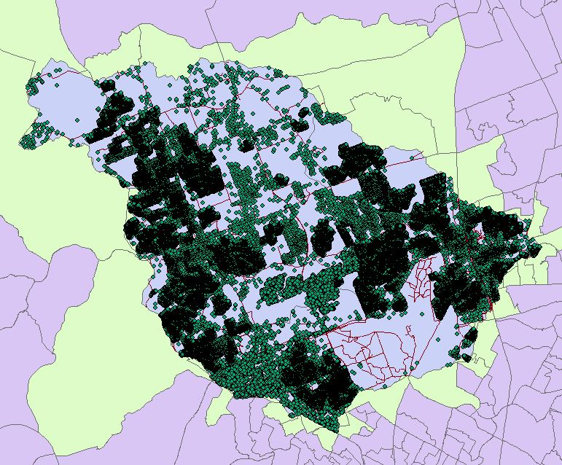
Address Points

Slide 7
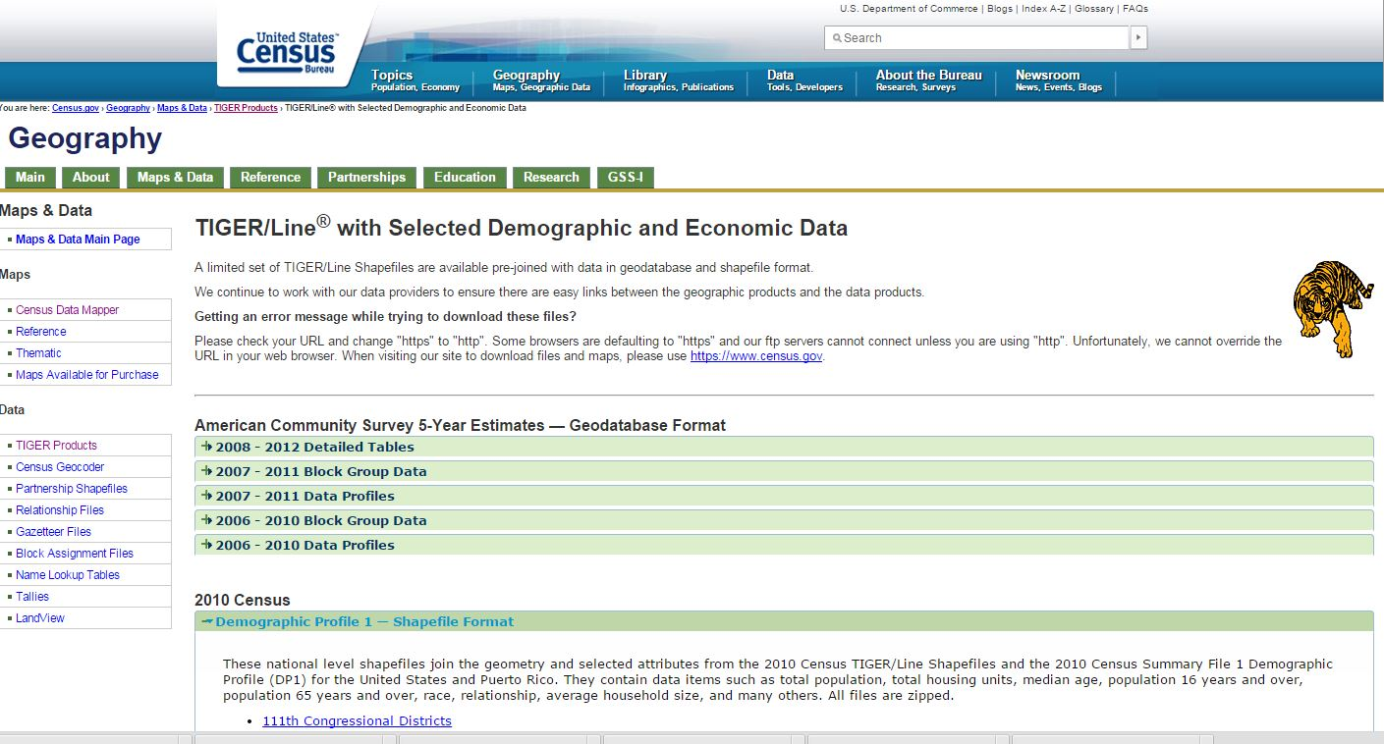
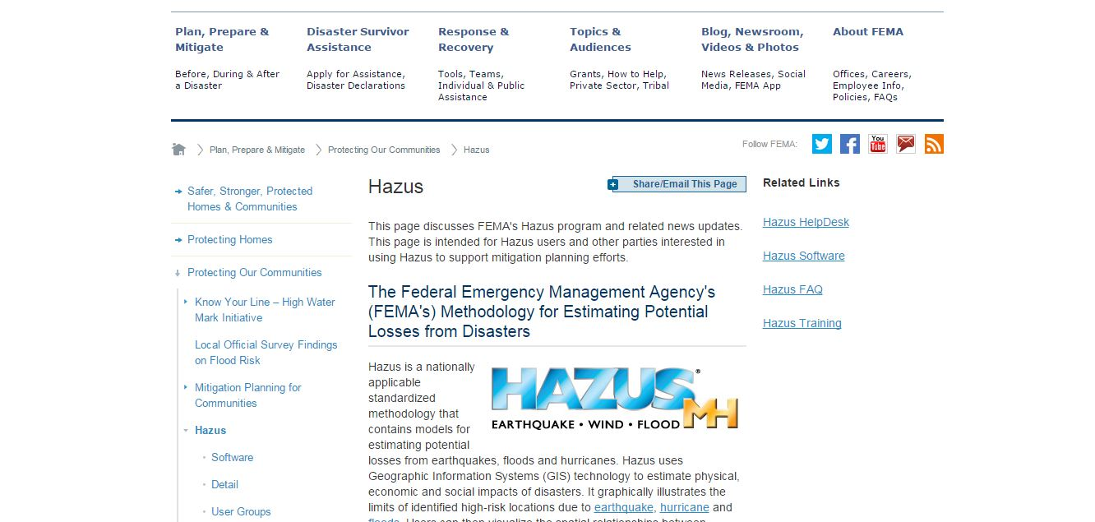
Demographic Data

Slide 8
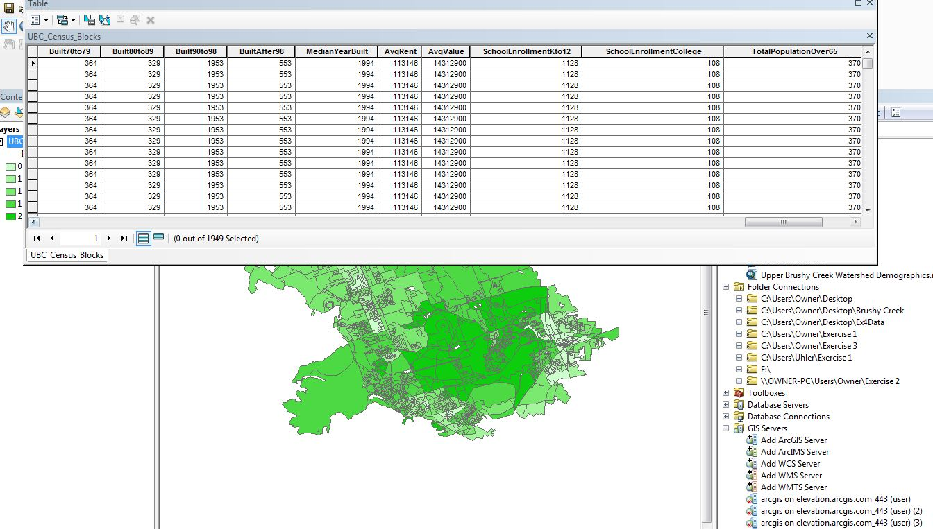

Slide 9
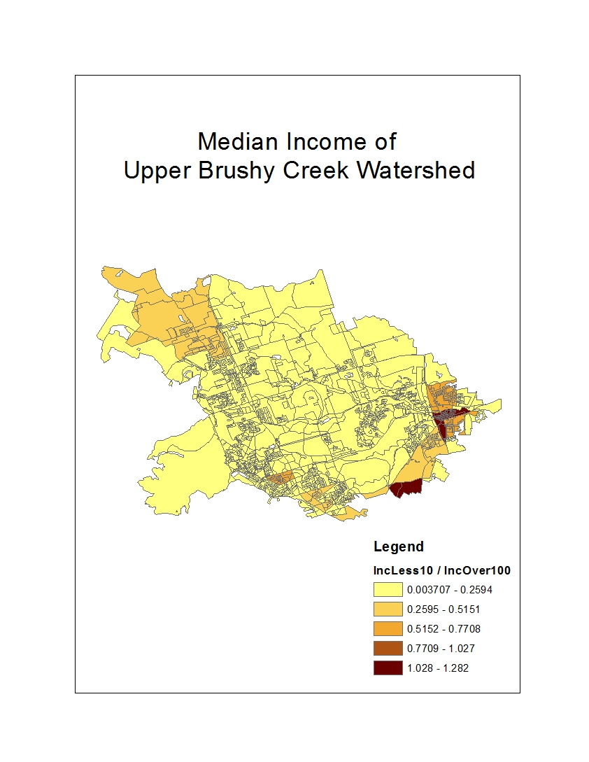
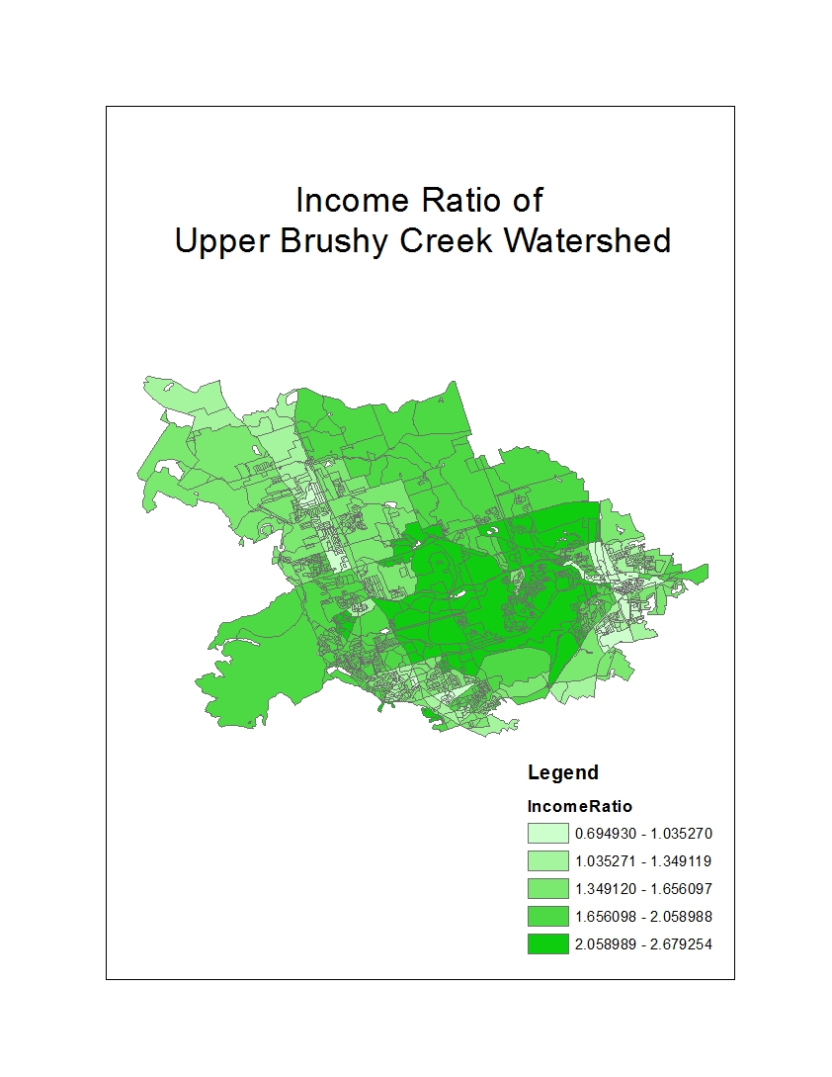

Slide 10
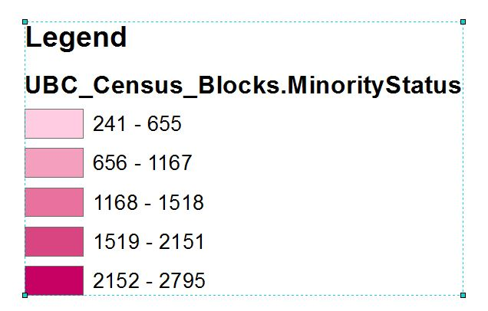
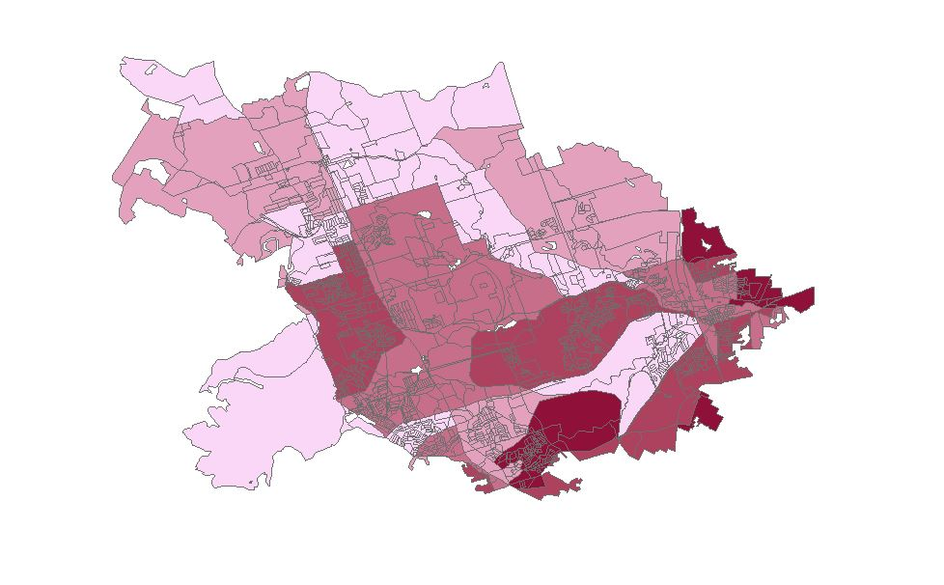
Ethnicity in Upper Brushy Creek

Slide 11
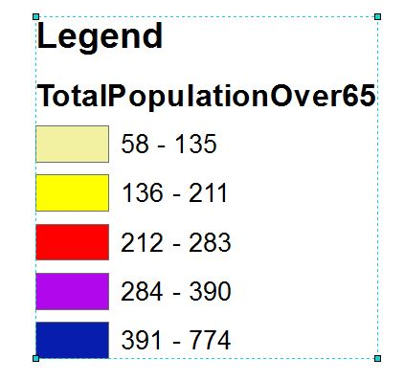
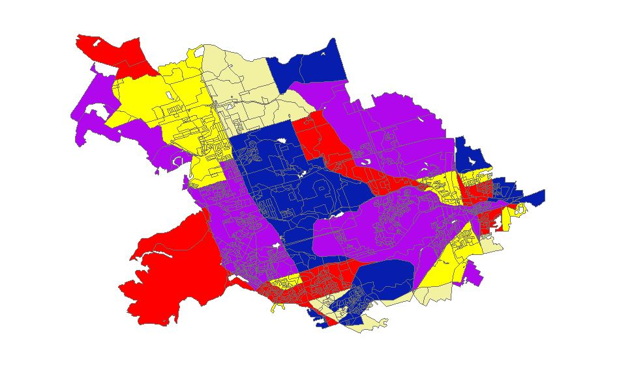
Elderly Population

Slide 12
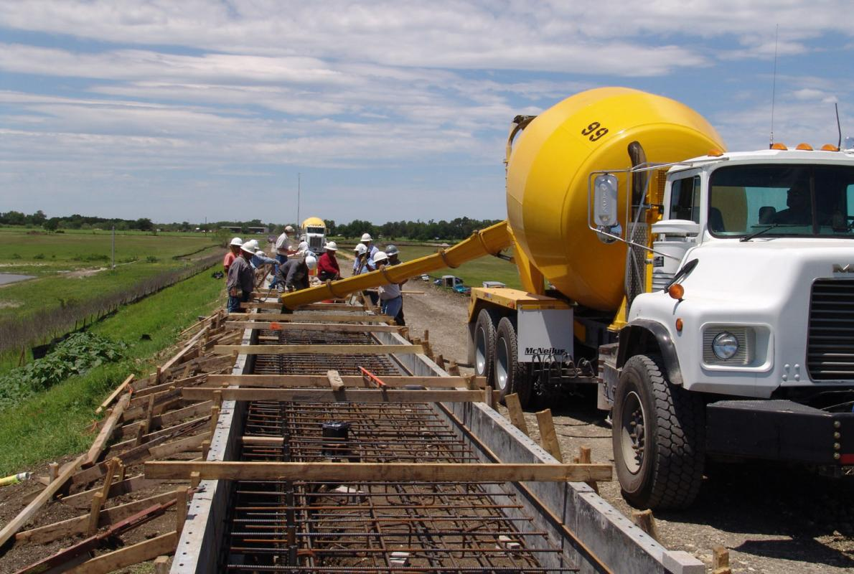
What’s Next?

