Slide 1
Data Sources for GIS in Water Resources by David R. Maidment, and David G. Tarboton
GIS in Water Resources
Fall 2014

Slide 2
Outline
The hierarchical system of watersheds and basins
Where to obtain data and maps
  National/State/Global Data repositories
  Hydrography
  USGS National Water Information System
  Land Cover
  Elevation
  Soil (Statsgo/Surgo)
  Weather
Ideas for term projects

Slide 3
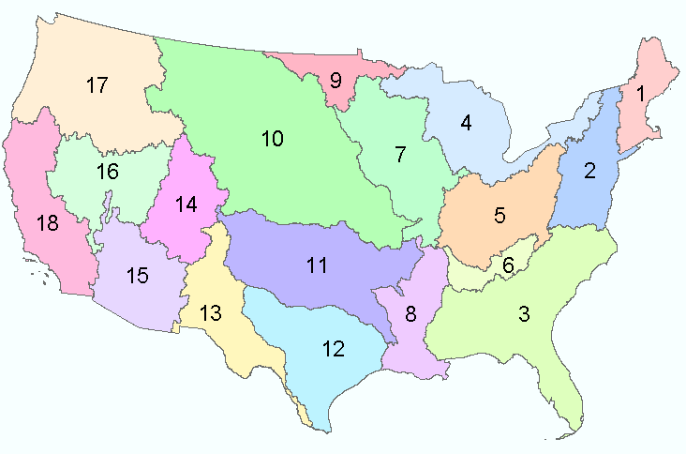
Water Resources Regions of the US
There are 21 water resources regions in the United States
Region 01 New England
Region 02 Mid-Atlantic
Region 03 South Atlantic-Gulf
Region 04 Great Lakes
Region 05 Ohio
Region 06 Tennessee
Region 07 Upper Mississippi
Region 08 Lower Mississippi
Region 09 Souris-Red-Rainy
Region 10 Missouri
Region 11 Arkansas-White-Red
Region 12 Texas-Gulf
Region 13 Rio Grande
Region 14 Upper Colorado
Region 15 Lower Colorado
Region 16 Great Basin
Region 17 Pacific Northwest
Region 18 California
Region 19 Alaska (Old numbering system)
Region 20 Hawaii
Region 21 Caribbean
Eighteen 2-digit water resource regions in the Contiguous US

Slide 4
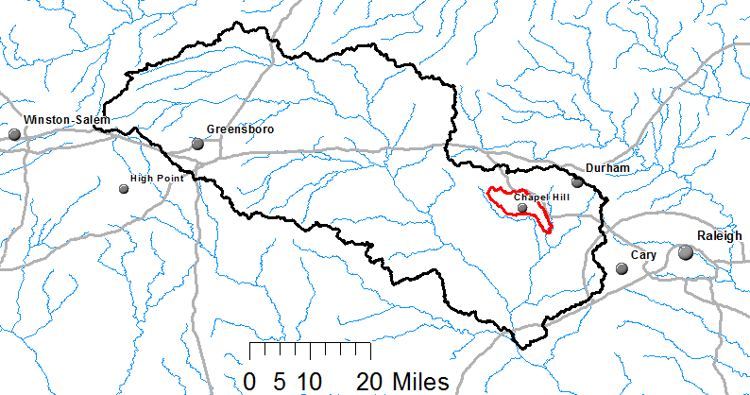
Watershed Hierarchy
Each hydrologic unit is identified by a unique hydrologic unit code (HUC) consisting of two to or more digits based on the levels of classification in the hydrologic unit system.
Digit #
2
4
6
8 HUC
10
12
NHDPlus
HAW HUC 8 03030002
Little Creek HUC 12 030300020603

Slide 5
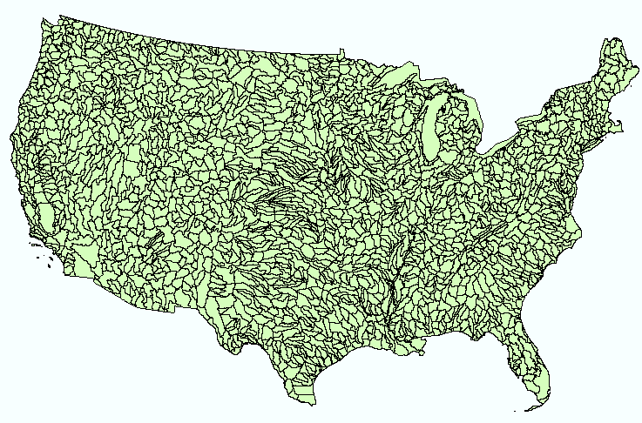
Hydrologic Unit Code Watersheds
~ 2000 HUC 8 for US, about the size of counties

Slide 6
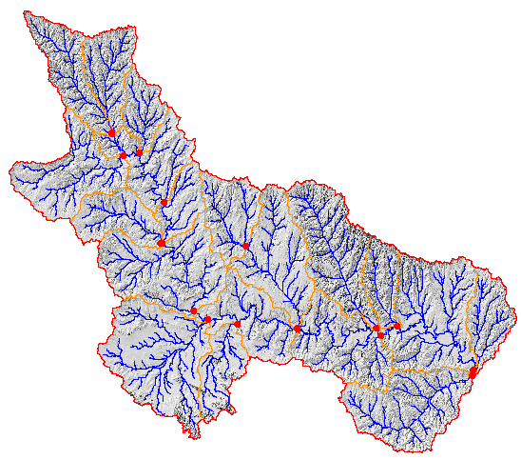
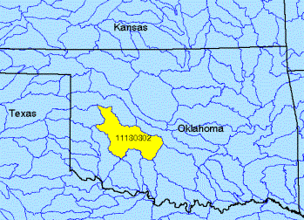
Watershed Boundary Dataset
http://nhd.usgs.gov/wbd.html
National Program by USGS and USDA (NRCS)
Boundaries for 10- and 12- digit watersheds
First cut is by automated delineation from NED
Hand checked and edited
10-digit watersheds

Slide 7
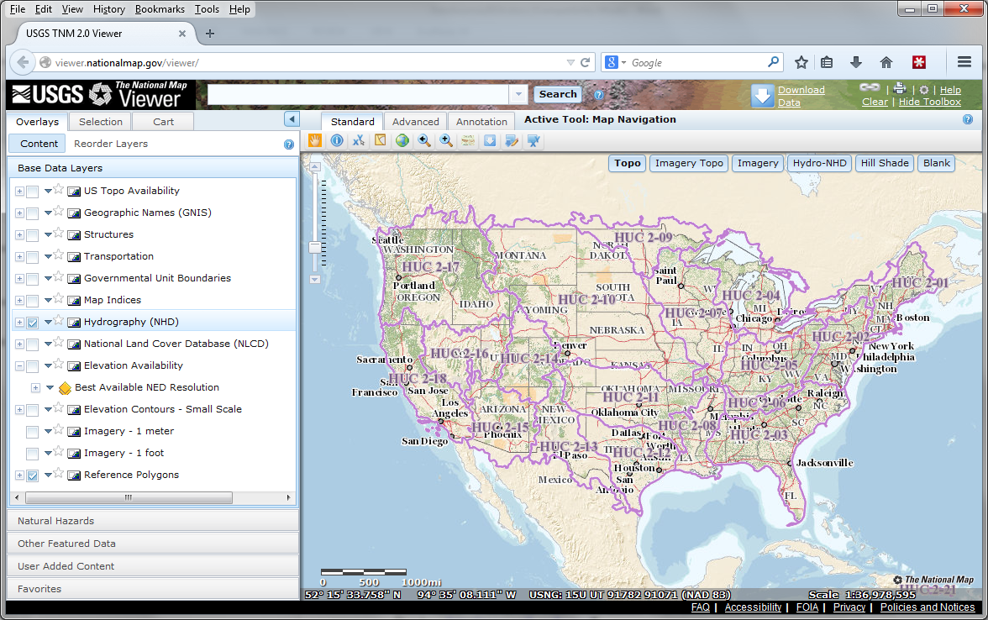
The National Map
http://nationalmap.gov/
A central source for US Government data

Slide 8
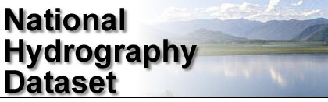
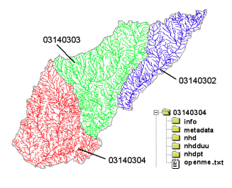
River networks
for 8-digit HUC
watersheds
http://nhd.usgs.gov/

Slide 9
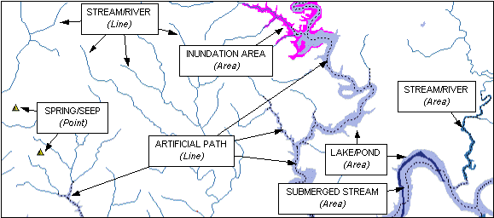

Slide 10

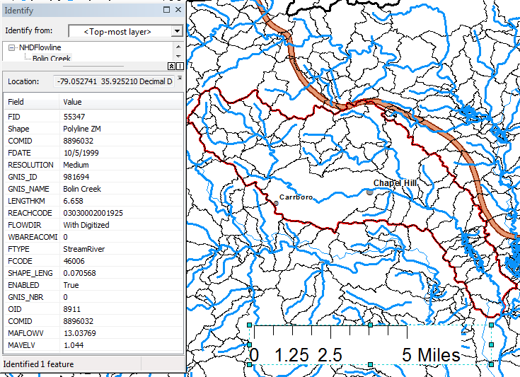
Slope
Elevation
Mean annual flow
  Corresponding velocity
Drainage area
% of upstream drainage area in different land uses
Stream order
http://www.horizon-systems.com/nhdplus/

Slide 11
River Reach Codes
Used for river address locations
ReachCode =
12030102000151
ReachCode = 12030102000005
HUC#
Segment#
Location 0.392
on Reach
12030102000005

Slide 12
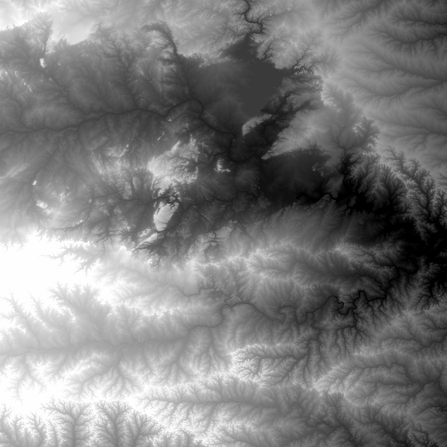
National Elevation Dataset
http://ned.usgs.gov/
Digital Elevation Model with 1 arc-second (30m), 1/3 arc-second (10m) and some 1/9 arc second (3m) cells
Distributed as part of the National Map
10 billion data
Derived from USGS 1:24,000 quadrangle sheets and at higher resolution from LIDAR
Get the data:
http://nationalmap.gov/viewer.html

Slide 13
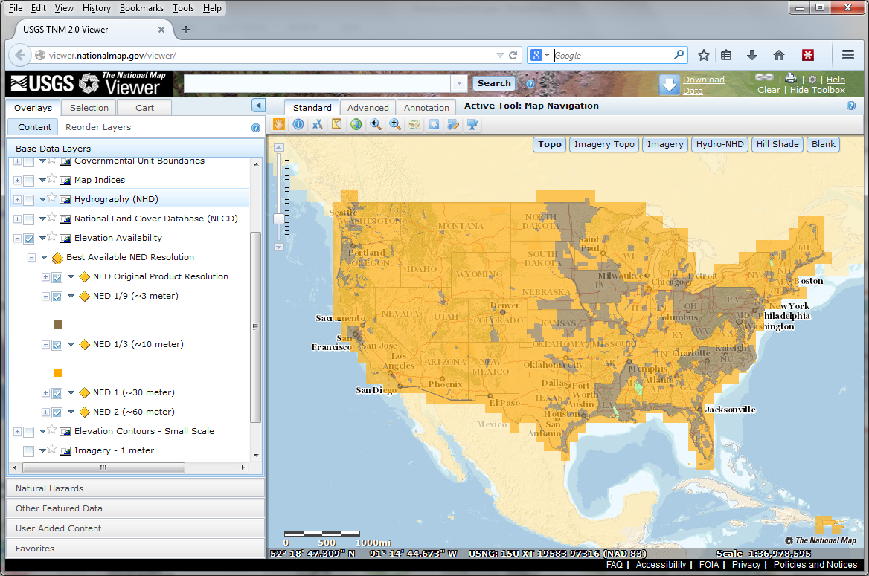
National Elevation Dataset Availability
From http://nationalmap.gov/viewer.html

Slide 14
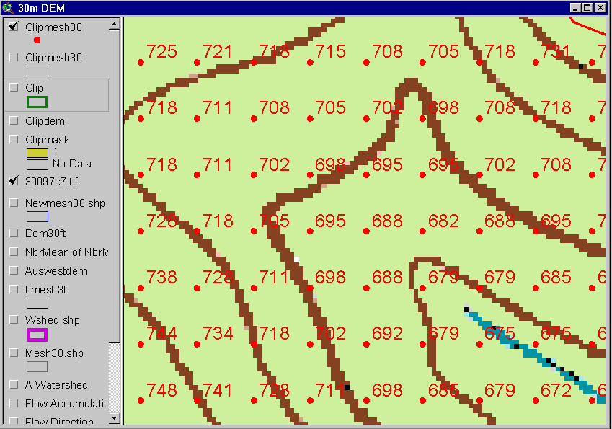
Digital Elevation Model (DEM)
720
720
Contours
740
720
700
680
740
720
700
680

Slide 15
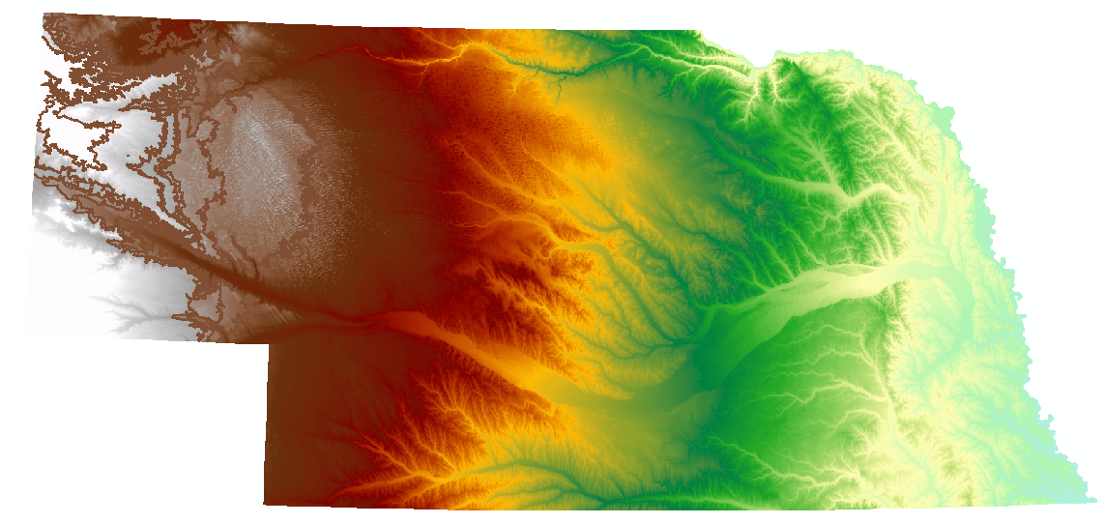
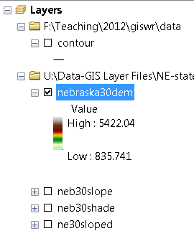
Digital Elevation Model (DEM)-30 meter

Slide 16
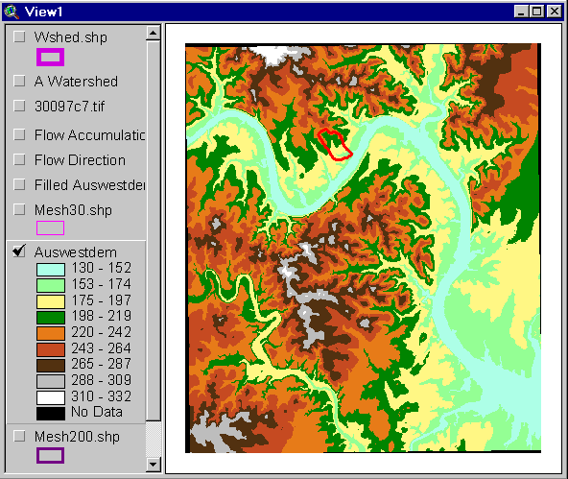
Austin West 30 Meter DEM

Slide 17
Eight Direction Pour Point Model
ArcGIS raster operations involved in watershed delineation are derived from the premise that “water flows downhill, in doing so, will follow the steepest descent
32
64
128
16
1
8
4
2
Water in a given cell flows one or more of eight adjacent cells in the direction of steepest descent (ArcGIS)

Slide 18
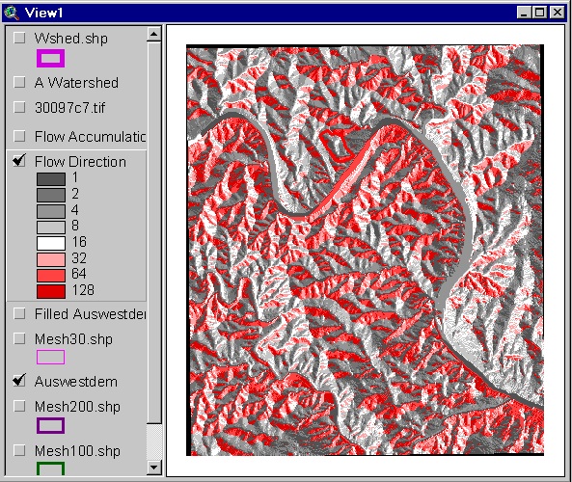
Flow Direction Grid
32
64
128
16
1
8
4
2

Slide 19
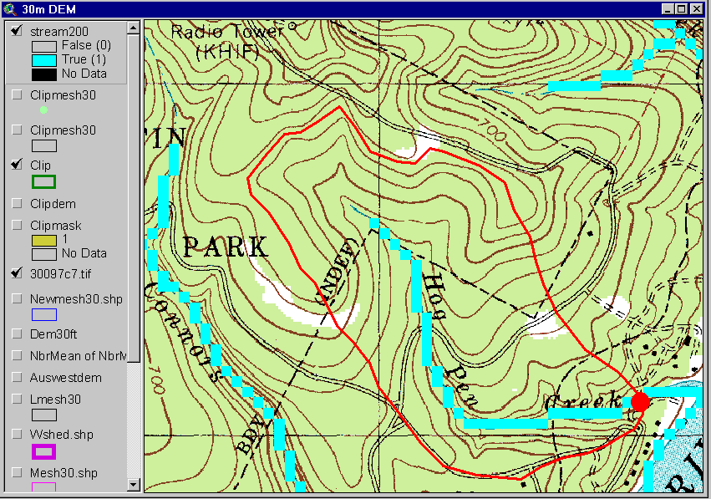
Delineation of Streams and Watersheds on a DEM

Slide 20
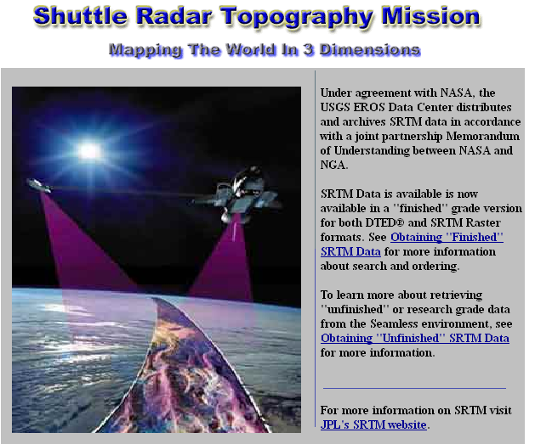
http://srtm.usgs.gov/

Slide 21
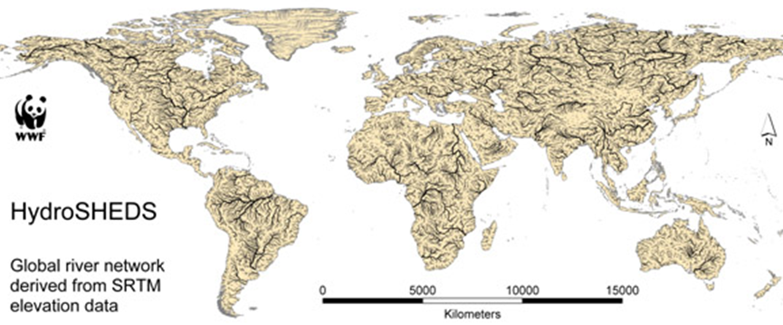
HydroSheds derived from SRTM
http://hydrosheds.cr.usgs.gov/

Slide 22
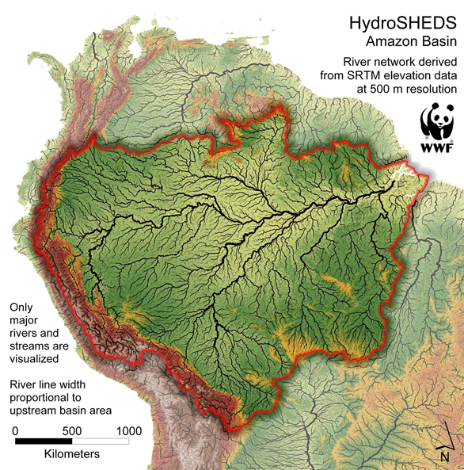

Slide 23
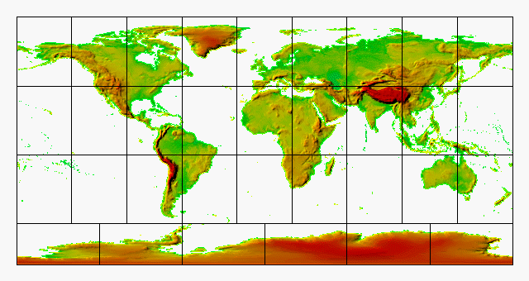
GTOPO30 - 1 km Digital Elevation Model of the Earth
https://lta.cr.usgs.gov/GTOPO30

Slide 24
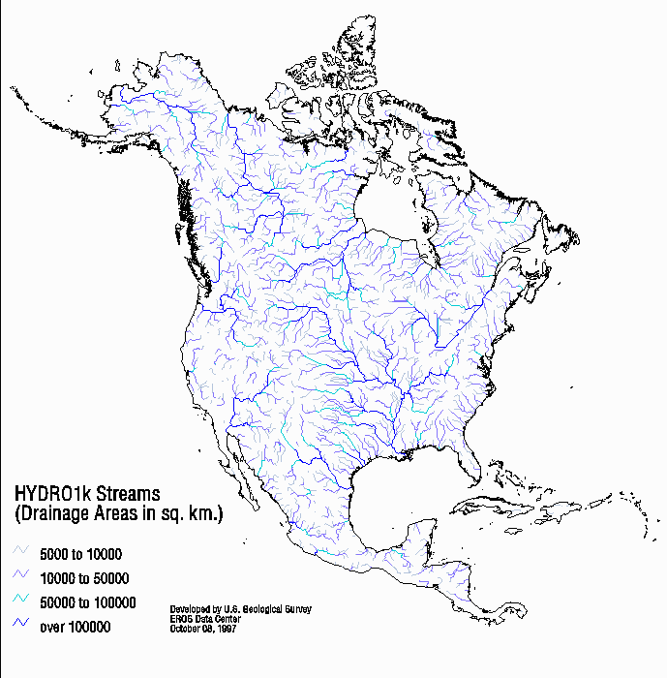
Drainage in North America
Hydro1K is
derived from
GTOPO30
using raster
GIS analysis
https://lta.cr.usgs.gov/HYDRO1K

Slide 25
Soil Data
Natural Resources Conservation Service (NRCS)
State Soil Geographic Database-STATSGO
Soil Survey Geographic Database- SSURGO
http://www.nrcs.usda.gov/wps/portal/nrcs/site/soils/home/
http://websoilsurvey.sc.egov.usda.gov/App/WebSoilSurvey.aspx
http://datagateway.nrcs.usda.gov/

Slide 26

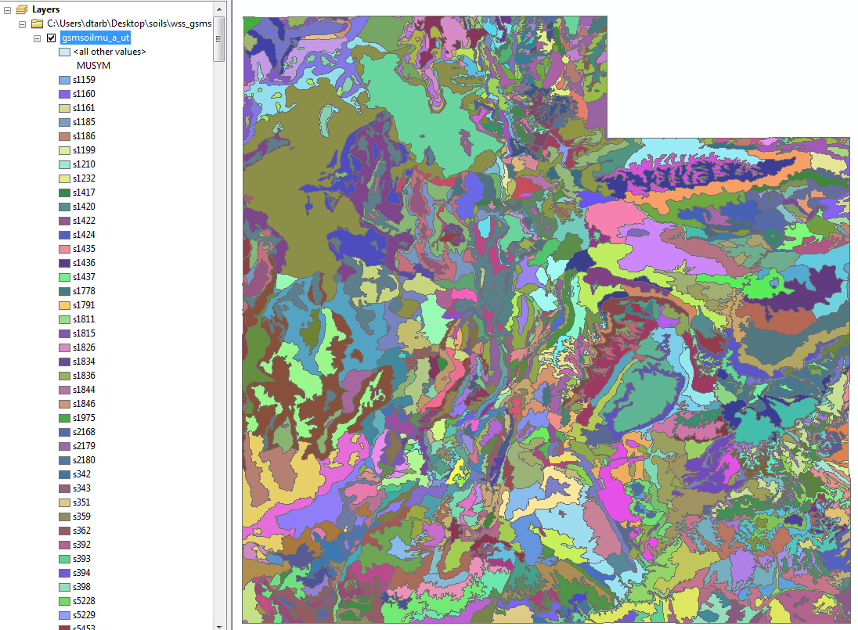
1:250,000 Scale Soil Information
http://datagateway.nrcs.usda.gov/

Slide 27
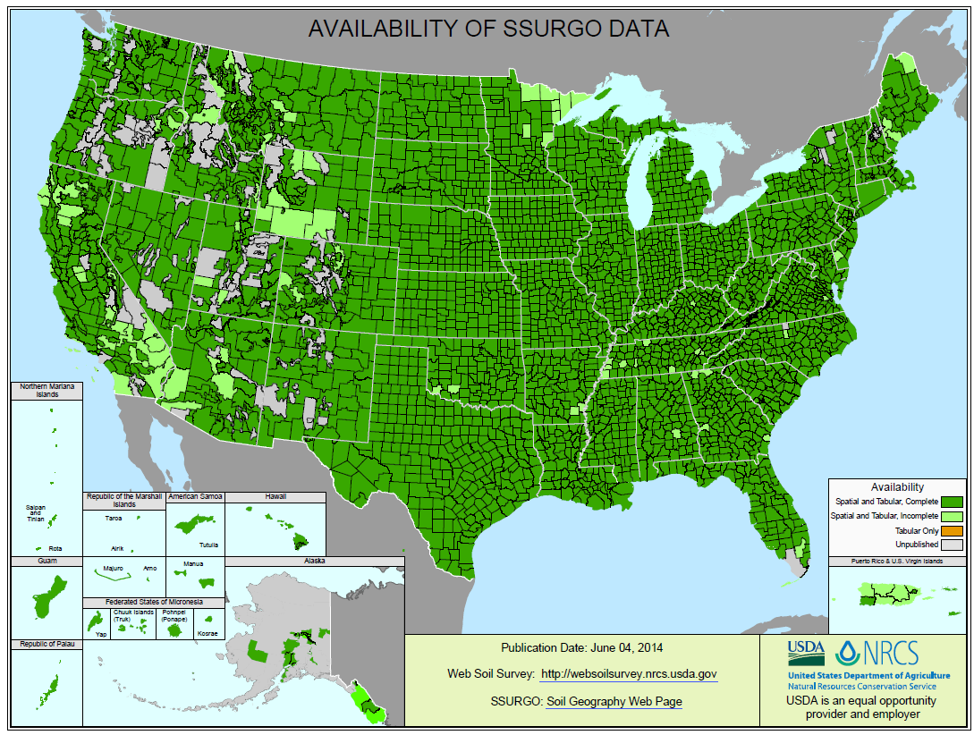
SSURGO:
County Level
Digital Soil Maps
1:24,000 scale
soil information
http://websoilsurvey.nrcs.usda.gov/DataAvailability/SoilDataAvailabilityMap.pdf

Slide 28
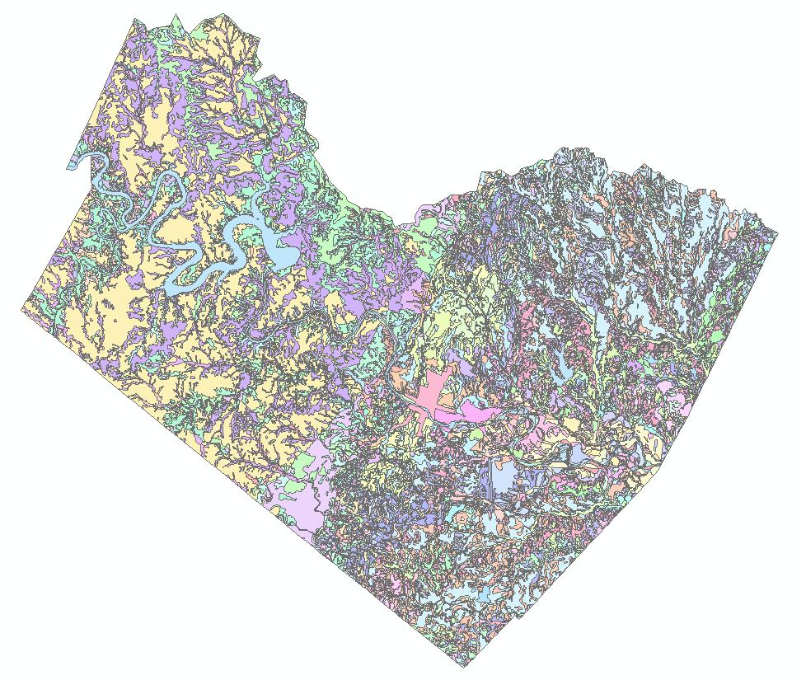
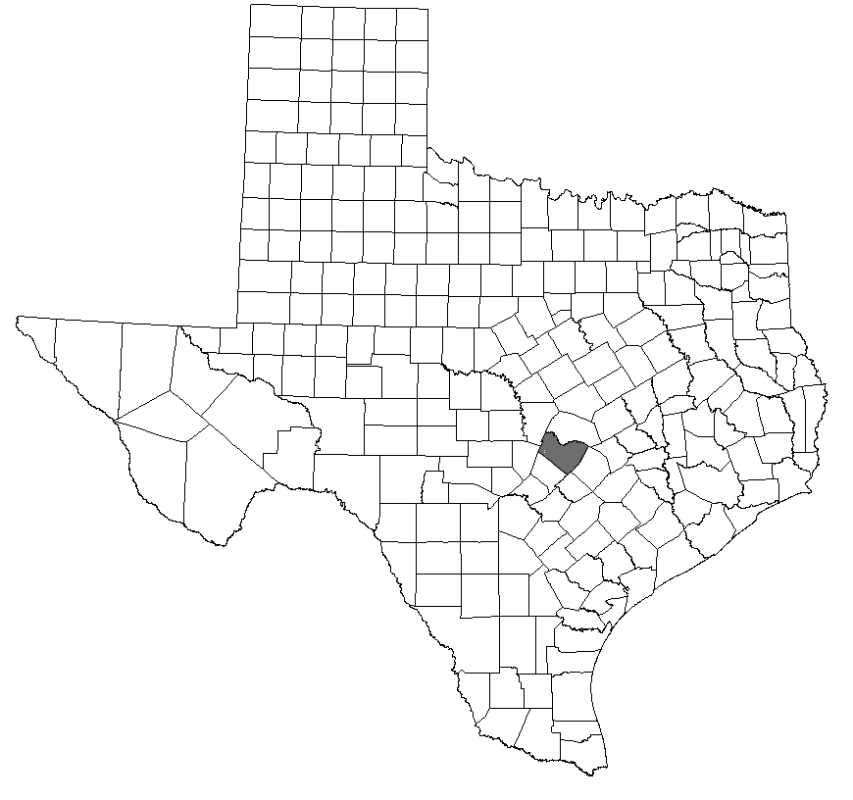
Ssurgo for Travis County
103 soil map units described by 7530 polygons of average area 35.37 ha (87 acres)

Slide 29
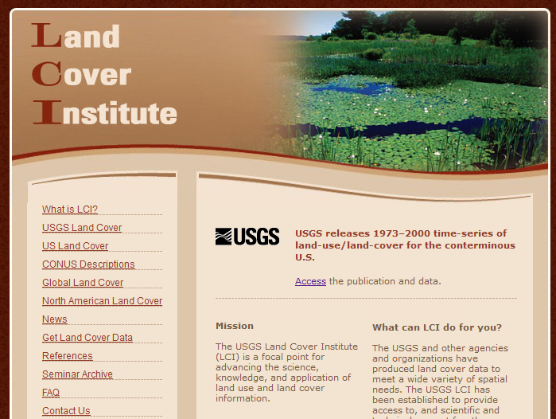
http://landcover.usgs.gov/

Slide 30
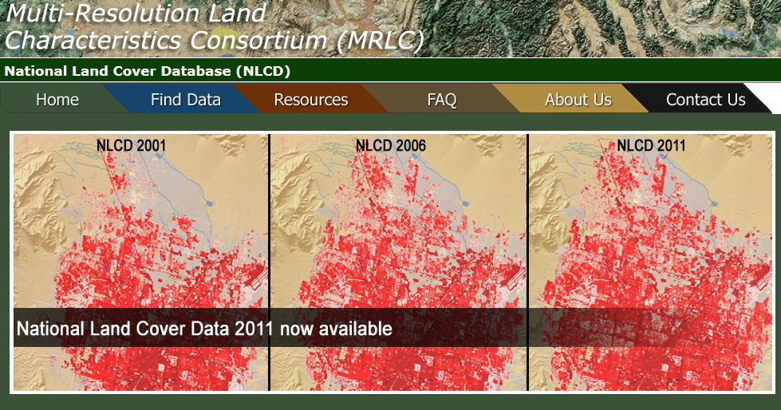
National Land Cover Dataset
1992, 2001, 2006 and 2011
Get the data:
http://www.mrlc.gov/

Slide 31
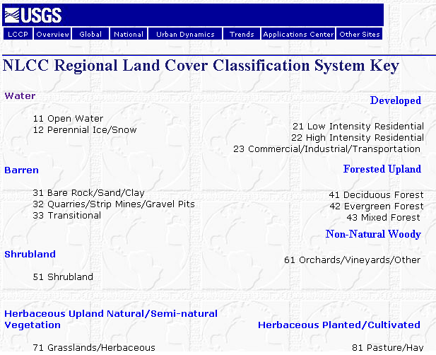

Slide 32

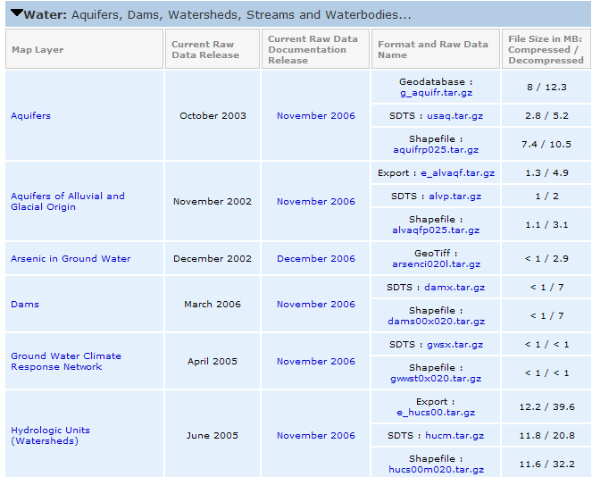
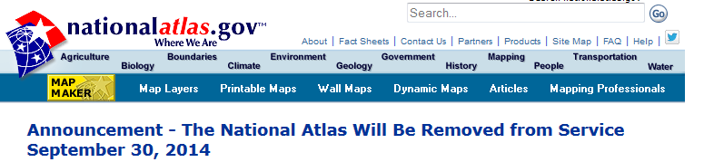
http://www.nationalatlas.gov/atlasftp.html

Slide 33
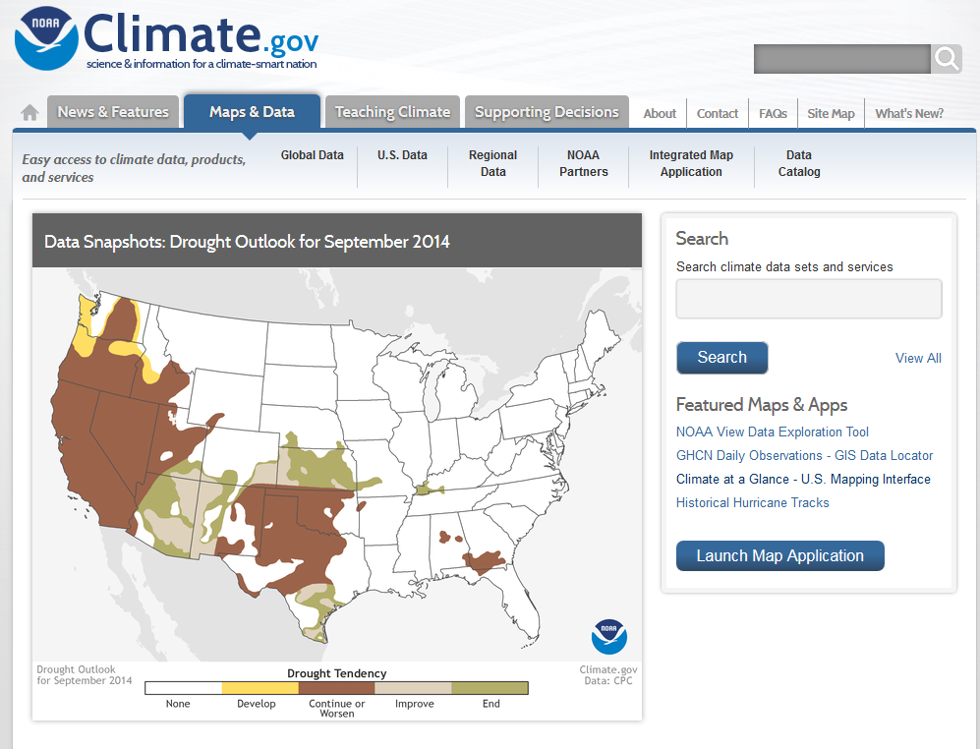
www.climate.gov

Slide 34
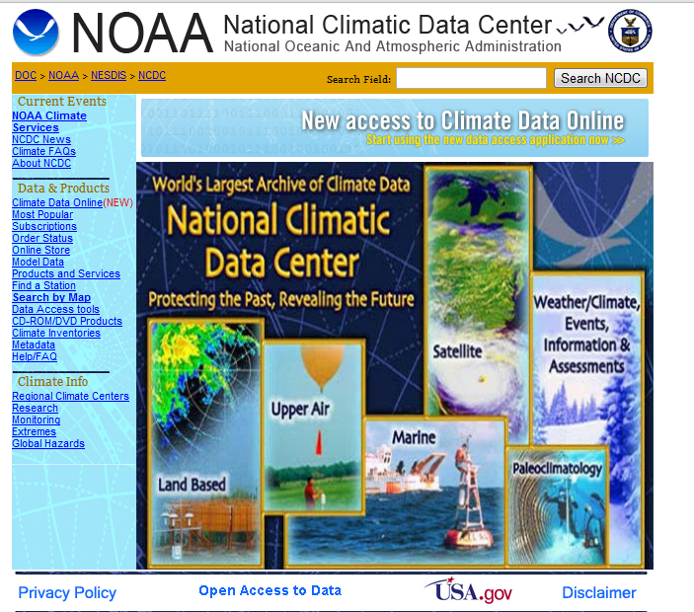
http://www.ncdc.noaa.gov/oa/ncdc.html

Slide 35

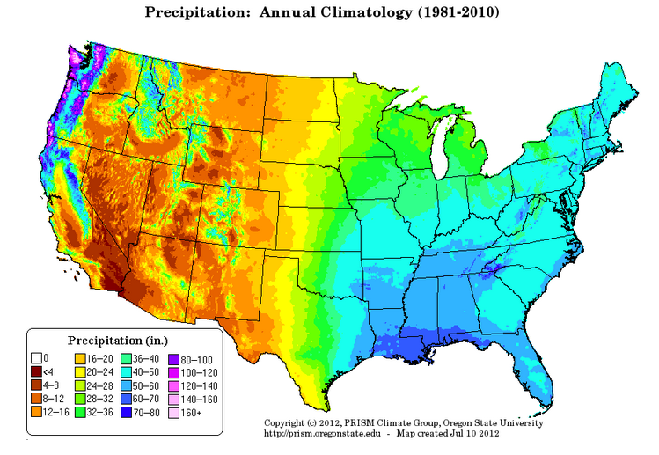
PRISM Mean Annual Precipitation (Oregon State U.)
http://www.wcc.nrcs.usda.gov/climate/prism.html

Slide 36
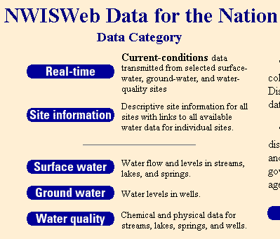
National Water Information System
Web access to USGS water
resources data in real time
http://waterdata.usgs.gov/usa/nwis/

Slide 37
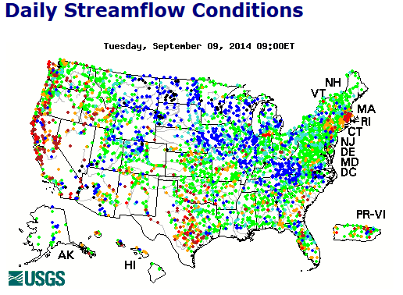
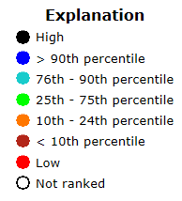
USGS Water Watch
Web access to USGS water resources data in real time
http://waterdata.usgs.gov/nwis/rt

Slide 38
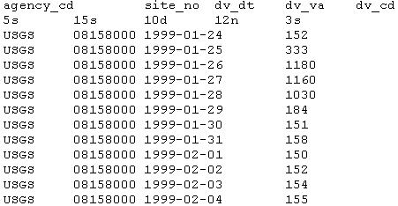
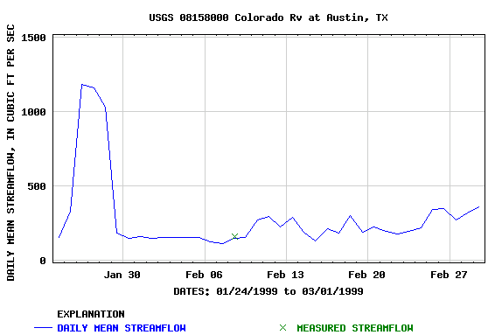
USGS National Water Information System.
Real-time and Historic Data
  Streamflow and stage
  Groundwater levels
  Water Quality
  Site information
Tabular or Graphical Format

Slide 39
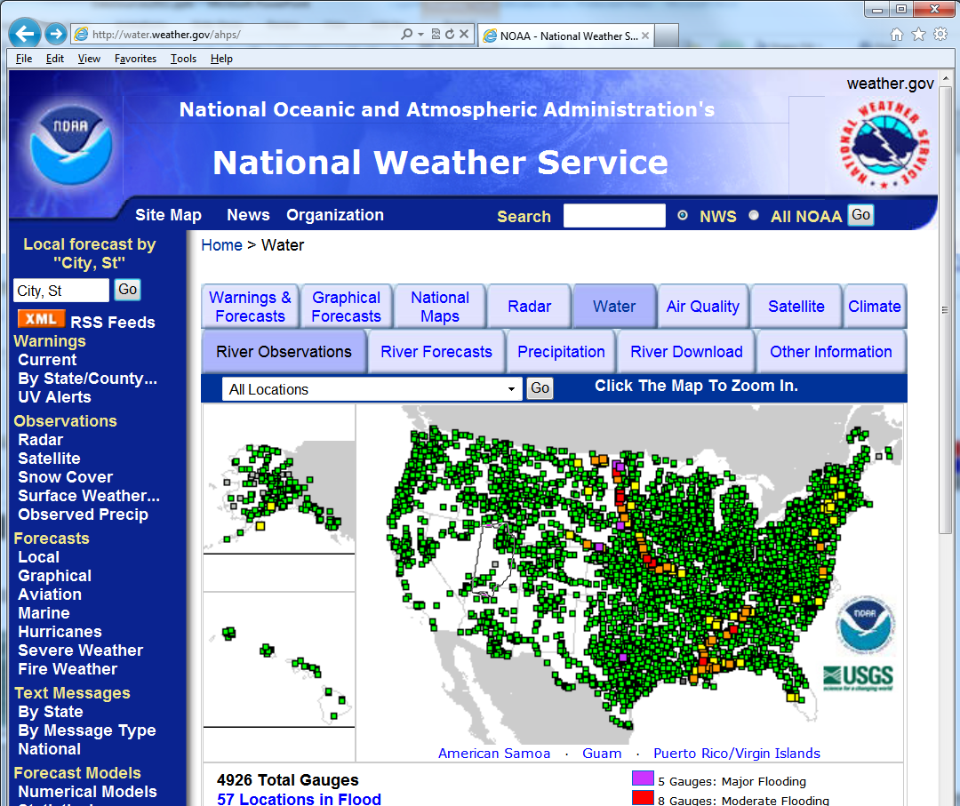
http://water.weather.gov/ahps/

Slide 40
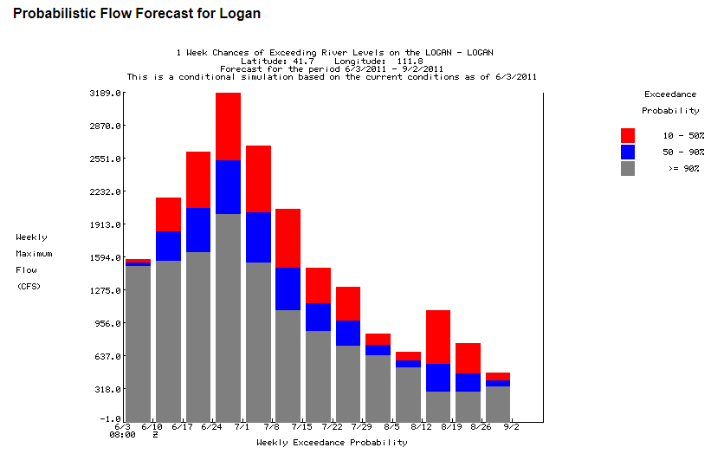
http://water.weather.gov/ahps/

Slide 41

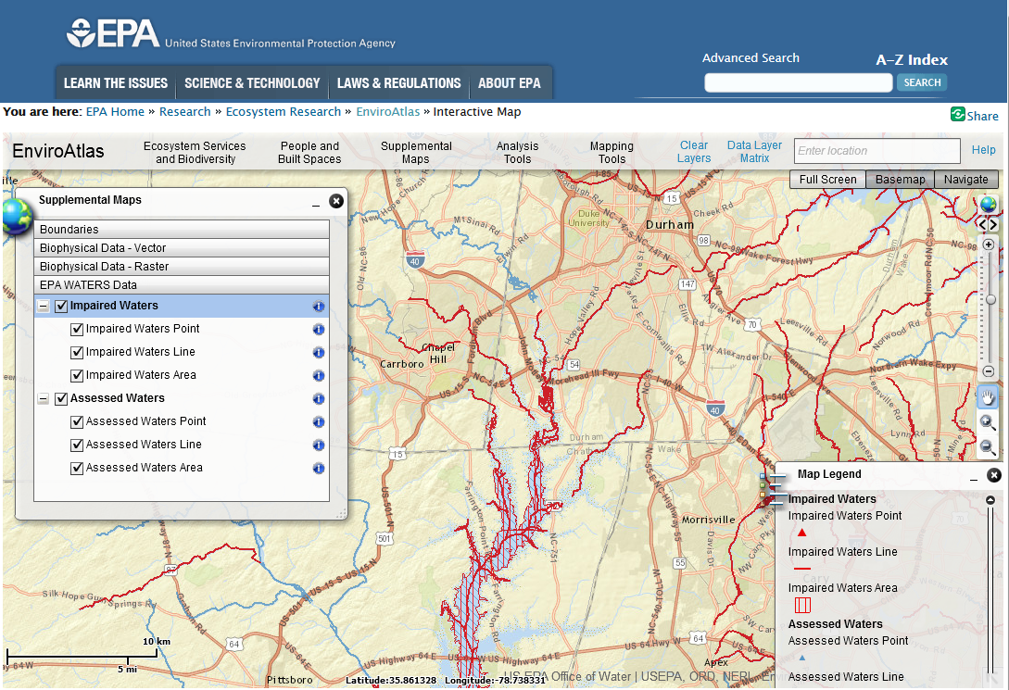
http://enviroatlas.epa.gov/enviroatlas/

Slide 42
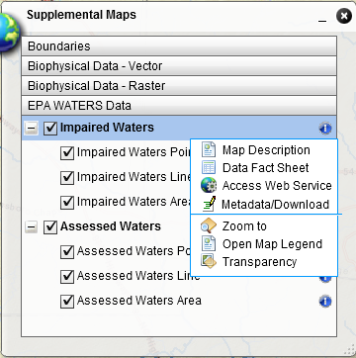
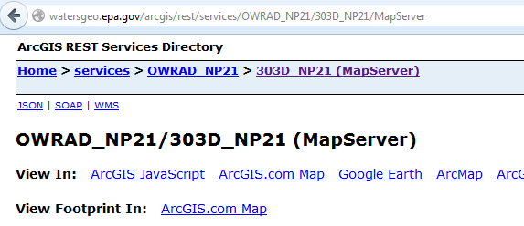
EnviroAtlas
All data is available for download
Some data is available for download as web service

Slide 43
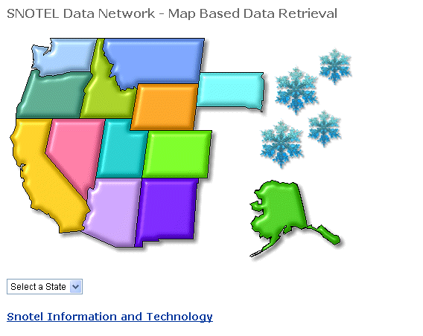
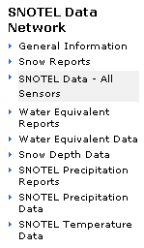
http://www.wcc.nrcs.usda.gov/snotel/

Slide 44
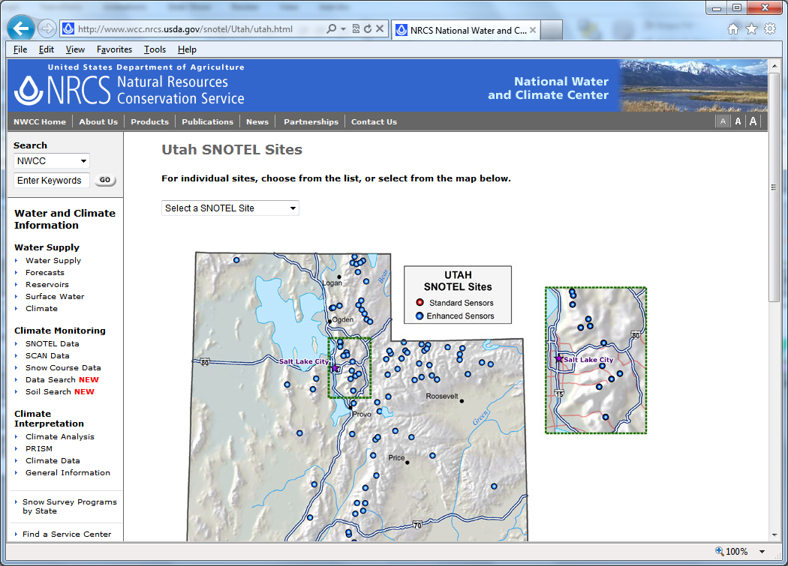
SNOTEL System for Measuring Snow and Supporting Spring Runoff and Water Supply Forecasts

Slide 45
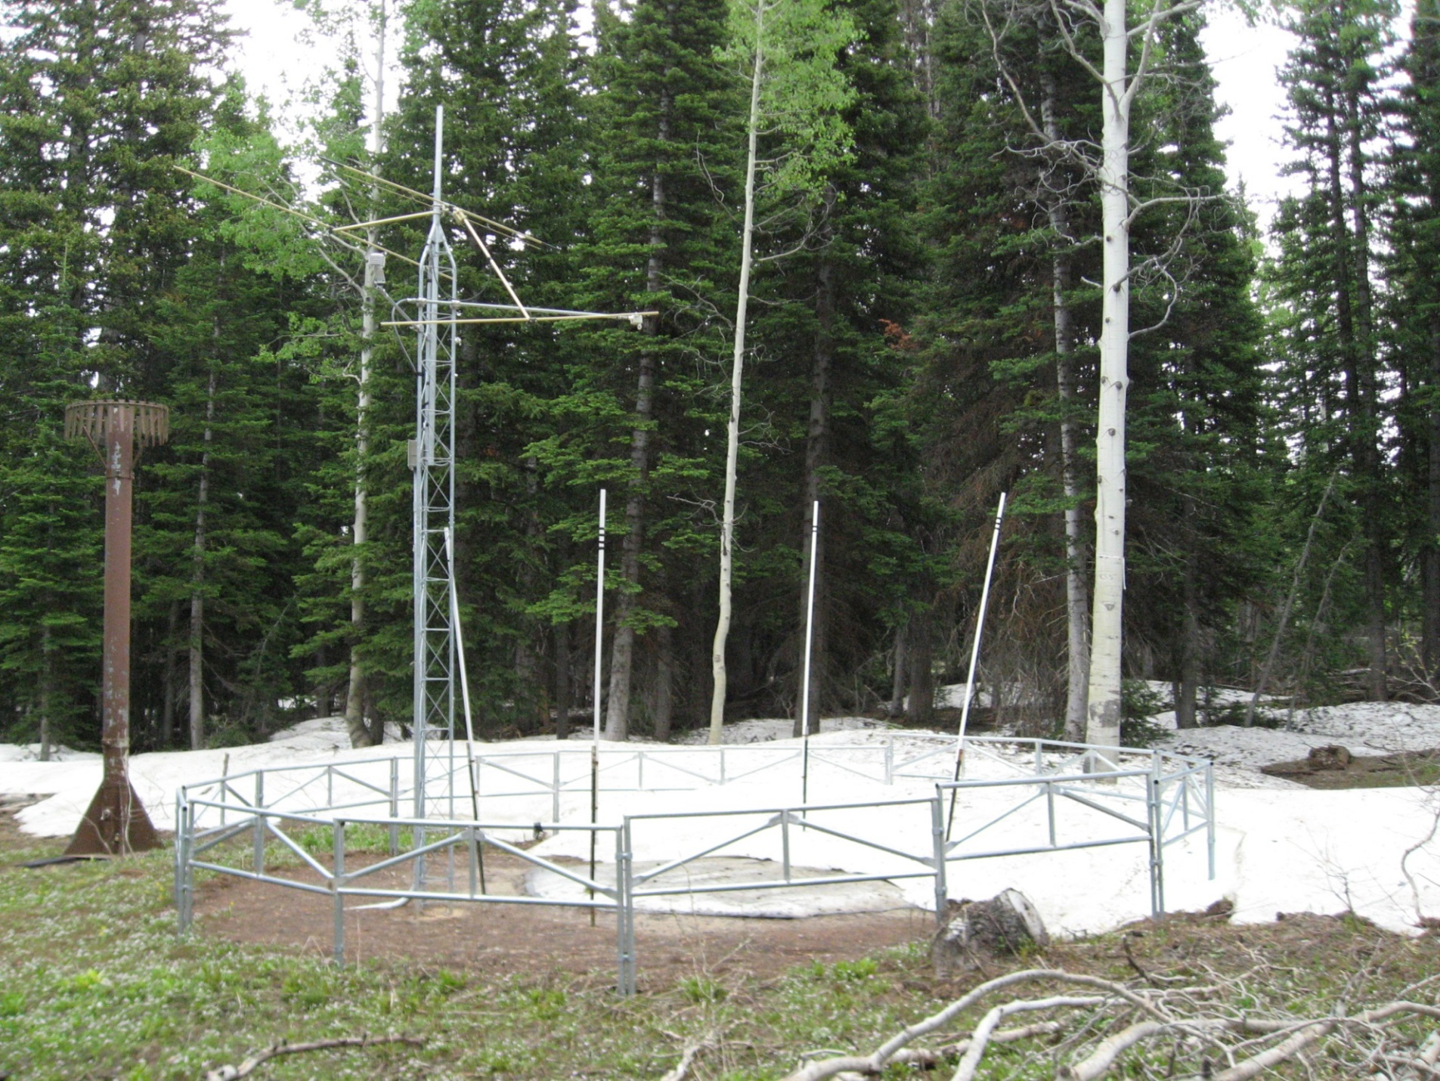
USU Doc Daniels SNOTEL Site

Slide 46
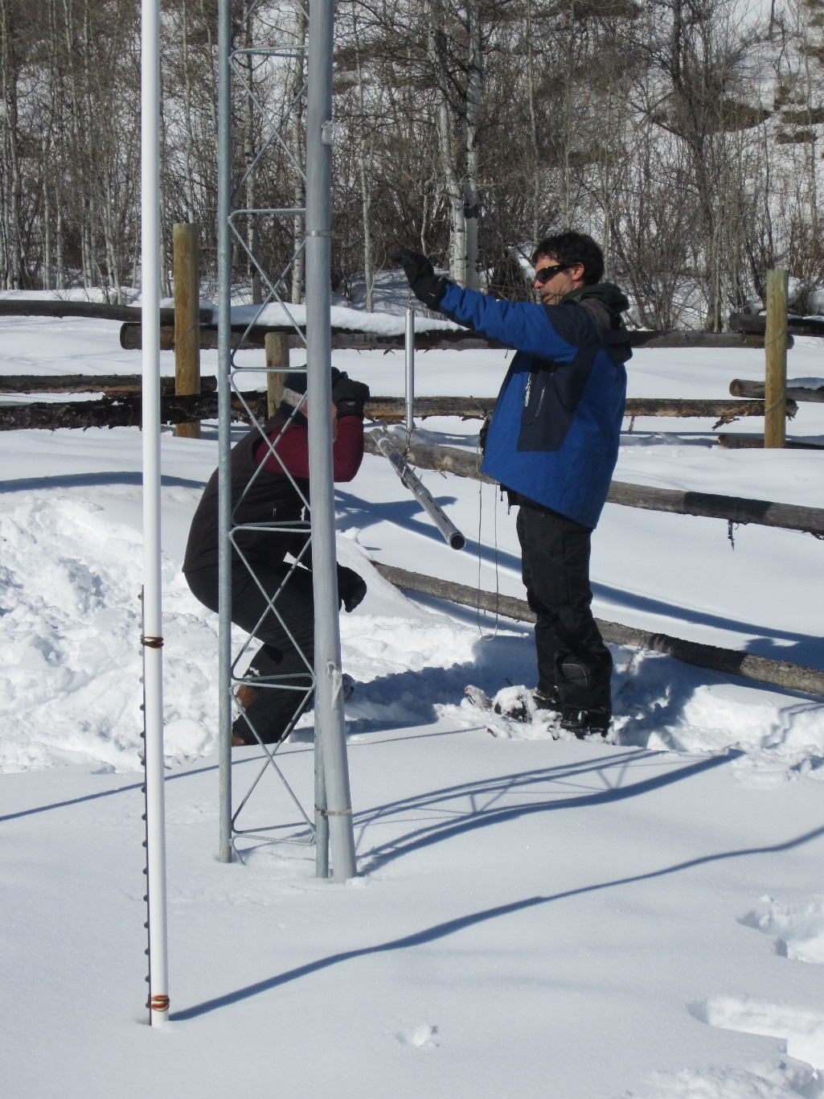

Measuring SWE

Slide 47

http://www.cbrfc.noaa.gov

Slide 48

CBRFC SNOTEL Ensemble
http://www.cbrfc.noaa.gov/station/sweplot/sweplot.cgi?tglu1

Slide 49


Texas Natural Resource Information System http://www.tnris.org/

Slide 50

TWDB http://www.twdb.state.tx.us/mapping/gisdata.asp

Slide 51

http://gis.utah.gov

Slide 52

Utah Terrain Basemap
To use as a basemap in ArcGIS see instructions at
http://gis.utah.gov/map-services/new-utah-terrain-base-map-and-cached-tile-service-available

Slide 53

Utah GIS Portal Download GIS Data
http://gis.utah.gov/data/

Slide 54

http://geology.utah.gov/maps/gis/index.htm

Slide 55

http://www.wrcc.dri.edu/

Slide 56

Bear River Watershed
http://www.bearriverinfo.org/

Slide 57

Great Salt Lake Info System
http://greatsaltlakeinfo.org/

Slide 58



http://www.nconemap.com/

Slide 59

http://www.ncfloodmaps.com/

Slide 60

What is Cloud Computing?
Following Slides are from Dr Kristin Tolle, Microsoft Research Connections
Notes:
Slide Objectives:
Main points you want to make
Transition:
Transition statement(s) to setup the slide
Speaking Points:
Speaking Point #1
Speaking Point #2
Notes:

Slide 61


Global Footprint
Where is the Cloud?
Notes:
Speaking Points:
Windows Azure itself is deployed around the world
With Windows Azure, we have a concept of regions, which is where you choose to place your code and run.
In each of the regions, we have a Microsoft datacenter.
These datacenters are massive facilities that host 10s or in some cases hundreds of thousands of servers
We have currently four regions in North America, two regions in Europe, and two in Asia
As you can see on this slide we also have a number of CDN edge points, which we can use to cache your content and deliver it even faster for customers. %
What you’re going to see in the next couple months and years is that we will rapidly expand our datacenter footprint around the world, so you will have more options for running your applications.
Once you build an application, you can choose where you want to run in the world and you can move your workloads from region to region.
You can also run your application in multiple regions simultaneously and just direct traffic and customers to whichever version of the app is closest to them.
That gives you a global footprint and a chance to reach a bigger customer base or audience in new markets
Notes:
Windows Azure services such as compute and storage are now available in 8 worldwide datacenters with an additional 24 Content Delivery Network endpoints.
You can’t have a real cloud without a data center.

Slide 62








Microsoft’s Data Center Evolution
  Data Center Co-Location Generation 1
  Quincy and San Antonio Generation 2
  Chicago and Dublin Generation 3
  Modular Data Center Generation 4
  Deployment Scale Unit
Server
Rack
Containers
IT PAC
Capacity
Density & Deployment
Scalability &
Sustainability
Time to Market
Lower TCO
Notes:
Slide Objectives:
Main points you want to make
Transition:
Transition statement(s) to setup the slide
Speaking Points:
Speaking Point #1
Speaking Point #2
Notes:

Slide 63



ArcGIS Online: Maps about the Earth
http://www.arcgis.com/features/maps/earth.html
Land Cover
Elevation
Soils

Slide 64


ArcGIS Online Services
http://landscape1.arcgis.com/arcgis/services/
http://landscape2.arcgis.com/arcgis/services/
http://landscape3.arcgis.com/arcgis/services/
http://elevation.arcgis.com/arcgis/services/
http://hydro.arcgis.com/arcgis/services

Slide 65



ArcGIS Services are Accessed through Catalog

Slide 66



Elevation Services

Slide 67



Dynamic Map Services

Slide 68



Extract the NHDPlus Flowlines

Slide 69




Elevation Profile of the Blanco River
Slope = 0.2%

Slide 70
Summary
There are a plethora of data sources available
Knowing what is available is important to scope GIS analyses and projects
GIS is about creating knowledge, telling stories, making decisions – all involve integrating information from multiple sources
The way that data is organized can enhance or inhibit the analyses that can be done
Data dissemination is increasingly becoming service based

Slide 71
Term paper suggestions
Your own research
An integration of information from multiple sources to address a problem or question of interest
A tool for doing something in GIS (python programming)
A map or dataset in ArcGIS online

Slide 72
Term paper suggestions continued
An examination of land cover change
  Deforestation
  Urban reforestation
  Impact of change on the water system
Flood plain mapping
  Examination of alternatives and changes to reduce flooding (impervious areas, obstructions) (NC Flood Maps)
Prioritize watershed restoration (river restoration and upland changes) (EnviroAtlas and NC specific sources)
  NC DENR project to prioritize HUC 12s within each HUC8 for mitigation
  Mitigation bankers, conservation organizations
  Based on length of degraded streams
  Impervious surface area
  Other ecosystem services (heat island, carbon sequestration)
  Composite weight
  Examine sensitivity to change using models (SWAT, RHESSys)
Riparian buffers
  An examination of land use and land cover in riparian buffer and mapping the quality of buffer and length of flow through buffer. TauDEM has some buffer flow length functions that could be used.
Terrain stability analysis
  Based on DEM Slope, contributing area – e.g. SINMAP
Stream bank stability analysis
  Based on flow, slope and channel conditions (NC Flood maps)

