Slide 1
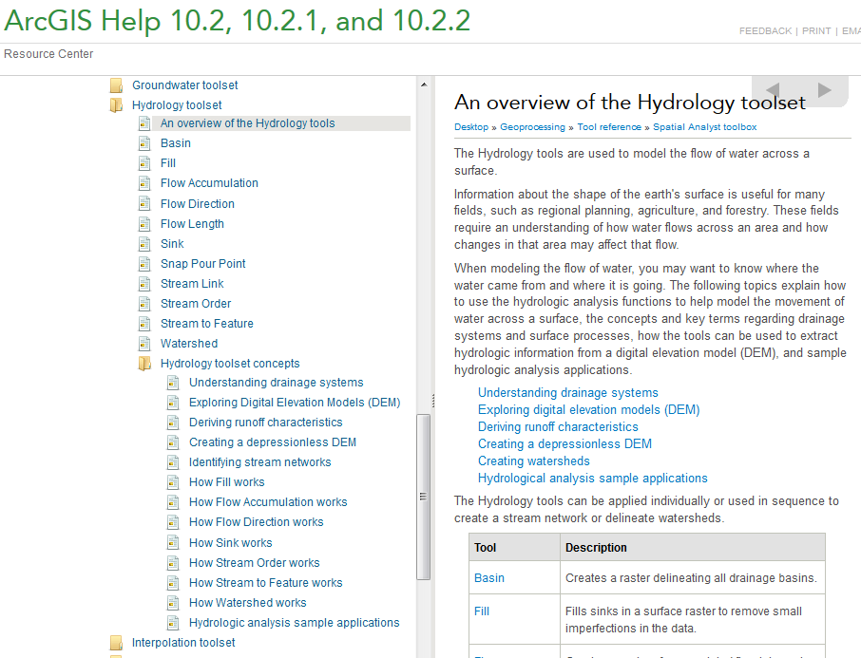
Digital Elevation Model Based Watershed and Stream Network Delineation
Reading
How to use
Understanding
http://resources.arcgis.com/en/help/main/10.2/index.html#//009z0000004w000000

Slide 2
Outline
Key Concepts from Exercise 3
Work the 2nd half of Exercise 3
DEM Pit removal
Flow direction field derivation
Flow Accumulation
Channels and Watersheds
Raster to Vector Connection
Using vector stream information (DEM reconditioning)
Enhanced pit removal

Slide 3
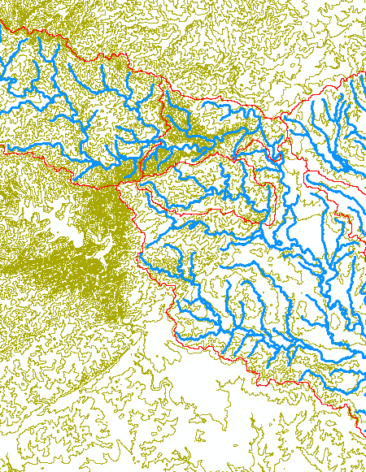
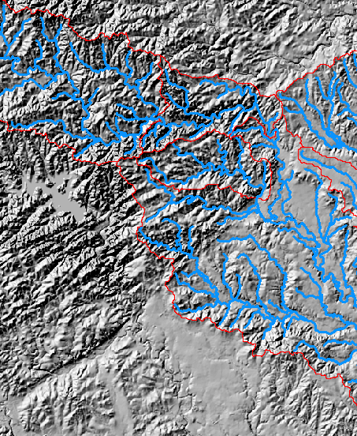
Key Spatial Analysis Concepts from Exercise 3
Contours and Hillshade to visualize topography

Slide 4
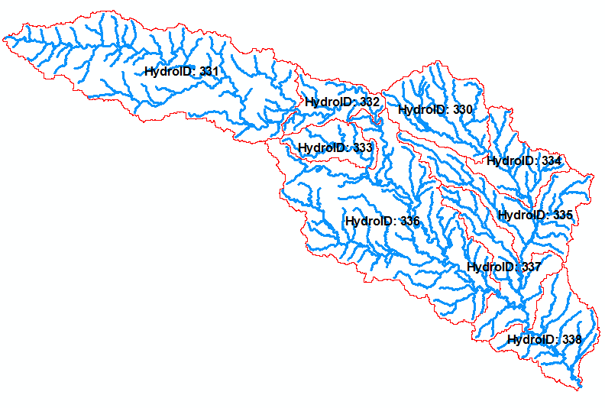
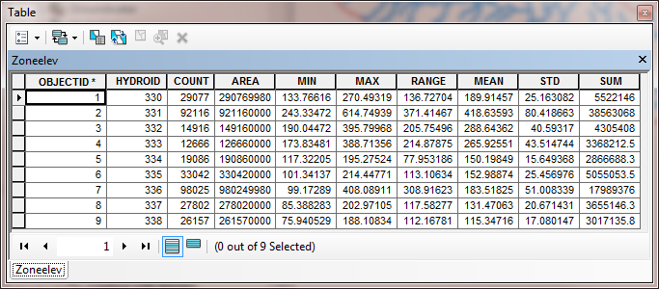
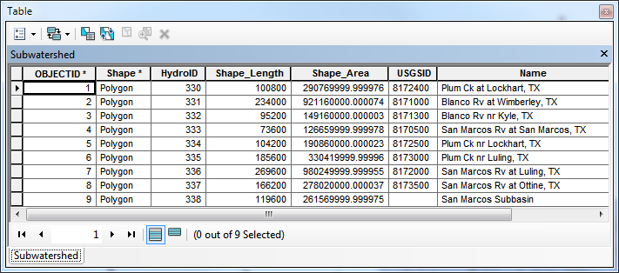
Zonal Average of Raster over Subwatershed
Join

Slide 5
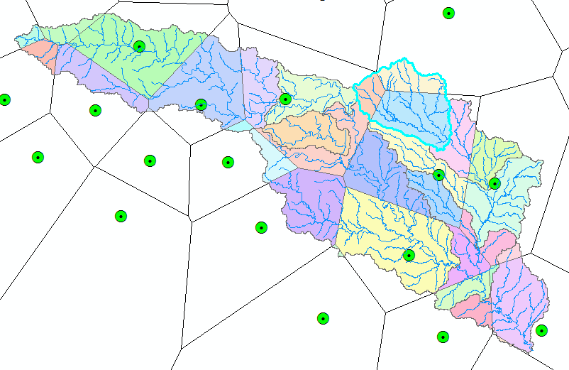
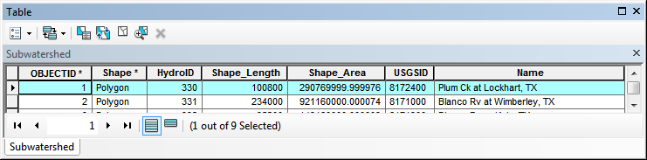
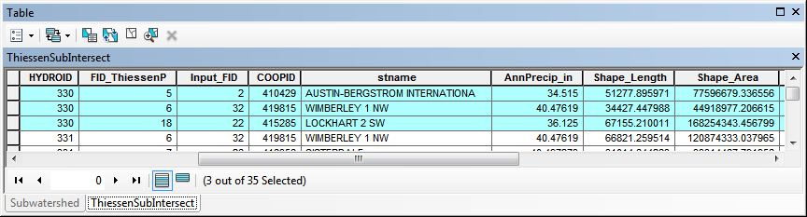
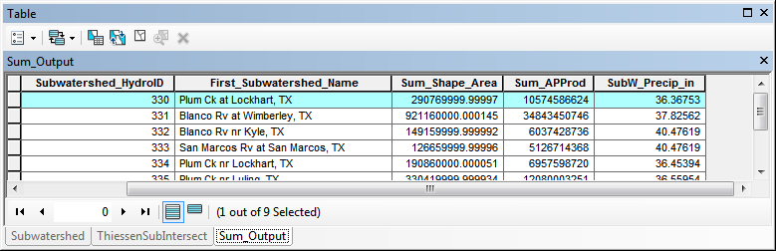
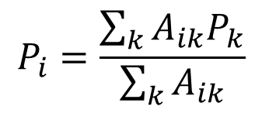
Subwatershed Precipitation by Thiessen Polygons
Thiessen Polygons
Intersect with Subwatersheds
Evaluate A*P Product
Summarize by subwatershed
$$P_{i}=\frac{\sum_{k}{A_{ik}P_{k}}}{\sum_{k}{A_{ik}}}$$

Slide 6
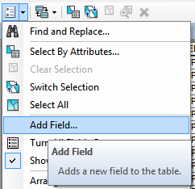
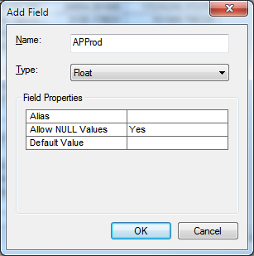
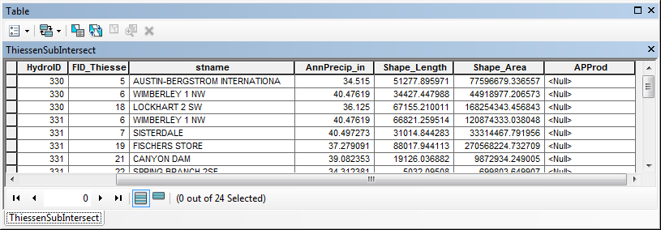
What Is Involved?
Add Field

Slide 7
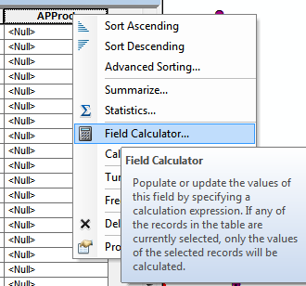
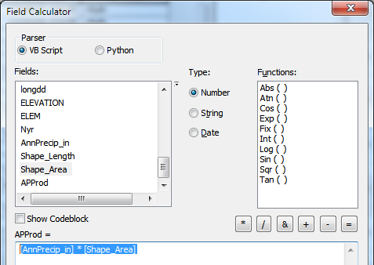
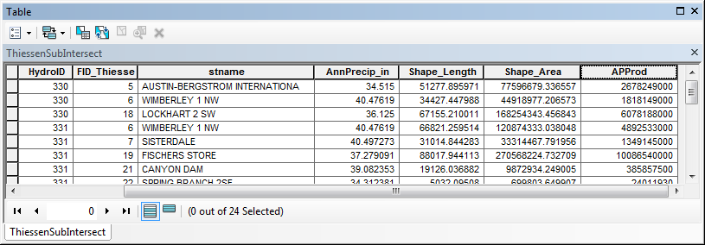
Field Calculator to Multiply A and P

Slide 8
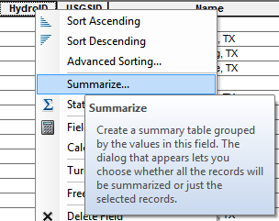
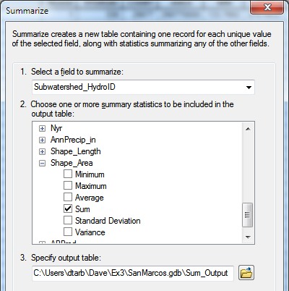
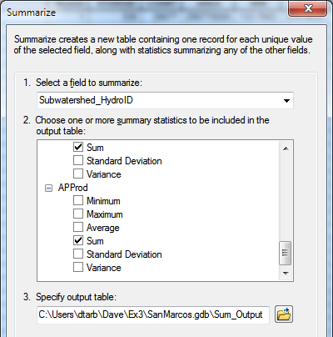
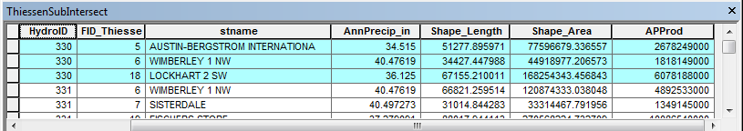
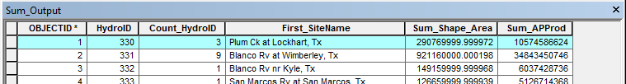

Summarize (Sum) for unique subwatersheds (by HydroID)
$$P_{i}=\frac{\sum_{k}{A_{ik}P_{k}}}{\sum_{k}{A_{ik}}}$$

Slide 9
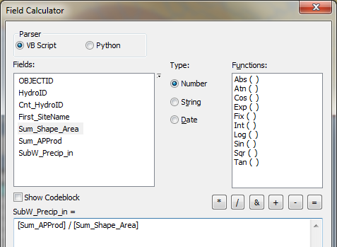
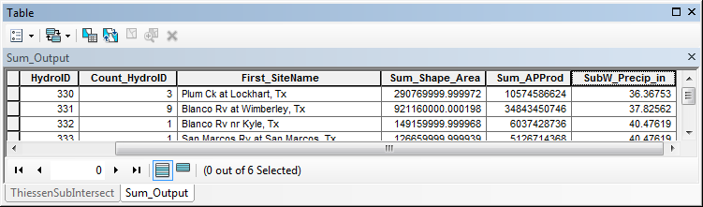

Now use field calculator to take the ratio
$$P_{i}=\frac{\sum_{k}{A_{ik}P_{k}}}{\sum_{k}{A_{ik}}}$$

Slide 10
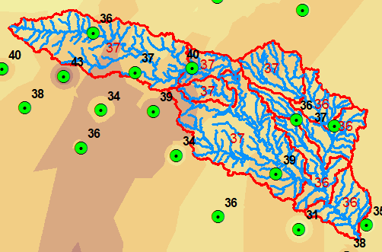
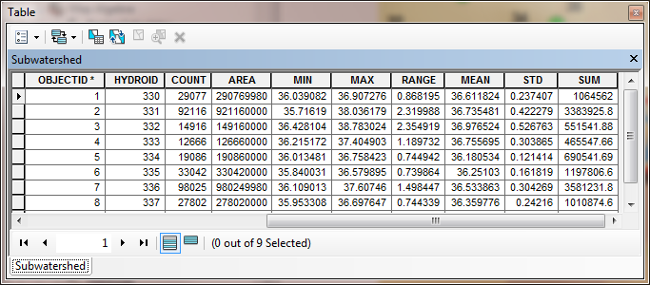
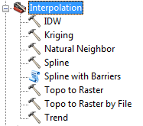
Subwatershed Precipitation by Interpolation
Kriging (on Precip field)
Zonal Statistics (Mean)
Join
Export

Slide 11
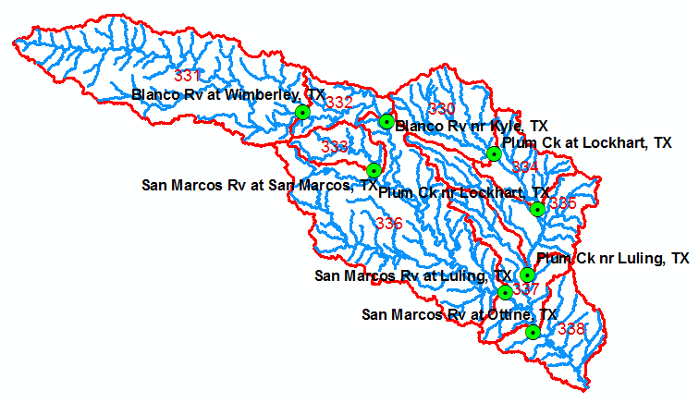
Runoff Coefficients
Interpolated precip for each subwatershed
Convert to volume, P
Sum over upstream subwatersheds in Excel
Runoff volume, Q
Ratio of Q/P
Watershed | HydroID's
Plum Ck at Lockhart, TX | 330
Blanco Rv nr Kyle, TX | 331, 332
San Marcos Rv at Luling, TX | 331,332,333,336

Slide 12
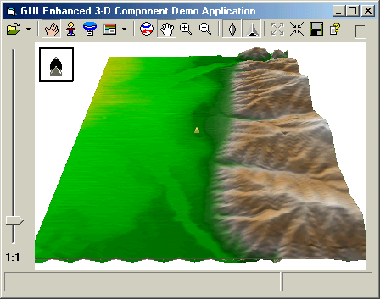

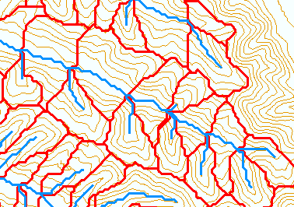
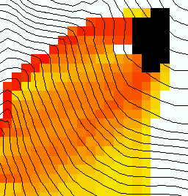
The terrain flow information model for deriving channels, watersheds, and flow related terrain information.
Raw DEM
Pit Removal (Filling)
Channels, Watersheds, Flow Related Terrain Information
Flow Field
Watersheds are the most basic hydrologic landscape elements
Notes:
This slide shows the general model for deriving flow field related derivative surfaces from digital elevation data. The input is a raw digital elevation model, generally elevation values on a grid. This is basic information used to derive further hydrology related spatial fields that enrich the information content of this basic data. The first step is to remove sinks, either by filling, or carving. Then a flow field is defined. This enables the calculation of flow related terrain information. My focus has been on flow related information working within this framework. I try to leave other GIS functionality, like radiation exposure, line of sight analyses and visualization to others. I have distributed my software in ways that it easily plugs in to mainstream systems, such as ArcGIS to enhance ease of use.

Slide 13
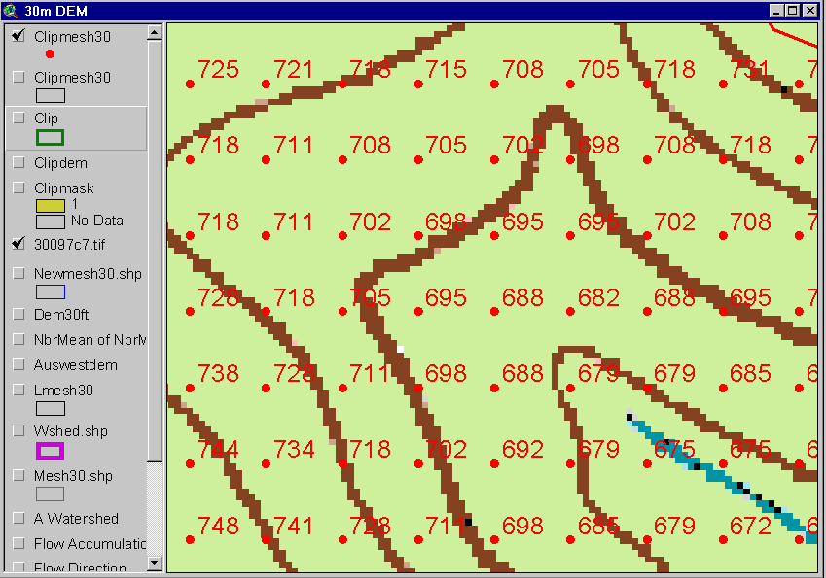
DEM Elevations
720
720
Contours
740
720
700
680
740
720
700
680

Slide 14
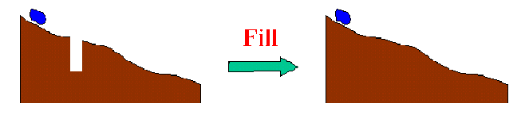
The Pit Removal Problem
DEM creation results in artificial pits in the landscape
A pit is a set of one or more cells which has no downstream cells around it
Unless these pits are removed they become sinks and isolate portions of the watershed
Pit removal is first thing done with a DEM

Slide 15
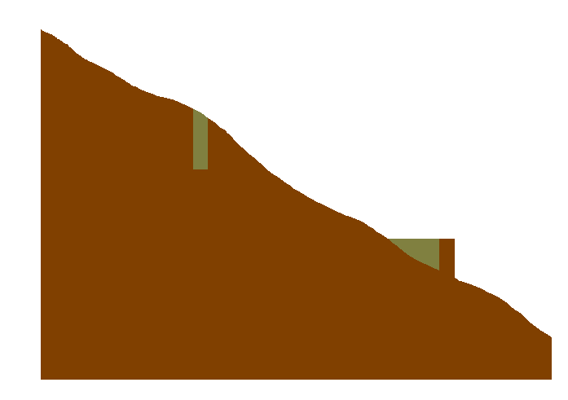

Pit Filling
Increase elevation to the pour point elevation until the pit drains to a neighbor

Slide 16
Pit Filling
Original DEM
Pits Filled
Pits
Pour Points
Grid cells or zones completely surrounded by higher terrain
The lowest grid cell adjacent to a pit
Notes:
Elevations are filled to that of the pools pour point

Slide 17
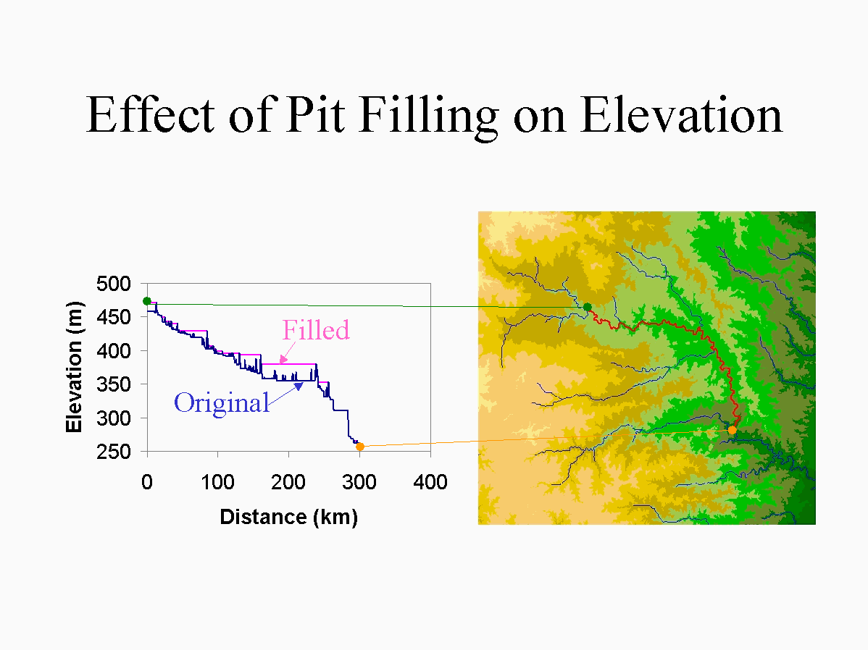

Slide 18
Hydrologic Slope
- Direction of Steepest Descent
30
30
80
74
63
80
74
63
69
67
56
69
67
56
60
52
48
60
52
48
Slope:

Slide 19
Eight Direction (D8) Flow Model
32
64
128
16
1
8
4
2
2
2
4
4
8
1
2
4
8
4
4
1
2
4
8
2
4
4
4
4
1
2
1
4
16

Slide 20
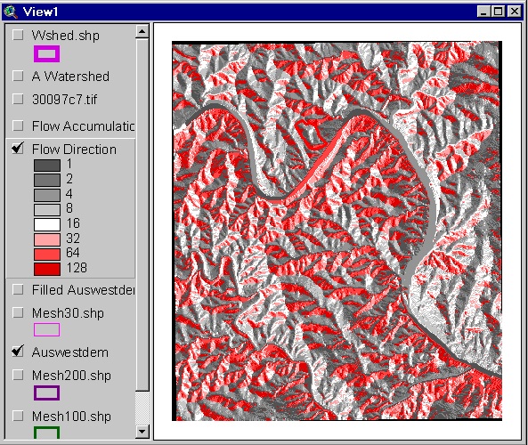
Flow Direction Grid
32
64
128
16
1
8
4
2

Slide 21
Grid Network

Slide 22
Flow Accumulation Grid.
Area draining in to a grid cell
0
0
0
0
0
0
0
0
0
0
0
2
2
2
0
0
2
2
2
0
0
0
10
0
1
0
0
1
0
10
1
0
0
14
0
1
0
0
0
14
0
4
1
19
1
0
4
1
1
19
Link to Grid calculator
ArcHydro Page 72

Slide 23
Stream Network for 10 cell Threshold Drainage Area
Flow Accumulation
> 10 Cell Threshold
0
0
0
0
0
0
0
0
0
0
0
2
2
2
0
0
2
2
2
0
0
0
10
0
1
0
0
1
0
10
1
0
0
14
0
1
0
0
0
14
0
4
1
19
1
0
4
1
1
19

Slide 24
TauDEM contributing area convention.
1
1
1
1
1
1
1
1
1
1
1
3
3
3
1
1
3
3
3
1
1
1
11
1
2
1
1
1
2
11
2
1
1
15
1
2
1
1
1
15
1
5
2
20
2
1
5
2
2
25
The area draining each grid cell includes the grid cell itself.

Slide 25
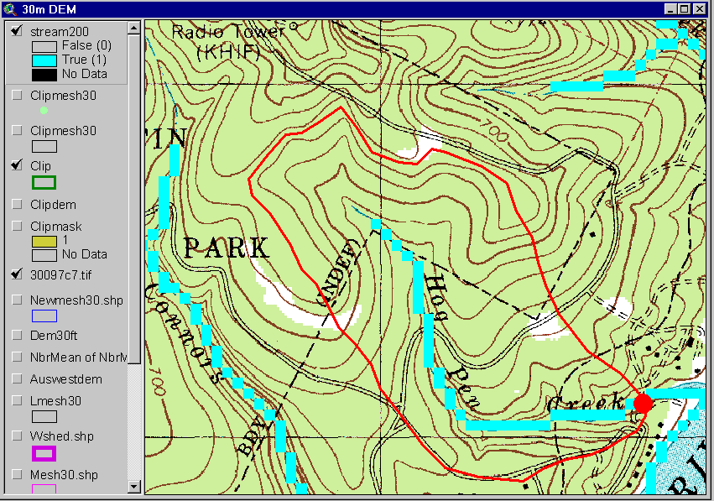
Streams with 200 cell Threshold
(>18 hectares or 13.5 acres drainage area)

Slide 26
Watershed Draining to Outlet

Slide 27
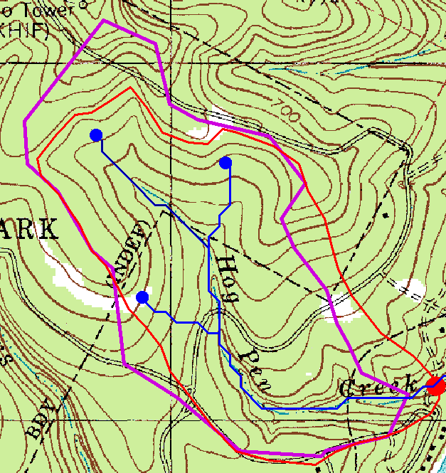
Watershed and Drainage Paths Delineated from 30m DEM
Automated method is more consistent than hand delineation

Slide 28
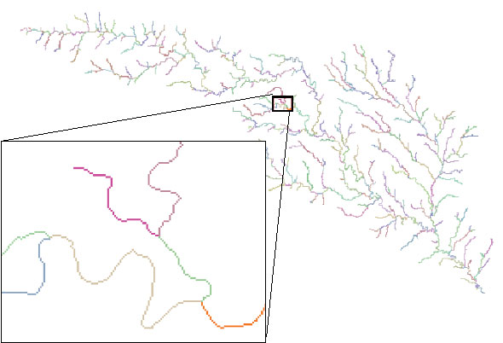
Stream Segments
201
172
202
203
206
204
209
Each link has a unique identifying number
ArcHydro Page 74

Slide 29
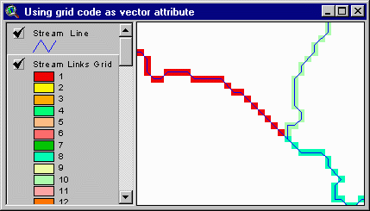
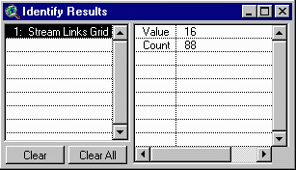
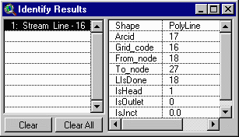
Vectorized Streams Linked Using Grid Code to Cell Equivalents
Vector
Streams
Grid
Streams
ArcHydro Page 75

Slide 30
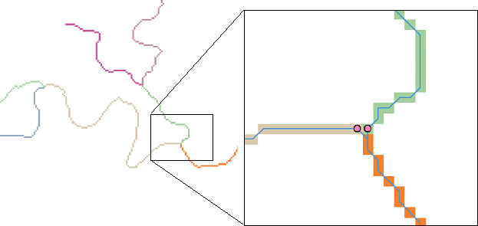
DrainageLines are drawn through the centers of cells on the stream links. DrainagePoints are located at the centers of the outlet cells of the catchments
ArcHydro Page 75

Slide 31
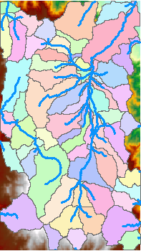
Catchments
For every stream segment, there is a corresponding catchment
Catchments are a tessellation of the landscape through a set of physical rules

Slide 32
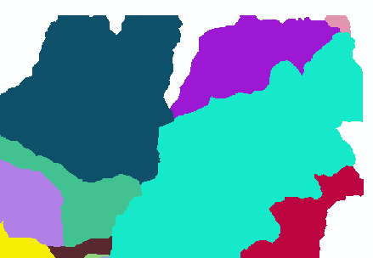
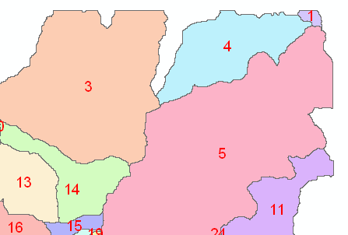
Raster Zones and Vector Polygons
One to one connection
DEM GridCode
Catchment GridID
4
3
5
Raster Zones
Vector Polygons

Slide 33
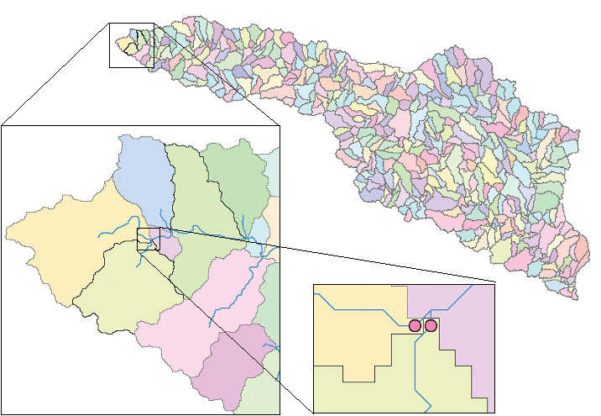
Catchments, DrainageLines and DrainagePoints of the San Marcos basin
ArcHydro Page 75

Slide 34
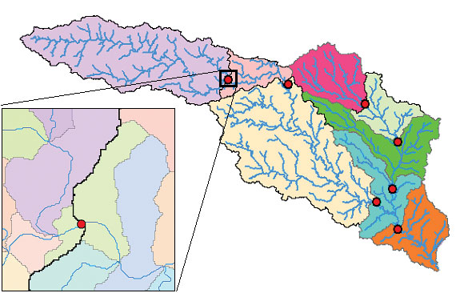
Catchment, Watershed, Subwatershed.
Subwatersheds
Catchments
Watershed
Watershed outlet points may lie within the interior of a catchment, e.g. at a USGS stream-gaging site.
ArcHydro Page 76

Slide 35
“Burning In” the Streams
• Take a mapped stream network and a DEM
• Make a grid of the streams
• Raise the off-stream DEM cells by an arbitrary elevation
increment
• Produces "burned in" DEM streams = mapped streams
+
=

Slide 36
AGREE Elevation Grid Modification Methodology – DEM Reconditioning

Slide 37

Carving
Lower elevation of neighbor along a predefined drainage path until the pit drains to the outlet point

Slide 38
Carving
Original DEM
Carved DEM
Pits
Carve outlets
Notes:
Elevations are filled to that of the pools pour point

Slide 39


Filling
Minimizing Alterations
Carving

Slide 40
Minimizing DEM Alterations
Original DEM
Optimally adjusted
Carved
Pits
Filled
Notes:
Elevations are filled to that of the pools pour point

Slide 41
Summary of Key Processing Steps
[DEM Reconditioning]
Pit Removal (Fill Sinks)
Flow Direction
Flow Accumulation
Stream Definition
Stream Segmentation
Catchment Grid Delineation
Raster to Vector Conversion (Catchment Polygon, Drainage Line, Catchment Outlet Points)

Slide 42
Summary Concepts
The eight direction pour point model approximates the surface flow using eight discrete grid directions
The elevation surface represented by a grid digital elevation model is used to derive surfaces representing other hydrologic variables of interest such as
  Slope
  Flow direction
  Drainage area
  Catchments, watersheds and channel networks

Slide 43
Are there any questions ?
AREA 2
3
AREA 1
12

