Slide 1
GIS in Water Resources
Midterm Review 2014
David Maidment, David Tarboton and Tony Castronova

Slide 2
Review for Midterm Exam
Location on the Earth
ArcGIS as a Geographic Information System
Working with Raster Data
Working with Vector Data

Slide 3
Review for Midterm Exam
Location on the Earth
ArcGIS as a Geographic Information System
Working with Raster Data
Working with Vector Data

Slide 4
Latitude and Longitude on a Spherical Earth
Longitude line (Meridian)
N
W
E
S
Range: 180ºW - 0º - 180ºE
Latitude line (Parallel)
N
W
E
S
(0ºN, 0ºE)
Equator, Prime Meridian
Range: 90ºS - 0º - 90ºN

Slide 5
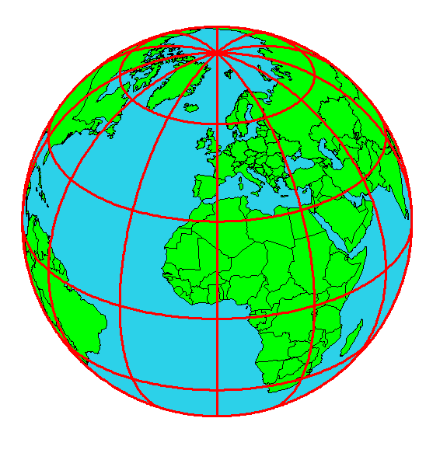
Origin of Geographic Coordinates
Equator
(0,0)
Prime Meridian

Slide 6

Length on Meridians and Parallels (Spherical Earth)
(Lat, Long) = (φ, λ)
Length on a Meridian:
AB = R_{e} Δφ
(same for all latitudes)
R
Δλ
D
30 N
R
C
R_{e}
Δφ
B
0 N
R_{e}
Length on a Parallel:
CD = R Δλ = R_{e} Δλ Cos φ
(varies with latitude)
A

Slide 7
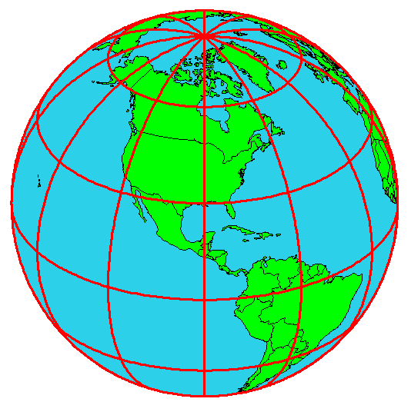
Example: What is the length of a 1º increment along
on a meridian and on a parallel at 30N, 90W?
Radius of the earth = 6370 km.
Solution:
A 1º angle has first to be converted to radians
π radians = 180 º, so 1º = π/180 = 3.1416/180 = 0.0175 radians
For the meridian, ΔL = R_{e} Δφ = 6370 ∗ 0.0175 = 111 km
For the parallel, ΔL = R_{e} Δλ Cos φ
= 6370 ∗ 0.0175 ∗ Cos 30
= 96.5 km
Parallels converge as poles are approached

Slide 8
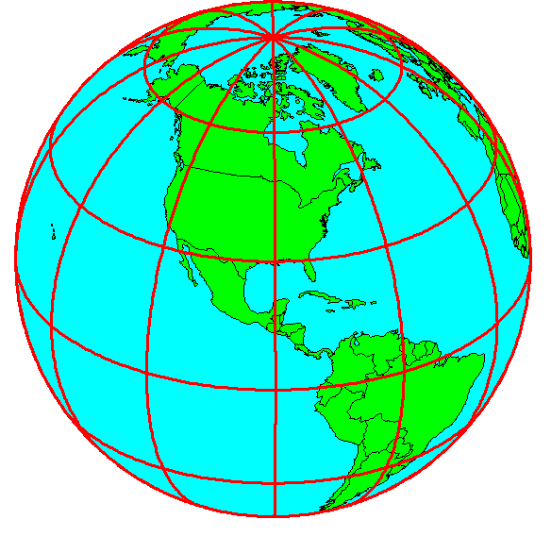
Shape of the Earth
It is actually a spheroid, slightly larger in radius at the equator than at the poles
We think of the
earth as a sphere

Slide 9
Ellipse
An ellipse is defined by:
Focal length = ε
Distance (F1, P, F2) is
constant for all points
on ellipse
When ε = 0, ellipse = circle
Z
b
O
a
X
F₁
ε
ε
F₂
For the earth:
Major axis, a = 6378 km
Minor axis, b = 6357 km
Flattening ratio, f = (a-b)/a
~ 1/300
P

Slide 10
Ellipsoid or Spheroid
Rotate an ellipse around an axis
Z
b
O
a
Y
a
X
Rotational axis

Slide 11
Horizontal Earth Datums
An earth datum is defined by an ellipse and an axis of rotation
NAD27 (North American Datum of 1927) uses the Clarke (1866) ellipsoid on a non geocentric axis of rotation
NAD83 (NAD,1983) uses the GRS80 ellipsoid on a geocentric axis of rotation
WGS84 (World Geodetic System of 1984) uses GRS80, almost the same as NAD83

Slide 12
Definition of Latitude, φ
m
S
p
O
n
φ
q
r
(1) Take a point S on the surface of the ellipsoid and define there the tangent plane, mn
(2) Define the line pq through S and normal to the
tangent plane
(3) Angle pqr which this line makes with the equatorial
plane is the latitude φ, of point S

Slide 13
Cutting Plane of a Meridian
P
Prime Meridian
Equator
Meridian
plane

Slide 14
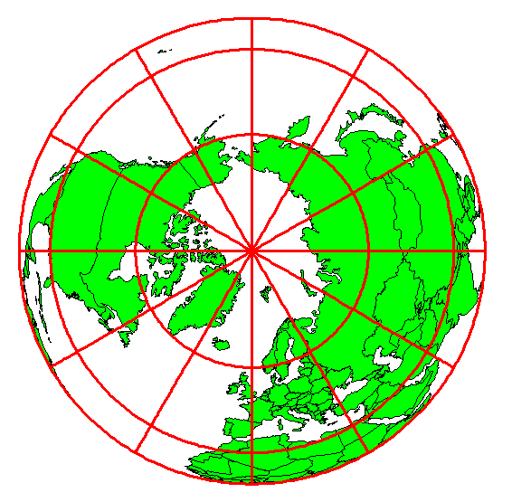
Definition of Longitude, λ
λ = the angle between a cutting plane on the prime meridian
and the cutting plane on the meridian through the point, P
180°E, W
-150°
150°
-120°
120°
90°W
(-90 °)
90°E
(+90 °)
-60°
P
λ
-60°
-30°
30°
0°E, W

Slide 15
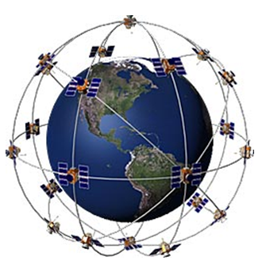
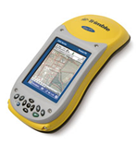
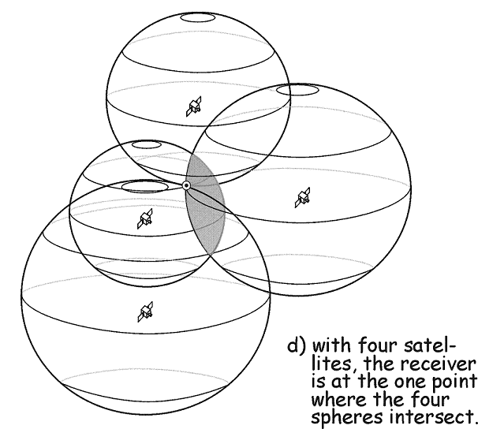
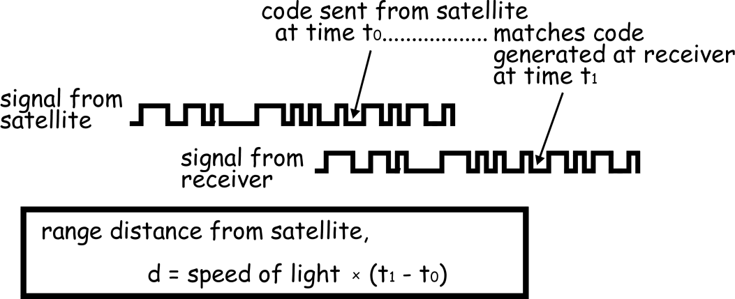
Global Positioning Systems
Distance to four satellites gives (x,y,z)
Notes:
If we then make a measurement from a third satellite and find that we're 13,000 miles from that one, that narrows our position down even further, to the two points where the 13,000 mile sphere cuts through the circle that's the intersection of the first two spheres.
So by ranging from three satellites we can narrow our position to just two points in space.
To decide which one is our true location we could make a fourth measurement. But usually one of the two points is a ridiculous answer (either too far from Earth or moving at an impossible velocity) and can be rejected without a measurement.
A fourth measurement does come in very handy for another reason however, but we'll tell you about that later

Slide 16
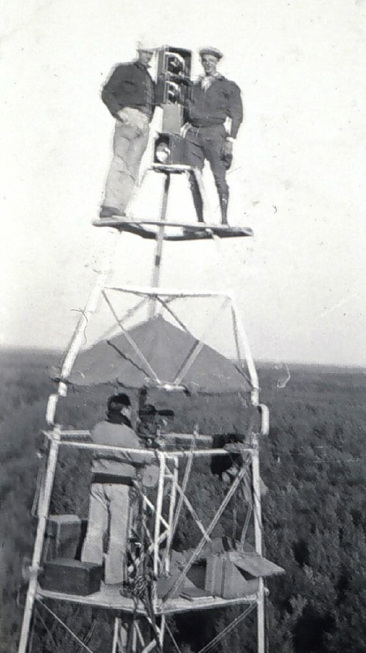
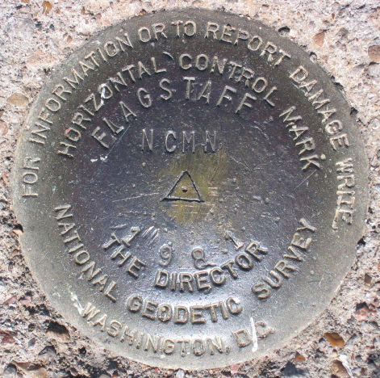
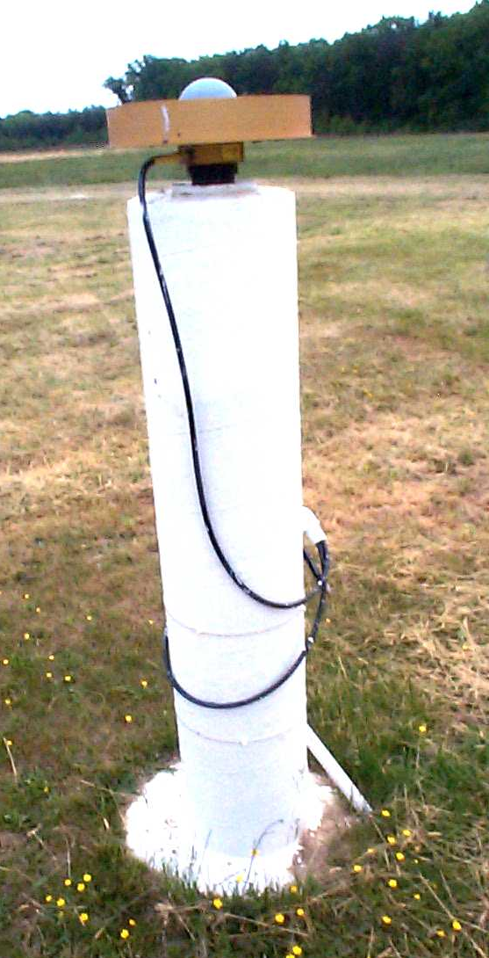

Revolution in Earth Measurement
Some images and slides from Michael Dennis, National Geodetic Survey and Lewis Lapine, South Carolina Geodetic Survey
Traditional Surveying uses benchmarks as reference points
Global Positioning uses fixed GPS receivers as reference points (Continuously Operating Reference System, CORS)

Slide 17
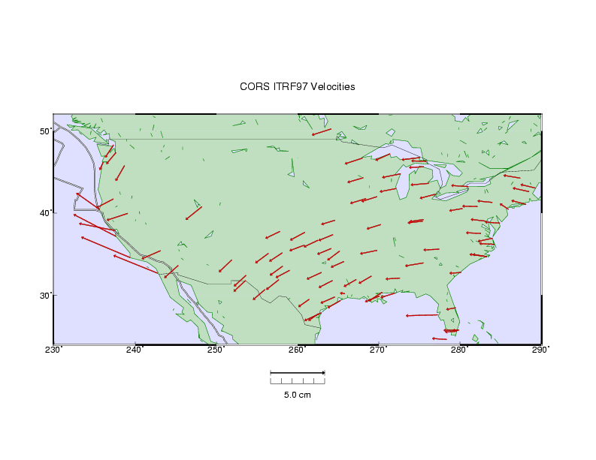

HORIZONTAL TECTONIC MOTIONS
Motion in cm/year
North American Plate
Pacific Plate
When is California not in North America …
…. when its on the Pacific Plate!

Slide 18
Representations of the Earth
Geoid is a surface of constant
gravitational potential
~ Sea surface
Ellipsoid
Earth surface
Geoid

Slide 19
Definition of Elevation
Elevation Z
P
z = z_{p}
•
z = 0
Land Surface
Mean Sea level = Geoid
Elevation is measured from the Geoid

Slide 20
Vertical Earth Datums
A vertical datum defines elevation, z
NGVD29 (National Geodetic Vertical Datum of 1929)
NAVD88 (North American Vertical Datum of 1988)
The National Elevation Dataset is in the NAVD88 datum
Heights are “elevation above datum”

Slide 21
Geodesy and Map Projections
Geodesy - the shape of the earth and definition of earth datums
Map Projection - the transformation of a curved earth to a flat map
Coordinate systems - (x,y) coordinate systems for map data

Slide 22
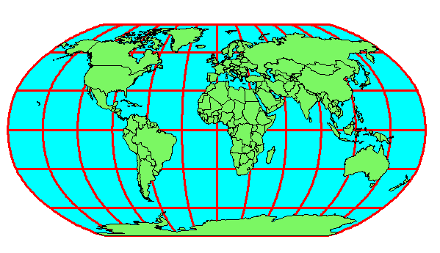
Earth to Globe to Map
Map Scale:
Map Projection:
Representative Fraction
Globe distance
Earth distance
Scale Factor
Map distance
Globe distance
=
=
(e.g. 1:24,000)
(e.g. 0.9996)

Slide 23
Types of Projections
Conic (Albers Equal Area, Lambert Conformal Conic) - good for East-West land areas
Cylindrical (Transverse Mercator) - good for North-South land areas
Azimuthal (Lambert Azimuthal Equal Area) - good for global views

Slide 24
Projections Preserve Some
Earth Properties
Area - correct earth surface area (Albers Equal Area) important for mass balances
Shape - local angles are shown correctly (Lambert Conformal Conic)
Direction - all directions are shown correctly relative to the center (Lambert Azimuthal Equal Area)
Distance - preserved along particular lines
Some projections preserve two properties

Slide 25
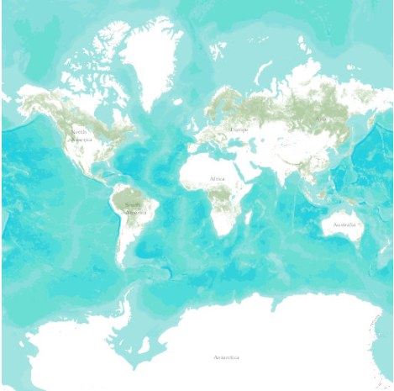
Web Mercator Projection
(used for ESRI Basemaps)
Web Mercator is one of the most popular coordinate systems used in web applications because it fits the entire globe into a square area that can be covered by 256 by 256 pixel tiles.
The spatial reference for the ArcGIS Online / Google Maps / Bing Maps tiling scheme is WGS 1984 Web Mercator (Auxiliary Sphere).

Slide 26
Coordinate Systems
A planar coordinate system is defined by a pair
of orthogonal (x,y) axes drawn through an origin
Y
Origin
X
(x_{o},y_{o})
(φ_{o},λ_{o})

Slide 27
State Plane Coordinate System
Defined for each State in the United States
East-West States (e.g. Texas) use Lambert Conformal Conic, North-South States (e.g. California) use Transverse Mercator
Texas has five zones (North, North Central, Central, South Central, South) to give accurate representation
Greatest accuracy for local measurements

Slide 28
Review for Midterm Exam
Location on the Earth
ArcGIS as a Geographic Information System
Working with Raster Data
Working with Vector Data

Slide 29




What is GIS
A geographic information system (GIS) is a system designed to capture, store, manipulate, analyze, manage, and present all types of geographical data. -- Wikipedia
data
computers
maps
tools

Slide 30
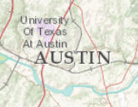
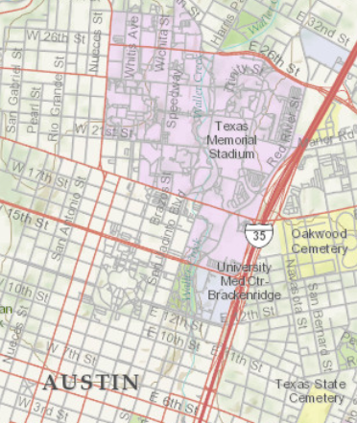
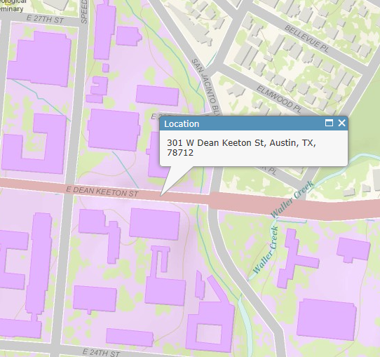
Geography is visualized in maps
map
www.arcgis.com

Slide 31
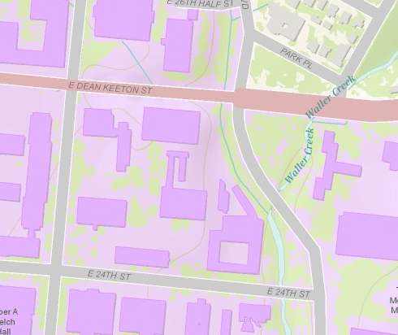
Maps are built from data
Road
Name: E. Dean Keeton St
Type: Div Highway
Speed: 35 mph
Shape: [Geometry]
Building
Name: Ernest Cockrell Jr Hall
Address: 301 E. Dean Keeton St
Shape: [Geometry]
data
Shape includes the geometry of the feature and where it is located on earth
map

Slide 32
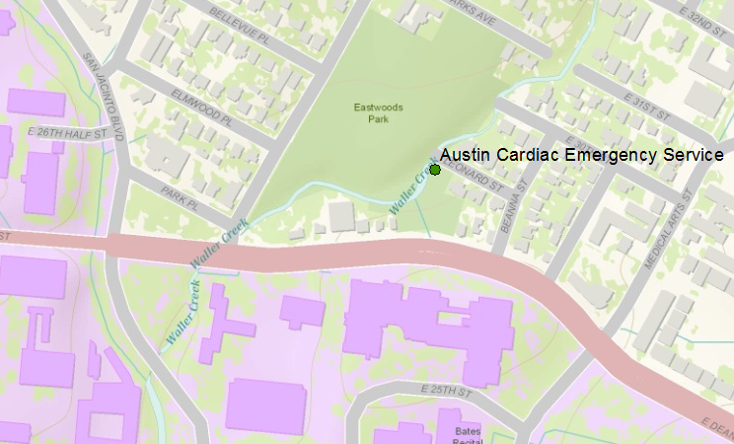
Vector data represent discrete features
points
lines
data
polygons
map

Slide 33
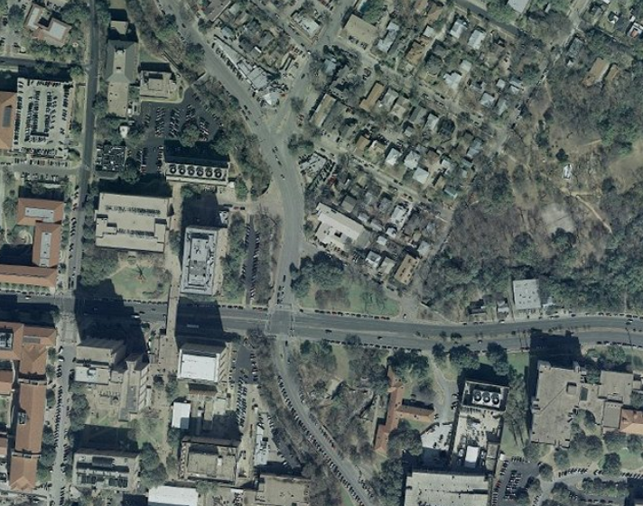
Raster data form a grid of cells or pixels
data
map

Slide 34
Data Model
Conceptual Model – a set of concepts that describe a subject and allow reasoning about it
Mathematical Model – a conceptual model expressed in symbols and equations
Data Model – a conceptual model expressed in a data structure (e.g. ascii files, Excel tables, …..)
Geographic Data Model – a conceptual model for describing and reasoning about the world expressed in a GIS database

Slide 35
Linking Geography and Attributes
GIS has a one to one association between a geographic feature and a record in an attribute table.
Geographic coordinates
Tabular attributes

Slide 36
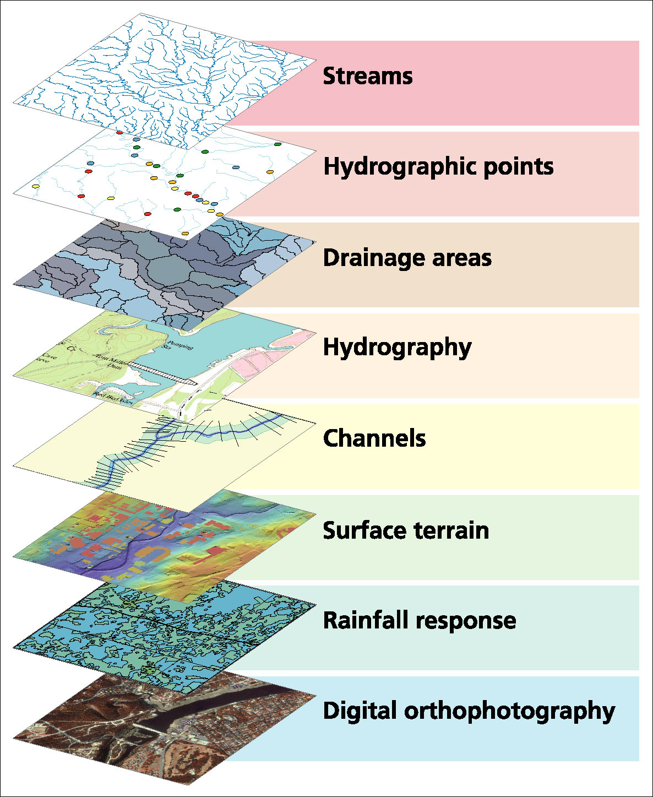
Data Model based on Inventory of data layers

Slide 37
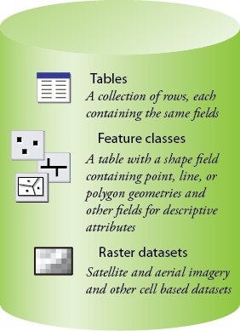
Common Geospatial Information Types
Image: Michael Zeiler, ESRI

Slide 38
Raster and Vector Data
Raster data are described by a cell grid, one value per cell
Vector
Raster
Point
Line
Zone of cells
Polygon

Slide 39
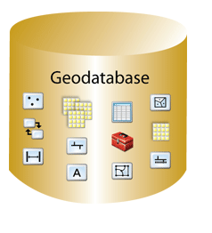
Geodatabase – a store for all types of geospatial information

Slide 40
Geodesy, Map Projections and Coordinate Systems
Geodesy - the shape of the earth and definition of earth datums
Map Projection - the transformation of a curved earth to a flat map
Coordinate systems - (x,y) coordinate systems for map data
Spatial Reference = Datum +
Projection +
Coordinate system

Slide 41
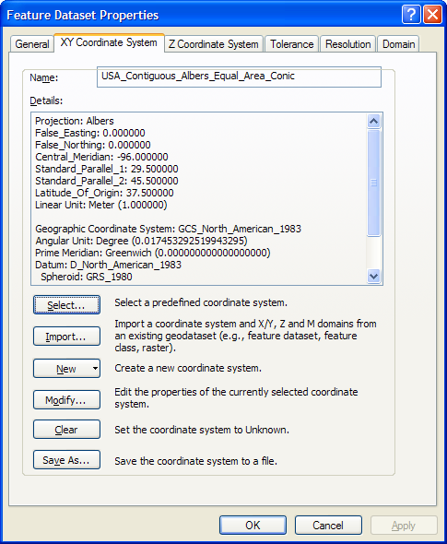
ArcGIS Spatial Reference Frames
Defined for a feature dataset in ArcCatalog
XY Coordinate System
  Projected
  Geographic
Z Coordinate system

Slide 42
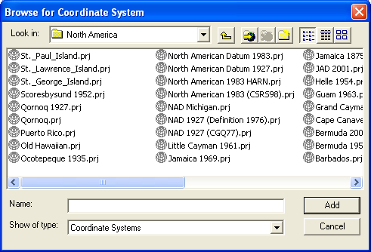
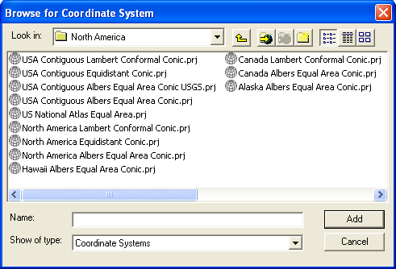
Horizontal Coordinate Systems
Geographic coordinates (decimal degrees)
Projected coordinates (length units, ft or meters)

Slide 43
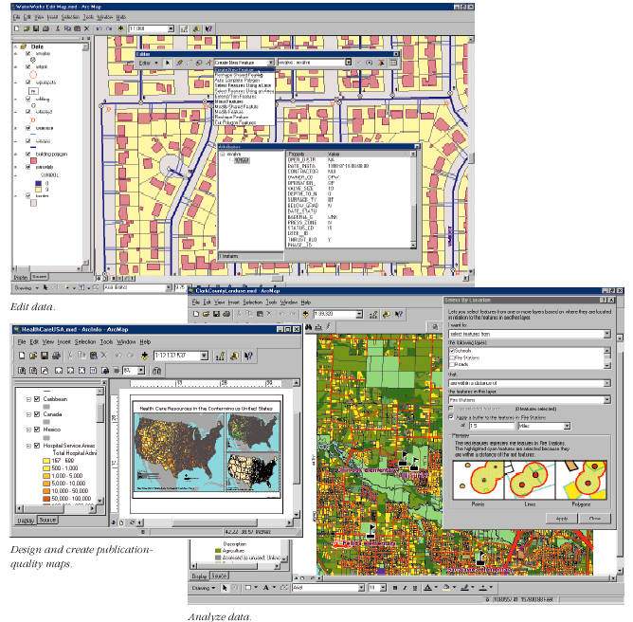
Key ArcGIS Software Components
ArcMap
ArcCatalog
ArcToolbox
Extensions
Geoprocessing

Slide 44
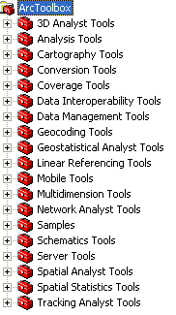
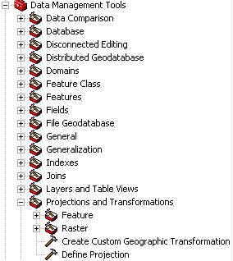
Arc Toolbox
Tools for commonly used tasks
Map Projections

Slide 45
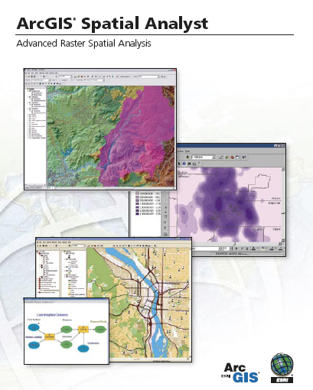
Spatial Analyst
Analysis of land surface terrain as a grid
Key means of defining drainage areas and connectivity to stream network

Slide 46
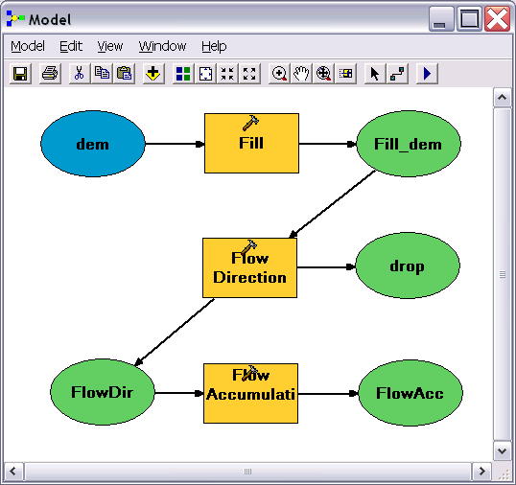
Geo-Processing
Toolbox tools linked together using the model builder to automate data processing

Slide 47
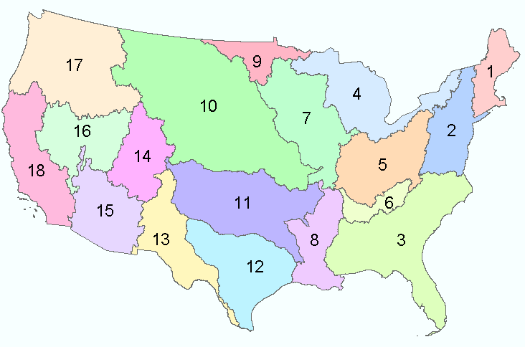
Water Resources Regions of the US
There are 21 water resources regions in the United States
Region 01 New England
Region 02 Mid-Atlantic
Region 03 South Atlantic-Gulf
Region 04 Great Lakes
Region 05 Ohio
Region 06 Tennessee
Region 07 Upper Mississippi
Region 08 Lower Mississippi
Region 09 Souris-Red-Rainy
Region 10 Missouri
Region 11 Arkansas-White-Red
Region 12 Texas-Gulf
Region 13 Rio Grande
Region 14 Upper Colorado
Region 15 Lower Colorado
Region 16 Great Basin
Region 17 Pacific Northwest
Region 18 California
Region 19 Alaska (Old numbering system)
Region 20 Hawaii
Region 21 Caribbean
Eighteen 2-digit water resource regions in the Contiguous US

Slide 48
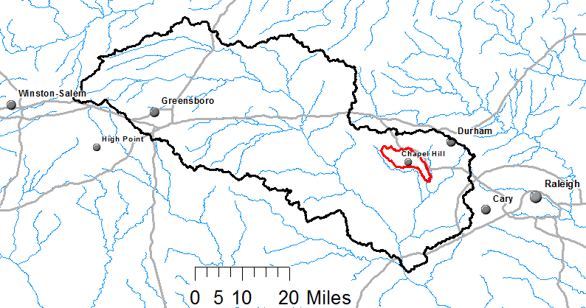
Watershed Hierarchy
Each hydrologic unit is identified by a unique hydrologic unit code (HUC) consisting of two to or more digits based on the levels of classification in the hydrologic unit system.
Digit #
2
4
6
8 HUC
10
12
NHDPlus
HAW HUC 8 03030002
Little Creek HUC 12 030300020603

Slide 49
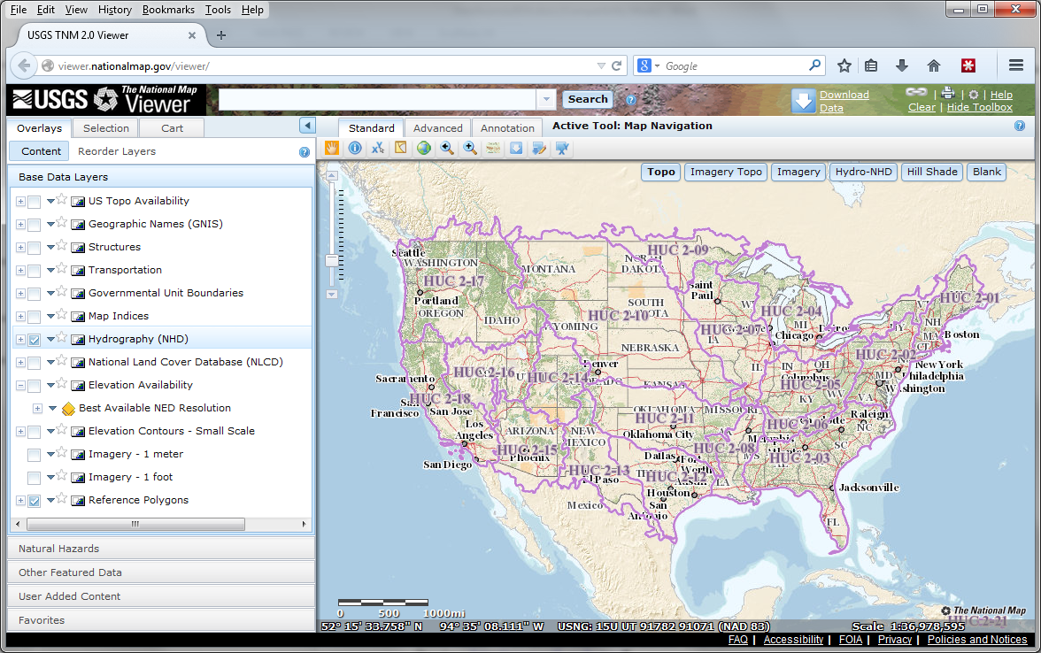
The National Map
http://nationalmap.gov/
A central source for US Government data

Slide 50
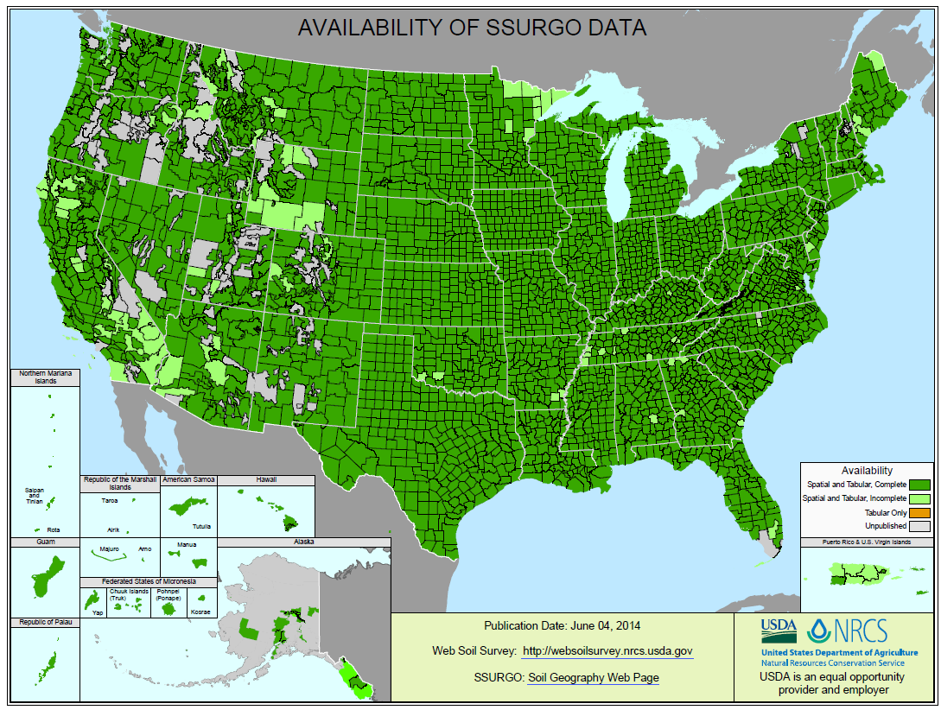
SSURGO:
County Level
Digital Soil Maps
1:24,000 scale
soil information
http://websoilsurvey.nrcs.usda.gov/DataAvailability/SoilDataAvailabilityMap.pdf

Slide 51
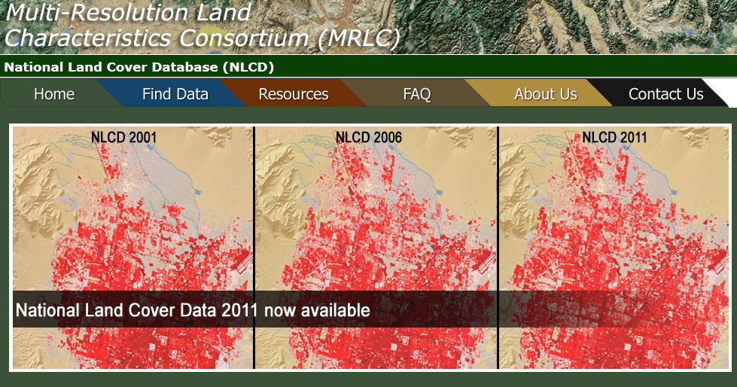
National Land Cover Dataset
1992, 2001, 2006 and 2011
Get the data:
http://www.mrlc.gov/

Slide 52

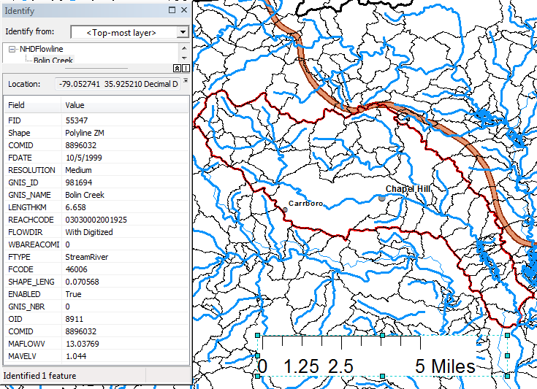
Slope
Elevation
Mean annual flow
  Corresponding velocity
Drainage area
% of upstream drainage area in different land uses
Stream order
http://www.horizon-systems.com/nhdplus/

Slide 53
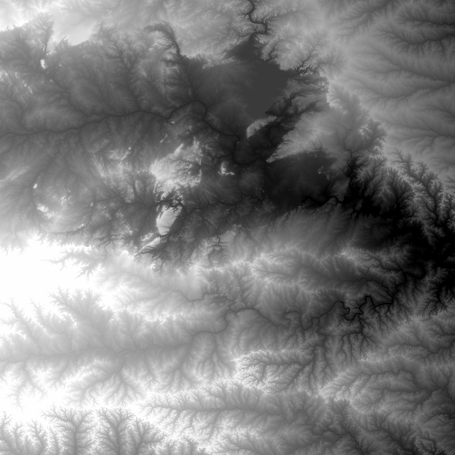
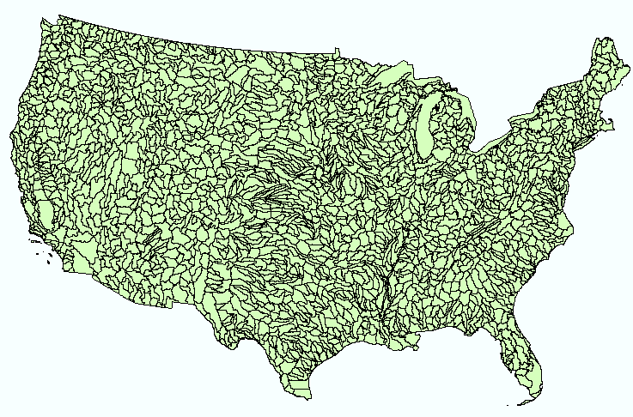
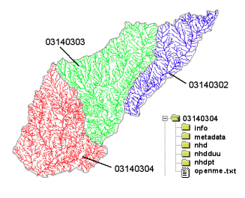
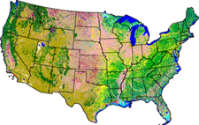
NHDPlus Version 2
Geospatial database for a national water data infrastructure
NHDPlus
(built 2004-2014)
National Elevation Dataset
Watershed Boundary Dataset
National Hydrography Dataset
National Land Cover Dataset
2.6 million catchments average area 3 km²,
reach length 2 km

Slide 54
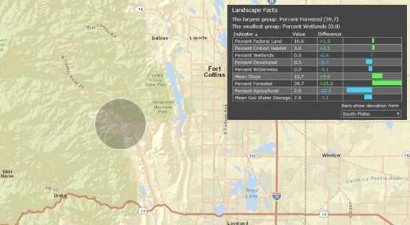
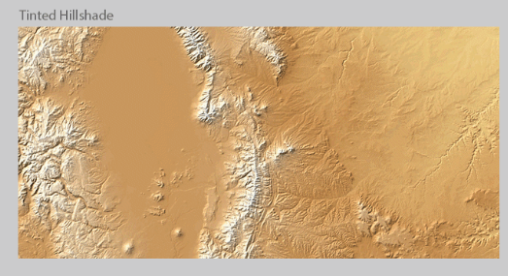
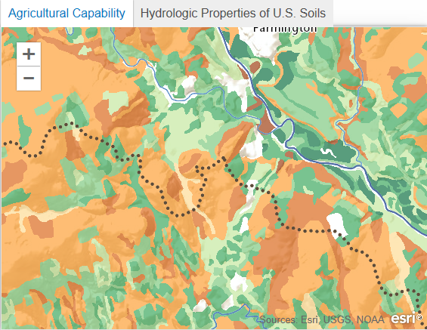
ArcGIS Online: Maps about the Earth
http://www.arcgis.com/features/maps/earth.html
Land Cover
Elevation
Soils

Slide 55
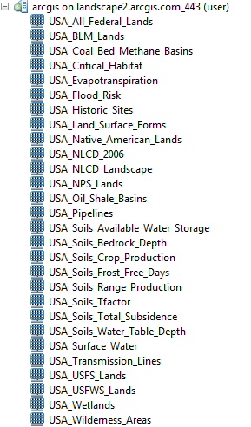
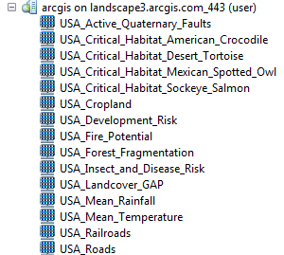
ArcGIS Online Services
http://landscape1.arcgis.com/arcgis/services/
http://landscape2.arcgis.com/arcgis/services/
http://landscape3.arcgis.com/arcgis/services/
http://elevation.arcgis.com/arcgis/services/
http://hydro.arcgis.com/arcgis/services

Slide 56
Review for Midterm Exam
Location on the Earth
ArcGIS as a Geographic Information System
Working with Raster Data
Working with Vector Data
Remote Sensing

Slide 57
f(x,y)
y
x

Slide 58
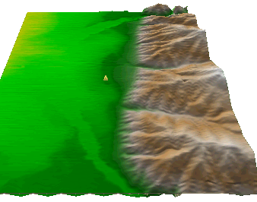
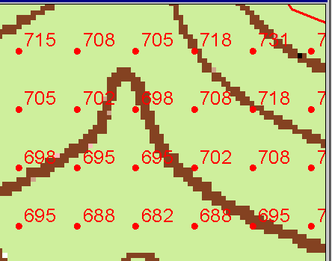
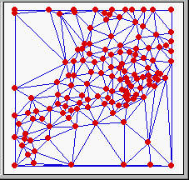
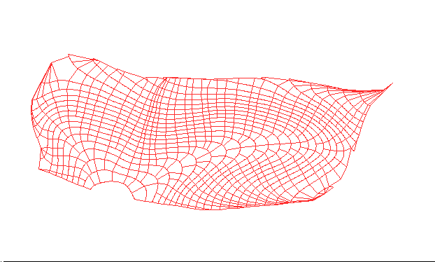
Numerical representation of a spatial surface (field)
Grid
TIN
Contour and flowline

Slide 59

Grid Datasets
Cellular-based data structure composed of square cells of equal size arranged in rows and columns.
The grid cell size and extent (number of rows and columns), as well as the value at each cell have to be stored as part of the grid definition.
Number of columns
Cell size
Number of rows

Slide 60

Raster Calculator
Cell by cell evaluation of mathematical functions

Slide 61



Nearest Neighbor Resampling with Cellsize Maximum of Inputs
100 m
40
50
55
40-0.5*4 = 38
42
47
43
55-0.5*6 = 52
38
52
42
44
41
42-0.5*2 = 41
41-0.5*4 = 39
41
39
150 m
4
6
2
4

Slide 62
Interpolation
Estimate values between known values.
A set of spatial analyst functions that predict values for a surface from a limited number of sample points creating a continuous raster.
Apparent improvement in resolution may not be justified

Slide 63
Interpolation methods
Nearest neighbor
Inverse distance weight
Bilinear interpolation
Kriging (best linear unbiased estimator)
Spline

Slide 64


Nearest Neighbor “Thiessen” Polygon Interpolation
Spline Interpolation

Slide 65

Topographic Slope
Defined or represented by one of the following
  Surface derivative ∇z
  Vector with x and y components
  Vector with magnitude (slope) and direction (aspect)

Slide 66

ArcGIS “Slope” tool
a
b
c
d
e
f
g
h
i

Slide 67
DEM Based Watershed and Stream Network Delineation Steps
DEM Reconditioning/Burning in Streams
Fill Sinks
Eight direction pour point model to evaluate flow directions
Flow accumulation
Threshold stream network definition
Stream segmentation
Watershed delineation
Raster to vector conversion of streams and watersheds

Slide 68


Digital Elevation Model (DEM)-30 meter
National Elevation Dataset

Slide 69

Filling in the Pits
DEM creation results in artificial pits in the landscape
A pit is a set of one or more cells which has no downstream cells around it
Unless these pits are filled they become sinks and isolate portions of the watershed
Pit filling is first thing done with a DEM

Slide 70
Identifying and Removing Pits/Sinks in a DEM
Contains pits
Filled
5 | 5 | 4 | 5 | 5 | 5 | 5 | 3 | 5 | 5
6 | 6 | 5 | 6 | 6.1 | 5 | 6 | 6 | 6 | 6
7 | 7 | 6 | 7 | 7 | 4 | 7 | 5 | 7 | 7
9 | 9 | 8 | 9 | 9 | 3.9 | 9 | 5 | 9 | 9
11 | 11 | 10 | 11 | 11 | 11 | 11 | 9 | 11 | 11
12 | 12 | 8 | 12 | 12 | 12 | 12 | 10 | 12 | 12
13 | 12 | 7 | 12 | 13 | 13 | 13 | 11 | 13 | 13
14 | 7 | 6 | 11 | 14 | 14 | 14 | 12 | 14 | 14
15 | 7 | 7 | 8 | 9 | 15 | 15 | 8 | 15 | 15
15 | 8 | 8 | 8 | 7 | 16 | 16 | 14 | 16 | 16
15 | 11 | 9 | 11 | 11 | 17 | 17 | 17 | 17 | 17
15 | 15 | 8 | 15 | 15 | 18 | 18 | 15 | 18 | 18
5 | 5 | 4 | 5 | 5 | 5 | 5 | 3 | 5 | 5
6 | 6 | 5 | 6 | 6.1 | 5 | 6 | 6 | 6 | 6
7 | 7 | 6 | 7 | 7 | 4 | 7 | 5 | 7 | 7
9 | 9 | 8 | 9 | 9 | 3.9 | 9 | 5 | 9 | 9
11 | 11 | 10 | 11 | 11 | 11 | 11 | 9 | 11 | 11
12 | 12 | 8 | 12 | 12 | 12 | 12 | 10 | 12 | 12
13 | 12 | 7 | 12 | 13 | 13 | 13 | 11 | 13 | 13
14 | 7 | 6 | 11 | 14 | 14 | 14 | 12 | 14 | 14
15 | 7 | 7 | 8 | 9 | 15 | 15 | 8 | 15 | 15
15 | 8 | 8 | 8 | 7 | 16 | 16 | 14 | 16 | 16
15 | 11 | 9 | 11 | 11 | 17 | 17 | 17 | 17 | 17
15 | 15 | 8 | 15 | 15 | 18 | 18 | 15 | 18 | 18
5 | 5 | 4 | 5 | 5 | 5 | 5 | 3 | 5 | 5
6 | 6 | 5 | 6 | 6.1 | 5 | 6 | 6 | 6 | 6
7 | 7 | 6 | 7 | 7 | 4 | 7 | 5 | 7 | 7
9 | 9 | 8 | 9 | 9 | 3.9 | 9 | 5 | 9 | 9
11 | 11 | 10 | 11 | 11 | 11 | 11 | 9 | 11 | 11
12 | 12 | 8 | 12 | 12 | 12 | 12 | 10 | 12 | 12
13 | 12 | 7 | 12 | 13 | 13 | 13 | 11 | 13 | 13
14 | 7 | 6 | 11 | 14 | 14 | 14 | 12 | 14 | 14
15 | 7 | 7 | 8 | 9 | 15 | 15 | 8 | 15 | 15
15 | 8 | 8 | 8 | 7 | 16 | 16 | 14 | 16 | 16
15 | 11 | 9 | 11 | 11 | 17 | 17 | 17 | 17 | 17
15 | 15 | 8 | 15 | 15 | 18 | 18 | 15 | 18 | 18
5 | 5 | 4 | 5 | 5 | 5 | 5 | 3 | 5 | 5
6 | 6 | 5 | 6 | 6.1 | 5 | 6 | 6 | 6 | 6
7 | 7 | 6 | 7 | 7 | 4 | 7 | 6 | 7 | 7
9 | 9 | 8 | 9 | 9 | 3.9 | 9 | 6 | 9 | 9
11 | 11 | 10 | 11 | 11 | 11 | 11 | 9 | 11 | 11
12 | 12 | 9 | 12 | 12 | 12 | 12 | 10 | 12 | 12
13 | 12 | 9 | 12 | 13 | 13 | 13 | 11 | 13 | 13
14 | 9 | 9 | 11 | 14 | 14 | 14 | 12 | 14 | 14
15 | 9 | 9 | 9 | 9 | 15 | 15 | 12 | 15 | 15
15 | 9 | 9 | 9 | 9 | 16 | 16 | 14 | 16 | 16
15 | 11 | 9 | 11 | 11 | 17 | 17 | 17 | 17 | 17
15 | 15 | 8 | 15 | 15 | 18 | 18 | 15 | 18 | 18
A pit is a set of one or more cells which has no downstream cells around it.

Slide 71
Hydrologic Slope
- Direction of Steepest Descent
30
30
67
56
49
67
56
49
52
48
37
52
48
37
58
55
22
58
55
22
Slope:

Slide 72
Eight Direction Pour Point Model
32
64
128
16
1
8
4
2
Water flows in the direction of steepest descent

Slide 73
Flow Accumulation Grid.
Area draining in to a grid cell
0
0
0
0
0
0
0
0
0
0
0
2
2
2
0
0
2
2
2
0
0
0
10
0
1
0
0
1
0
10
1
0
0
14
0
1
0
0
0
14
0
4
1
19
1
0
4
1
1
19
Flow Accumulation > Threshold
ArcHydro Page 72

Slide 74
Watershed Draining to Outlet

Slide 75

Stream links grid for the San Marcos subbasin
201
172
202
203
206
204
209
Each link has a unique identifying number

Slide 76
Review for Midterm Exam
Location on the Earth
ArcGIS as a Geographic Information System
Working with Raster Data
Working with Vector Data

Slide 77

Catchments for Stream Links
Same Cell Value

Slide 78



Vectorized Streams Linked Using Grid Code to Cell Equivalents
Vector
Streams
Grid
Streams

Slide 79


Raster Zones and Vector Polygons
One to one connection
Raster pixel value
Catchment Grid_code
4
3
5
Raster Zones
Vector Polygons

Slide 80
Relationship
A relationship is an association or link between two objects in a database.
A relationship can exist between spatial objects (features in feature classes), non-spatial objects (objects in object classes), or between spatial and non-spatial objects.

Slide 81




Relationships linking Catchments and Drainage Lines

Slide 82



Zonal Average of Raster over Subwatershed
Join

Slide 83





Subwatershed Precipitation by Thiessen Polygons
Thiessen Polygons
Intersect with Subwatersheds
Evaluate A*P Product
Summarize by subwatershed
$$P_{i}=\frac{\sum_{k}{A_{ik}P_{k}}}{\sum_{k}{A_{ik}}}$$

Slide 84

Catchment, Watershed, Subwatershed.
Subwatersheds
Catchments
Watershed
Watershed outlet points may lie within the interior of a catchment, e.g. at a USGS stream-gaging site.

Slide 85
Drainage Density
D_{d} = L/A
Hillslope length ≈ 1/2D_{d}
B
B
Hillslope length = B
A = 2B L
D_{d} = L/A = 1/2B
∴ B= 1/2D_{d}
L

Slide 86



Drainage Density for Different Support Area Thresholds
EPA Reach Files
100 grid cell threshold
1000 grid cell threshold

Slide 87



ArcGIS Hydrology Toolset

Slide 88



Representation of Flow Field
Steepest single direction
48
52
56
67
D8
D∞
Tarboton, D. G., (1997), "A New Method for the Determination of Flow Directions and Contributing Areas in Grid Digital Elevation Models," Water Resources Research, 33(2): 309-319.)
Notes:
This slide shows how the terrain flow field is represented. Early DEM work used a single flow direction model, D8. In 1997 I published the Dinfinity method that proportions flow from each grid cell among downslope neighbors. This, at the expense of some dispersion, allows a better approximation of flow across surfaces.

Slide 89


Upstream Trace Solvers

Slide 90




Connecting Land and Water
Four key ideas:
  Cell to cell water movement on DEMs
  Line to Line water movement on networks
  Area flows to line (connect land and water systems – Reach Catchments)
  Area flows to point on line (Watershed delineation from designated points)

Slide 91

Cell Flows to a Cell
Core concept of flow on digital elevation models

Slide 92


Line Flows to a Line
Geometric Network of NHDFlowlines

Slide 93

Area Flows to a Line
Reach Catchments from NHDPlus
Flowline and Catchment have the same COMID

Slide 94

Area Flows to a Point on a Line
Watersheds for USGS Gages

Slide 95


National Water Data Center
Located on Tuscaloosa Campus of University of Alabama
Operated by National Weather Service to support IWRSS partners (NWS, USGS, Corps of Engineers, FEMA)

Slide 96



Goals
National Flood Interoperability Experiment
Close the gap between national flood forecasting
and local emergency response
  Impact at the street level
Create real-time flood information services
  Shared among organizations, geographies, people
Engage academic community through the National Water Center
  Innovation for transformative change

Slide 97





Why – Science
Synthesize the four examples of “high impact” earth observations
Weather and seasonal climate monitoring and prediction e.g. Ground-based Weather Radars
Dynamic land-surface monitoring and characterization e.g. Soil Observations
Water level and flow i.e. Stream Gage Network
These are very different kinds of data.
How to make them smoothly interoperable?
Elevation and geo-location – Airborne light Detection and ranging (LiDAR)

Slide 98

Why – Technology
Build a national high spatial resolution, near real-time river and stream model
River flow in the Mississippi River Basin
Use Weather Research and Forecasting Hydro model (WRF-Hydro)
(from NCAR)
Like this but for
whole continental US
Link to current
NWS River Forecasts
Build on NHDPlus
(from EPA and USGS)
using RAPID river model
Source: http://rapid-hub.org/

