Slide 1
Coastal Flooding in Brevard County, FL
Presented by: Helen Gerlach

Slide 2
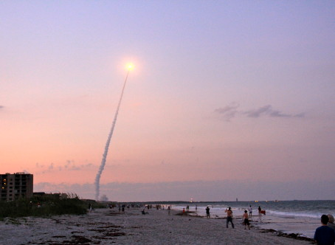
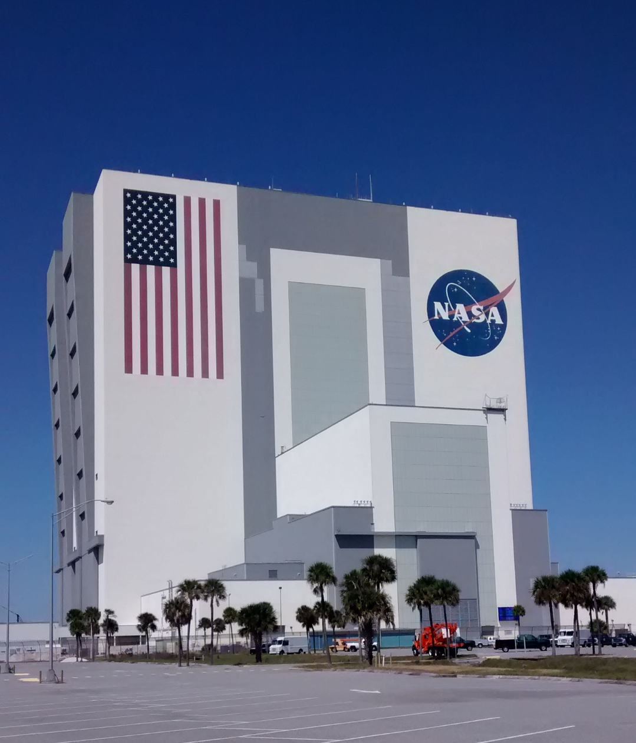
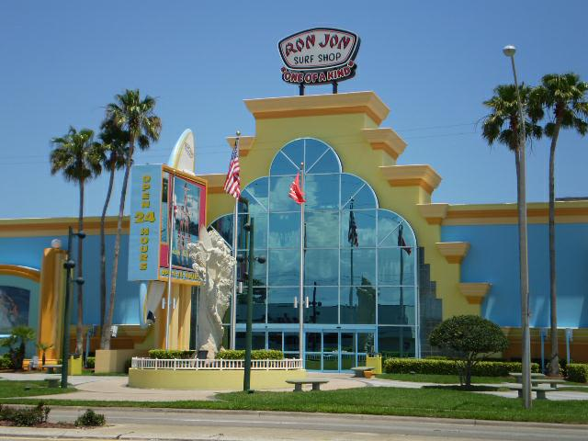
Brevard County, FL

Slide 3
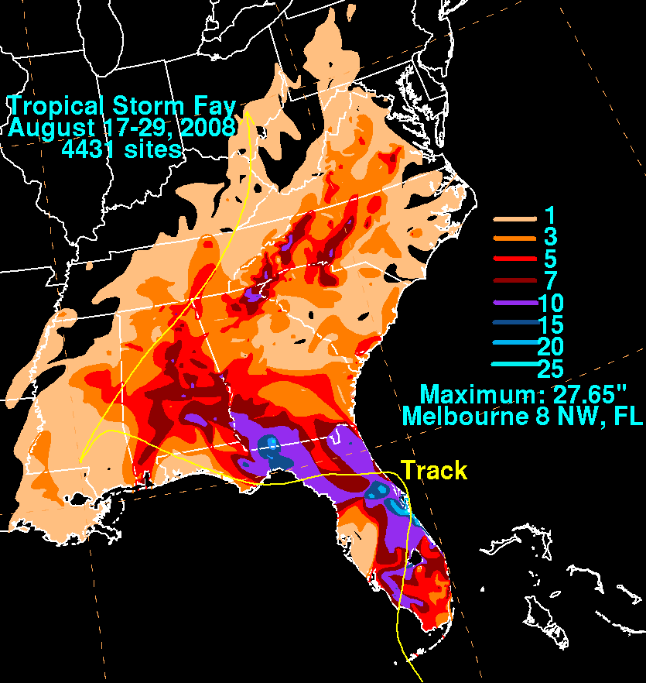
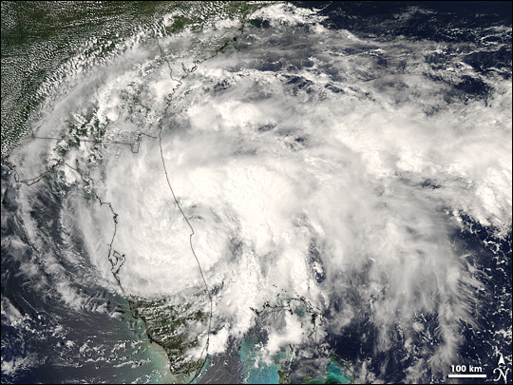
Tropical Storm Fay
Made landfall in Florida on August 19, 2008
Fay was the first storm in history to make landfall in Florida 4 times
Slow movement caused extensive flooding
Total damage in Brevard County was estimated around $12 million

Slide 4
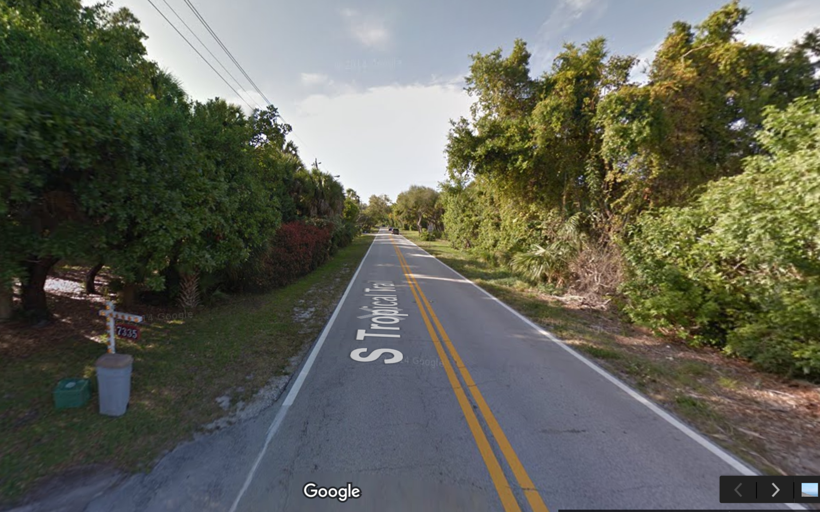
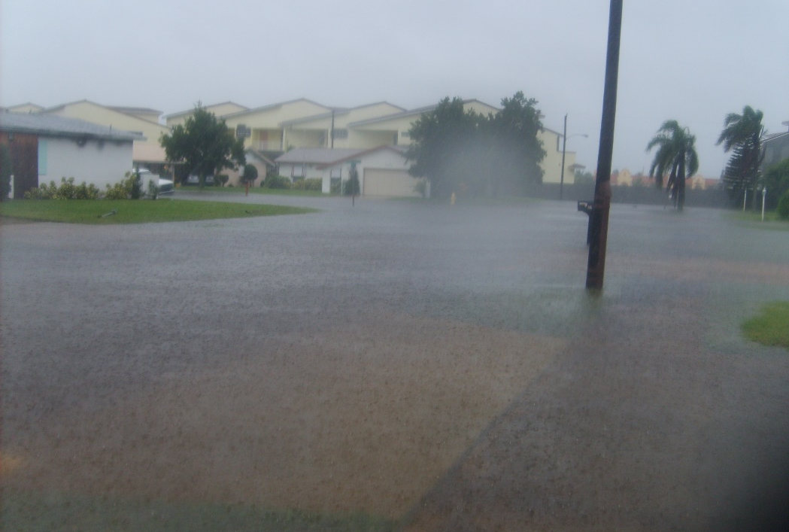
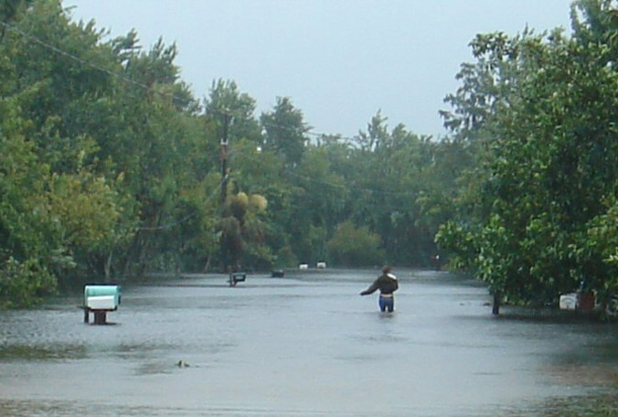
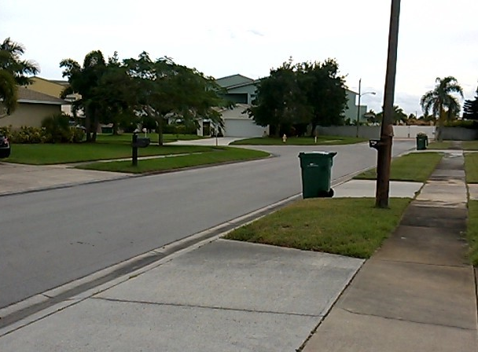
Before
and
After

Slide 5
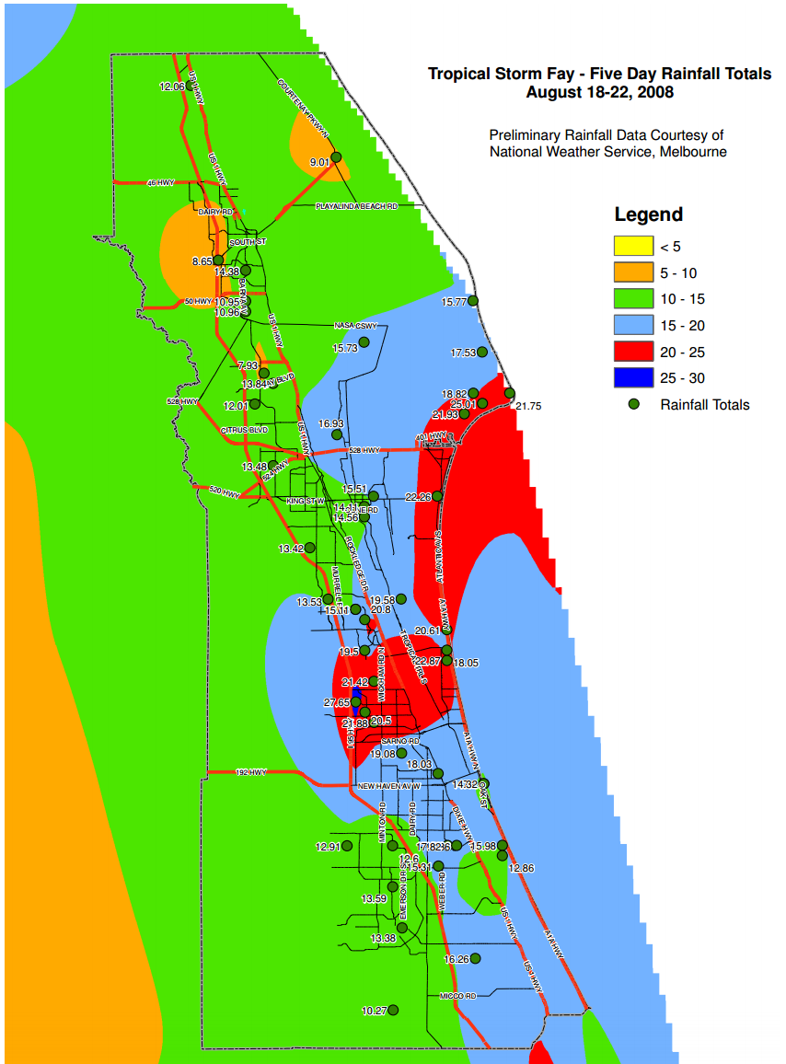
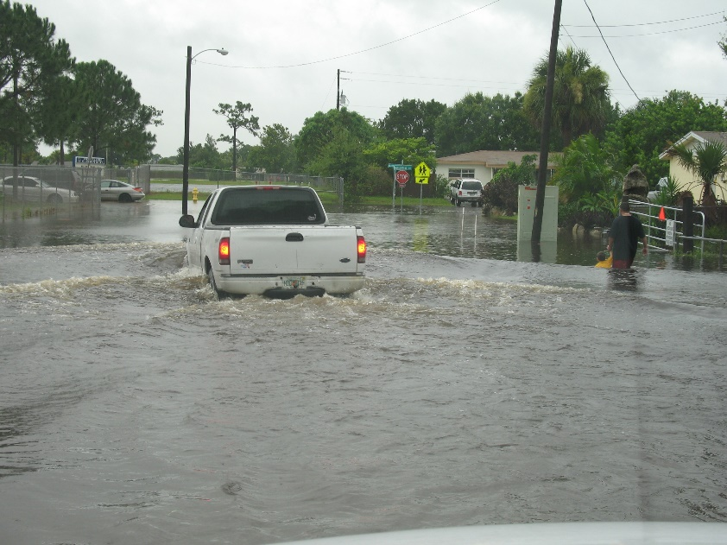
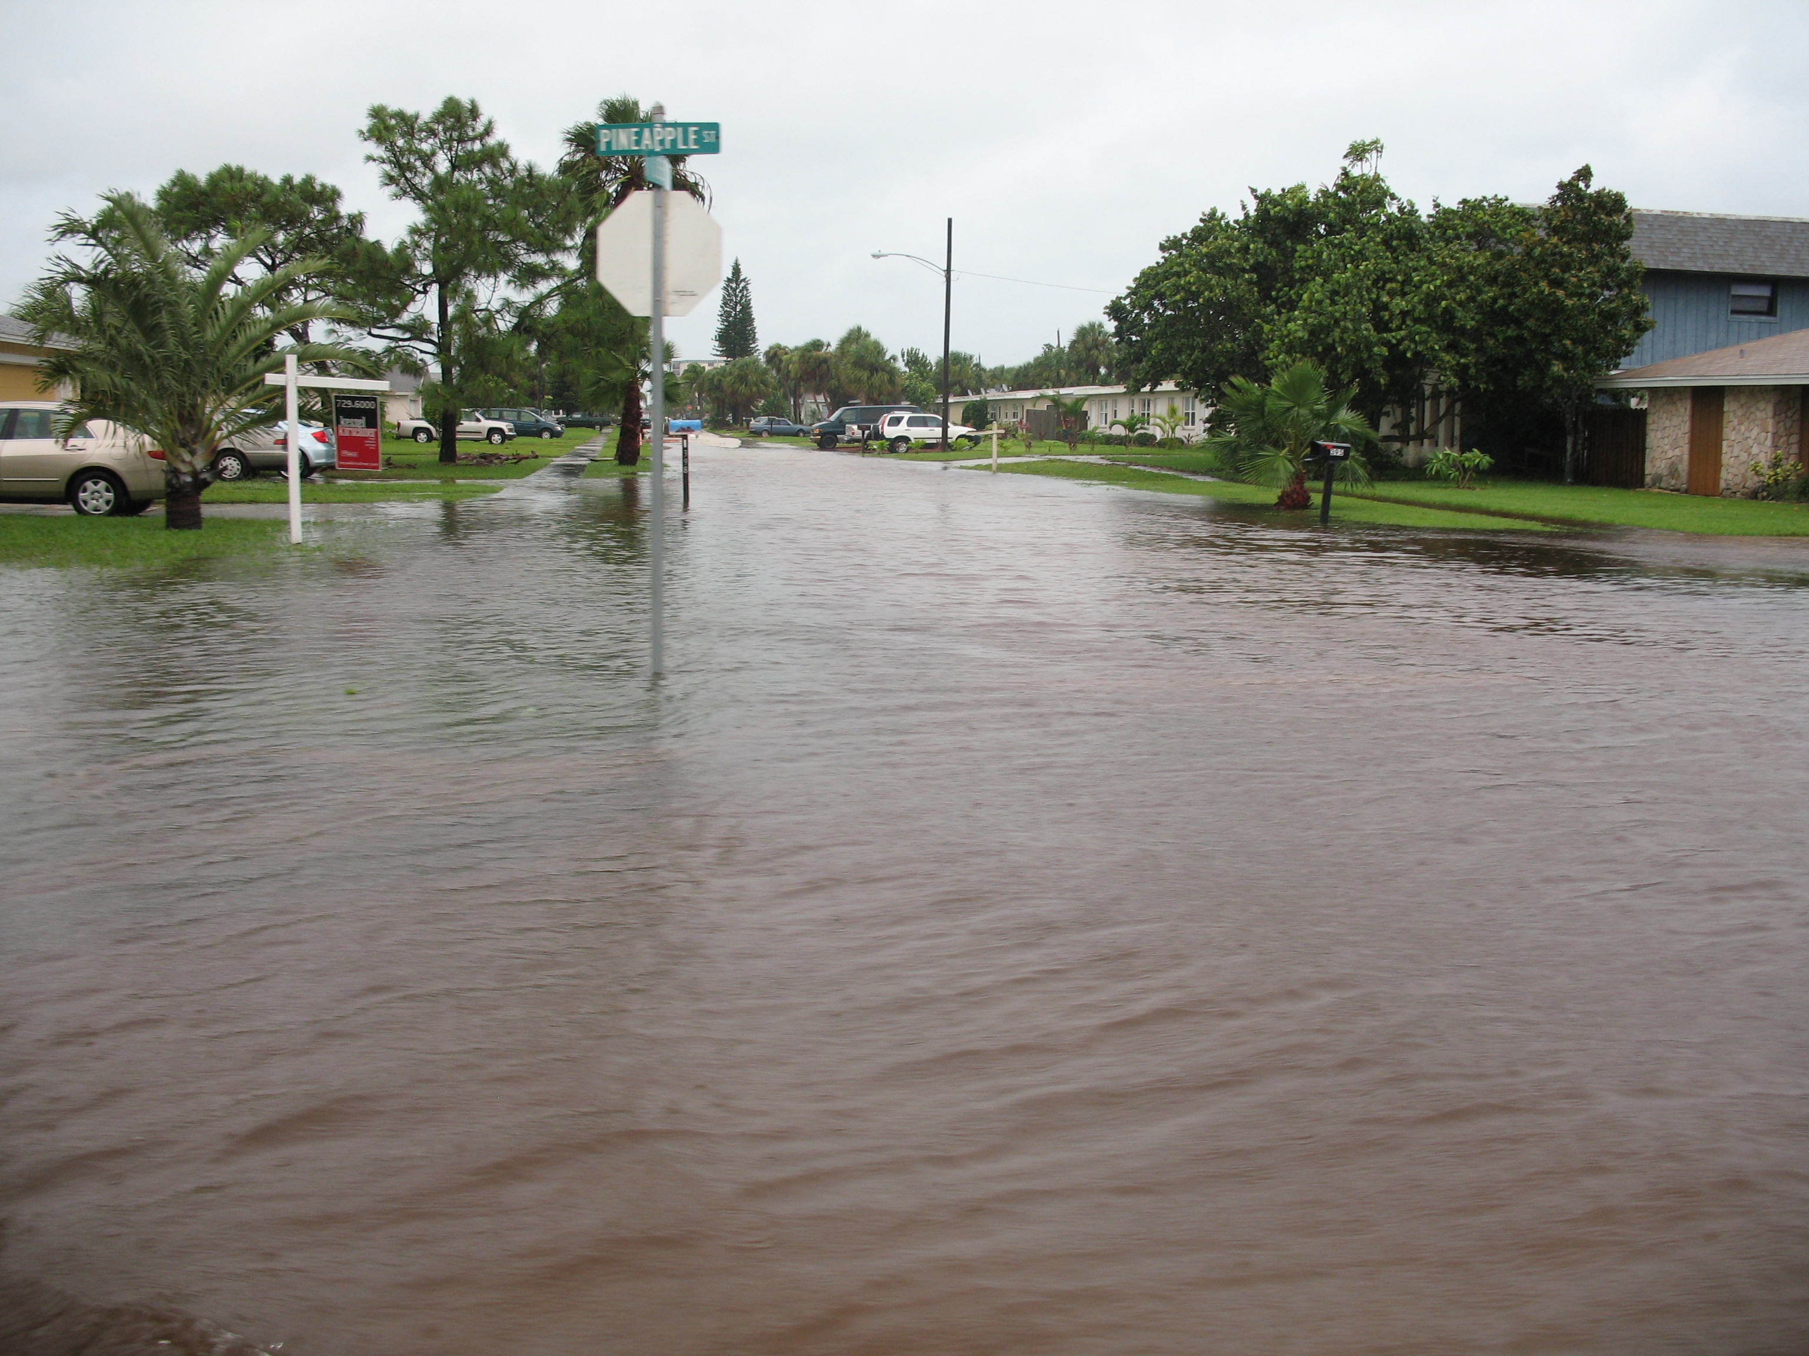
Rainfall in Brevard

Slide 7
Goal: to map the flooding experienced in Brevard County during Fay
Gather precipitation data for the state of Florida from August 18-23, 2008
Find average rainfall in each Florida watershed
Determine amount of available soil water storage
Compare difference in available water storage to amount of rainfall to determine flooding
Datasets used:
Watersheds (NIFE)
Available soil water storage (GIS server)
Florida precipitation (NOAA and NWS)
Storm path (NOAA)

Slide 8
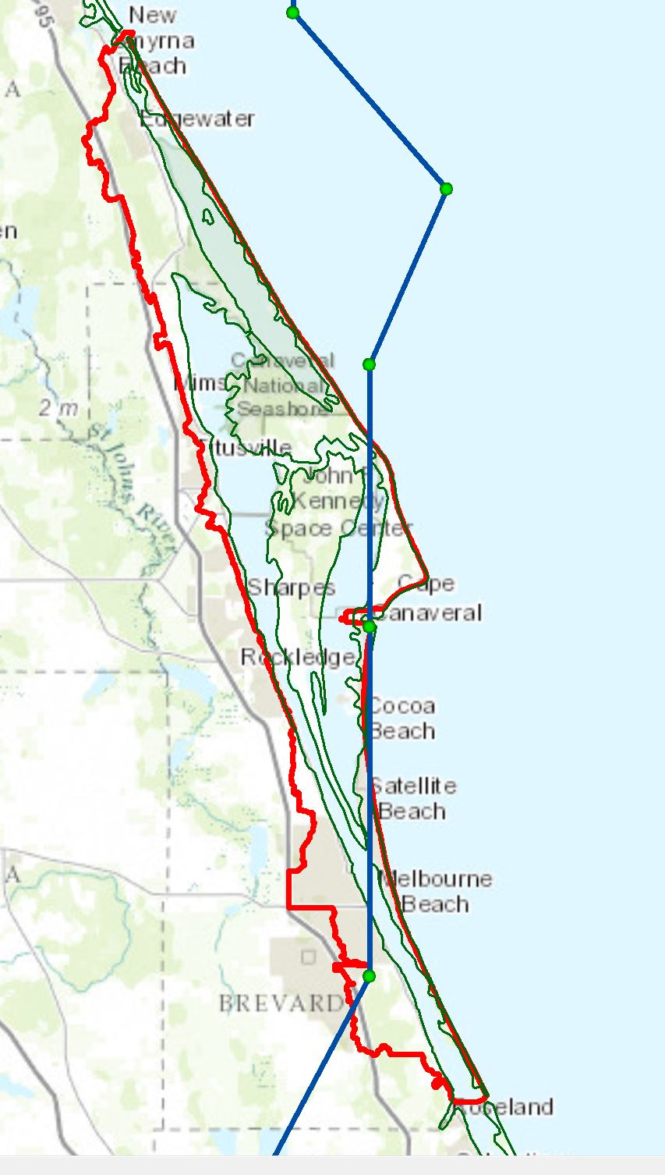
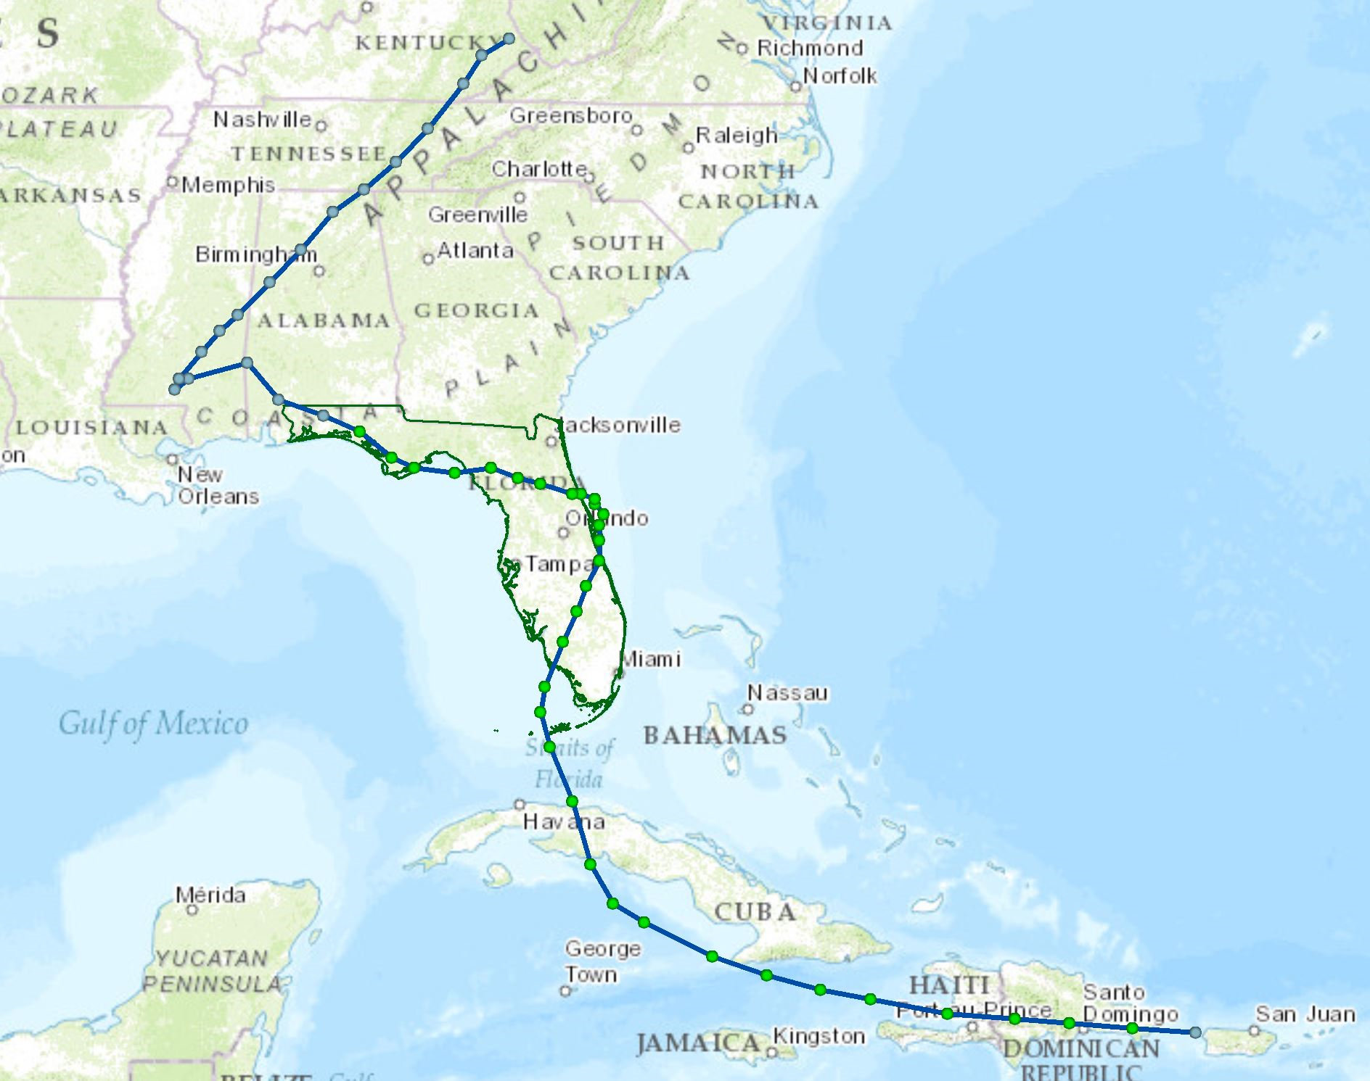
Storm path
My house!
My house!

Slide 9
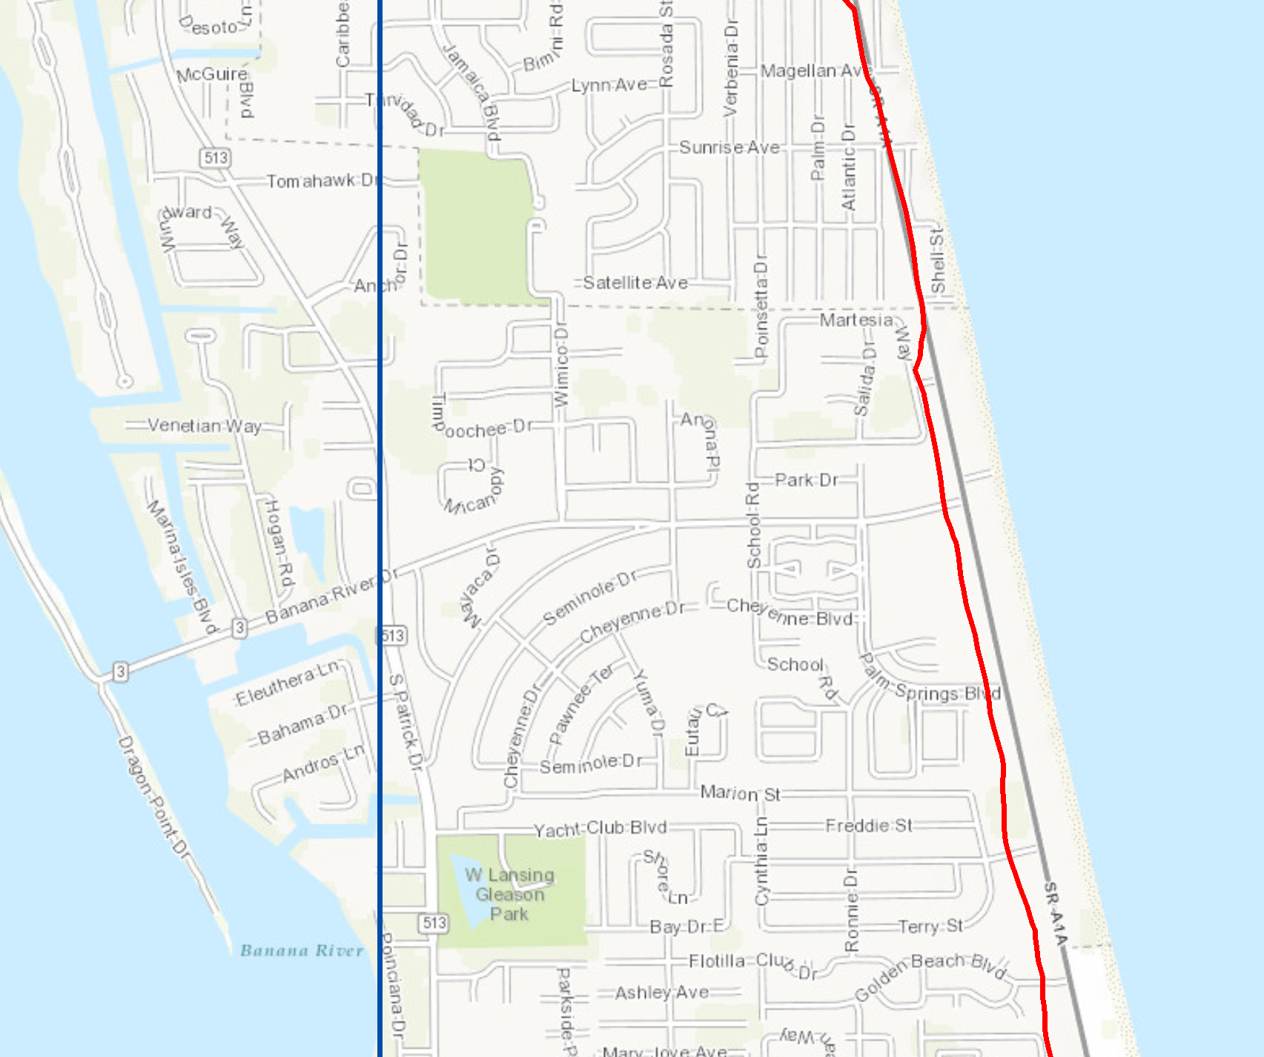
Storm path
My house!

Slide 10
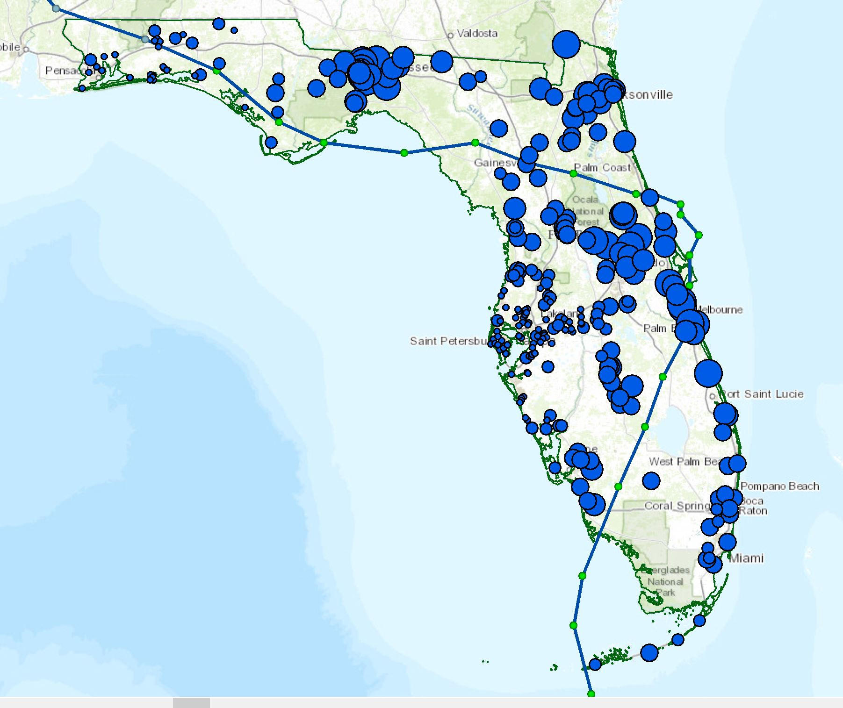
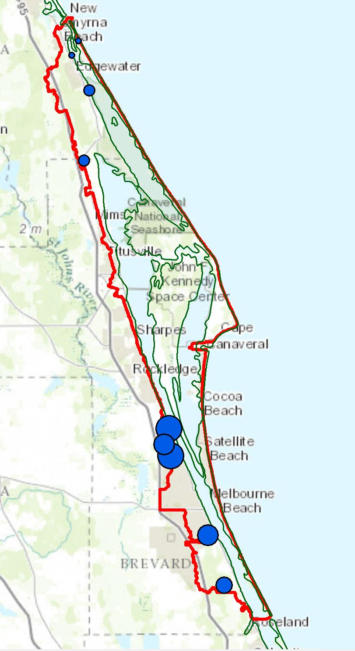
Precipitation data and gauge locations

Slide 11
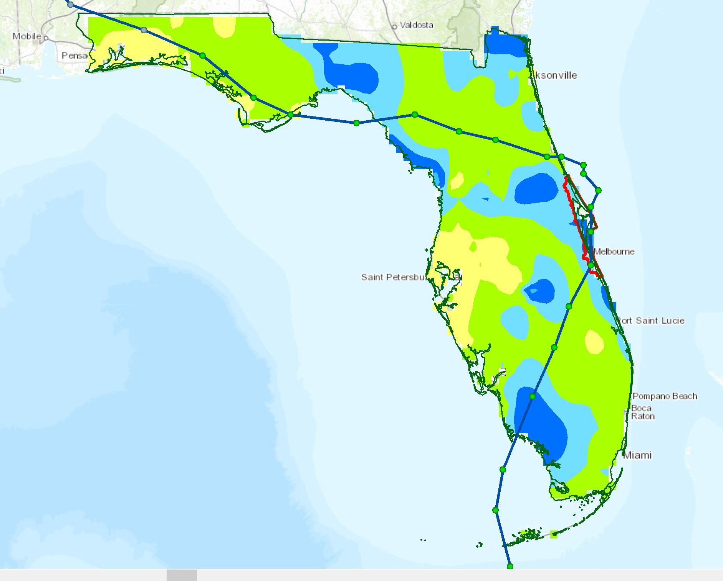
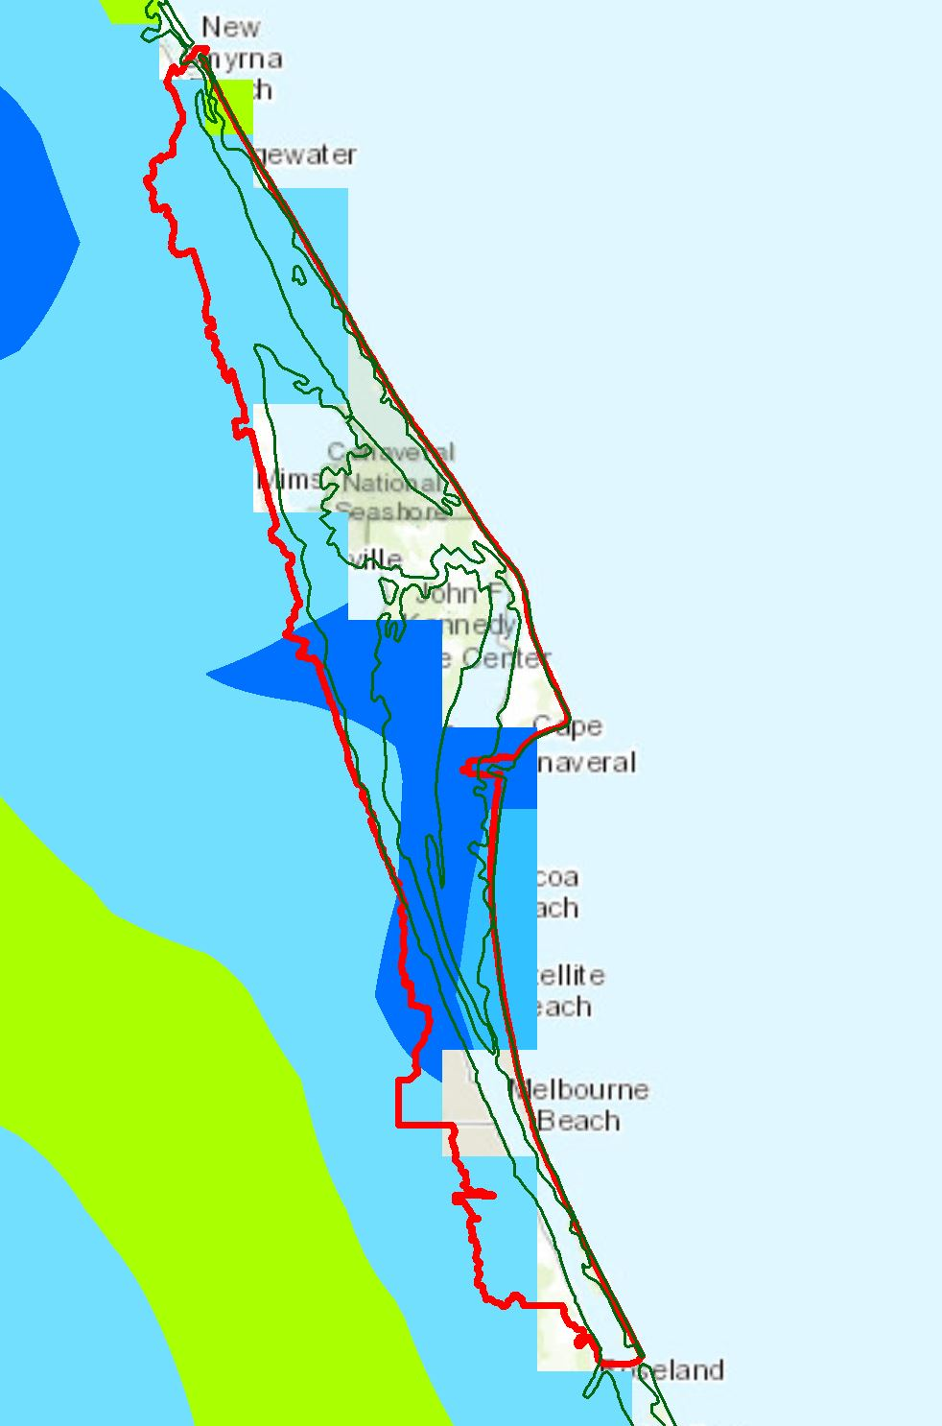
Average precipitation using Spline

Slide 12
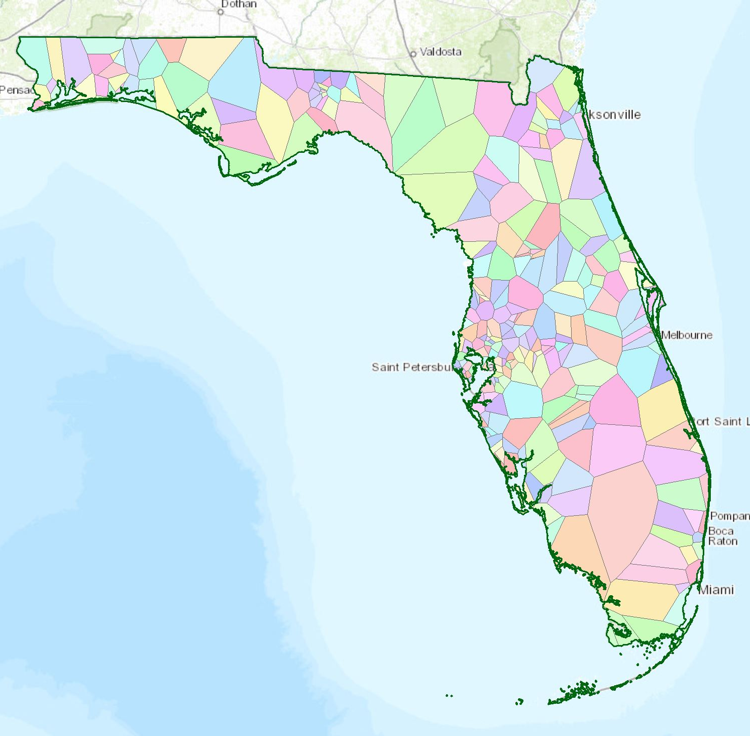
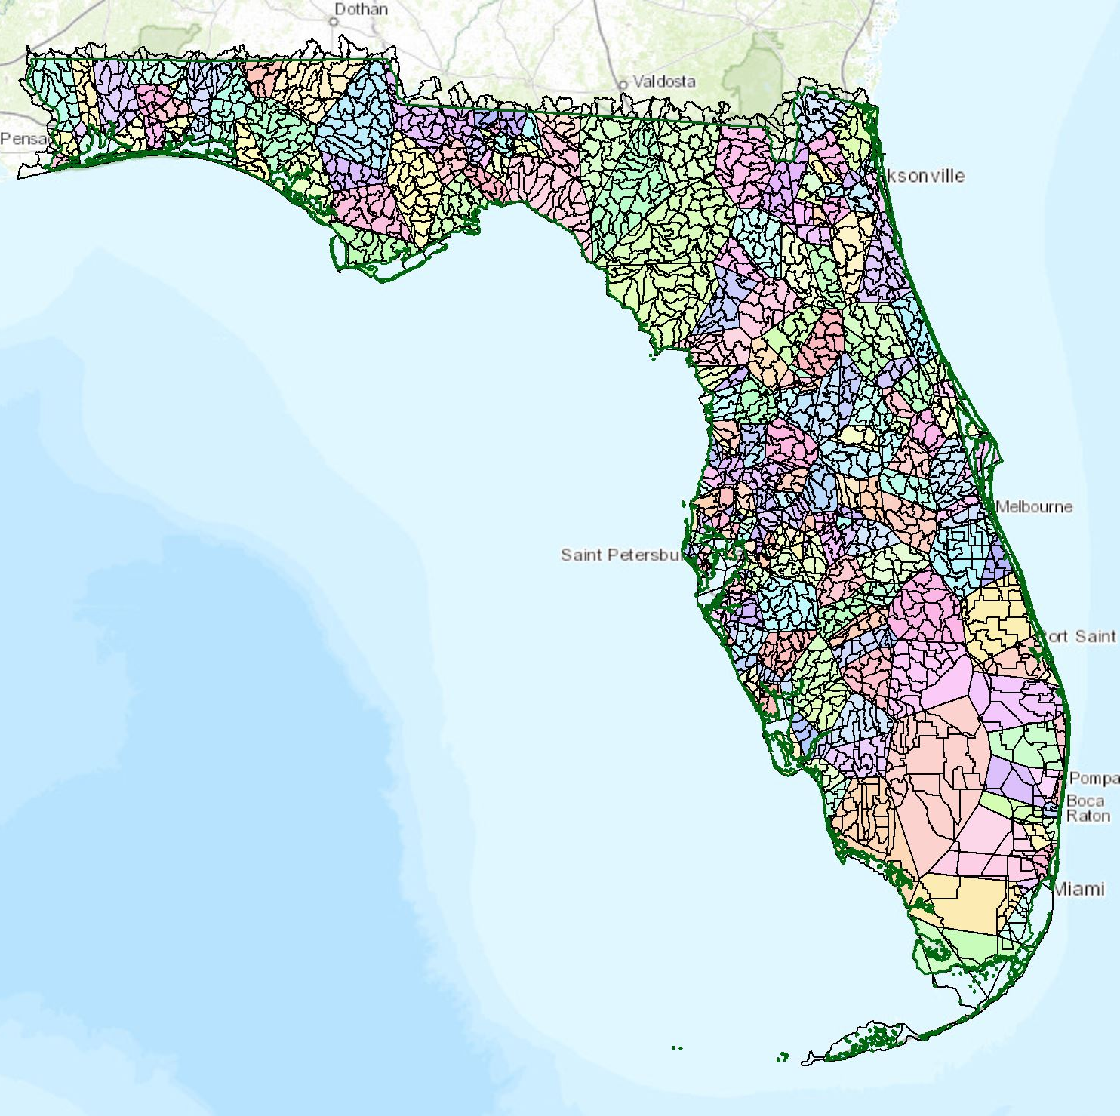
Average precipitation using Thiessen Polygons

Slide 13
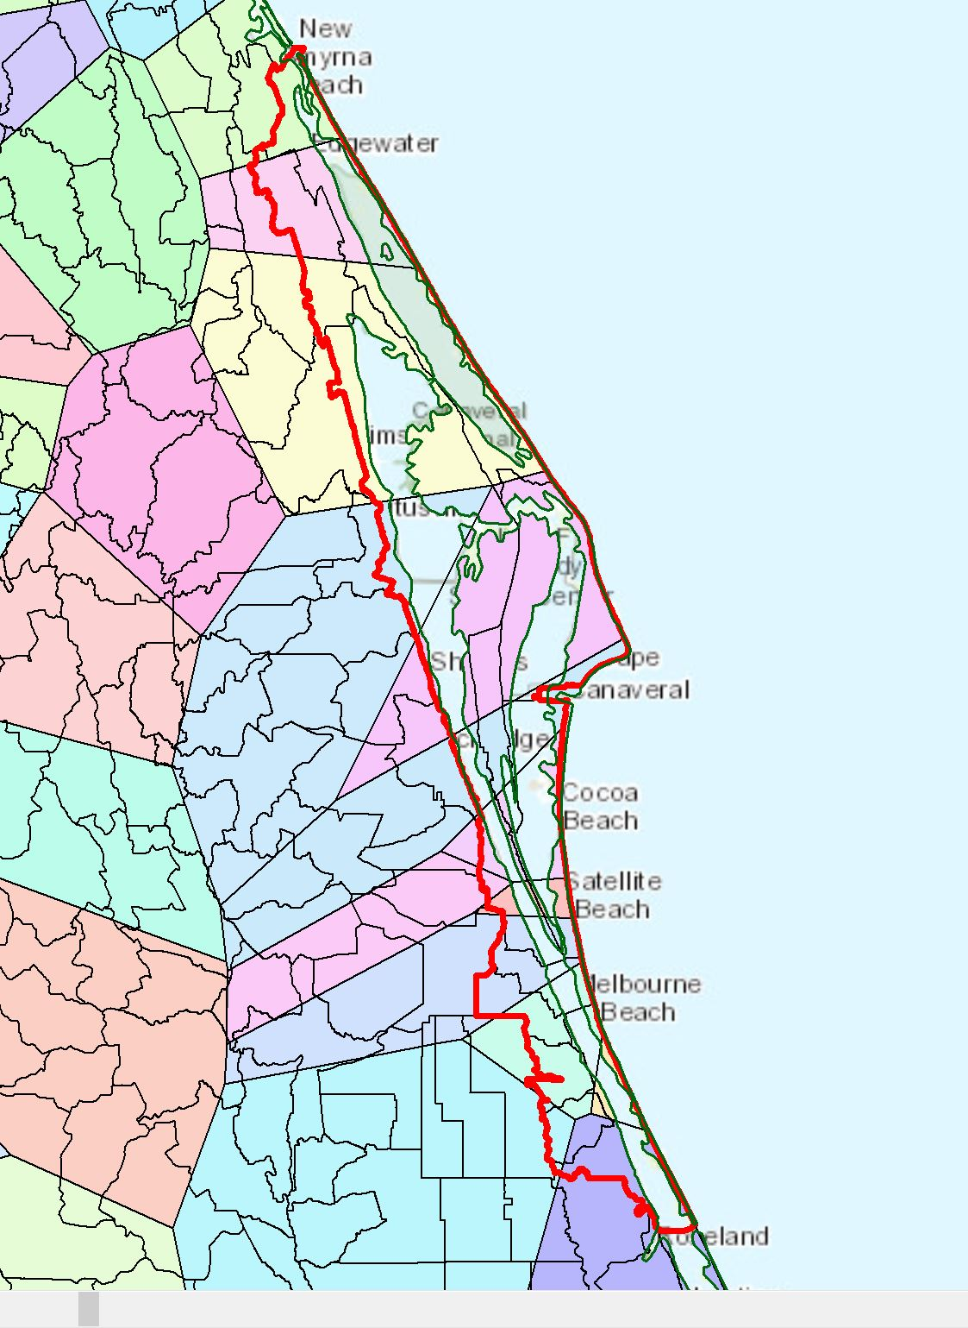
Thiessen Polygons for Brevard

Slide 14
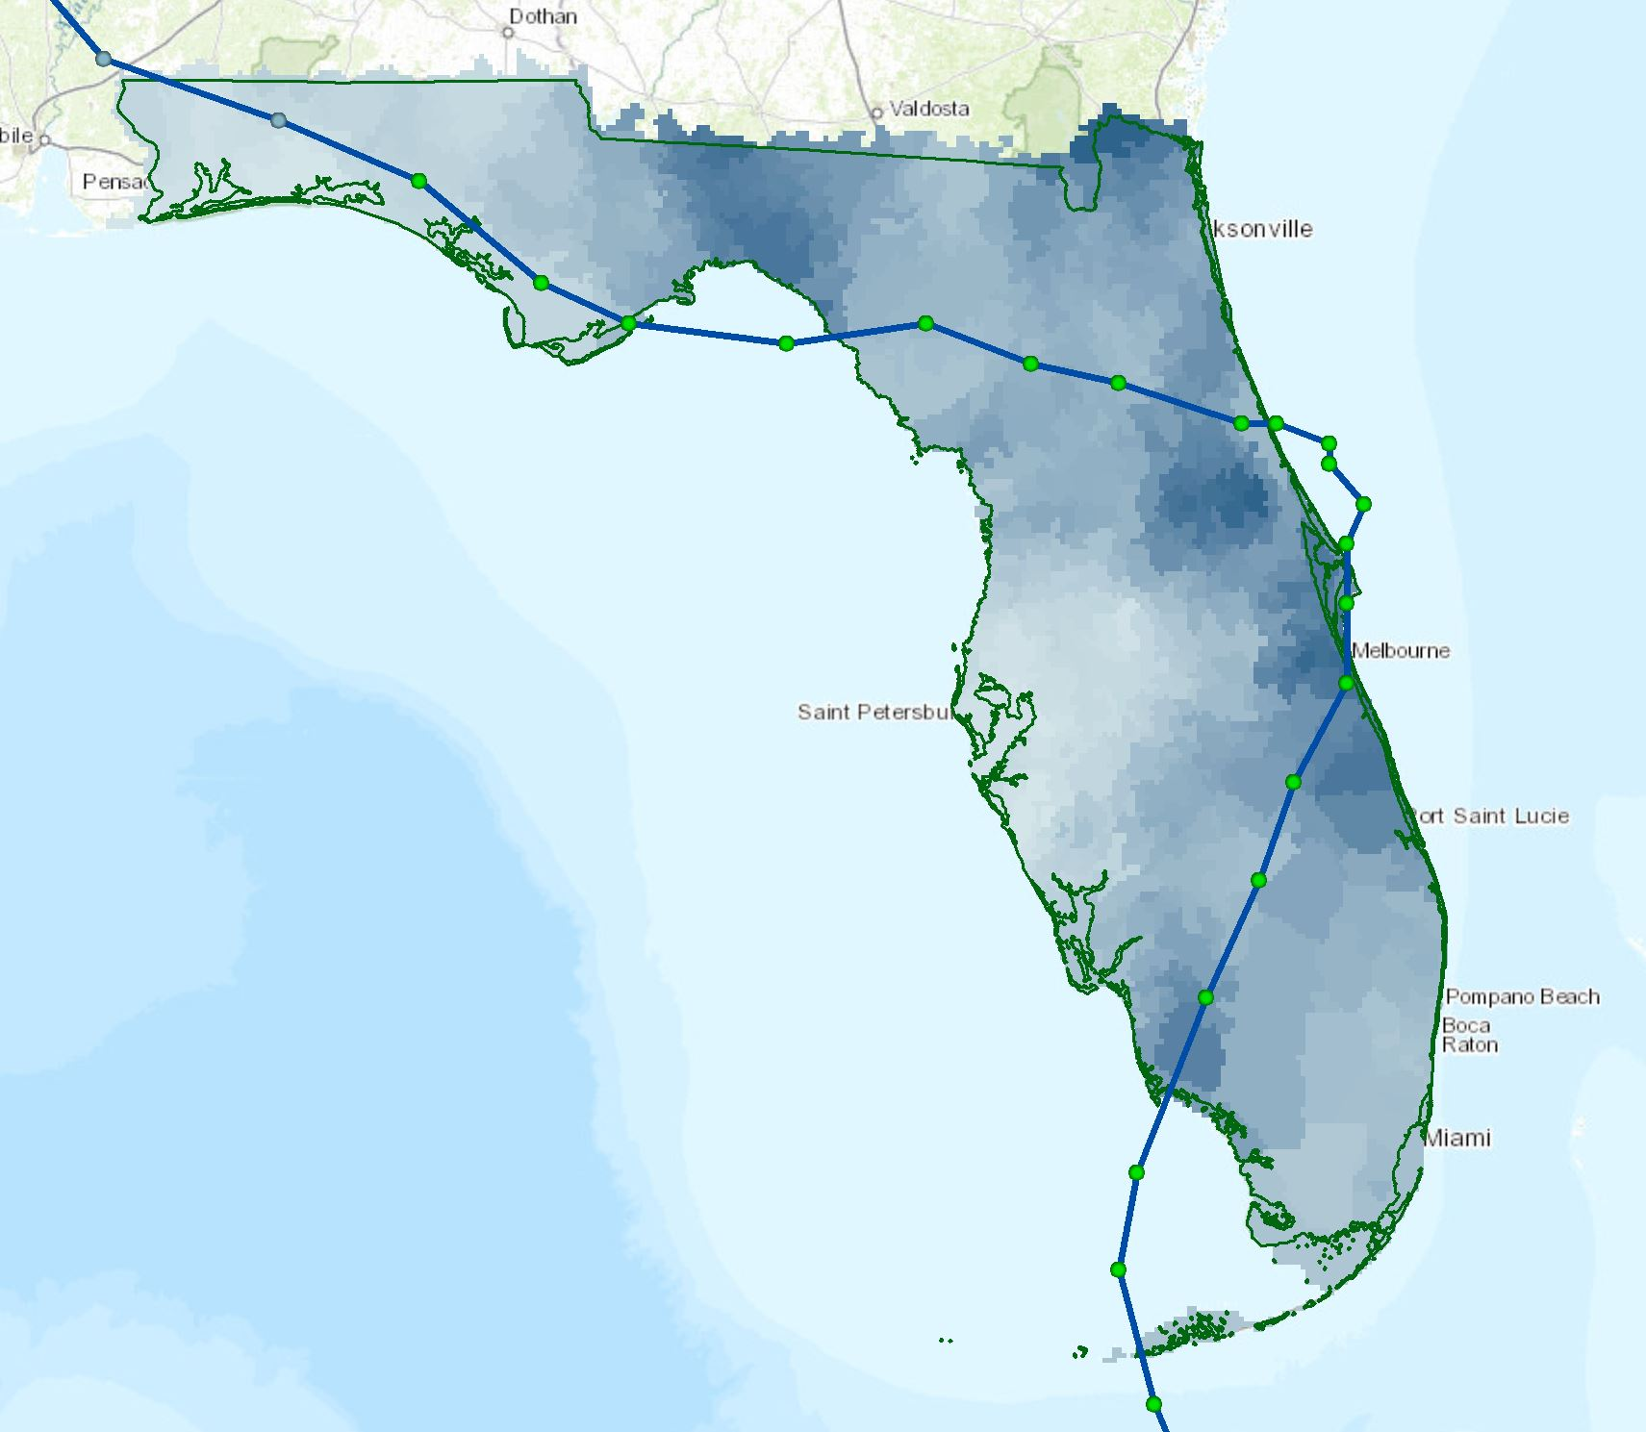
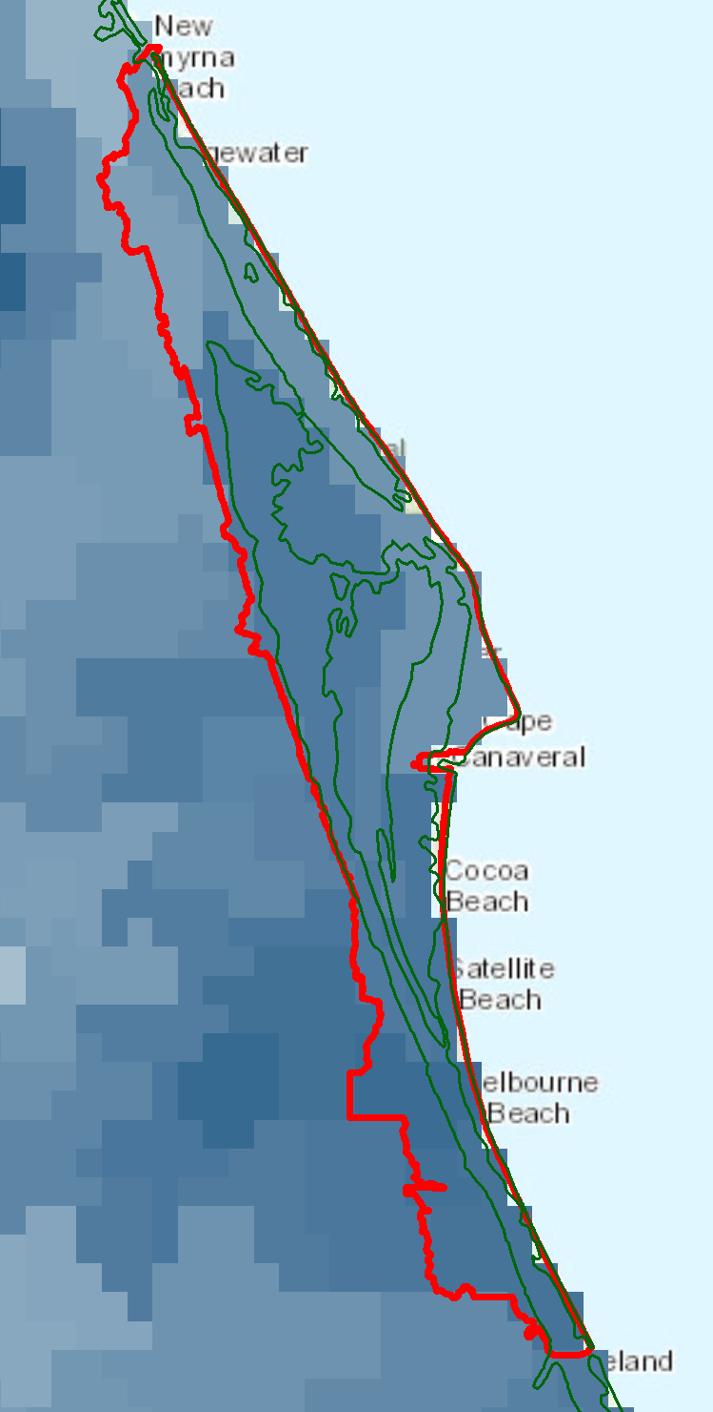
Calculating average precipitation for each watershed
$$P_{i}=\frac{\sum_{k}{A_{ik}P_{k}}}{\sum_{k}{A_{ik}}}$$

Slide 15
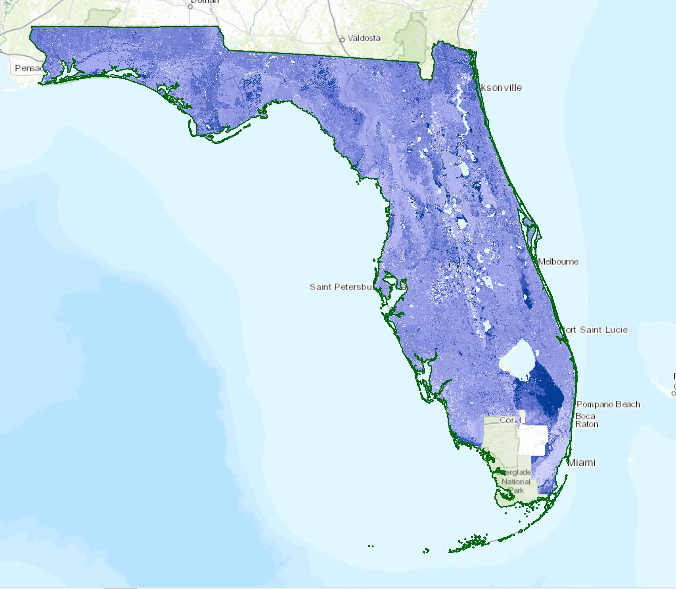
Available soil water storage

Slide 16
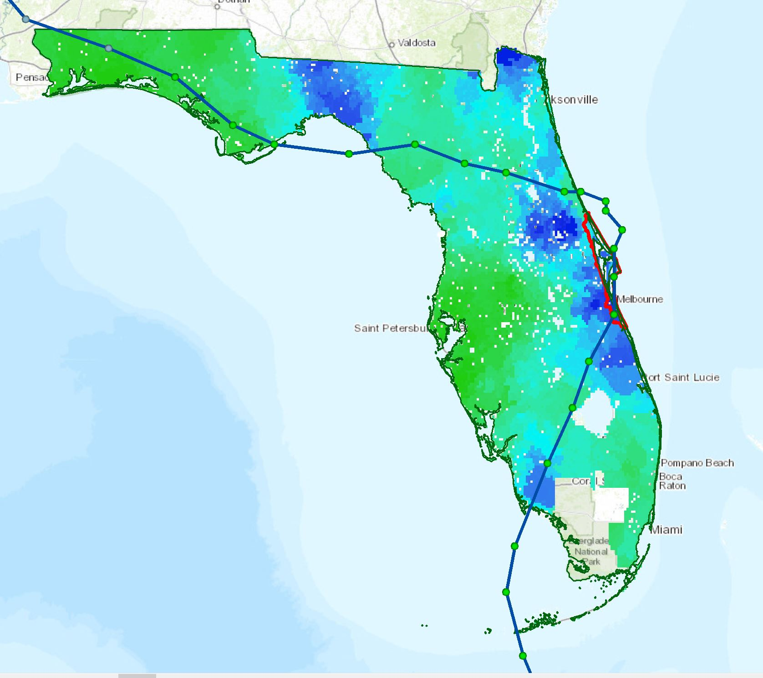
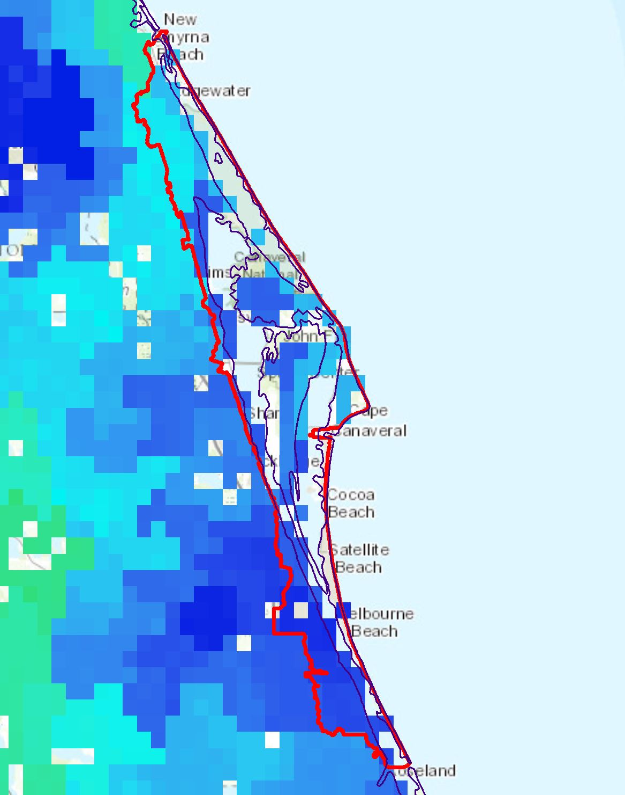
Flood model for Brevard during TS Fay

Slide 17
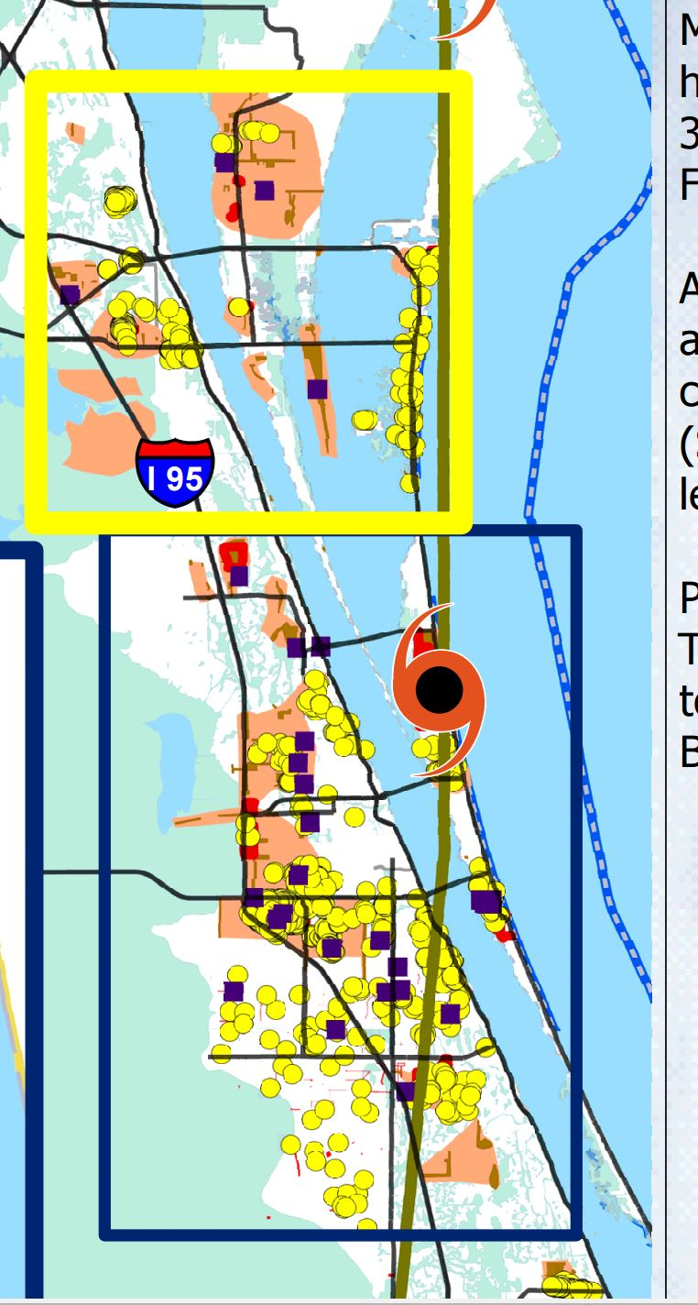
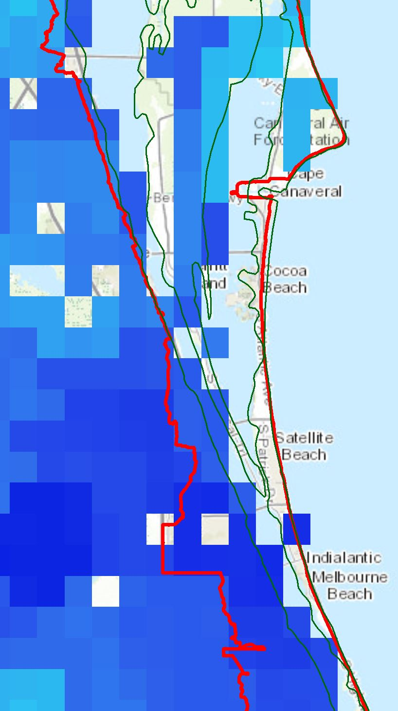
Conclusions
My model matches published data fairly well
With more accurate soil water storage data, I could refine the results even more
HEC-HMS model could show time series of events
Could also consider effects such as:
Elevated stream flow
Storm surge
Pervious surfaces
Elevation and drainage

Slide 18
Questions?
Citations:
http://cocoabeachcondogallery.com/wp-content/uploads/2013/05/IMG_5028-454x332.jpg
http://activerain.com/image_store/uploads/1/1/7/6/4/ar124165770946711.JPG
http://www.wpc.ncep.noaa.gov/tropical/rain/fay2008filledrainblk.gif
https://encrypted-tbn2.gstatic.com/images?q=tbn:ANd9GcSAif9D5fLwxtBFCywr0q92AVlQ4m87Oz_jjF0Iz5TXcCFmoQES
http://www.mynews13.com/content/dam/news/images/2014/10/Week%202/fay-2008-merritt-island-wc.jpg
https://www.google.com/url?sa=i&rct=j&q=&esrc=s&source=images&cd=&cad=rja&uact=8&ved=0CAcQjRxqFQoTCKCtitmzjMkCFVEriAodX-IKiQ&url=http%3A%2F%2Fwww.floridatoday.com%2Farticle%2F20080906%2FNEWS01%2F809060322%2FHurricane-Ike-speeds-up-Category-4&bvm=bv.107467506,d.cGU&psig=AFQjCNGA0u3MQbAVf4hJDTXzeuDaYSgZkQ&ust=1447469882948778
https://upload.wikimedia.org/wikipedia/commons/6/69/Cocoa_Beach_pier_FLAUSA.jpg
https://www.google.com/maps?bav=on.2,or.&bvm=bv.107467506,d.cGU&biw=1280&bih=595&dpr=2.5&q=merritt+island&um=1&ie=UTF-8&sa=X&ved=0CAYQ_AUoAWoVChMIhOXc_7OMyQIVQzuICh1mBAaO
http://www.srh.noaa.gov/images/mlb/surveys/fay/Fayrev2.pdf
http://www.srh.noaa.gov/mlb/?n=fay
file:///C:/Users/Helen/Downloads/Tropical+Storm+Fay+Flood+Damage+in+East+Central+Florida+Region%20(1).pdf

