Slide 1
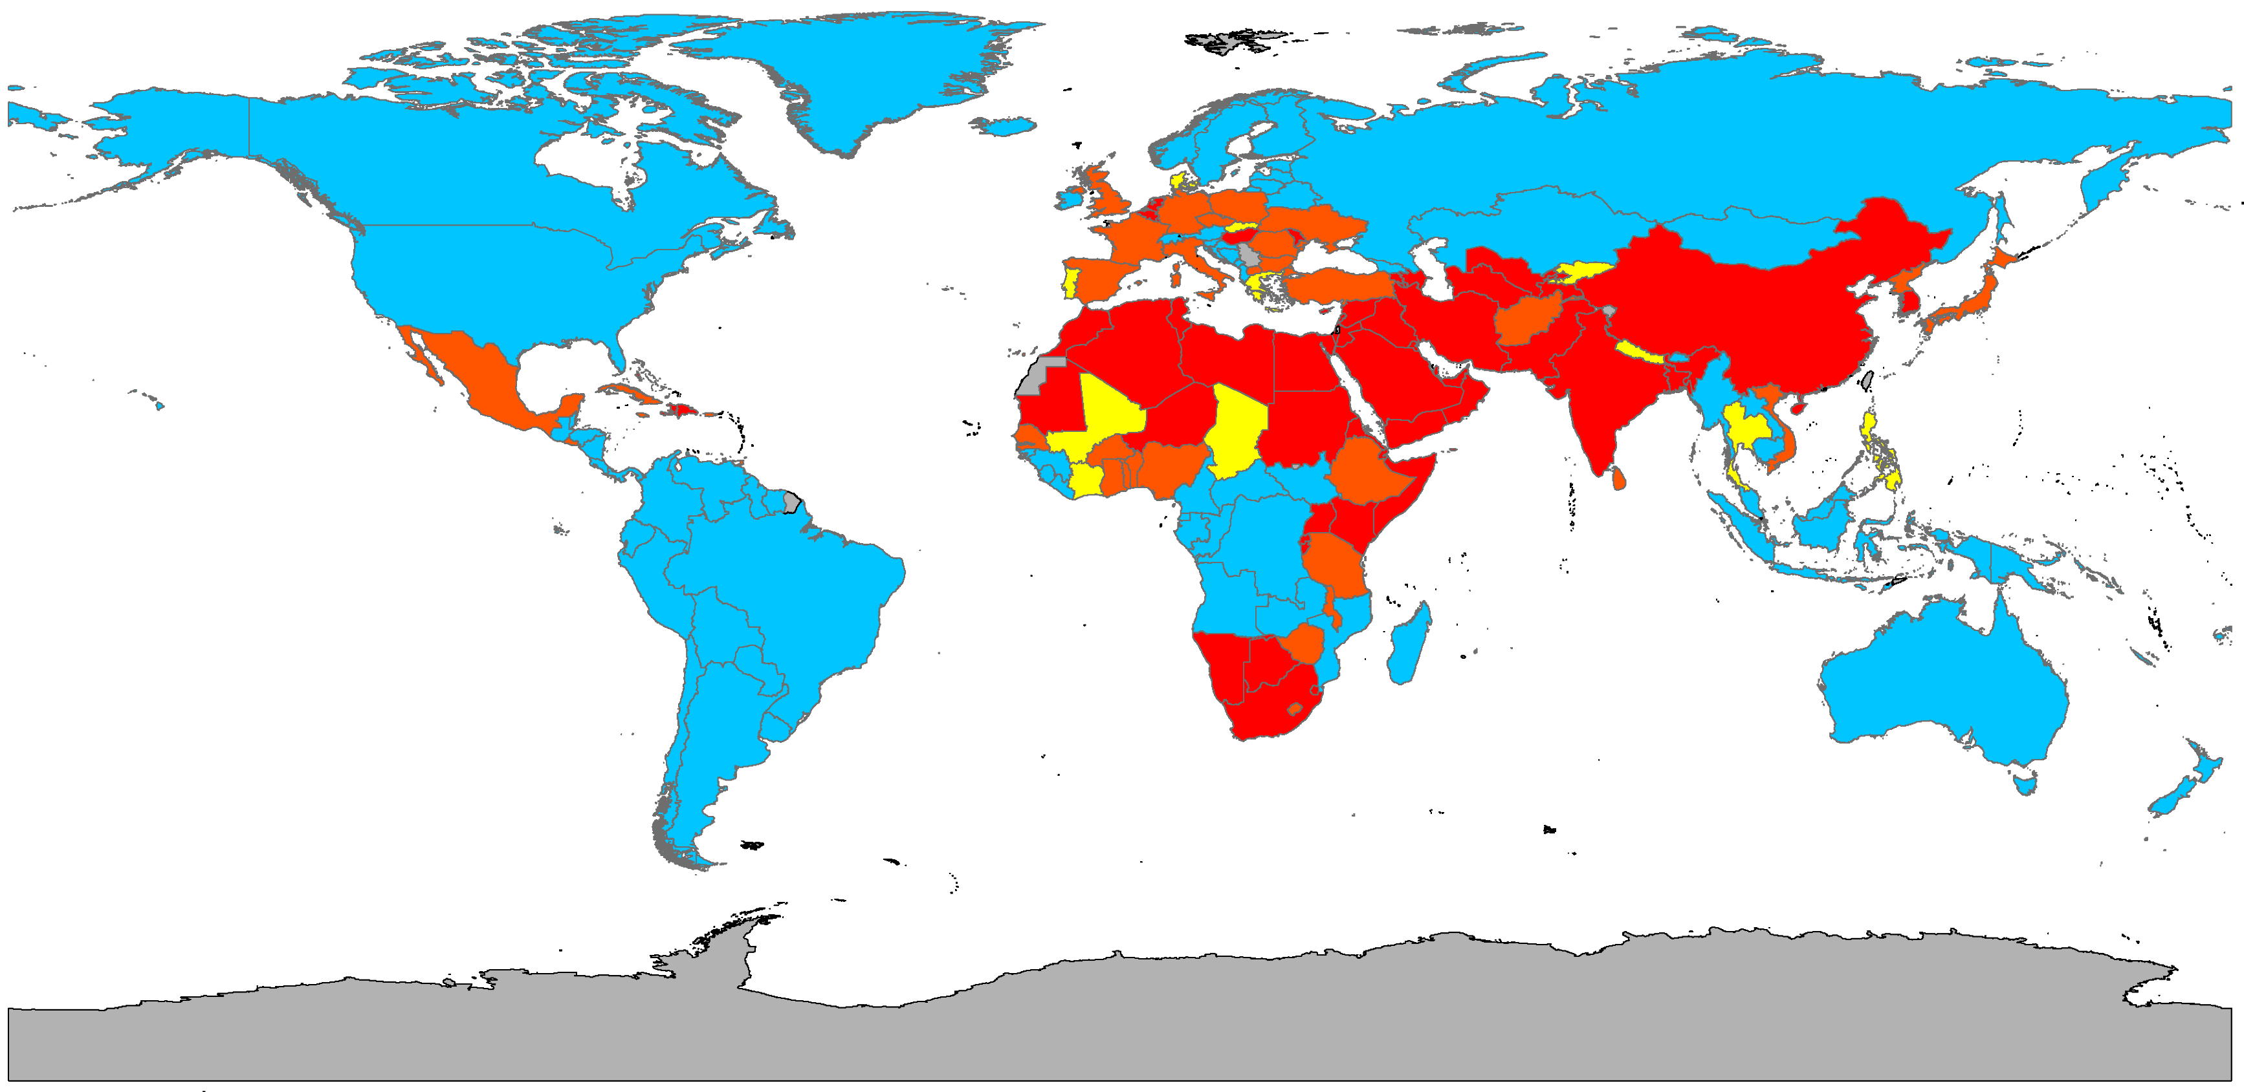
Mapping Global Water Scarcity Indices
By Paul Ruess
November 19, 2015

Slide 2
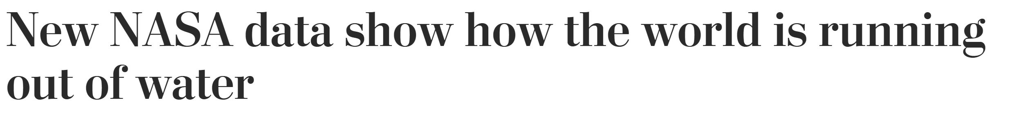
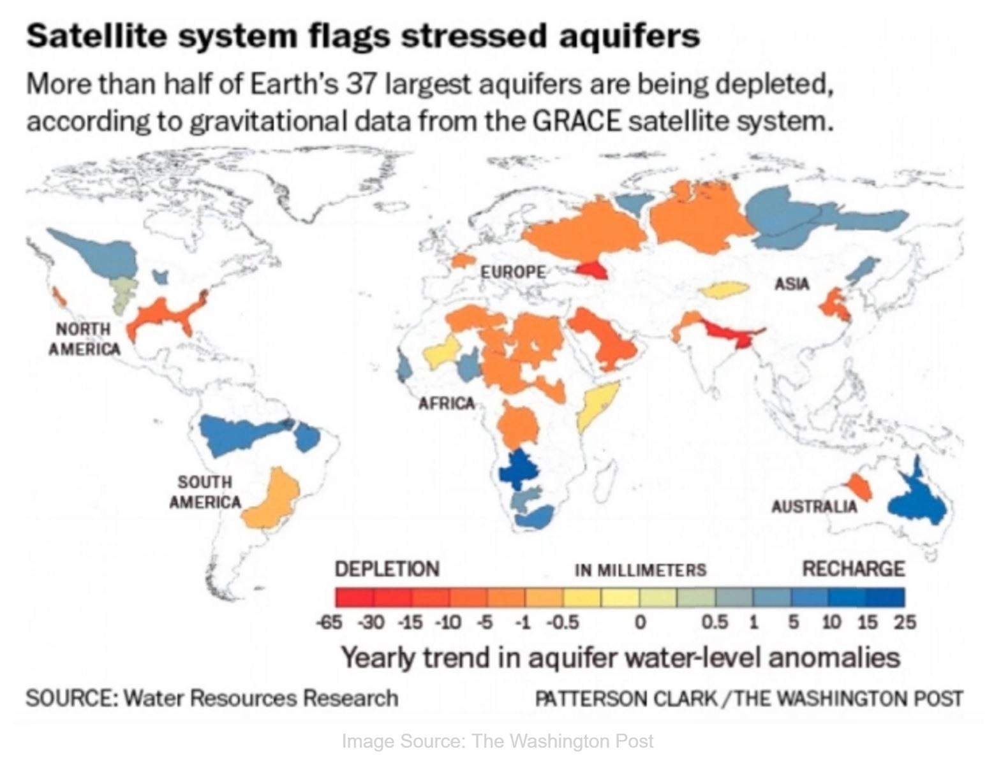
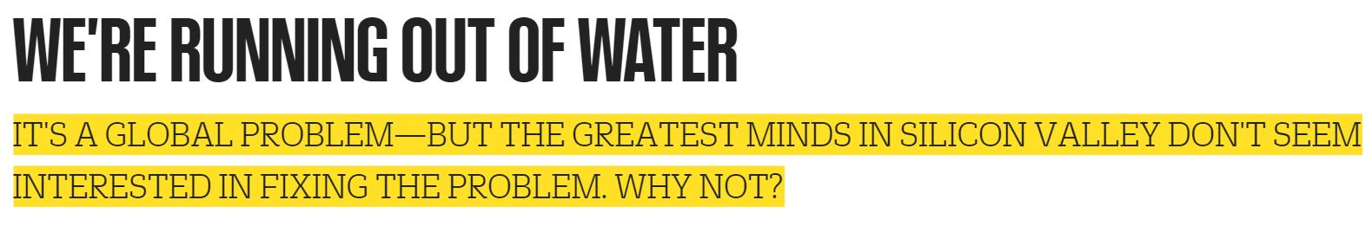
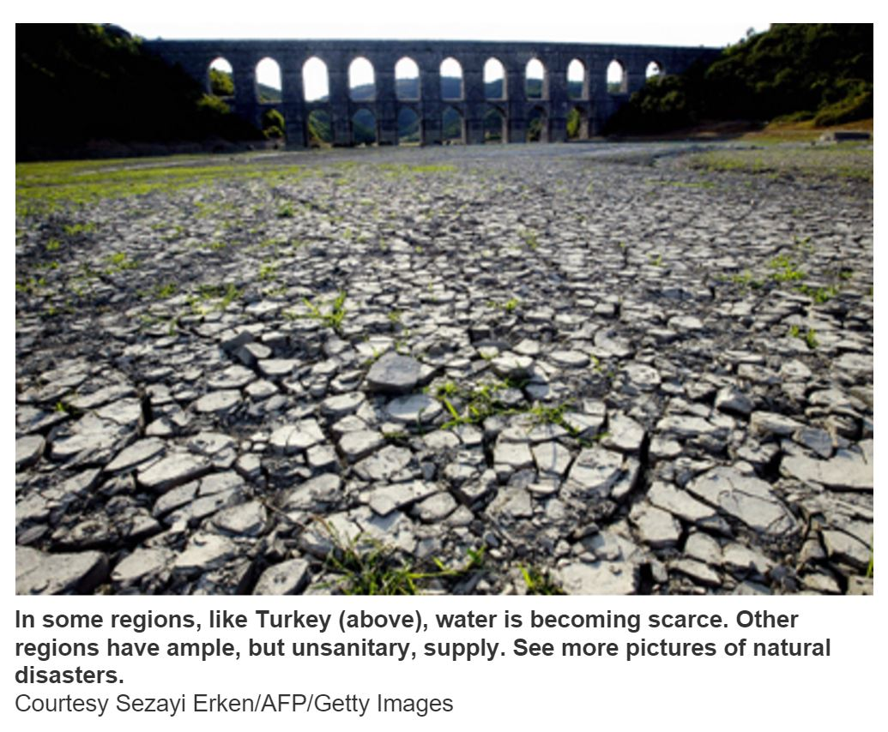
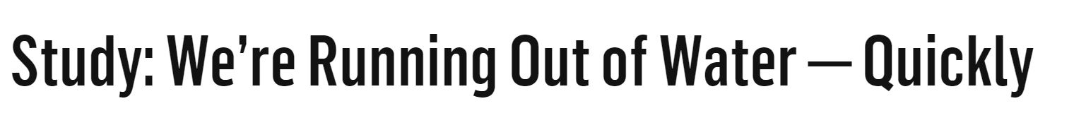

Slide 3
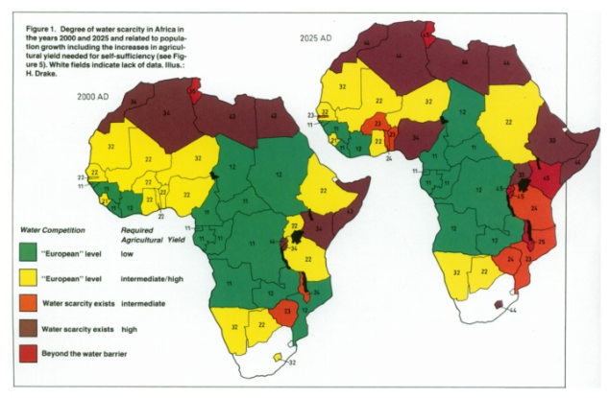
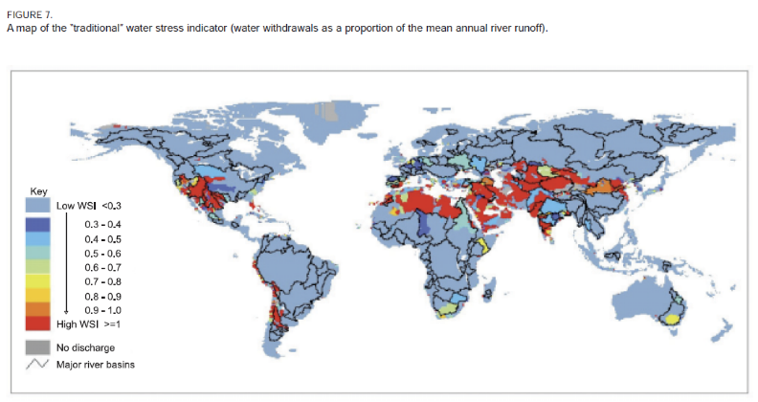

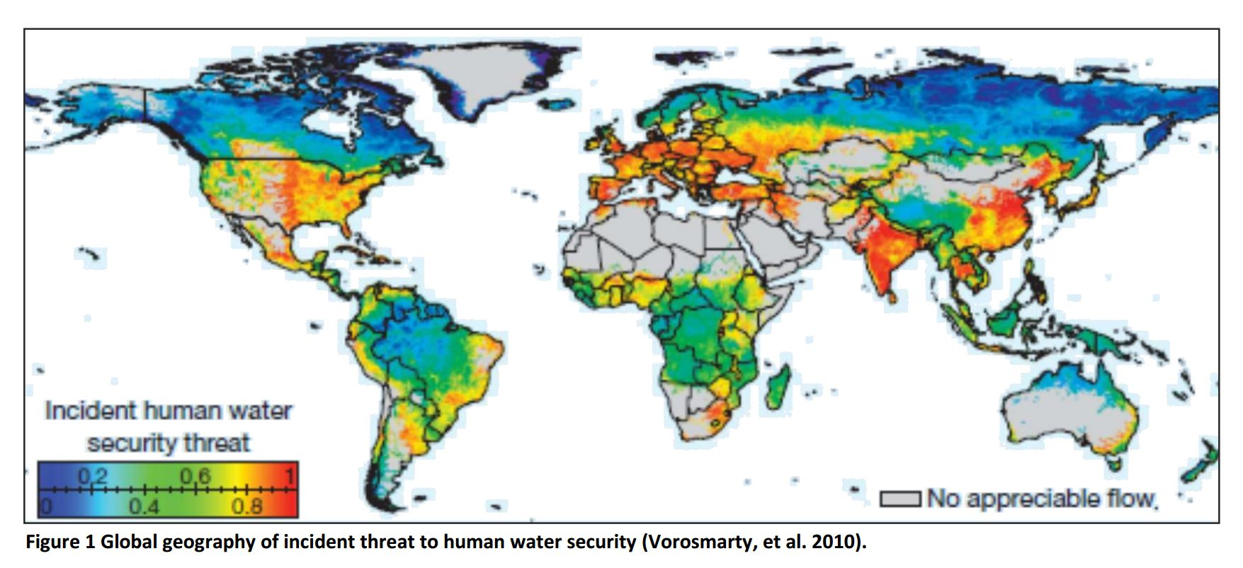
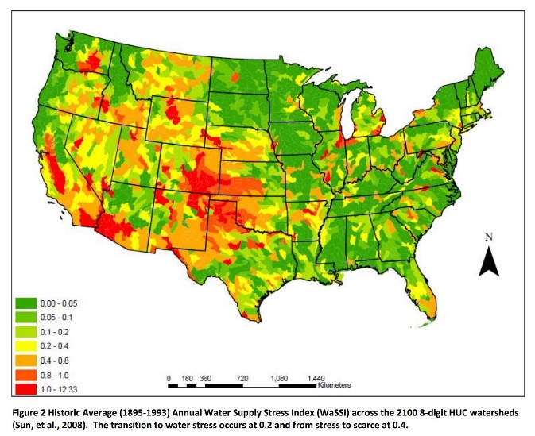
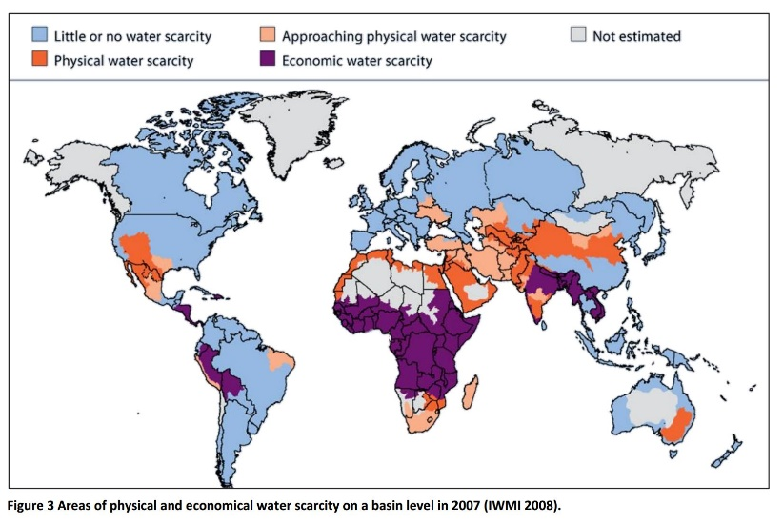
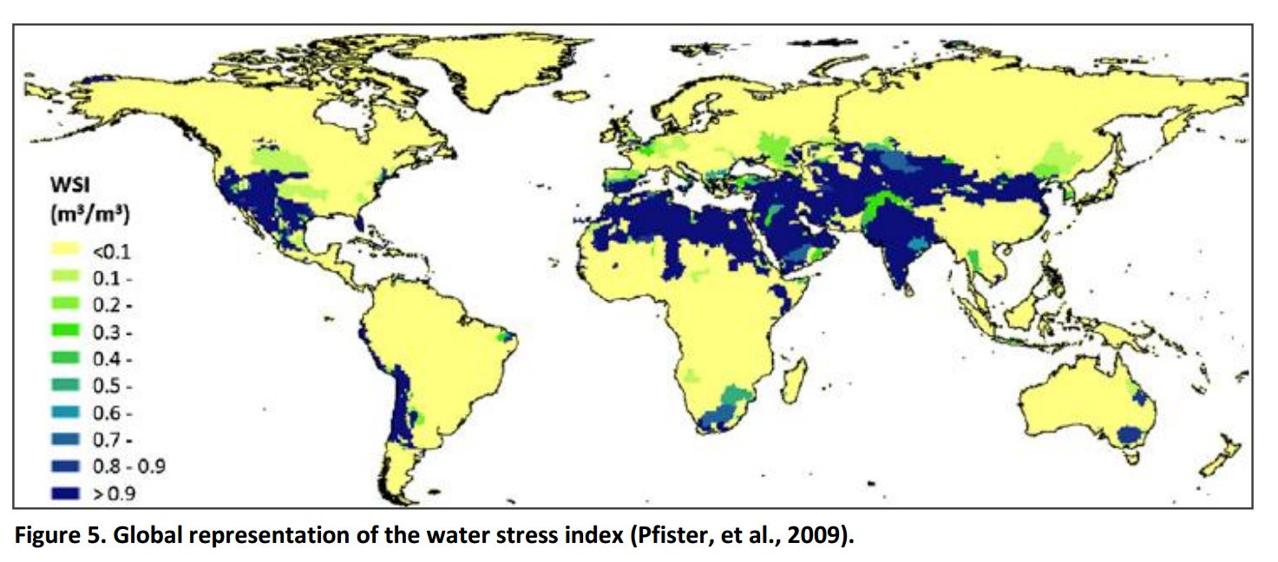
Indices based on Human Water Rights
  Falkenmark Indicator
Water Resources Vulnerability Indices
Indices Incorporating Environmental Water Requirements
  Water Stress Indicator (WSI)
LCA and Water Footprint
Figures taken from Falkenmark, 1989; Smakhtin, 2004; and Brown & Marlock, 2011.

Slide 4

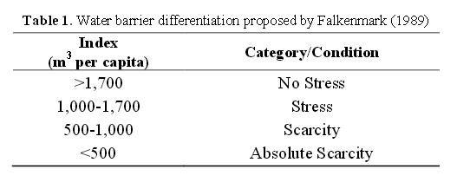
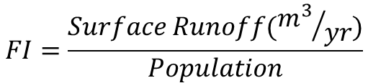
Falkenmark Indicator
“Water (m³) available per person per year”
$$FI=\frac{Surface Runoff({m^{3}}/{yr})}{Population}$$
Notes:
Falkenmark, M. (1989). The massive water scarcity now threatening Africa: why isn't it being addressed?. Ambio, 112-118.
Falkenmark, M. (1990). Rapid population growth and water scarcity: The predicament of tomorrow's Africa. Population and Development Review, 81-94.

Slide 5
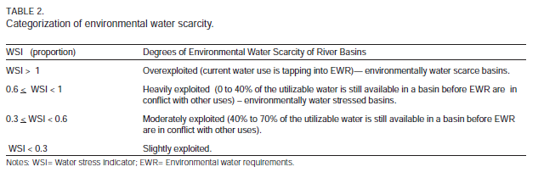


Water Stress Indicator (WSI)
Withdrawals (m³/yr)
MAR: Mean Annual Runoff (m³/yr)
EWR: Environmental Water Requirements (m³/yr)
$$WSI=\frac{Withdrawals}{MAR}$$
$$WSI=\frac{Withdrawals}{MAR−EWR}$$

Slide 6
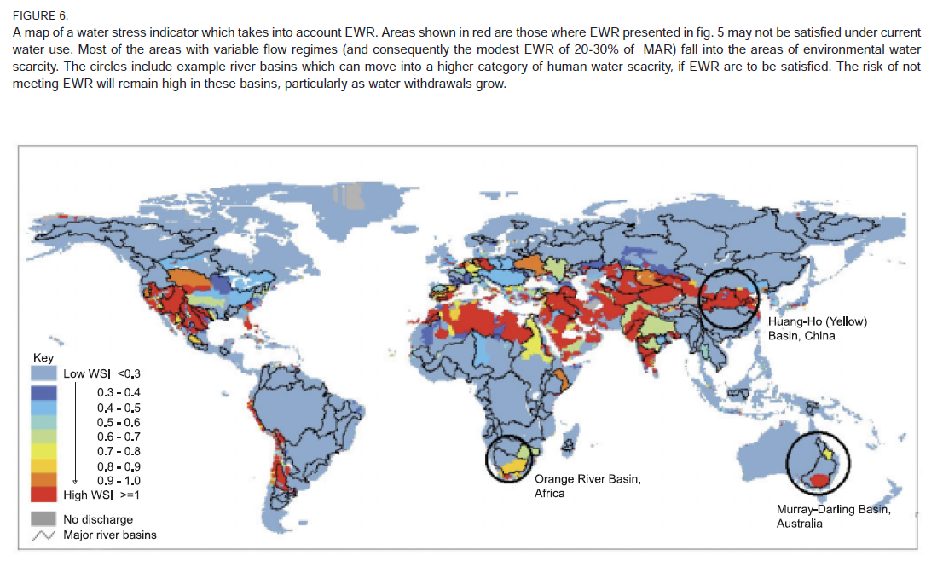



Water Stress Indicator (WSI)
$$WSI=\frac{Withdrawals}{MAR}$$
$$WSI=\frac{Withdrawals}{MAR−EWR}$$
Environmental Water Requirements (EWR) calculated for each area
Watershed boundaries used, as opposed to country boundaries

Slide 7
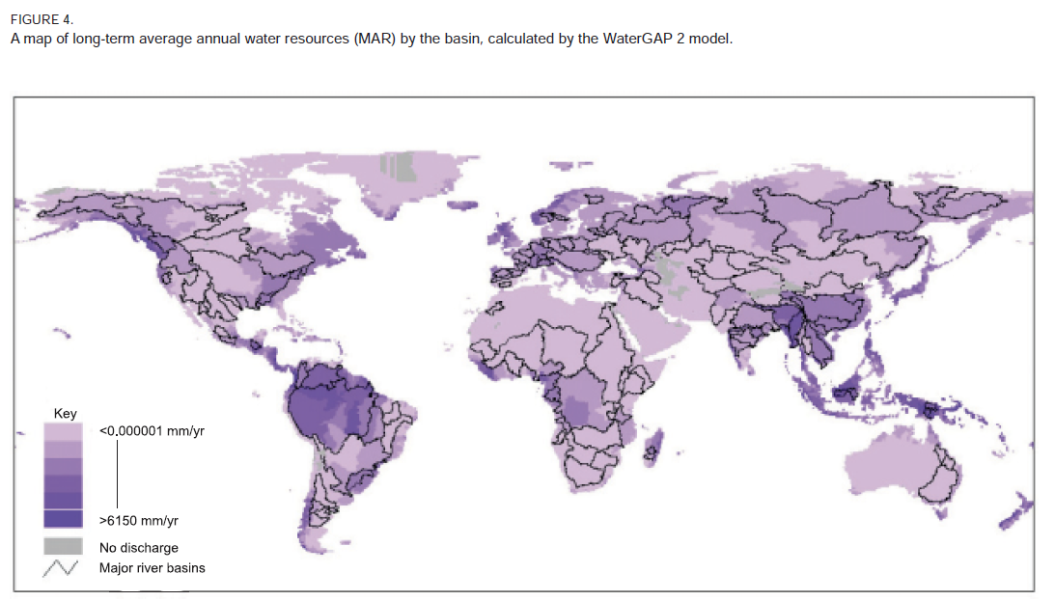
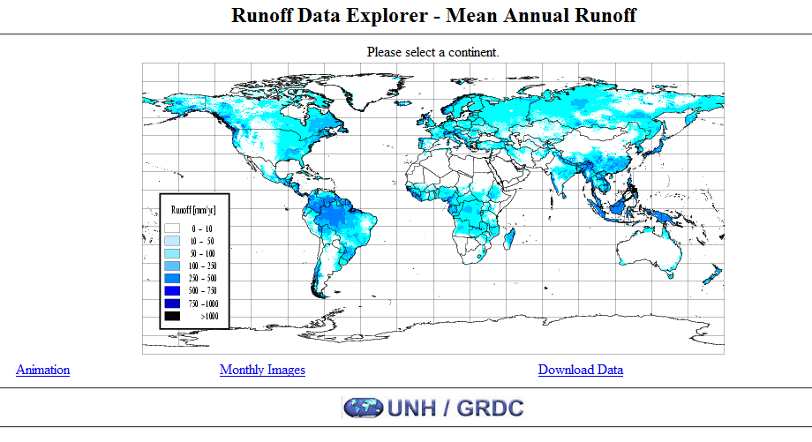
Mean Annual Runoff (Surface Runoff)
Smakhtin used WaterGAP 2.0 model to calculate MAR
MAR provided by the University of New Hampshire and the Global Runoff Data Center (UNH/GRDC).
Notes:
Fekete, B. M., C. J. Vörösmarty, and W. Grabs (2002), High-resolution fields of global runoff combining observed river discharge and simulated water balances, Global Biogeochem. Cycles, 16(3), 1042 - See more at: https://climatedataguide.ucar.edu/climate-data/unhgrdc-estimated-river-runoff#sthash.05NPO4HI.dpuf

Slide 8
UNH/GRDC Data
30-minute resolution (0.5 degrees)
  0.5 degrees = 55,660 meters at equator
  Changes with latitude (39,357 m @ 45°)
  Roughly 3.1 billion m² per area (1.9 million mi²)

Slide 9
UNH/GRDC Data
Plotted MAR using zonal statistics
Created table with MAR values
  Spatial associations
Global population data

Slide 10
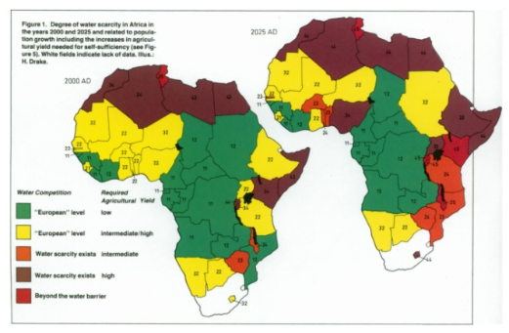
Falkenmark Indicator
Conclusions
Amazon is water scarce
Russia is water scarce
The USA has no data

Slide 11

Falkenmark Indicator (Fixed)
Why is the USA not stressed?
Does not take into account withdrawals!

Slide 12
Withdrawals vs. Population
India and China are high in both areas
USA, Canada, and Russia are higher in withdrawals
Africa is higher in population

Slide 13

Global WSI – 0% EWR
$$WSI=\frac{Withdrawals}{MAR}$$
US more stressed
Europe less stressed

Slide 14

Global WSI – 20% & 50% EWR
$$WSI=\frac{Withdrawals}{MAR−EWR}$$
Is more detail better?

Slide 15
WSI Gradient – 20% & 50%
What about all of the states?

Slide 16
What about the United States?

Slide 19


Next Steps
$$FI=\frac{Surface Runoff}{Population}$$
$$WSI=\frac{Withdrawals}{MAR−EWR}$$
WHERE is change needed?
WHEN is change needed?
Global average of water stress
  If all countries had same FI and WSI, what would those values be?
Compare average value to currently calculated values for each country
Map the acceptable population and acceptable withdrawals for each country
  With globally equalized FI and WSI
Population and withdrawal projections
  1900s, 2000s, 2030, 2050, etc.
  Fit population/withdrawal curves
Calculate which year a country will become water scarce
  Based on FI and WSI parameters
  Assign year values to each country
Map years remaining to scarcity
  Each country has a “scarcity year”

Slide 20
Questions?

