Slide 1
River flow routing using HydroSHEDS for North America
Wen-Ying Wu
Jackson School of Geosciences,
The University of Texas at Austin
Email: wenying@utexas.edu
2016.11.15

Slide 2
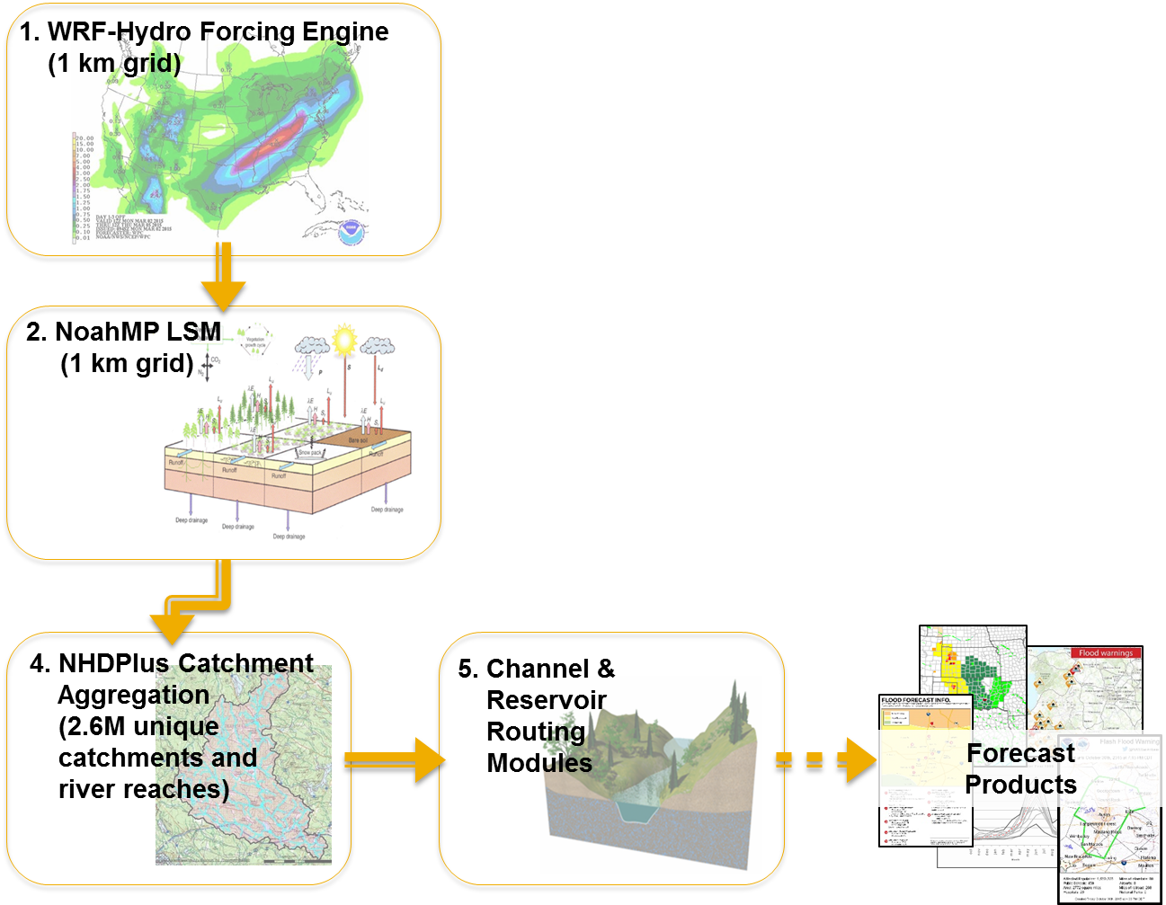
Motivation-National Water Model
Slide from Course of “GIS in Water Resources” by Dr. David Maidment
2.7 million rivers

Slide 3
Our Task- to apply it globally, but first try NA
Historical Runoff Data
HydroSHEDS river network
RAPID
Historical Stream Flow
Output of land surface model
Global converge, but first try NA
River network connectivity information
Inflow of surface and subsurface water to the river network
Some estimation of model parameters

Slide 4
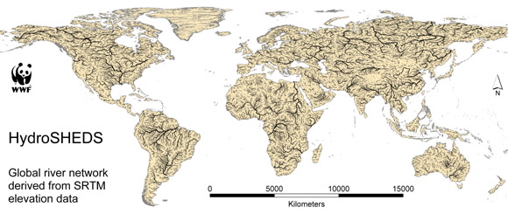
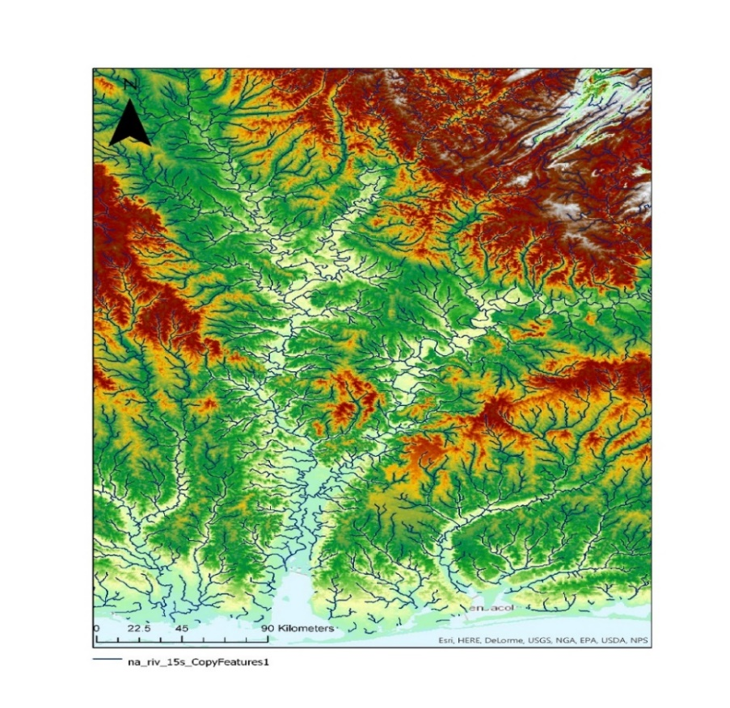
HydroSHEDS
HydroSHEDS
(Hydrological data and maps based on Shuttle Elevation Derivatives at multiple Scales)
15sec GRID: Flow Direction
15sec SHAPE: River Network
approx. 450 meters at the equator
About 46789 rivers in North America

Slide 5
ArcGIS Toolbox for preprocessing river network
Toolbox | Geoprocessing | Purpose
ArcHydro | Generate From/to Node for Lines | Create connectivity of river by morphology
 | Find Next Downstream lines
GIS | Watershed | Define watershed for each stream line
 | Extract Value to Point | Find centroid for each watershed
 | Joint Netcdf for raster
 | Feature to Table
 | Feature to Raster
 | Raster to Polygon
 | Export Table to Excel
 | Polyline to raster
 | Join Field
 | Extract Value to Point

Slide 6
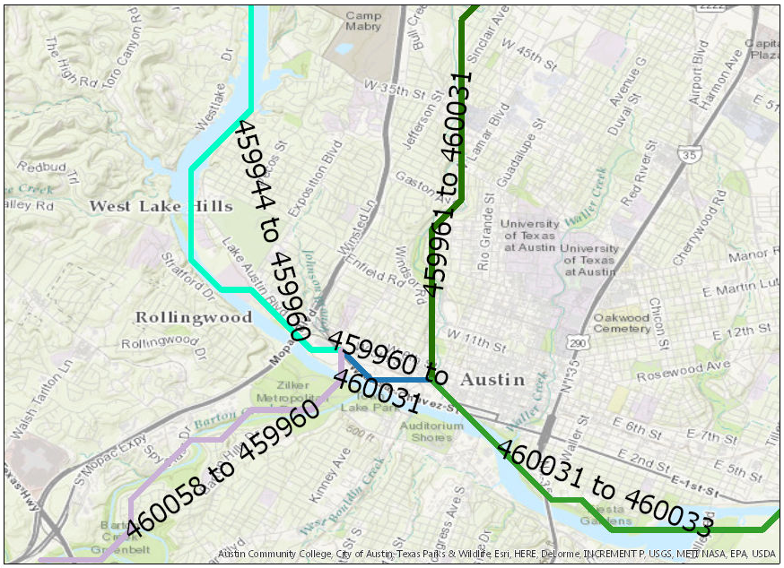
Tool-Generate From/to Node for Lines Find Next Downstream lines
Create connectivity of river by morphology
HydroID NextDownID
459944 459960
459960 460031
459961 460031
460031 460033
460058 459960

Slide 7
Tool-Watersheds, Feature to Point
Watersheds-Define watershed for each stream line(with flow direction)
Extract Value to Point-Find centroid for each watershed

Slide 8
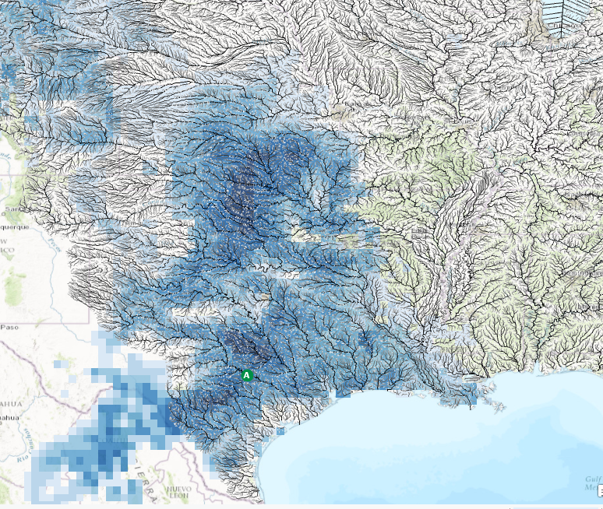
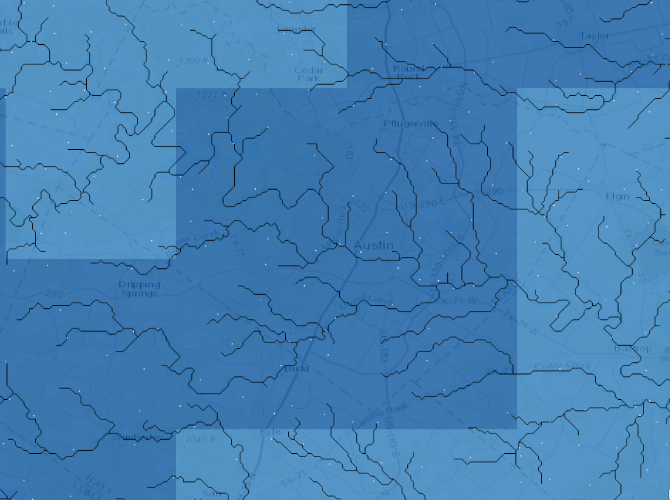
Runoff data
Case: 2015. May Texas Flooding
Model run: 2015.05.15~2015.05.31
Runoff Data:
GLDAS 0.25 degree 3-hourly
(Including surface runoff and surface runoff)
GLDAS Surface Runoff 2015.05.24 00z

Slide 9
RAPID output- all streamline
Streamflow
2015.05.15
2015.05.31

Slide 10
RAPID output-Animation

Slide 11
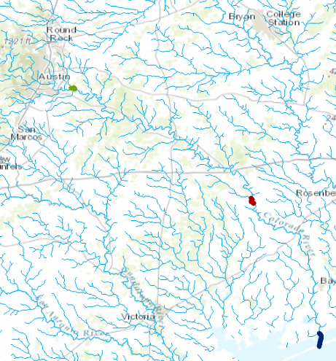
RAPID output-Colorado River Basin

Slide 12
Future work
Evaluate the results with gage station
Longer time period
Other continent

Slide 13
Thanks for listening!
Question?

