Slide 1
GIS In Water Resources C E 394K Impact of Floods to the Bridge Deterioration Process – The case of Onion Creek
Oscar Galvis
Nov 22th
2016

Slide 2
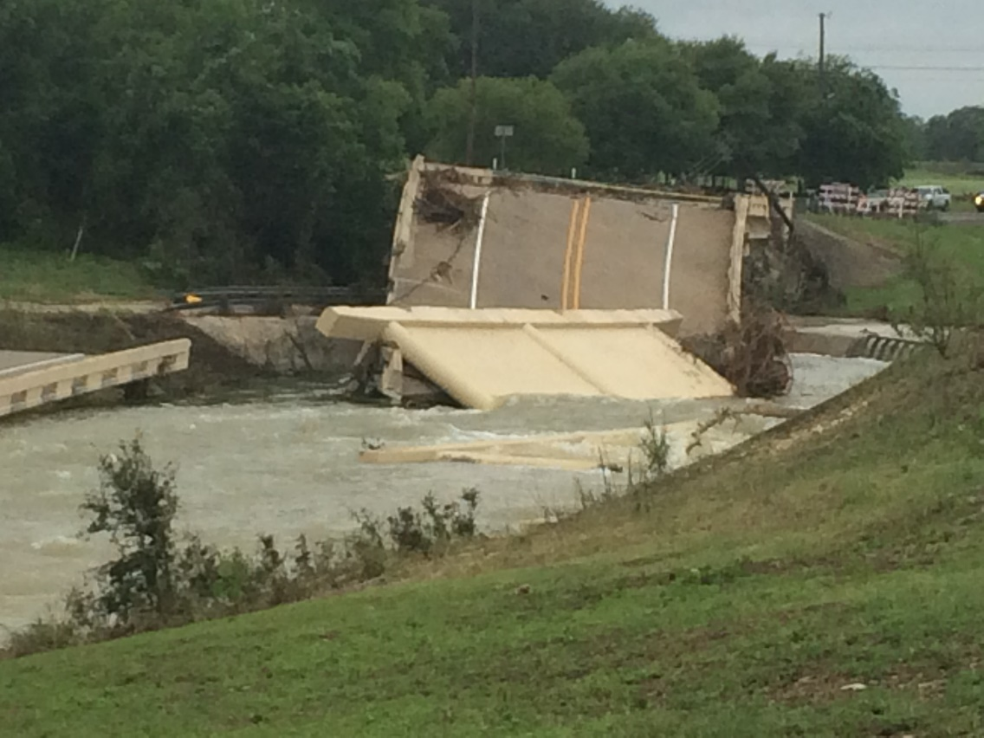
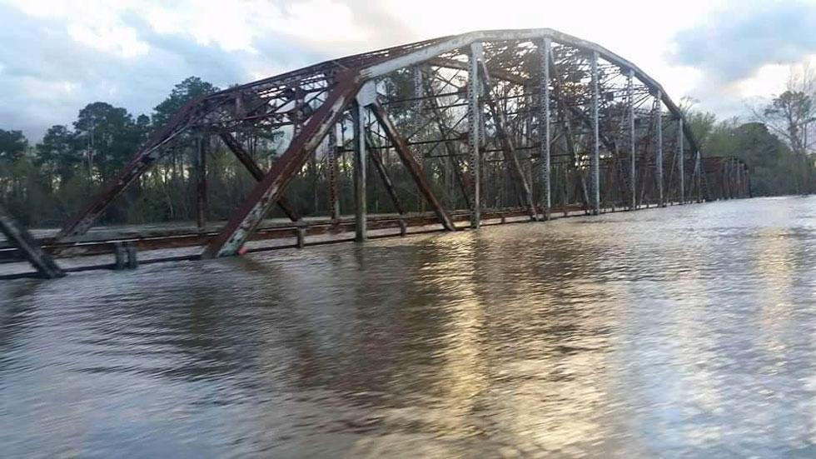
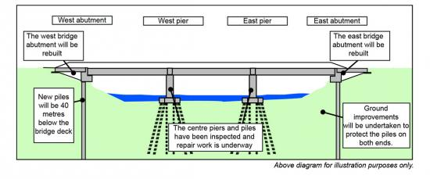
Problem: Floods Impact Bridge “Natural” Deterioration
Overtopping
Impacts on Piers and abutments
And a lot more!

Slide 3
Methodology
Bridge Inventory
Hydrologic Information
HAND Analysis
Bridge Deterioration Due to Floods
Assess Impacts on Bridges
LIDAR Information
Estimate Economic Impact

Slide 4
Case Study: Onion Creek

Slide 5
Inputs
Bridge Inventory
Lidar Information (Thanks to Lukas Godbout)
Height of the Bridges
Hydrologic Information
NHD flowlines
Maximum flow
Wright et al. (2012)
Potential Maximum Flow for 2100

Slide 6
Bridge Deterioration Due to Floods
Overtopping
Inundation height is 90% or more of bridge structure height
Treatment: Replacement
Erosion of Piers Base
Inundation height between 70% - 90% of bridge structure height
Treatment: Increase footing depth

Slide 7
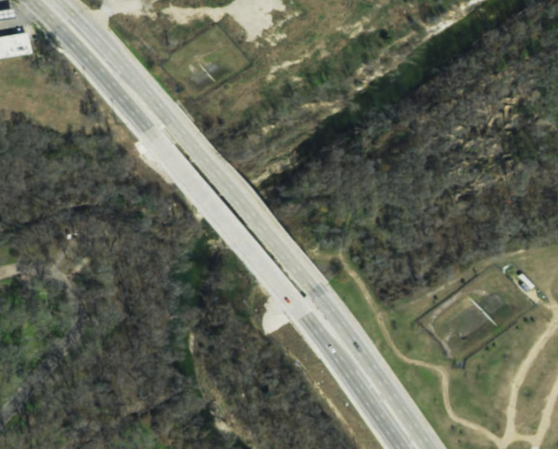
Results
N

Slide 8
Results
Bridge Height = 12 ft

Slide 9
Results
Inundation Height based on Maximum Flow = 14.2 ft

Slide 10
Moving Forward
Automate analysis for more catchments

Slide 11
Thanks you for your attention!
Any questions?

