Slide 1
December 2017
A visualization of Water supply resources in montgomery county, TX
James Bronikowski
EWRE Graduate Student, The University of Texas at Austin

Slide 2
Background
Prolific use of GW wells, 1 surface reservoir
History of regional land subsidence
Creation of Lone Star GCD
District Regulatory Plan

Slide 3
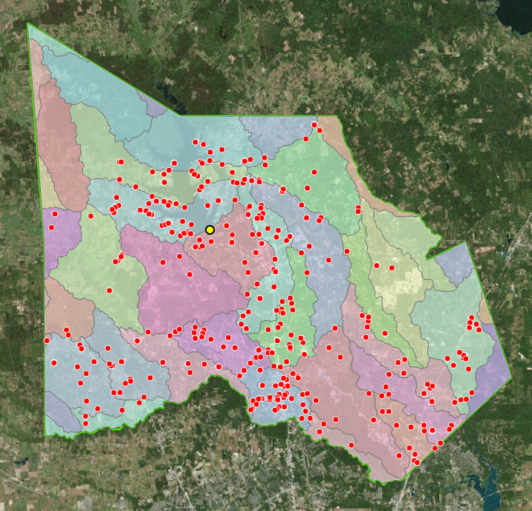
Public Groundwater Wells
400+ PWS wells
~15.7 billion gallons (PWS)
~18.4 billion gallons (Total)
~500,000 people
~507 mi²

Slide 4
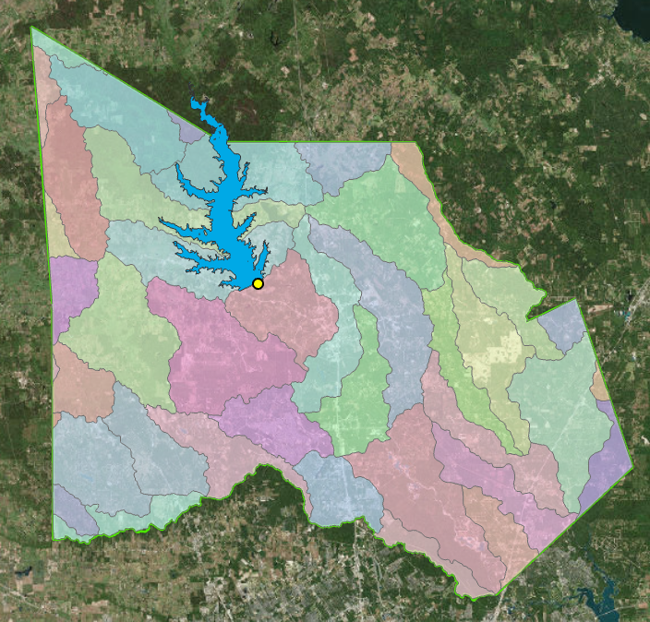
Lake Conroe
Normal Pool@ 201’ above MSL
Up to 100,000 ac-ft/yr under permit (Phased)
Max permitted release = Up to 4’ drawdown in lake level

Slide 5
GCD Regulatory Situation
GW Level reduction of 30% by Jan 1, 2016
200+ PWS in the county
SJRA GRP – Large SW supply project
Over-conversion by large volume users

Slide 7
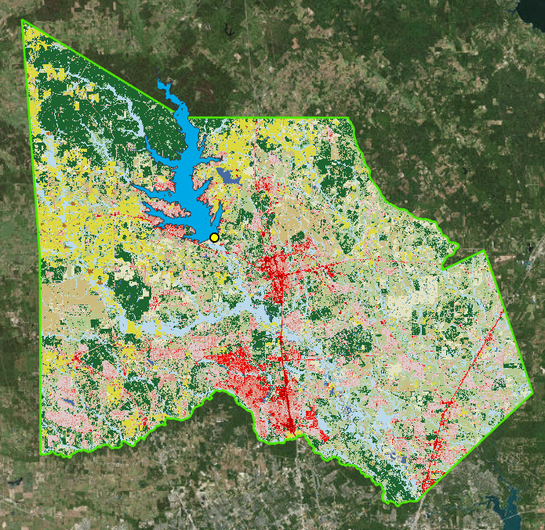
Population & Land Use Trends
Increase in Impervious Cover
2000
2010

Slide 8
Population Trends
2016: ~500,000 people
Over 1 million people within 20 years
Conroe is the largest city (~82,000)
Many small rural communities
Growing lakefront community with various economic levels

Slide 9
Precipitation & Recharge
Precipitation – Relatively Uniform, E➔W Decrease
Recharge Rate – Relatively Uniform, N➔S Decrease

Slide 10
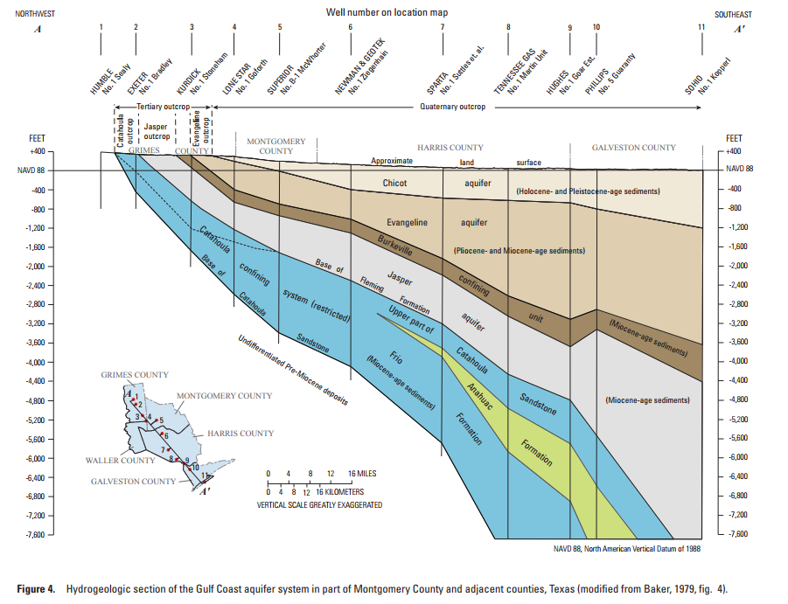
Groundwater Trends
Multiple formations in the Gulf Coast Aquifer
Well depths range from xx’ to XX’
Historical use of Chicot and Evangeline formations
Subsidence effects from overdrafting of these 2 formations

Slide 11
Observations
GW levels are changing (Up/down by location)
Current GW withdrawals do exceed annual recharge rates
Surface Water supply is relatively limited, conservation and AWS must be considered
MAG – How much should be pumped?

Slide 12
Work to be Completed
Elevation/Distance to SW Source
Well density analysis
Water Level changes at monitoring wells (Analyze data file)
Calculate increase in impervious cover

Slide 13
Questions

