Slide 1
Contrasting Detailed and Approximate Floodplain Studies
Matagorda County, TX
CE 394K Fall 2017
Sydney Kase

Slide 2
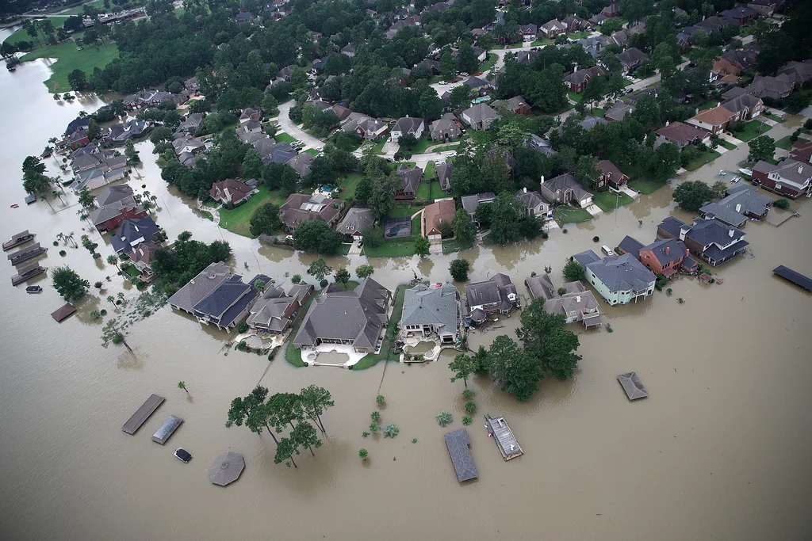
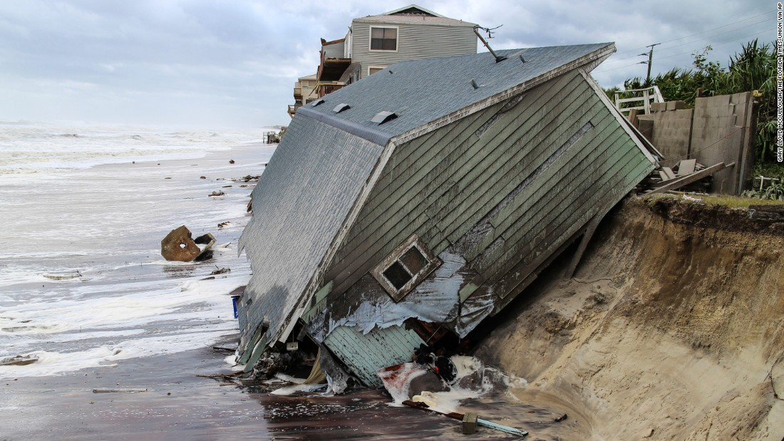
Essential Questions
Why does FEMA create the NFHL and FIRM maps?
Why does it take so long to produce effective floodplain maps?
What does the Qualitative Review process really achieve?
What are the differences between detailed and approximate studies?

Slide 3
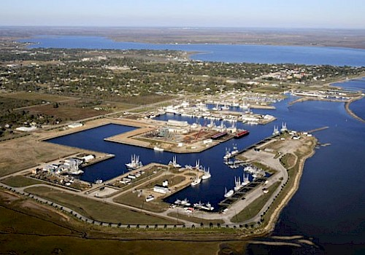
Matagorda County, TX

Slide 4
The Path to new Effective Mapping

Slide 5
Example Timeline

Slide 6
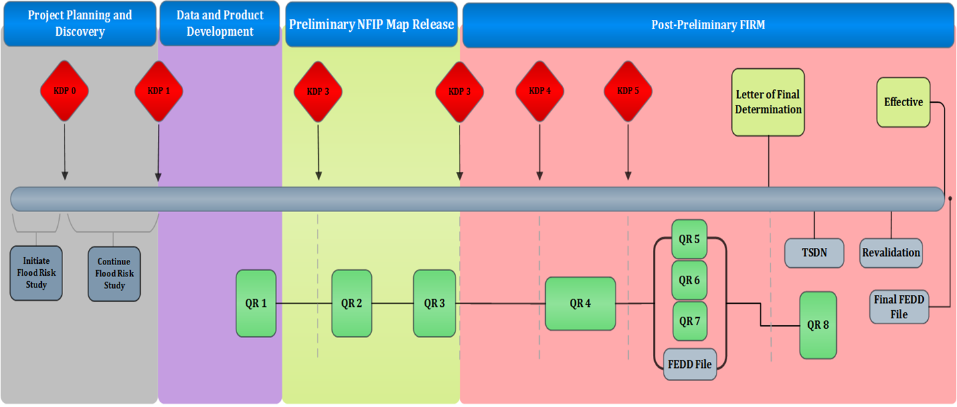
The Qualitative Review Process

Slide 7
Why choose detailed studies over approximate?
Approximate Studies
Detailed Studies
“Best Guess” Method
Less time/labor intensive
Commonly employed in sparsely populated areas
Redelineation of previous inundation on new topography
Base Flood Elevations are used determine inundation extents, but gathered from more informal sources
Contour Interpolation Method
Historical high-water marks
Stream gage data
Account for wave height (coastal)
Models structures (culvert geometry, etc.)
Higher accuracy
Developed outside of GIS software
XP-Swmm
XPstorm
HEC-RAS
HEC-HMS
FLO-2D

Slide 8
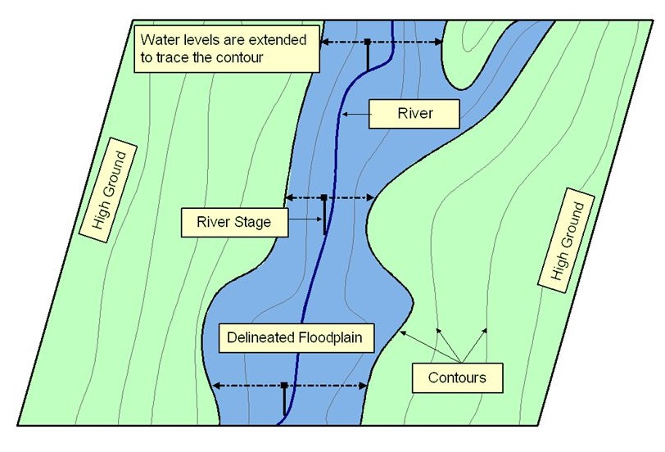
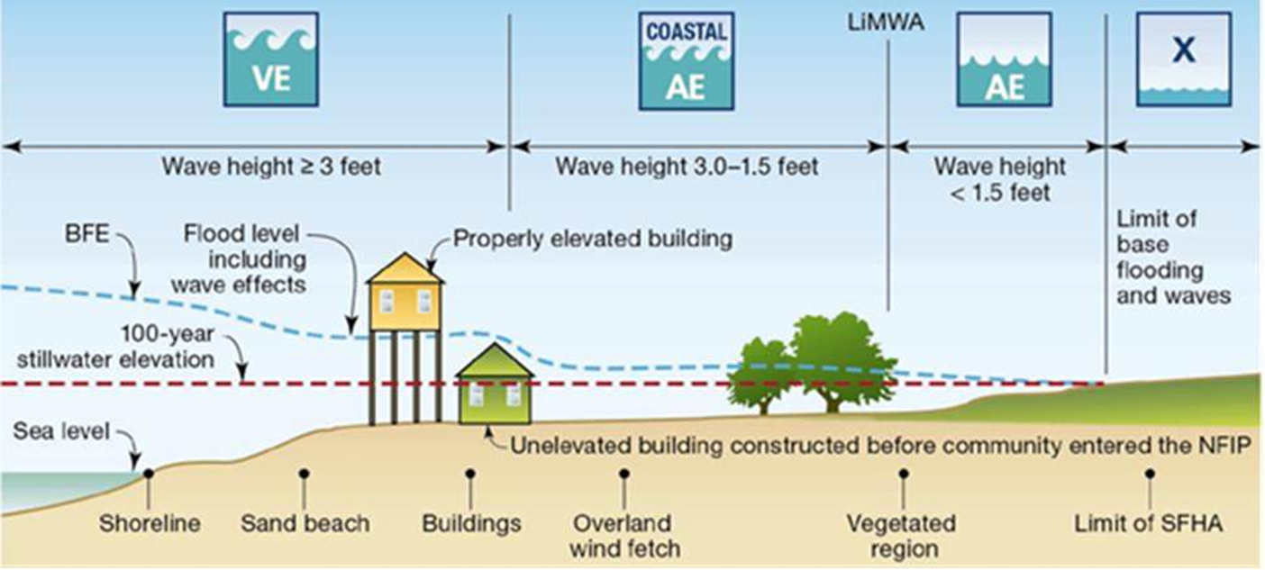
Approximate Modeling Versus Detailed Modeling
Approximate
Detailed

Slide 9
Why choose detailed studies over approximate?
Approximate Studies
Detailed Studies

Slide 10
Comparison

Slide 11
Conclusions
Why does FEMA create the NFHL and FIRM maps?
To warn the public of their flood risk and set flood insurance rates.
Why does it take so long to produce effective floodplain maps?
Meetings, appeals, qualitative review process
What does the Qualitative Review process really achieve?
Catches errors in the data/panels/reports/letters, allows time for a deeper investigation of the material.
What are the differences between detailed and approximate studies?
There are several, but the main differences are:
Accuracy
Time/Cost
Source data

Slide 12
Questions

