Slide 1
December 2018
Social vulnerability during extreme weather events
Using The Visible Infrared Imaging Radiometer Suite (VIIRS) DNB Satellite Imagery as an Estimation Tool for Socio-Economic Factors
MATTHEW PREISSER
Dual Master’s Degree Student Public Affairs and Environmental & Water Resources Engineering

Slide 2
Overview
Motivation
Literature Review
Study Area
Methodology
Results: Social Vulnerability
Results: Satellite Imagery Analysis
Future Research

Slide 3
Motivation
Frequency of extreme weather events
Social vulnerability varies across populations
Census Data is extremely costly
Needs of US and International Governments
Notes:
2010 census cost 13 billion dollars
Expressed desire from numerous agencies to incorporate near real time socioeconomic factors in disaster prediction tools

Slide 4
Literature Review
Using satellite imagery for socioeconomic predictions is emerging area of study
Correlations with population density, GDP, poverty, power consumption, CO emissions
Notes:
Visible Infrared Imaging Radiometer Suite (VIIRS) Day Night Band

Slide 5
Notes:
Applications to countries and regions that do not have accurate census data, but for the sake of this project keeping it local

Slide 6
Methodology
Social Vulnerability
Fuzzy Logic
HAND Analysis
Census Data
Satellite Imagery Analysis
VIIRS DNB Comp.
R Studio
Correlate with Population Estimates

Slide 7
Social Vulnerability and Fuzzy Logic
Overlay analysis technique
Population, Age, Income, and Unemployment (tract level)
HAND Analysis for flooding threat
Model Builder for repeatability
Notes:
It scales everything on a 0 to 1, popular for datasets that have inaccuracies in their attributes and geometry
Median age and median household income

Slide 8
Notes:
Began to go through the validation process and comparing some of the tracts with known vulnerability data online. Census tract 2125 which is on the east side of Houston, and the poverty rate is nearly double that of Harris county, nearly half the children under the age of 18 live in poverty. Listed as one of the least vulnerable.
Census tract 2101, which is the most immediate downtown tracts, has average aged citizens (around 31) has a median income of 4 times that of Houston, and no one living in poverty.
There are a lot of ways to adjust this kind of model such as putting a heavier weight on the hand analysis, or other environmental factors.

Slide 9
Satellite Imagery
Notes:
Looked at the Metropolitan Statistical areas to start

Slide 10
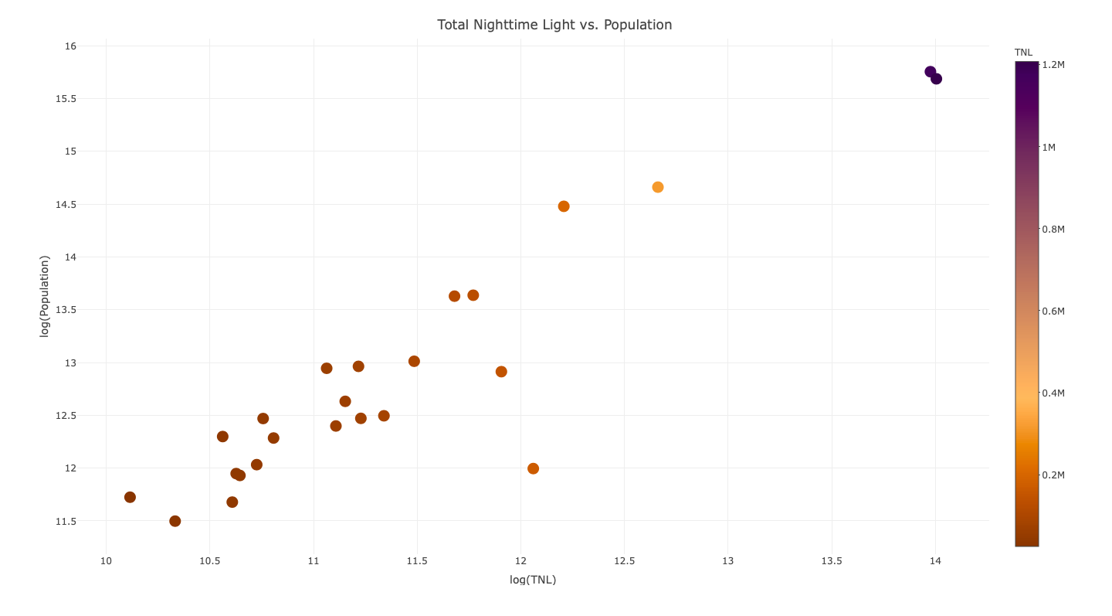
Notes:
R2 of 0.85 (88% of all Texans live within 88 counties that make up these MSAs)

Slide 11
Future Research
Application to countries with little to no census resources
Incorporate other satellite imaging datasets
Satellite data resolution analysis

Slide 12
Questions?

