Slide 1
Watershed Delineations
A watershed delineation comparison between the USGS method and the ESRI Ready-to-Use method
Emily Pease
Masters Student, Energy and Earth Resources
(USGS Hydrologist)

Slide 2
Background:
Current USGS method:
Tedious
Computationally expensive
Time-consuming
Accurate
Reliable
ESRI’s Ready-to-Use method:
Quick-and-easy
Computationally inexpensive

Slide 3
Background:
Current USGS method:
Tedious
Computationally expensive
Time-consuming
Accurate
Reliable
ESRI’s Ready-to-Use method:
Quick-and-easy
Computationally inexpensive
Accurate??
Reliable??

Slide 4
Is the ESRI Ready-to-Use tool reliable?
Could it serve as a replacement for the current USGS method?

Slide 5
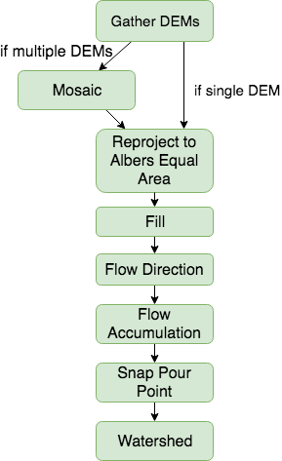
Workflow (USGS Method)

Slide 6
Workflow (USGS Method)
TOTAL TIME = 1 HOUR TO 10+ HOURS DEPENDING ON SIZE

Slide 7
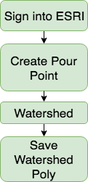
Workflow (ESRI Method)

Slide 8
Workflow (ESRI Method)
TOTAL TIME = 10 mins or less

Slide 9
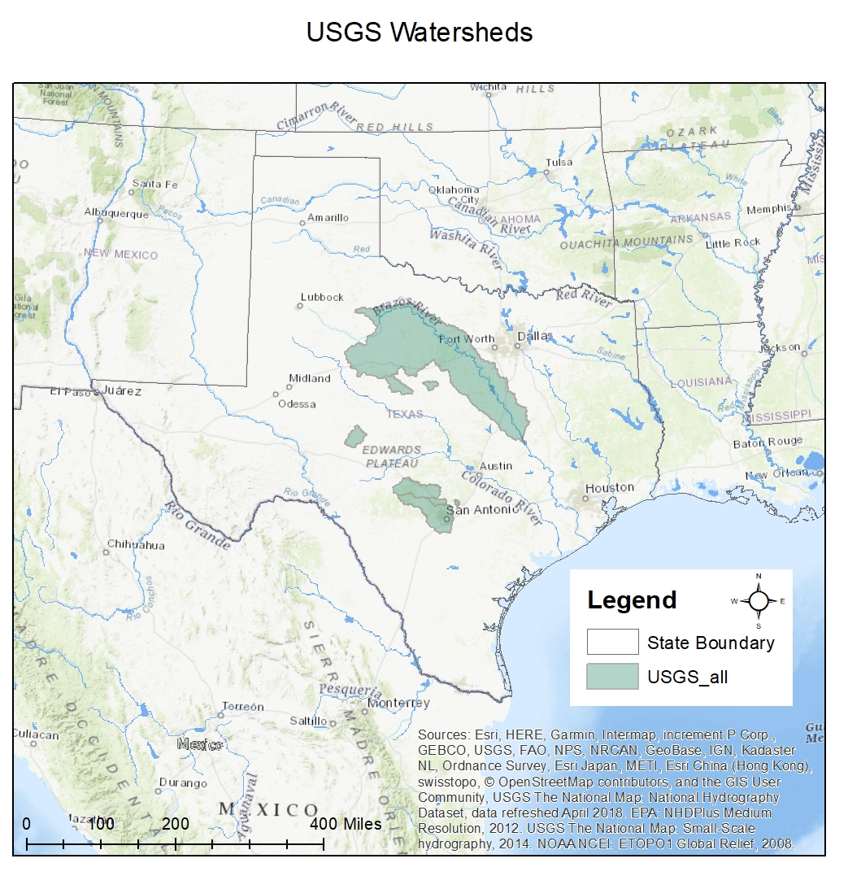
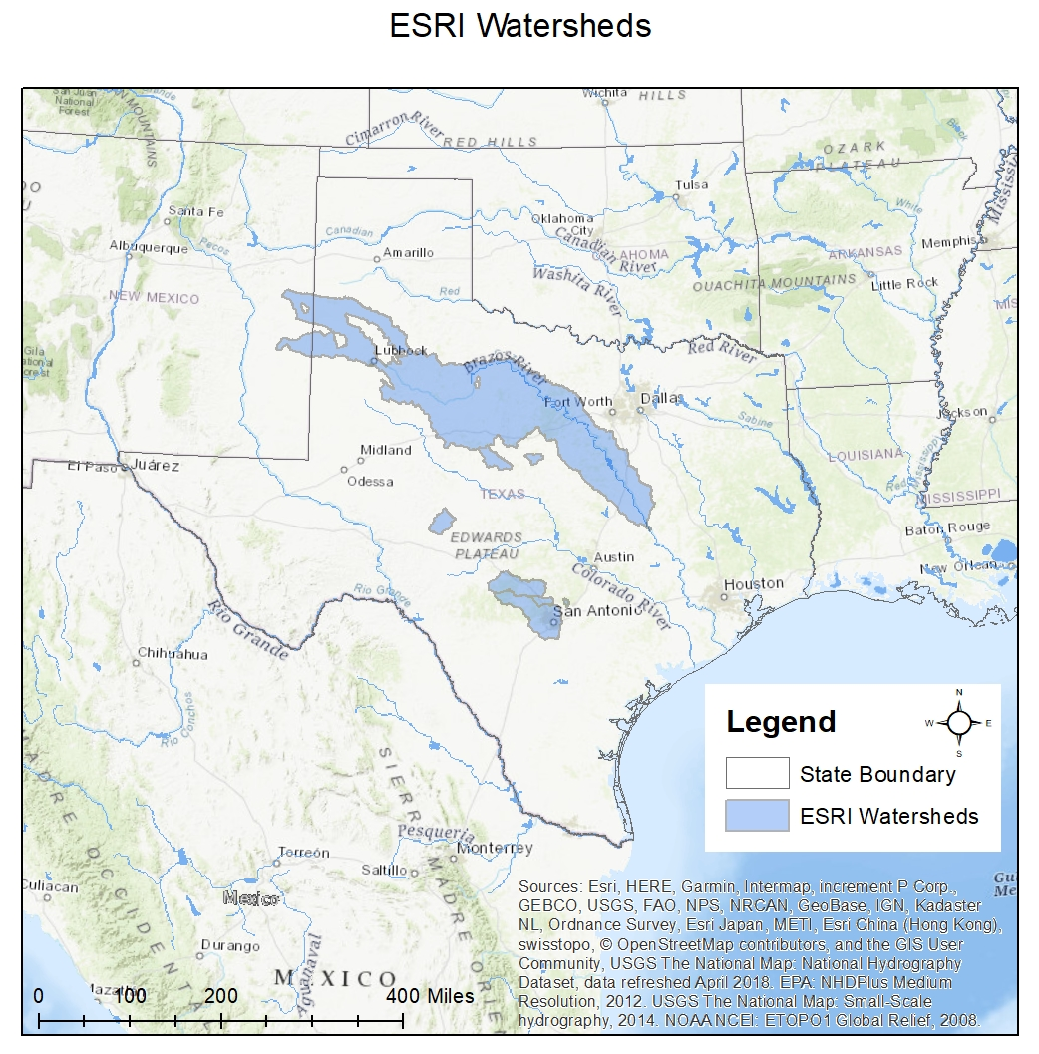

Slide 10
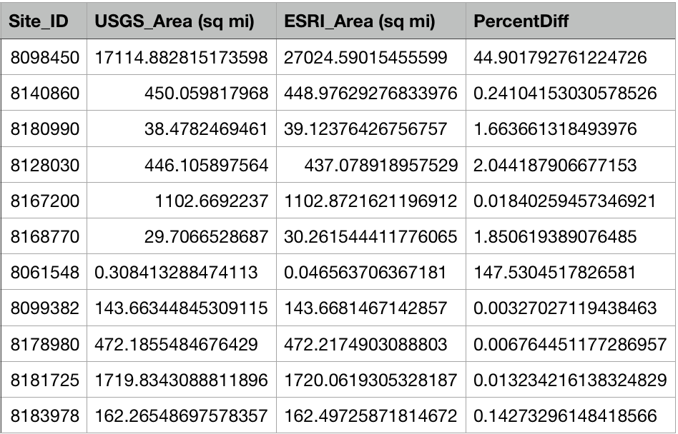
Looking at percent differences, overall really great results!
Except for two...

Slide 11
Looking at percent differences, overall really great results!
Except for two…
08098450
08061548
What happened?

Slide 12
Looking at percent differences, overall really great results!
Except for two…
08098450
08061548
What happened?
Large

Slide 13
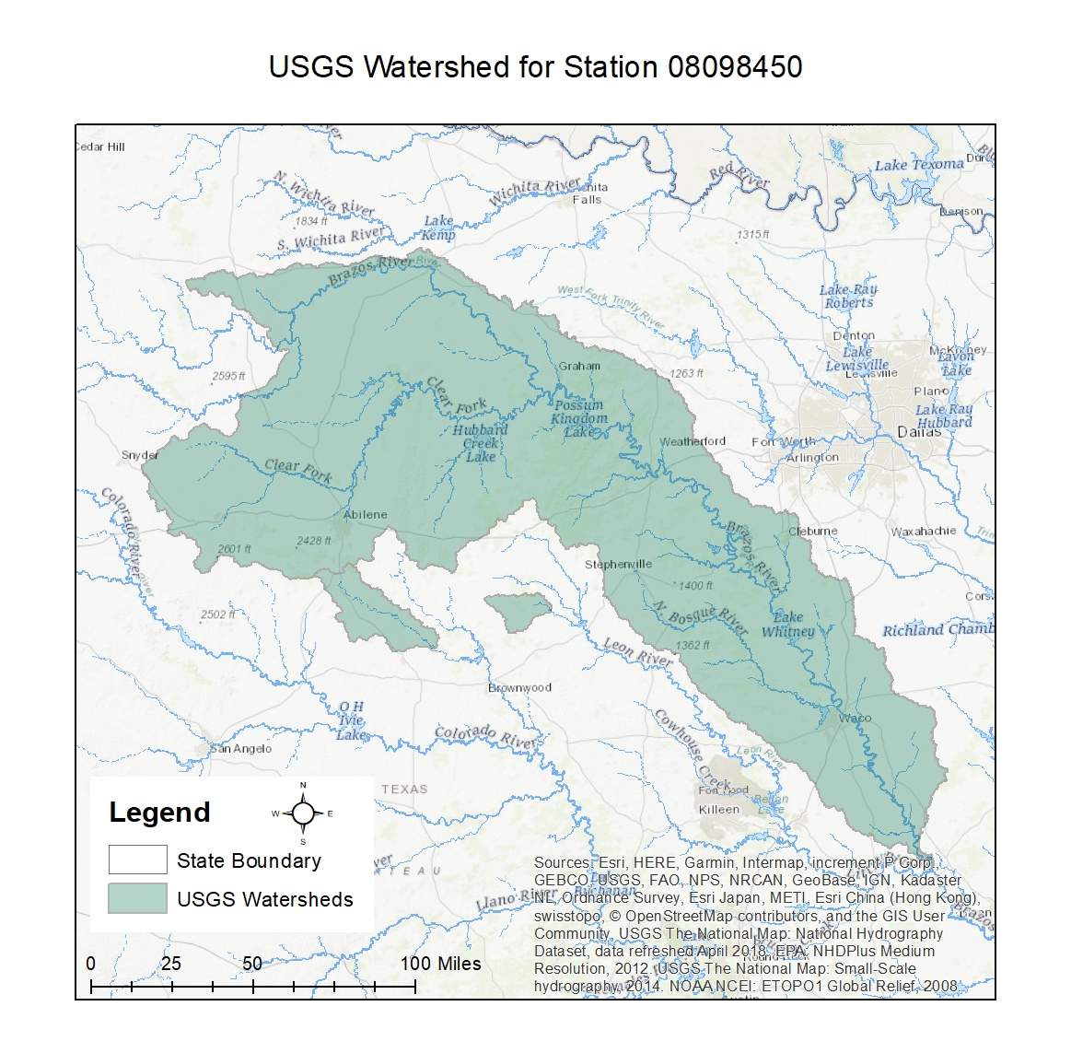
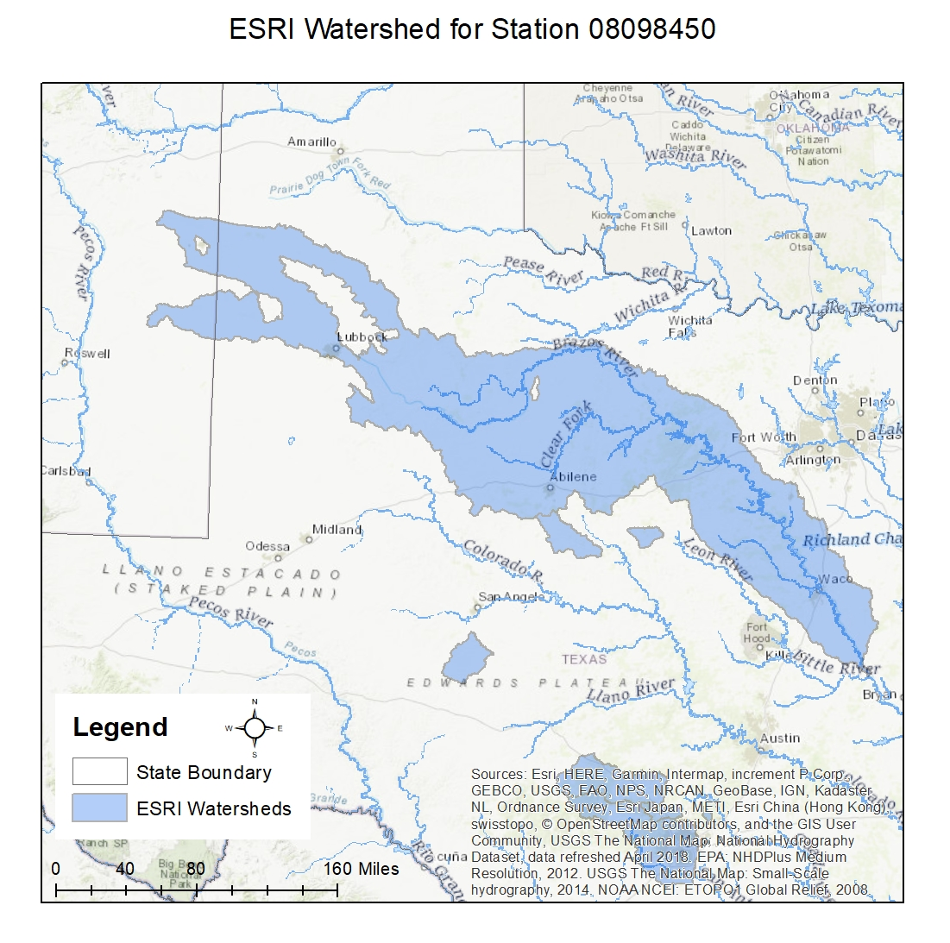

Slide 14
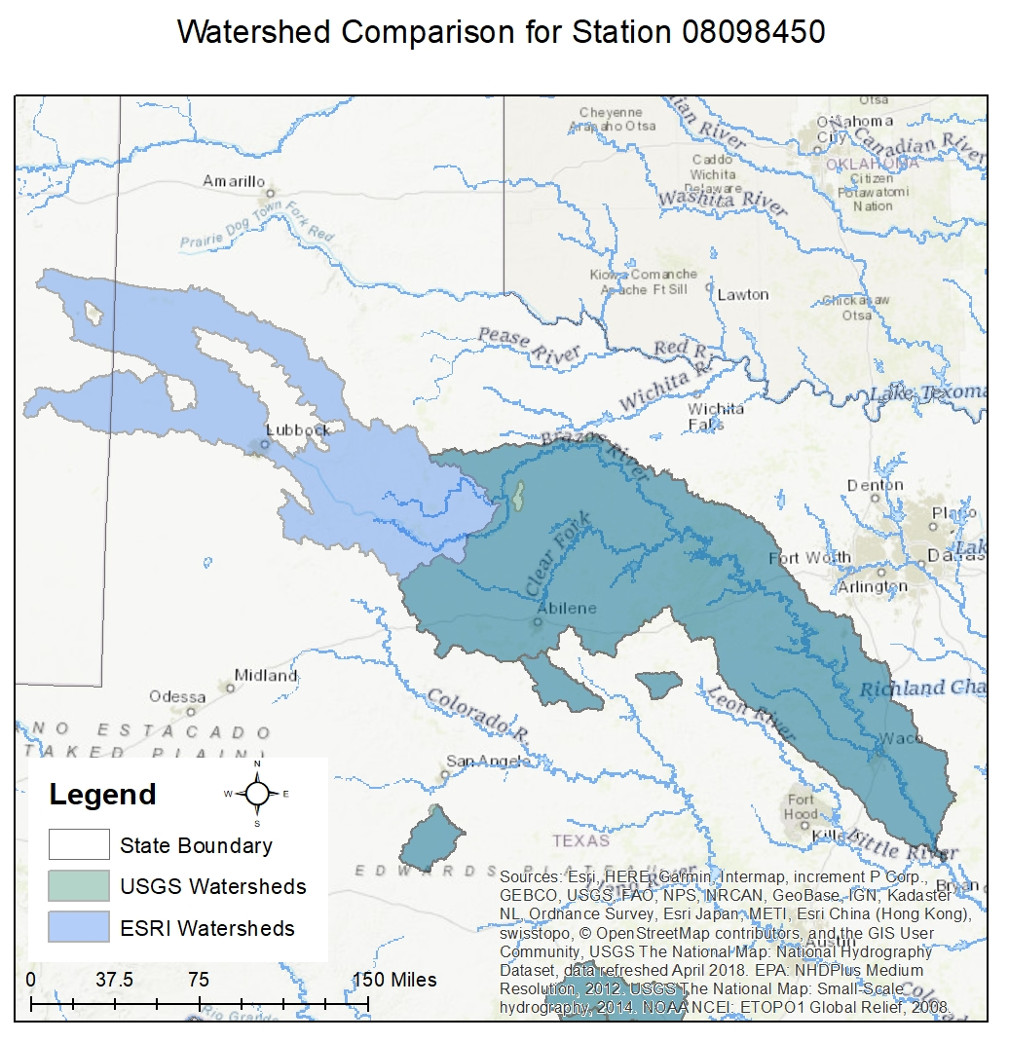
ESRI watershed area = 27,000 square miles
USGS watershed area = 17,000 square miles
Percent difference = 45%
ESRI
USGS

Slide 15
Percent difference = 45%
Why?
ESRI included the non-contributing drainage area (Playa Lakes)
USGS included only contributing drainage area
ESRI
USGS

Slide 16
Percent difference = 45%
Now why is this an issue?
Editing required
Less accurate after editing overall + more time needed (and money!)
ESRI
USGS

Slide 17
Looking at percent differences, overall really great results!
Except for two…
08098450
08061548
What happened?
Small

Slide 18
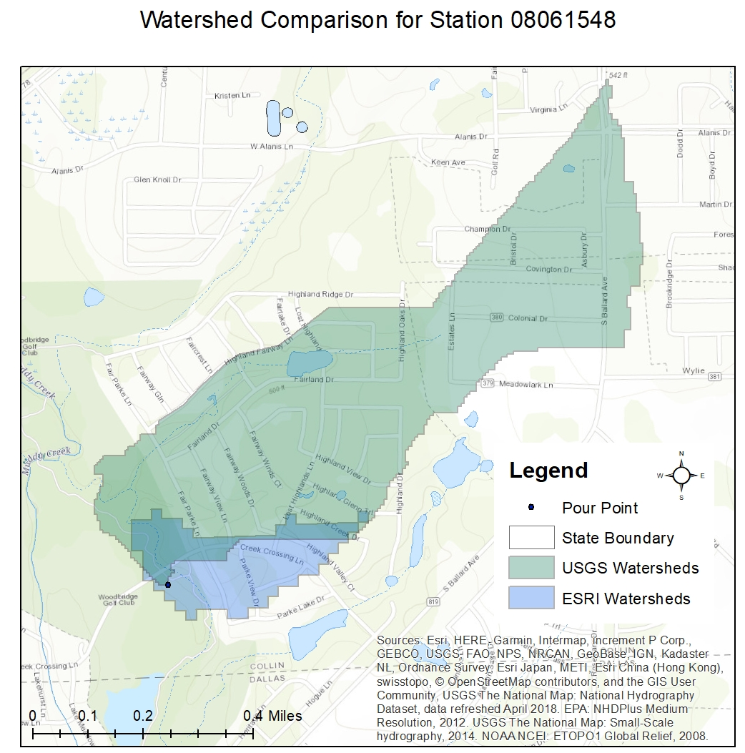
USGS
ESRI

Slide 19
ESRI watershed area = 0.04 square miles
USGS watershed area = 0.3 square miles
Percent difference = 147%
USGS
ESRI

Slide 20
Percent difference = 147%
Why?
ESRI resolution is 30m
USGS resolution is 10m
USGS
ESRI

Slide 21
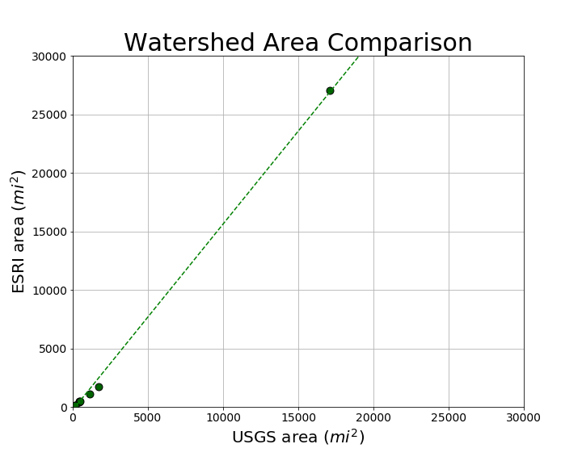

Slide 22
Arithmetic Scale:
Mostly one-to-one in size, with the obvious exception of 08098050
TRENDLINE
ONE-TO-ONE LINE

Slide 23
Let’s zoom in a bit
TRENDLINE
ONE-TO-ONE LINE

Slide 24
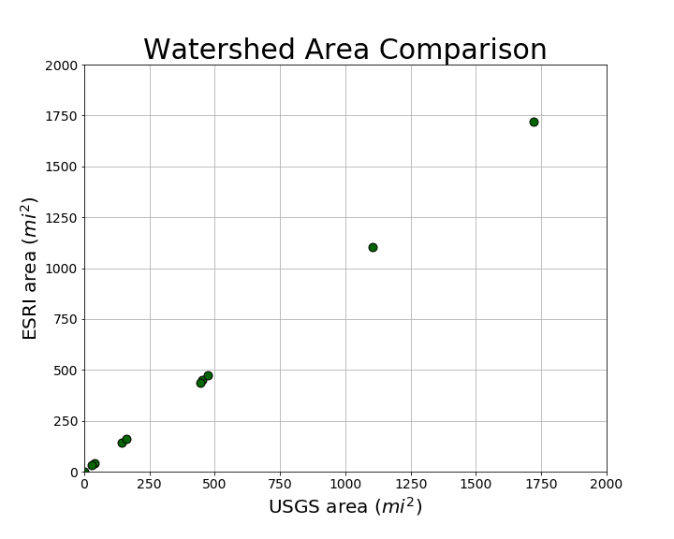
Let’s zoom in a bit
Clear one-to-one ratio (minimal residuals) in most watersheds

Slide 25
Conclusion
Is the ESRI method reliable? No, but it is useful.
Can the USGS replace its current method with the ESRI method? No, but it can help the analyst gain a general understanding of the basin area

Slide 26
Conclusion
Limitations of the ESRI method:
Gives option of 10m resolution, always only uses 30m (not accurate on smaller watersheds)
Includes contributing area without an option for separating out non-contributing area
Does not include some sinks
Pros:
Fast, efficient
Produces quick-and-easy watershed boundary to quickly visualize basin area

Slide 27
Questions?

