Slide 1
Impact of Land use on Air pollution in Austin
Rijul Gosar

Slide 2
Contents
Objective
Data used for the study
Pre-processing and challenges
Preliminary analysis
On-going and future analysis
Conclusion

Slide 3
Objective
Build a map of concentration variation across the city for Carbon Dioxide, Nitrogen Dioxide, PM_{2.5}, and Ultrafine Particles
Obtain land use, spatial, and population covariates to build a Land Use Regression (LUR) model to predict daytime summer concentrations

Slide 4
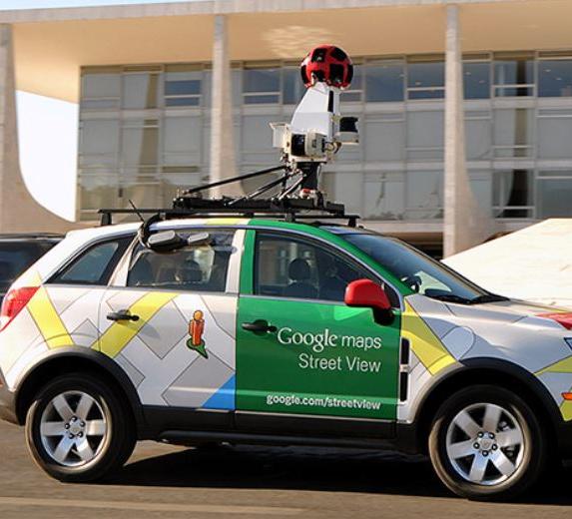
Data used for the study
Mobile monitoring data collected over the summer
Instruments mounted on Google Street View Vehicles
Gas (CO₂, NO, NO₂) and Particle instruments (PM_{2.5} and UFP)
Source: google.com/streetview

Slide 5
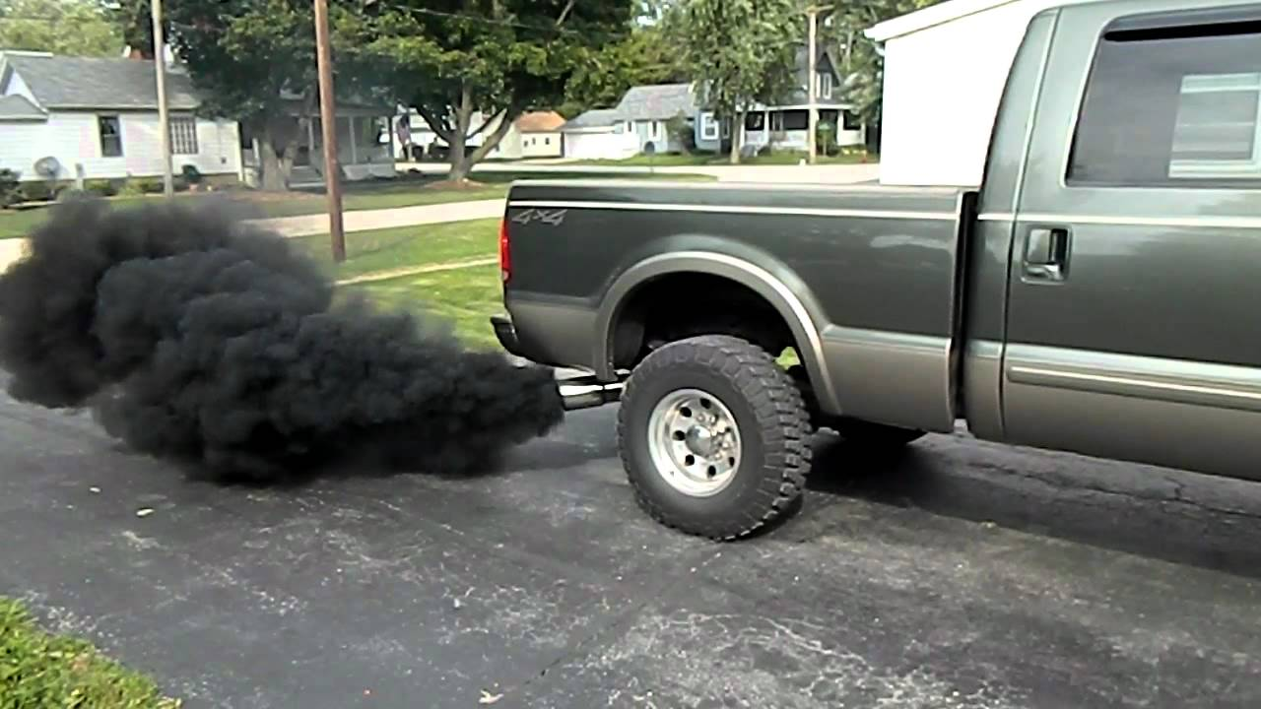
Challenges and data pre-processing
CHALLENGES | PRE-PROCESSING APPROACH
Rogue peaks in concentration | Multiple passes at the same location
Accounting for temporal variation | Median of drive pass means value
Different distances covered | “Snapping” points to equal intervals
Limitations on sampling times | Model only that portion of sampling

Slide 6
Preliminary Analysis
Carbon Dioxide (ppm)
NO₂ (ppb)

Slide 7
Preliminary Analysis
Gases like CO₂ and NO₂ are highly correlated with traffic
Ultrafine particles also exhibit some pattern associated with vehicular emissions
UFP emissions are also linked to other sources like barbequing and construction activities
Ultrafine Particles (#/cm³)

Slide 8
On-going analysis
Covariate extraction for building an LUR model
National Land Cover Database (NLCD) to obtain land use information
Open source road data to obtain road lengths and categories, to understand the effect of each road class
Population data on a block-by-block basis for exposure assessment

Slide 9
Target
A table which contains Land Cover, Population, and road network in different buffer sizes (50m, 100m, 500m, 1km) around each sampling point
Build an LUR model for each pollutant and let the model choose the variables that predict the median concentration best, in each buffer size
Compare the difference, if any, in the variables the model chooses for the multiple buffers

Slide 10
Conclusion
Mobile monitoring offers the opportunity to sample a large area with much fewer instruments
GIS based analysis can help understand the role of individual factors contributing to air pollution
Building an LUR can help make predictions with limited measurements, and this can be extended to other locations with similar weather conditions

Slide 11
Questions?

