Slide 1
November 2018
GIS-Enabled Rain Garden Design: Austin, Texas
Using widely-available datasets to allow engineers and city planners to quickly design and implement green infrastructure without the use of multiple programs and models.
Clint h. Smith, MSCE
Graduate Research Assistant, The University of Texas at Austin

Slide 2
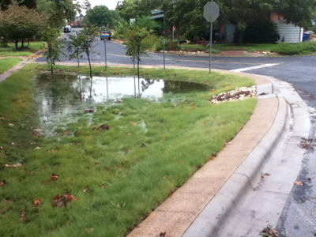
Contents:
Background
Implementation of GI
Timeline of Tool
Novelty
Tool
Conclusions
Rain Garden in Austin, TX
Source: http://austintexas.gov/department/austins-small-scale-green-infrastructure
Notes:
Implementation of what?

Slide 3
Background:
Green Infrastructure
Types:
Rain Gardens*
Vegetated Swales
Green Roofs
Permeable Pavement
Slows stormwater down
Can be implemented in series
Removes pollutants
Recharges groundwater table
More maintenance
Easier to retrofit
Gray Infrastructure
Traditional means of stormwater conveyance
Types:
Culverts (concrete, metal)
Concrete ditches
General stormwater conveyance
High velocity, no pollutant removal
No groundwater recharge
Designed for 50 year lifespan at current site characteristics
“Green Infrastructure and Ground Water Impacts.” EPA, Environmental Protection Agency, 22 June 2018, www.epa.gov/green-infrastructure/green-infrastructure-and-ground-water-impacts.

Slide 4
Implementation of GI:
Barriers:
Many barriers to implementation
Time constraints
Knowledge of how to design
Time to learn how to design
“Overcoming Barriers to Green Infrastructure.” EPA, Environmental Protection Agency, 22 June 2018, www.epa.gov/green-infrastructure/overcoming-barriers-green-infrastructure.

Slide 5
Implementation:

Slide 6
Novelty:
Instead of city planners needing to use multiple programs, all of the design is done in one interface (ArcMap)
Eliminates use of manually retrieving and processing data in multiple programs such as EPA SWMM, HEC-RAS, HEC-HMS.
Correia, Francisco Nunes, et al. "Coupling GIS with hydrologic and hydraulic flood modelling." Water Resources Management 12.3 (1998): 229-249.

Slide 7
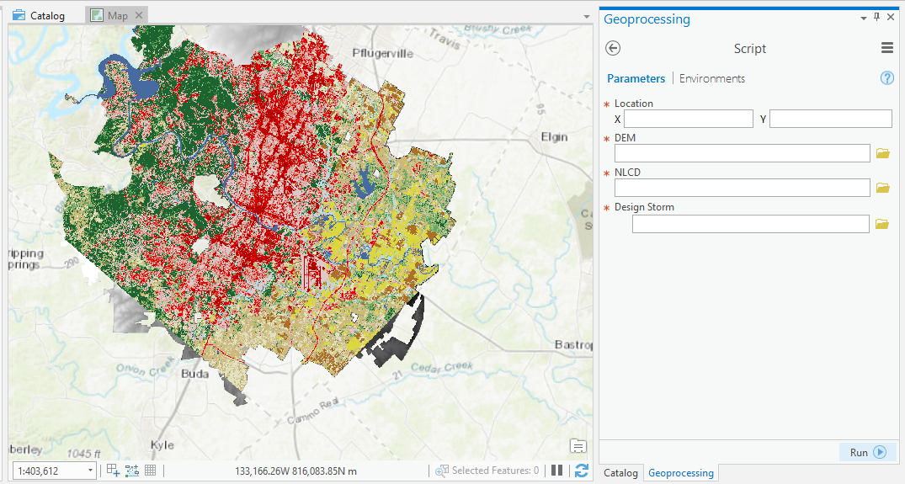
Tool:
Uses 2 Widely Available Data Sets:
National Land Cover Dataset (NLCD 2011)
Digital Elevation Model (DEM)
The higher resolution the better (to an extent)
City of Austin DEM seen with Rain Garden Design Tool

Slide 8
Timeline:
Single Barrel Concrete Culvert in VBA Fall 2015
Zachary Wilbanks, Leah Clifton, Bradford Wilson
GIS Term Project
Single Barrel Concrete Culvert in Python Fall 2016
Ashton Greer
Ph.D. Project Work
Vegetated Swale in Python Spring 2018
Ashton Greer
EPA P3 Grant
Rain Garden in Python Fall 2018
Clint Smith
GIS Term Project
Greer, A. D., Wilbanks, Z. B., Clifton, L. D., Wilson, B., & Graettinger, A. J. Advances in Civil Engineering GIS Enabled Culvert Design: A Case Study in Tuscaloosa, Alabama.

Slide 9
Tool:
Uses industrial standard equations:
Rational Method: Q = CiA
Kirpich Equation: t_{c} =(0.0078)*(L^{0.077})/(S^{0.385})
City of Austin Rain Garden Equations:
Volume/ft² (VSF) = Depth (d)* 0.623
Surface Area (SA) = Q/VSF
Minimum SA (SA _{min}) = Q/ (4+(1.33)*d)
Iterates (depth) calculations until constraints are met
Outputs: Surface Area, depth, and Diameter
City of Austin, Drainage Criteria Manual, Austin, Texas, January 1977
“ENVIRONMENTAL CRITERIA MANUAL City of AUSTIN, TEXAS Codified through Rule No. 161-18.05, Enacted June 12, 2018. (Supp. No. 8-2018).” Municode Library.

Slide 10
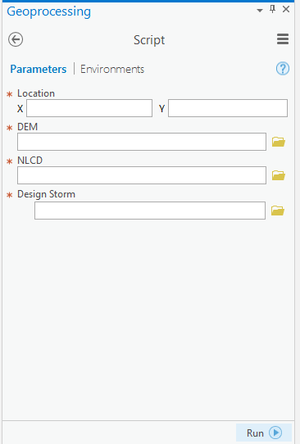
Tool for Circular Rain Garden:
Performs all calculations needed for design
User needs to know site characteristics
Further work can be done to automate design process and extract site characteristics from LiDAR

Slide 11
Conclusions:
Rain garden design is very interpretive and iterative
No strict set of guidelines across all governing agencies
EPA, TCEQ, City of Austin…
City planners and engineers will know what plants to use based on region
Rain garden design can be further optimized using deep learning methods
*Side Note
Coding is hard
Interpreting someone else’s code is harder
Editing a code you did not originally write is not fun

Slide 12
Acknowledgements
Thanks to Dr. Maidment for his assistance throughout the project.
Thanks to The University of Alabama GIS Lab for the original culvert design script.
www.gisresearch.ua.edu

Slide 13
Questions?

