Slide 1
Mapping water availability & changes in water consumption patterns in Texas river basins due to changes in water demand by Electricity Generating Units in the wake of highly volatile Natural Gas Prices.
Paras Vaid
MS- Civil & Environmental Engineering, UT Austin

Slide 2
Why this study?
Dramatic increase in production of natural gas- hydraulic fracturing (Water intensive tech.)
Resultant fall in prices of Natural Gas- Consequent extensive use by different Electricity Generating Power Plants.
Affect on water availability in river basins

Slide 3
Spatial and temporal patterns of changes in consumptive water use in Texas river basins during a period of rapid shale gas development and use in electricity generation (Aug 2008 study)

Slide 4
Some Facts:
23 major river basins in Texas
Most power plants located near banks of major river
Use water for purposes like cooling etc.

Slide 5
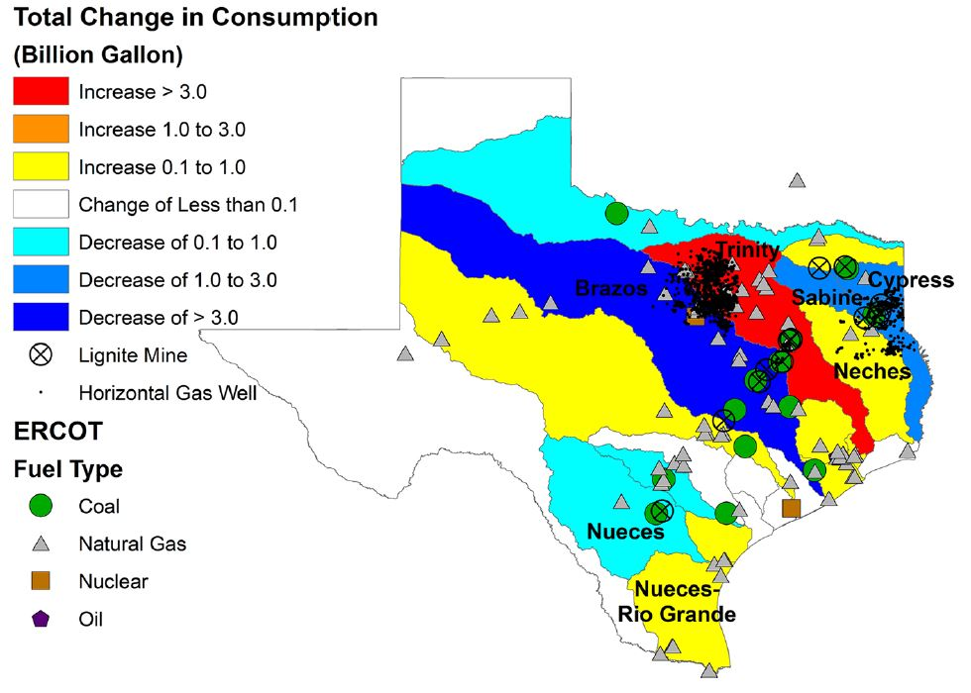
Drought Intensity Index
Change in total water consumption in Texas river basins during the August 2008 through December 2009 (Period of low natural gas prices)
Barnett Shale
Production wells
US Energy Information administration: https://www.eia.gov/maps/layer_info-m.php
Pacsi, A. P. et al. Spatial and Temporal Impacts on Water Consumption in Texas from Shale Gas Development and Use. ACS Sustainable Chem. Eng. 2014, 2, 2028−2035.

Slide 6
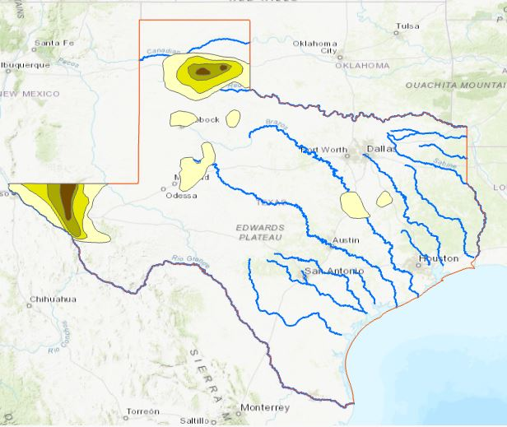
Drought Intensity Index
Depends upon:
Rainfall
Water consumption activities
Ref: US National Drought Mitigation Center:
https://droughtmonitor.unl.edu/Data/GISData.aspx

Slide 8
Conclusion & further development:
Natural Gas has changed energy production scenario of US
Aim of study to achieve efficient Water Resources Management
Study of changes in water availability in river basins
Use current data to predict future variations.

Slide 9
Thank you

