Slide 1
A Comparative Study of the National Water Model Forecast to Observed Streamflow Data
By leah Huling

Slide 2
Project Overview
Introduction
Getting to know the data
Results
Analysis
Conclusions
What’s next

Slide 3
National Water Model (NWM)
Covered in class extensively so I won’t go into excruciating detail
My study is concerned with the zero hour forecast
Essentially, what the NWM thinks is happening right now
At this point in the NWM, physical data is being forced into the model
Defined as a “snapshot of current hydrologic conditions”
Includes meteorological data and USGS streamflow gauges

Slide 4
City of Austin Gage Network
32 COA gages located within the NWM reach
Stage level collected every 15 minutes
Operational since December 2016
That is a lot of data

Slide 5
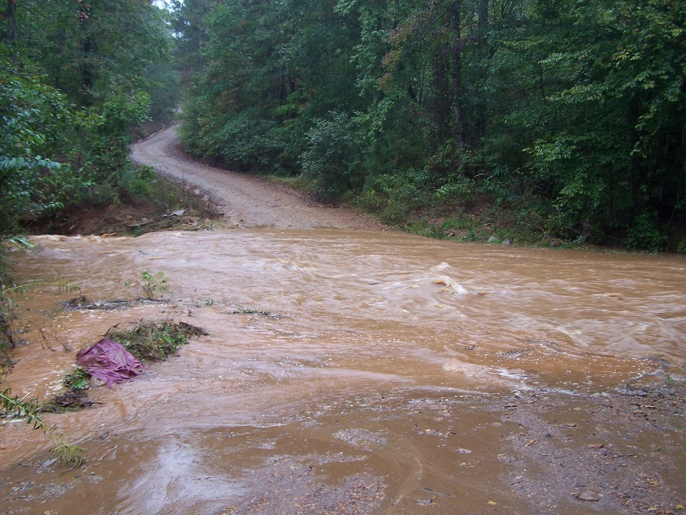
Significance
Smaller streamflows are difficult to predict
Tributaries are often susceptible to flash floods in significant storm events
The Austin Fire Department is interested in an accurate method of predicting/monitoring flooding events at crucial points in Austin

Slide 6
Project Overview
Introduction
Getting to know the data
Results
Analysis
Conclusions
What’s next

Slide 7
KISTERS
KISTERS is a software development and strategic water information management firm that houses the COA data
Matt Ables is my local contact and has been handling the COA gage network
Matt created an output that uses the HAND process to convert NWM streamflow data (volume/time) to stage values (length)
This allows for a direct comparison between NWM and COA data
Currently, there is missing data over large time frames

Slide 8
Project Overview
Introduction
Getting to know the data
Results
Analysis
Conclusions
What’s next

Slide 9
Typical Results
Obvious missing data
For analysis, I focused on Dec 2016 – Sep 2017

Slide 10
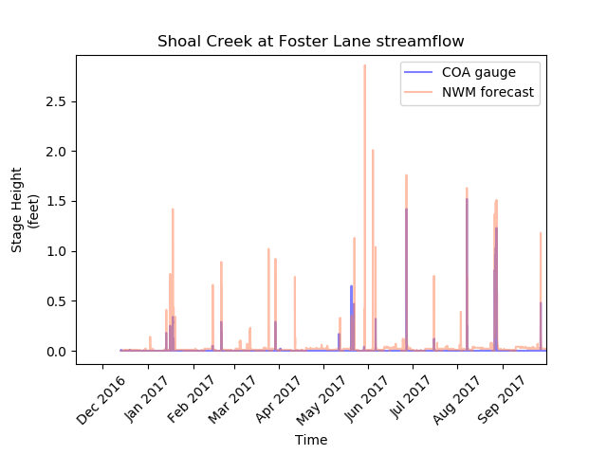
Typical Results

Slide 11
Project Overview
Introduction
Getting to know the data
Results
Analysis
Conclusions
What’s next

Slide 12
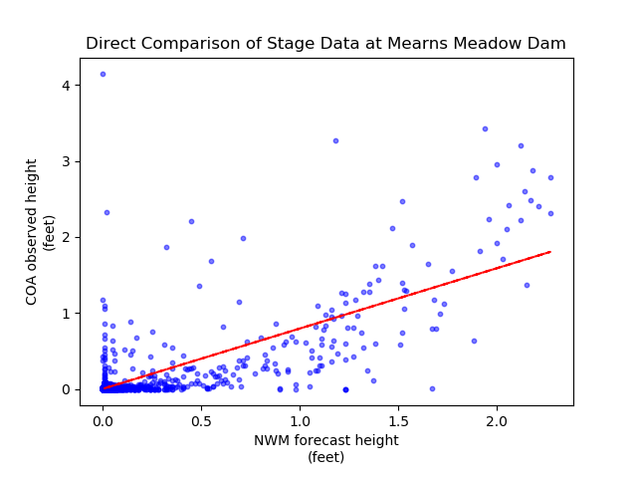
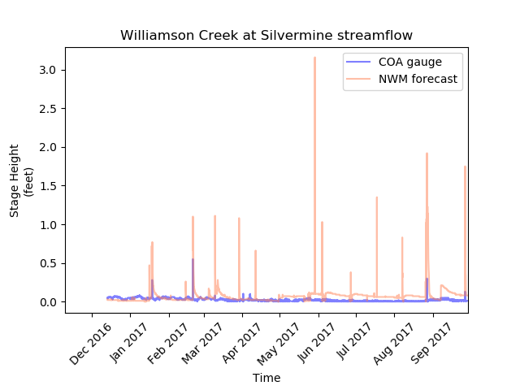
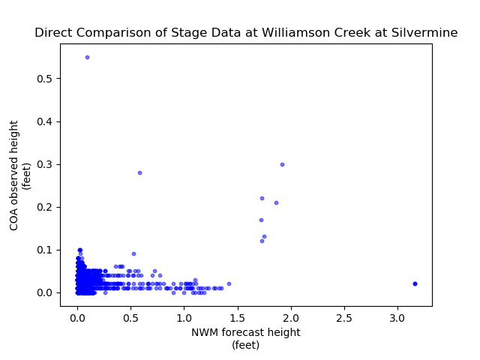
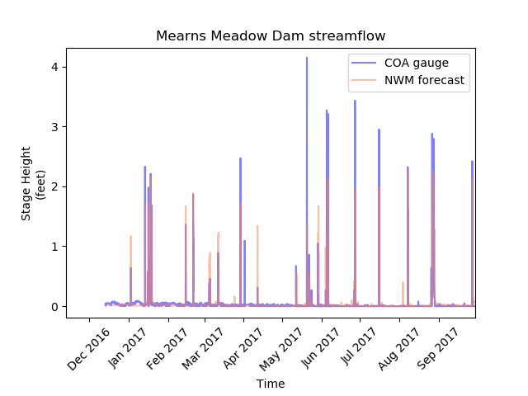
Analysis
Pearson’s correlation coefficient
A measure of the linear correlation between two variables X and Y, giving a value between +1 and −1 inclusive, where 1 is total positive correlation, 0 is no correlation, and −1 is total negative correlation
The coefficients vary from 0 to 0.77

Slide 13
Project Overview
Introduction
Getting to know the data
Results
Analysis
Conclusions
What’s next

Slide 14
Conclusions
Most storms are caught on the National Water Model
The NWM is inconsistent with the magnitude
There was not significant flooding in Austin in 2017
Greatest stage height across all COA gages was 6 ft
Greatest forecast prediction was 6.5 ft
If the National Water Model were to be forced with gages outside the USGS, it would improve the accuracy of prediction

Slide 15
Project Overview
Introduction
Getting to know the data
Results
Analysis
Conclusions
What’s next

Slide 16
Future Steps
Create an inundation map, comparing the inundated area between the observed and forecasted stage heights
I should have the missing data by the end of the week
Conduct further statistical analysis
Compare the data across space rather than time
Determine the likelihood that the NWM will 1) miss a storm event, 2) predict a false storm event, or 3) accurately predict a true storm event

Slide 17
Thank you, any questions?

