Slide 1
New Orleans Inundation from Hurricane Katrina
Sruthi Kakuturu
University of Texas at Austin

Slide 2
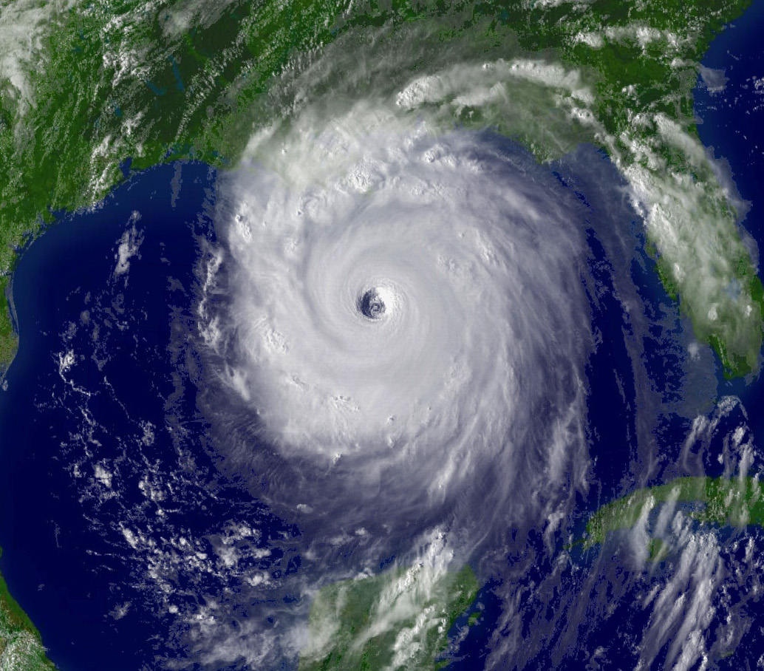
Hurricane Katrina
DEADLIEST since 1928
12,000 deaths
COSTLIEST on record
$17 billion for New Orleans alone
August 23-30, 2005

Slide 3
Current DEM
Lake Pontchartrain
Mississippi River
New Orleans

Slide 4
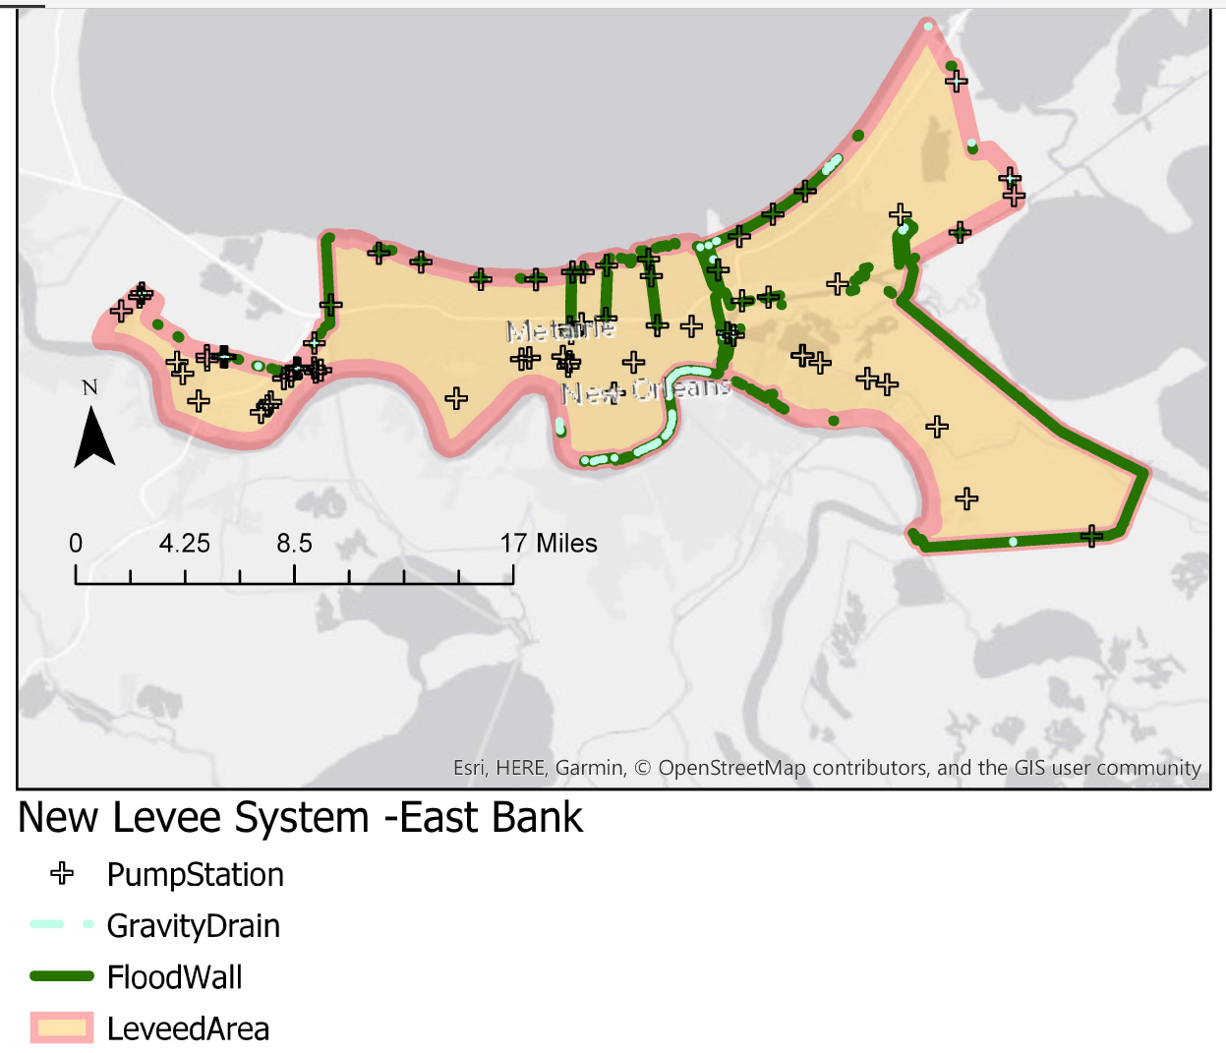

Slide 5
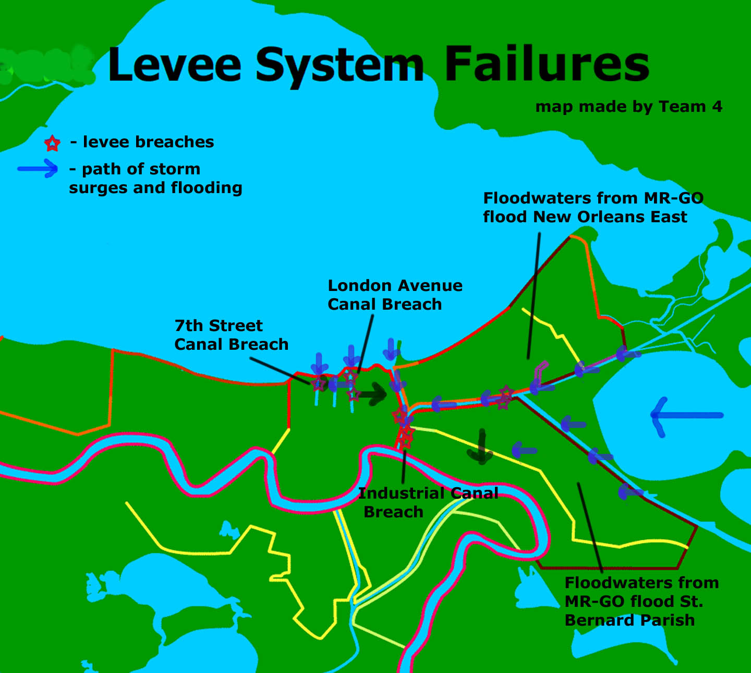

Slide 6
DEM-based analysis

Slide 7
Volume Calculations

Slide 8
Assumption

Slide 9
Expected Results

Slide 10
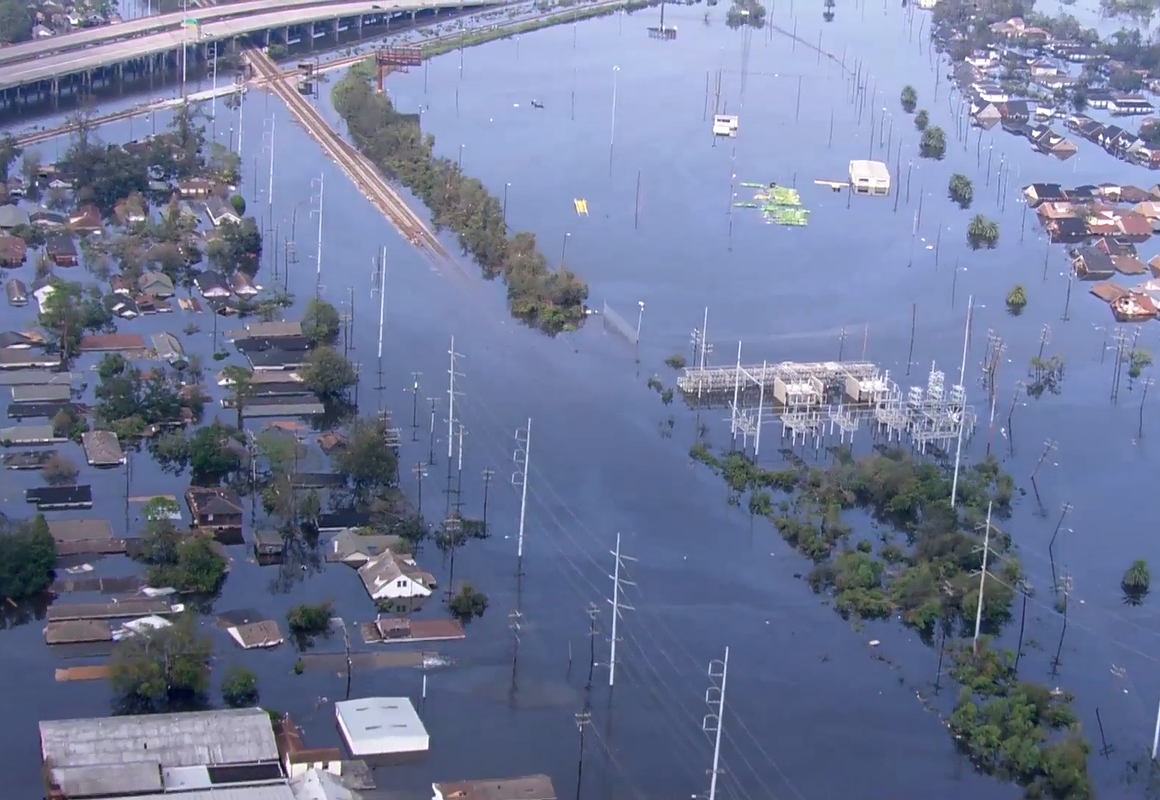
Future Work and Conclusions
More temporal analysis
Time is took to drain the city
Flood dewatering efforts
Timeline and detailed analysis

