Slide 1
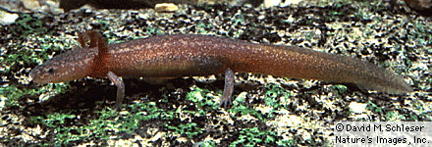
Sufficiency of publicly-available spatial data to monitor Central Texas groundwater salamanders (Eurycea)
Katie Lyons,
Ecology, Evolution, and Behavior Program

Slide 2
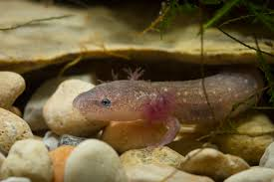
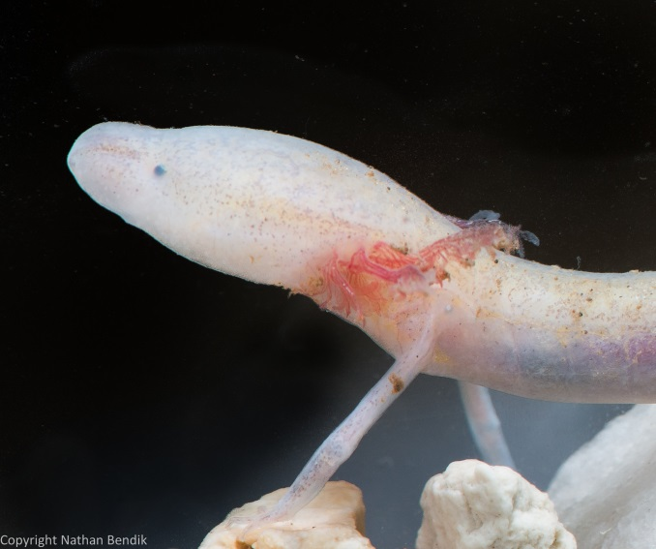
Eurycea
Central and West-Central TX
Subterranean (aquifer-dwelling)
Some endangered
Fully aquatic
Connections underground?
E. sosorum, Barton Springs salamander
E. tridentifera, Comal Blind salamander

Slide 3
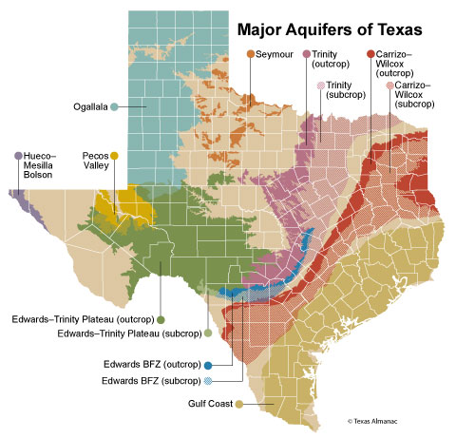
Texas Aquifers
9 major, 22 minor
Supply 62% of water as of 2014
Susceptible to contamination, especially in recharge zone

Slide 4
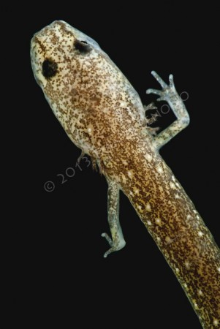
Project Overview
Evaluate publicly-available GIS data
Is it sufficient for monitoring the Eurycea complex?
Cross-reference occurrence data to other geographic and hydrological features
E. troglodytes

Slide 5
Eurycea Occurrence Data

Slide 6
Eurycea Watersheds

Slide 7
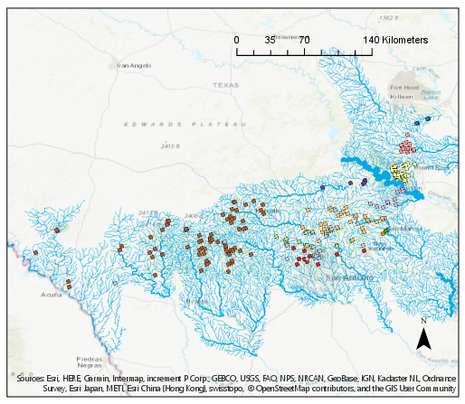
Eurycea Streams

Slide 8
Stream Distance
Low resolution?
Well samples?

Slide 9
Eurycea Aquifers

Slide 10
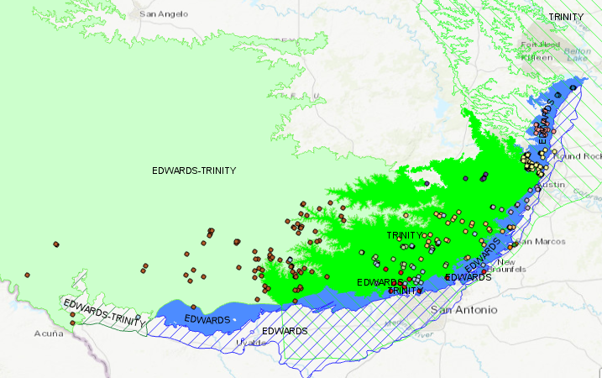
Eurycea Aquifers

Slide 11
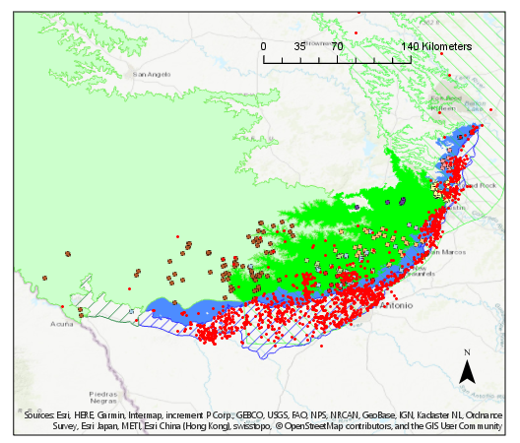
Eurycea Aquifers – USGS Wells

Slide 12
Distance from Occurrence to Well

Slide 13
Distance from Occurrence to Well

Slide 14
Well Depth
Nearest to occurrence sites:
All wells:

Slide 15
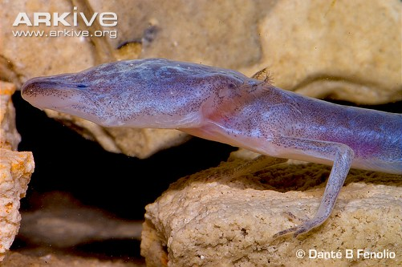
Future Directions
Obtain more well data
Explore groundwater flow modeling
Differentiate occurrence types
Incorporate my own data

