Slide 1
Hydrologic Data Access Using Web Services
David R. Maidment
Center for Research in Water Resources
University of Texas at Austin
Canadian Water Resources Association Conference
St John’s, Newfoundland, 28 June 2011

Slide 2
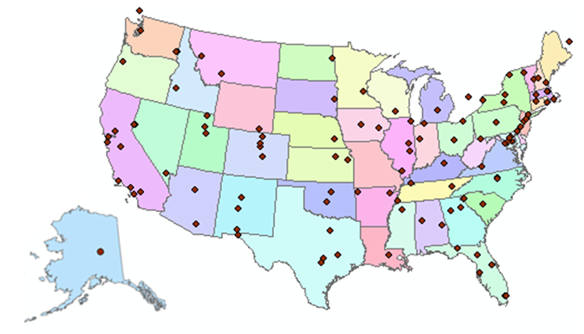
http://www.cuahsi.org
CUAHSI is a consortium representing 125 US universities
Supported by the National Science Foundation Earth Science Division
Advances hydrologic science in nation’s universities
Includes a Hydrologic Information System project

Slide 3
How the web works
Catalog (Google)
Catalog harvest
Search
Web Server
(CNN.com)
Access
Browser
(Firefox)
HTML – web language for text and pictures

Slide 4
Services-Oriented Architecture for Water Data
Catalog
Service registration
Search
Catalog harvest
Server
Data access
User
WaterML – web language for water data

Slide 5
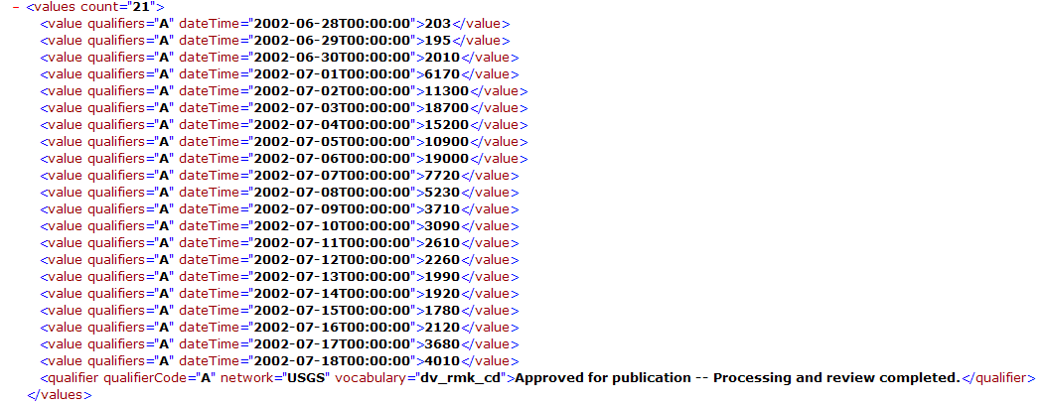
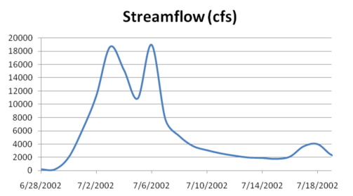
WaterML as a Web Language
Discharge of the San Marcos River at Luling, TX June 28 - July 18, 2002
USGS Streamflow data in WaterML language
The USGS now publishes its time series data as WaterML web services

Slide 6
Colorado River at Austin
I accessed this WaterML service from USGS at 9PM last night
http://waterservices.usgs.gov/nwis/iv?sites=08158000&period=P7D&parameterCd=00060
And got back these flow data from USGS which are up to 8PM Central time

Slide 7
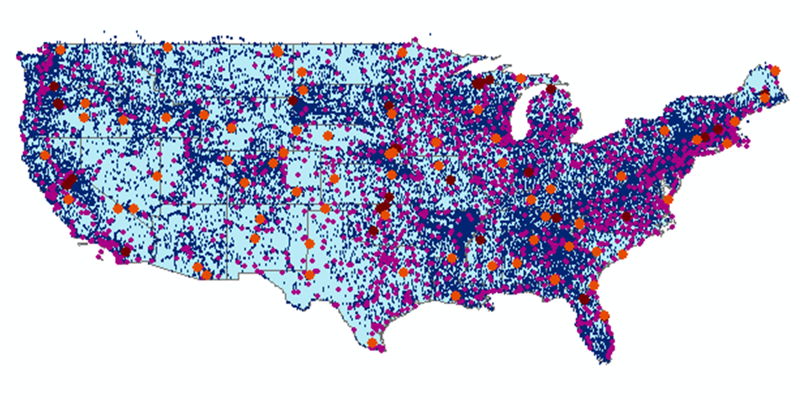
CUAHSI Water Data Services Catalog
66 public services
18,000 variables
1.9 million sites
23 million series
5.1 billion data values
And growing
The largest water data catalog in the world
maintained at the San Diego Supercomputer Center

Slide 8
Point Observations Information Model
Niagara Peninsula Conservation Authority
Information is transmitted through the internet in WaterML as web services
Data Source
Water Quality
Network
GetSites
BA001
Sites
GetSiteInfo
Total Phosphorus
Variables
GetVariableInfo
GetValues
0.89 mg/L, 20 April 2009
Values
{Value, Time, Metadata}
A data source operates an observation network
A network is a set of observation sites
A site is a point location where one or more variables are measured
A variable is a property describing the flow or quality of water
A value is an observation of a variable at a particular time
A metadata quantity provides additional information about the value

Slide 9
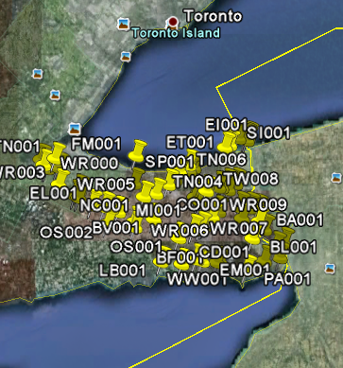
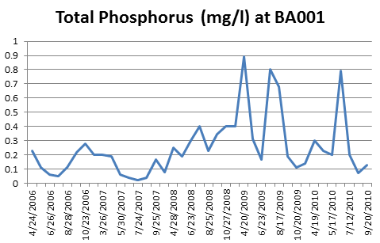
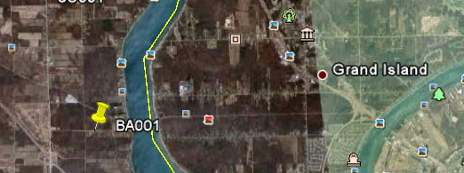
Niagara Peninsula Conservation Authority
http://www.his.npca.ca/waterdataservices_quality/cuahsi_1_1.asmx?WSDL
71 Observation sites
76 water quality variables
3797 time series
148, 693 data values

Slide 10
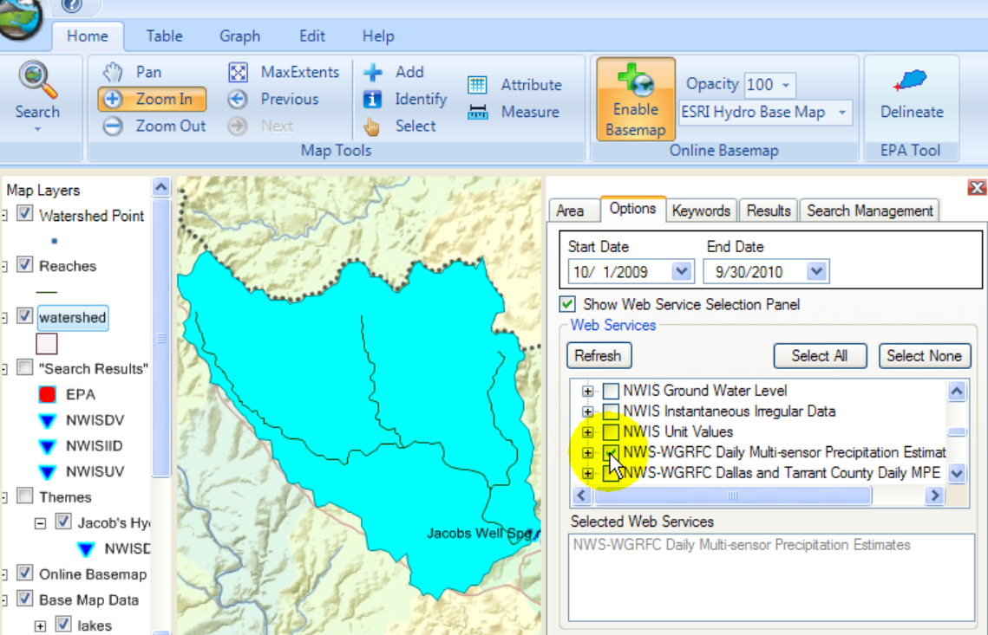
HydroDesktop – Desktop HIS
Metadata
Catalog
Data

Slide 11
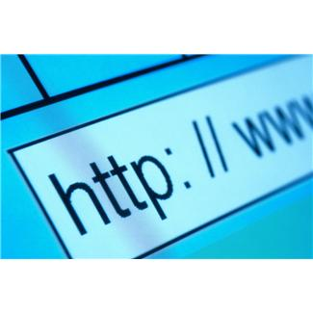
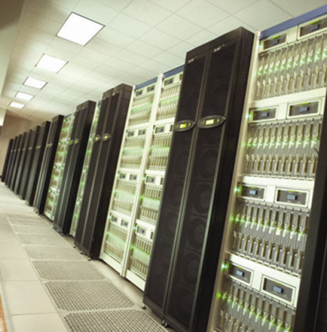
Three Categories of Data Services
Data Services – which convey the data
Metadata Services – which convey metadata about specific collections or series of data
Search Services – which enable search, discovery, and selection of data and convey metadata required for accessing data using data services
Metadata
Search
Data
Data
Services
Metadata
Search

Slide 12
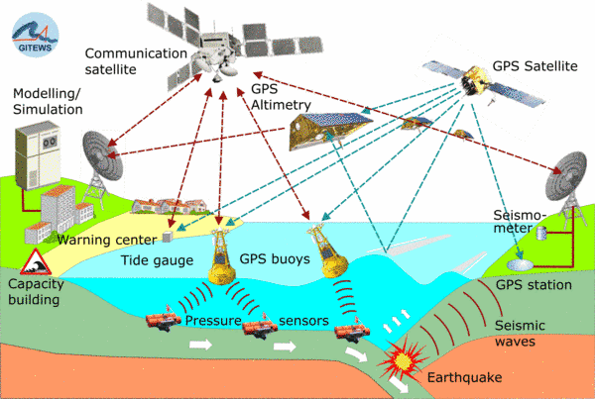
Open Geospatial Consortium Web Service Standards
Map Services
Web Map Service (WMS)
Web Feature Service (WFS)
Web Coverage Service (WCS)
Catalog Services for the Web (CS/W)
Observation Services
Observations and Measurements Model
Sensor Web Enablement (SWE)
Sensor Observation Service (SOS)

Slide 13
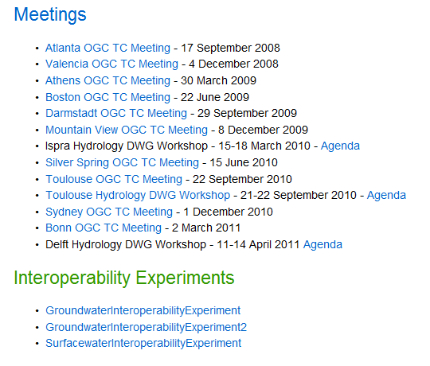
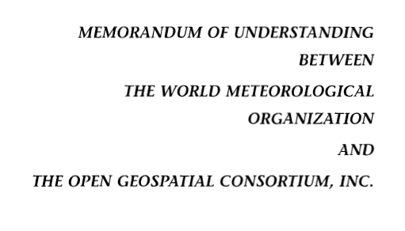
Jointly with World Meteorological Organization
Evolving WaterML into an International Standard
Meets every 3 months
Teleconferences most weeks
November 2009
Hydrology, Meteorology, Climatology, and Oceanography
WaterML Version 2 standard proposed
Vote for adoption later this year

Slide 14
OGC/WMO Hydrology Domain Working Group
This is now an accepted forum for international evolution of water data sharing standards
September 2011 OGC Technical Committee meeting in Boulder, CO, includes a “Hydrology Summit”
March 2012 OGC Technical Committee meeting will be in Austin, Texas

Slide 15
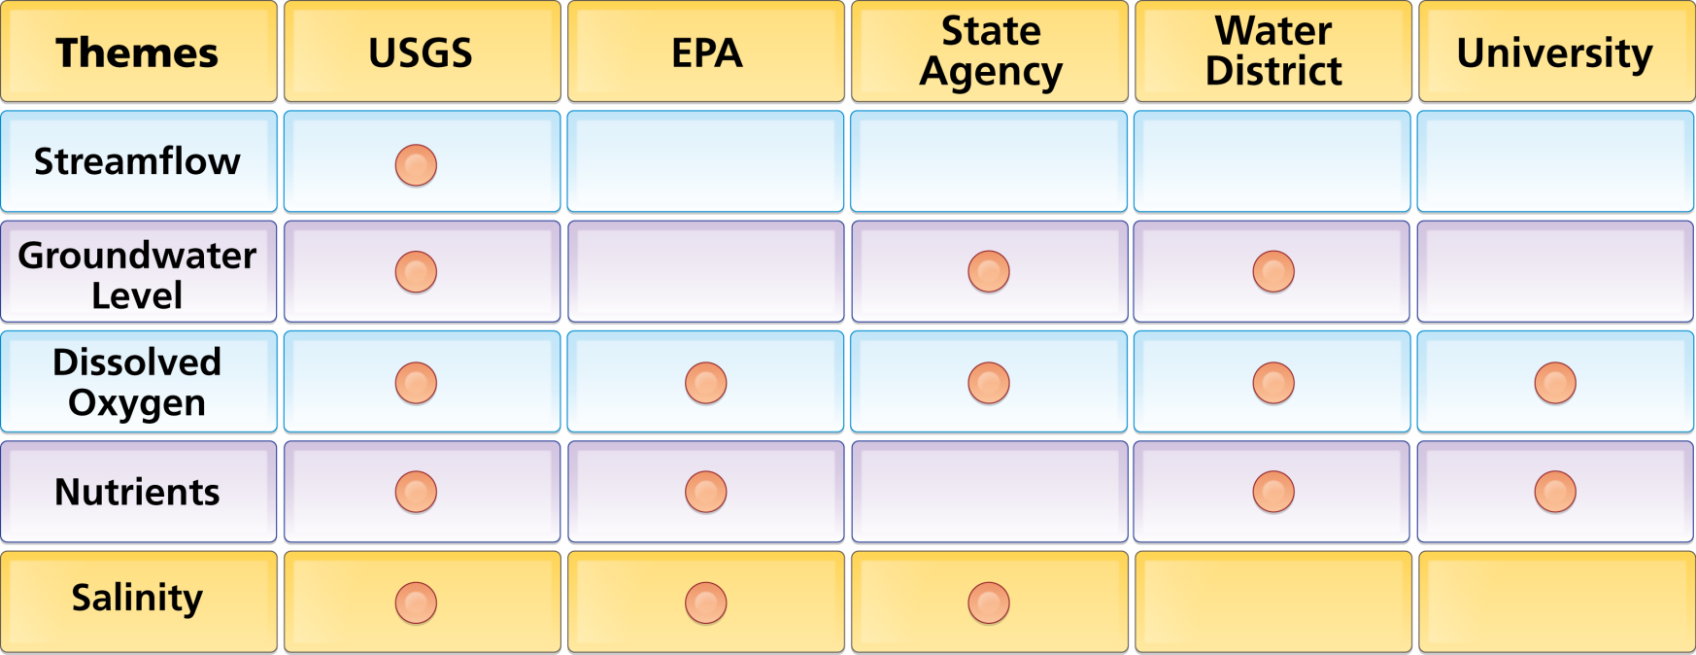
Organize Water Data Into “Themes”
Integrating Water Data Services From Multiple Sources
WaterML
WaterML
WaterML
WaterML
WaterML
. . . Across Groups of Organizations

Slide 16
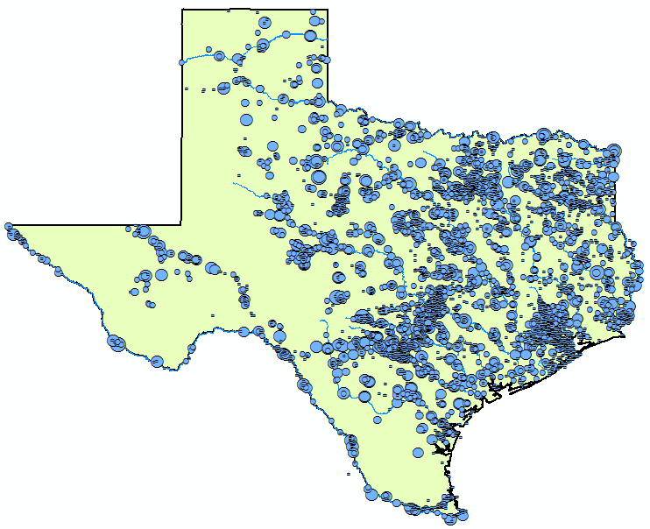
Streamflow Data Services
2 services
7 variables
4,363 sites
11,484 series
9,493,968 records
Notes:
Here’s an example showing where streamflow is measured in Texas from two different services (i.e., data providers).

Slide 17
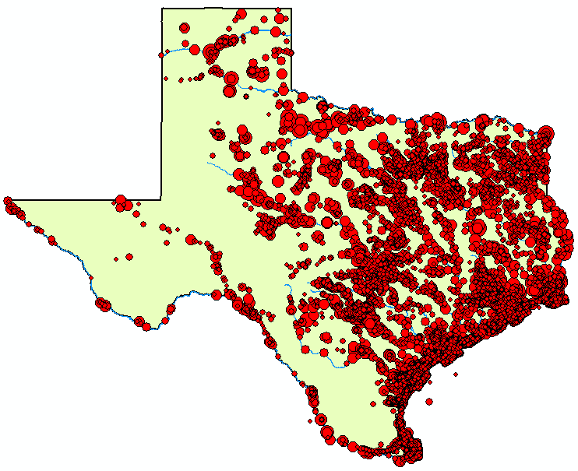
Water
Temperature Data Services
6 services
11 variables
11,158 sites
22,953 series
1,546,841 records

Slide 18
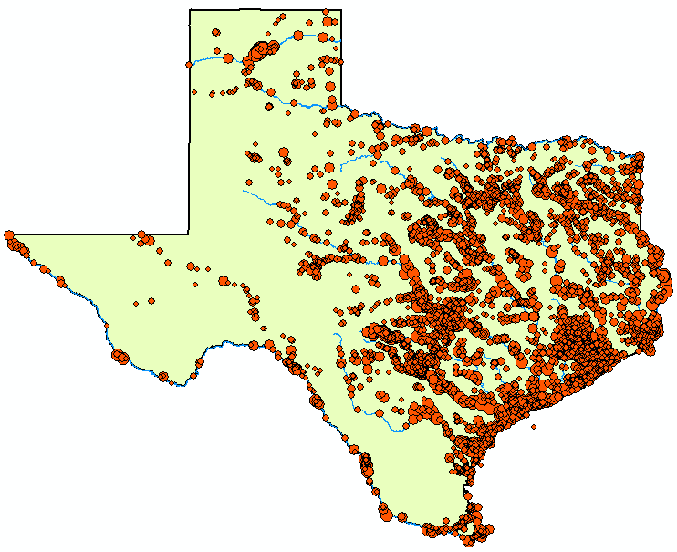
Bacteria Data Services
1 service
21 variables
4,801 sites
15,483 series
297,849 records

Slide 19
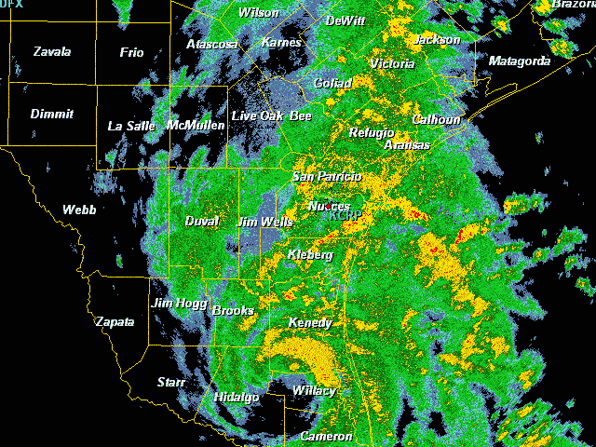
Tropical Storm Hermine, Sept 7-8, 2010

Slide 20
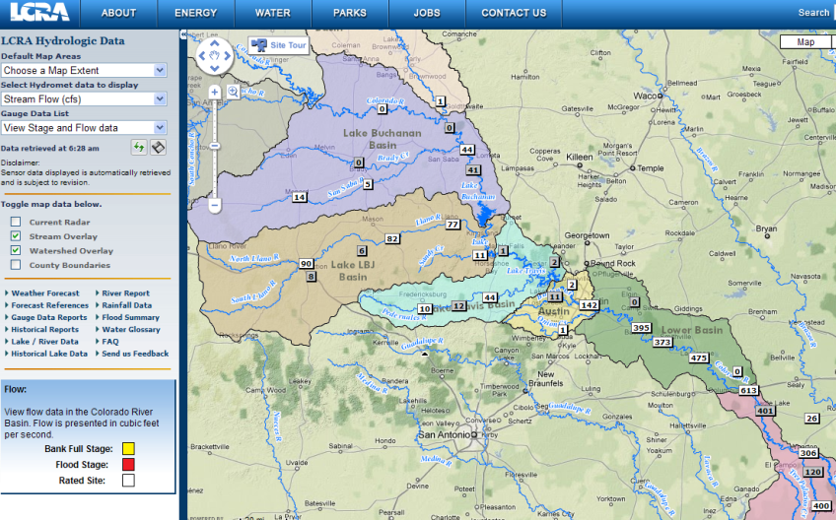
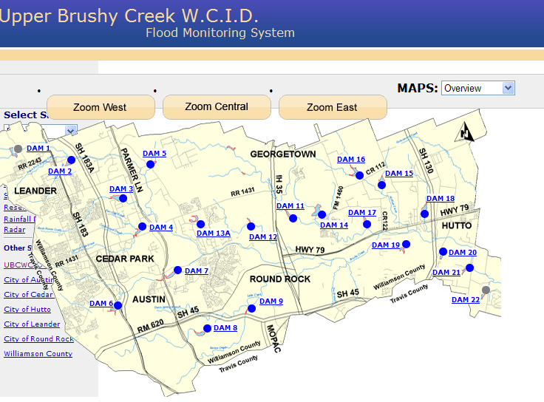
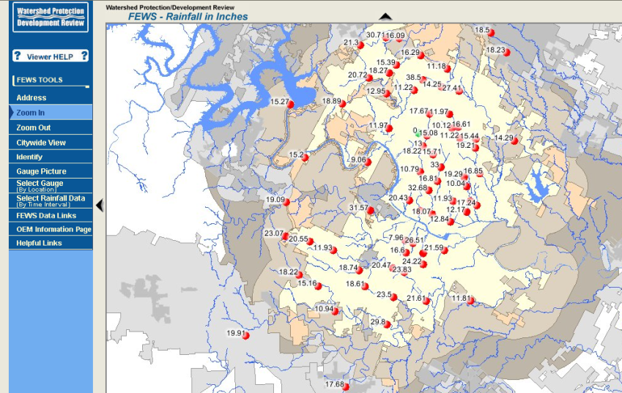
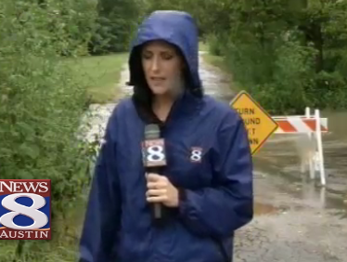
Local Information during Tropical Storm Hermine (7-8 Sept 2010)
Upper Brushy Creek (Round Rock)
LCRA
Bring data together into one system
http://hydromet.lcra.org
http://ubcwcid.org/Overview/Overview.aspx?id=1
TV
City of Austin
http://coagis1.ci.austin.tx.us/website/COAViewer_fews/viewer.htm

Slide 21
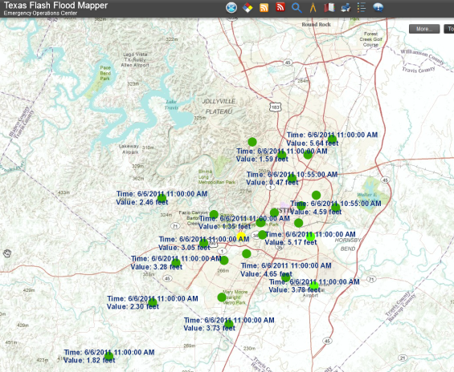
Real-Time Observations Map Layer
Real-Time WaterML service
Map Query Layer
Query Script to acquire observations
Output Map Layer for results
Output Map Service
Viewing System
http://waterservices.usgs.gov/nwis/iv?sites=08158000&period=P1D&parameterCd=00065
Stage Height Map Service (USGS and City of Austin) http://129.116.104.176/ArcGIS/rest/services/RealTime/COA_REALTIME/MapServer
NEXRAD Map Service http://129.116.104.176/ArcGIS/rest/services/RealTime/COA_NEXRAD/MapServer
Continually updating
Common Operating Picture Viewer:
http://129.116.104.176/PublicSafetyCOP/index.html

Slide 22
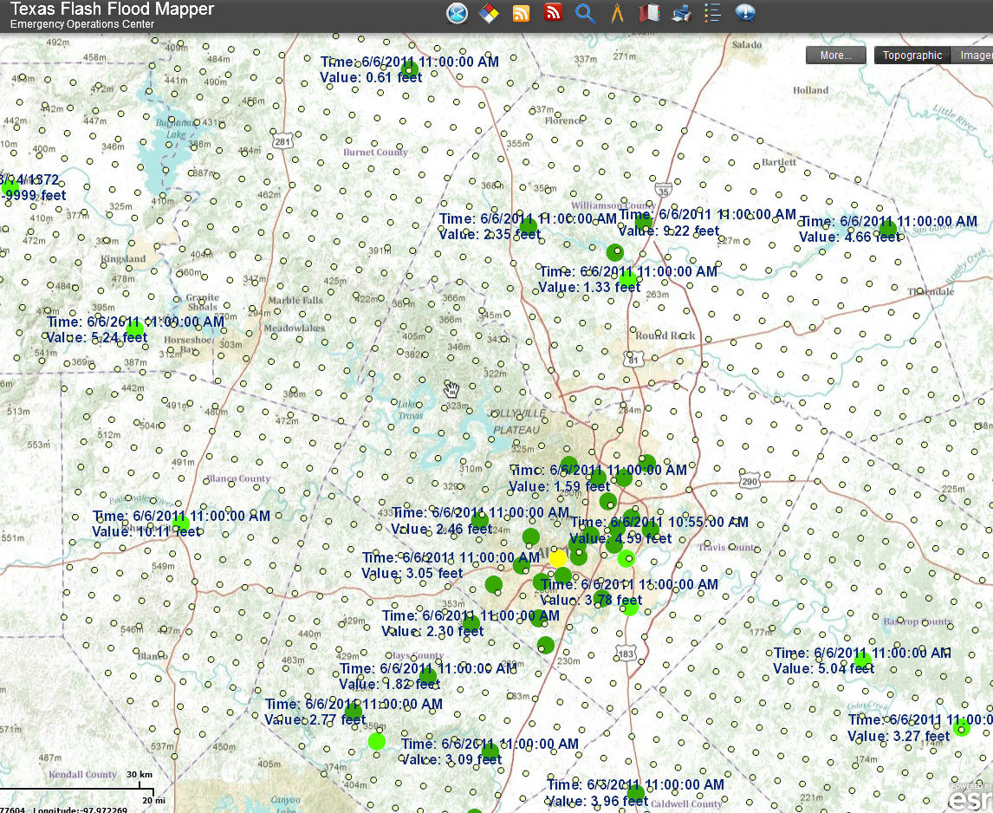
ESRI Public Safety Situational Awareness Viewer
Continuously updated maps of rainfall and stage height from multiple web services

Slide 23
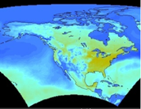
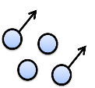
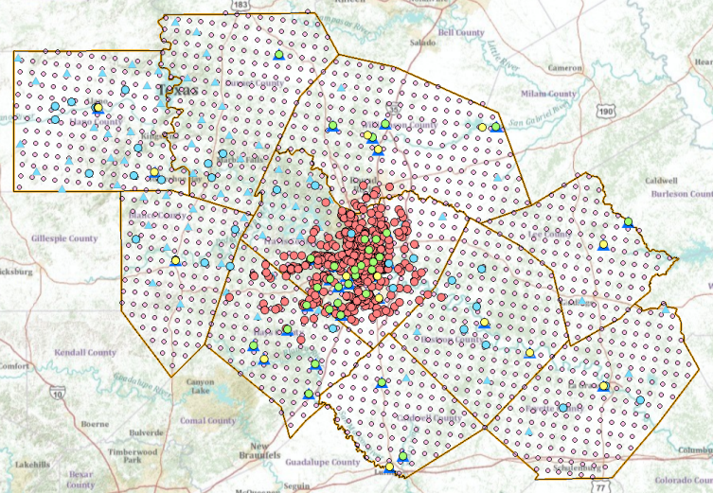
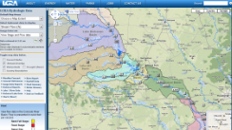
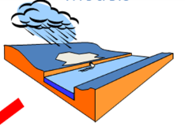
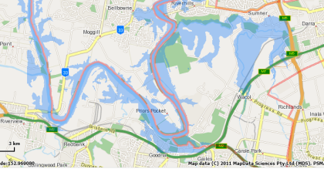
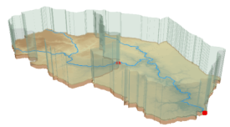
Web Services HUB
Inputs
Outputs
Web Services HUB
Observation
Data
Services
(WaterML)
Observation
Data
Services
(WaterML)
USGS
LCRA
COA
Channel
Data
Services
(WFS)
NWS
Mapping
Services
(WFS)
AHPS
Data
Services
(WFS)
Modeling
Services
Mapping
Services
(WFS)
Models
Maps

Slide 24
Conclusions
Water web services are operational
There are three levels
Publishing individual time series (USGS)
Publish an observations network (NPCA)
Publishing a collection of networks (Texas Water Development Board, CUAHSI)
Thematic maps can be built from time series
This is all supported and endorsed by WMO

