Slide 1
Towards a 3D National Hydrography Dataset
Presentation made to the US Geological Survey
By David R. Maidment
Center for Research in Water Resources
University of Texas at Austin
4 December 2013

Slide 2
Key Transitions in GIS
Paper maps to digital data
  National Spatial Data Infrastructure development
  Started in 1990’s
  Took more than a decade to complete
Digital data to web services
  Started about 3 years ago
  Will take years to complete
  Both data and model services
Maps
Data
Services

Slide 3

Desktop and Web GIS
Web GIS
Desktop GIS
Maps
Maps
Data
Services
Desktop GIS creates maps using local data on your computer
Web GIS creates maps using web services coming from anywhere

Slide 4
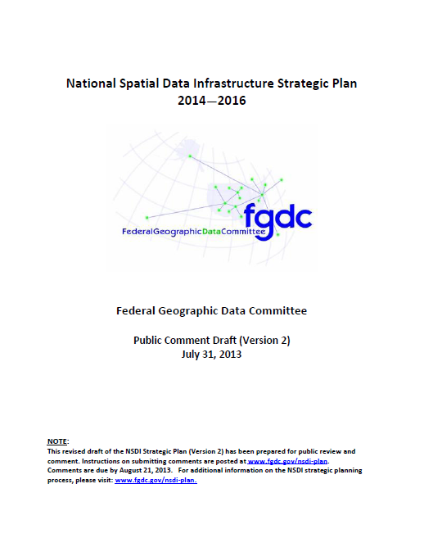
Vision for the NSDI – shared services
Desired Future State of NSDI
Create network of resources and services
Facilitate discovery, access and application of resources
Leverage shared standard-based services
Develop core set of information layers that interface with nonspatial data
Use real-time data feeds and sensor webs
This could equally be applied to water services

Slide 5
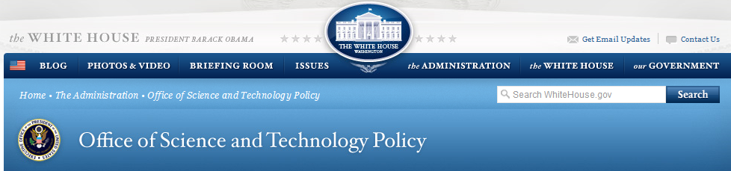
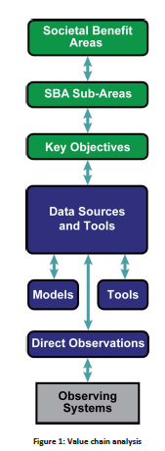

Committee on Environmental, Natural Resources, and Sustainability (CENRS)
“WaterML: Water Markup Language (ML) is an informatics initiative of the CENRS Subcommittee on Water Availability and Quality that provides a systematic way to access water information from point observation sites.” (p.21)
http://www.whitehouse.gov/sites/default/files/microsites/ostp/nstc_2013_earthobsstrategy.pdf

Slide 6
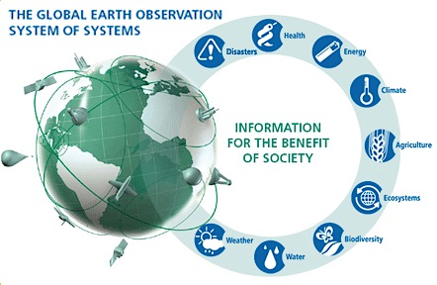
GEOSS – Global Earth Observation System of Systems
Group on Earth Observations (GEO) . . .
. . . located with WMO in Geneva

Slide 7
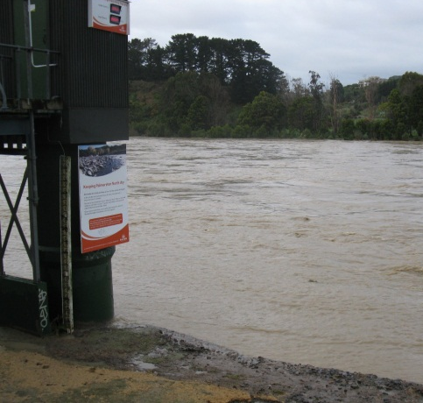
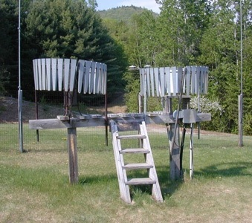
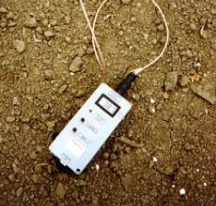
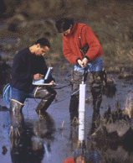
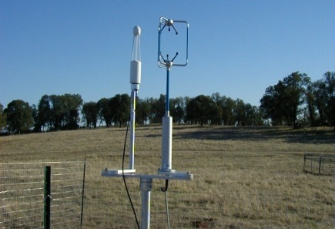
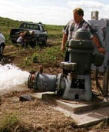
Water Observation – In Situ
Time series data at point locations
Water Quantity
Rainfall
Soil Water
Water Quality
Meteorology
Groundwater

Slide 8


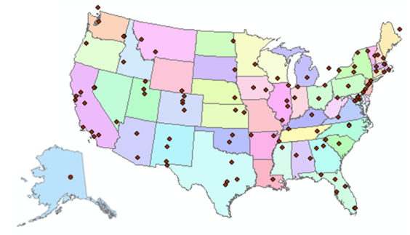
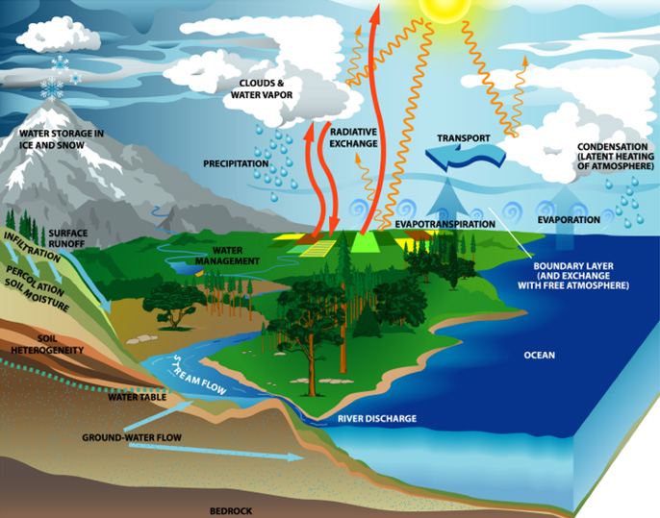
Consortium of Universities for the Advancement of Hydrologic Science, Inc.
www.cuahsi.org
CUAHSI
A consortium representing 125 US universities
Dr. Richard Hooper, President and CEO
Supported by the National Science Foundation Earth Science Division
Advances hydrologic science in nation’s universities
Includes a Hydrologic Information System project
Invented WaterML language for water resources time series
Building an academic prototype system

Slide 9
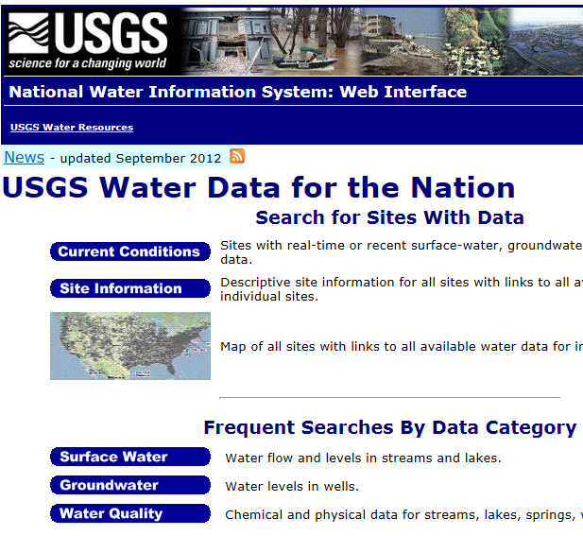
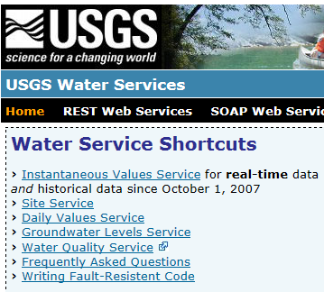
Web Pages and Web Services
Web pages deliver text and images
http://water.usgs.gov
Web services deliver data encoded in XML
http://waterservices.usgs.gov/

Slide 10

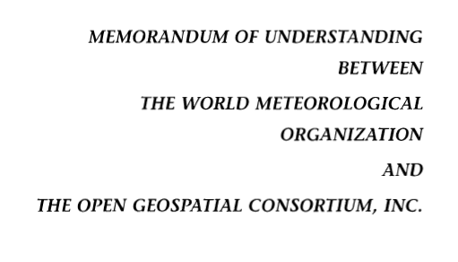
OGC/WMO Hydrology Domain Working Group
4-Year International Effort – WaterML2
A time series for one variable at one location
Hydrology Domain Working Group formed
OGC at WMO Commission on Hydrology
Technical Meetings Each 3 Months
Four Interoperability Experiments
(Surface water, groundwater, forecasting)
Annual week-long workshops
Involvement by many countries
November 2009
Acknowledgements: OGC, WMO, GRDC, CUAHSI, BoM/CSIRO, USGS, GSC, Kisters, …….
2008
2009
2010
2011
2012
Notes:
(1) A four-year international effort has been undertaken to reconcile WaterML with international standards;
(2) This effort was initiated with the establishment of an Hydrology Domain Working Group by the Open Geospatial Consortium in September 2008;
(3) An OGC representative attended the WMO Congress of the Commission for Hydrology in 2008
(4) A formal agreement between Secretary General of WMO and President of OGC in 2009 to jointly develop standards for hydrology, climatology, oceanography and climatology;
(5) The joint OGC/WMO Hydrology Domain Working Group was supported by a large work effort, annual week-long workshops, four interoperability experiments for surface and groundwater data exchange, and participation by many countries;
(6) In June 2012, the OGC voted to adopt the revised version, WaterML2 as an international standard for exchange of water resources time series (the first such public standard that has existed);
(7) This Congress to the WMO Commission for Hydrology to whom I am speaking is considering WaterML2 for adoption as an official standard by WMO

Slide 11
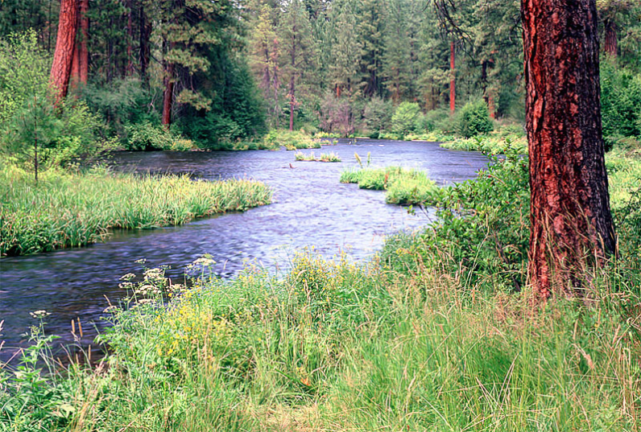
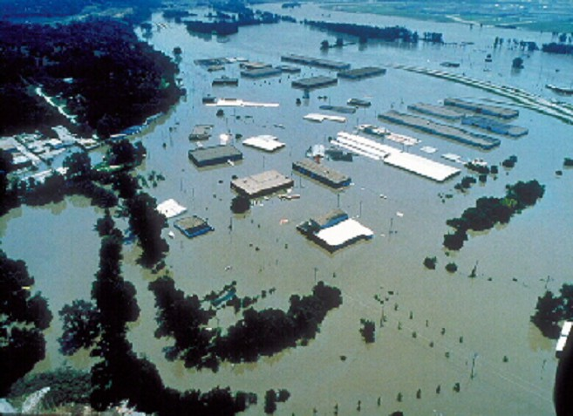
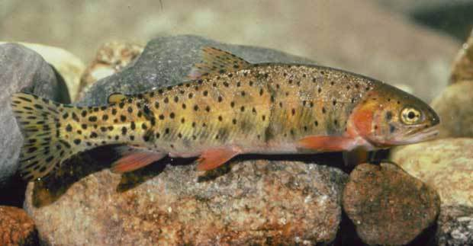
River Channels
River Network
Channel Shape
Geography
Flooding
Aquatic Biology
Applications

Slide 12



RiverML: Standardizing the Communication of River Model Data
Stephen R. Jackson
David R. Maidment
David K. Arctur
Center for Research in Water Resources
University of Texas at Austin
OCI-1148453 (2012-2017)
OCI-1148090 (2012-2017)

Slide 13
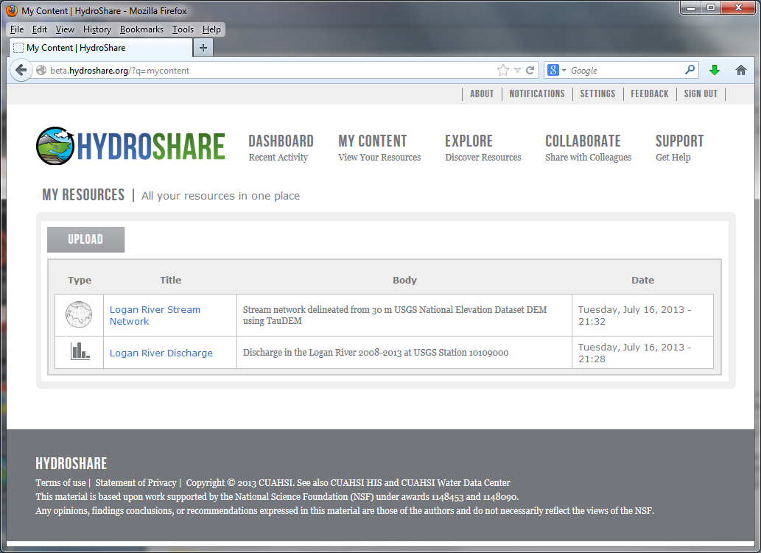

Slide 14
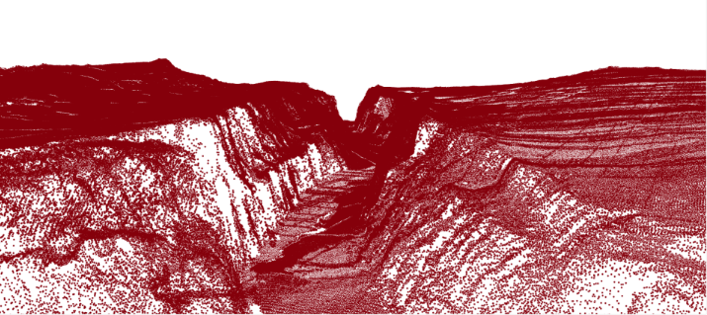
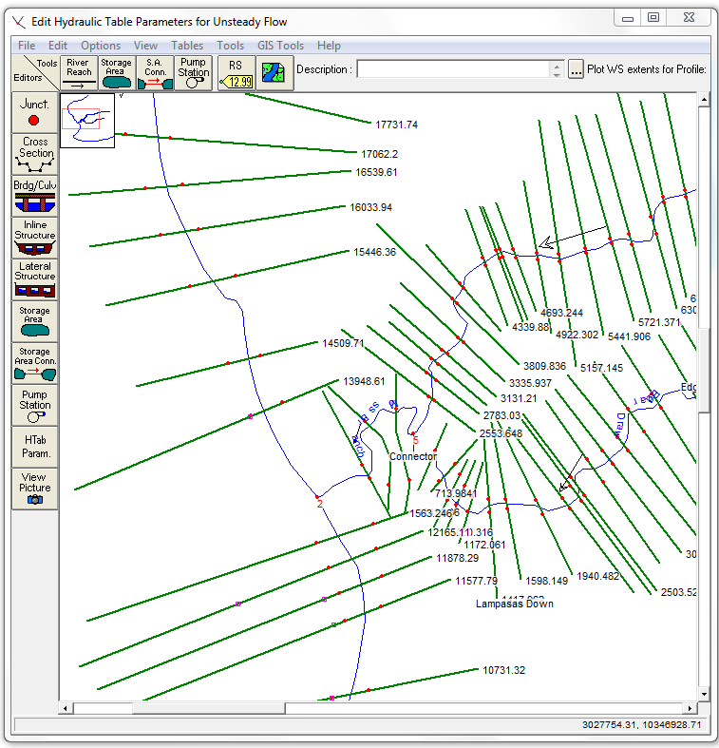
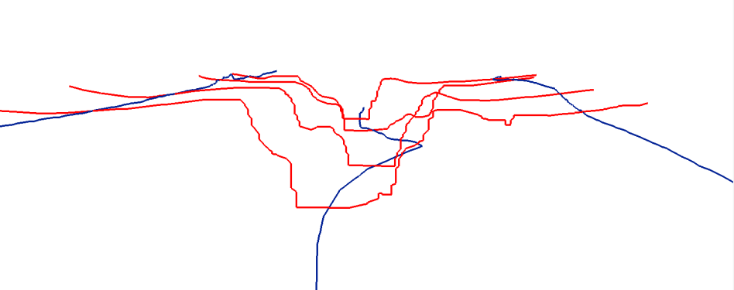
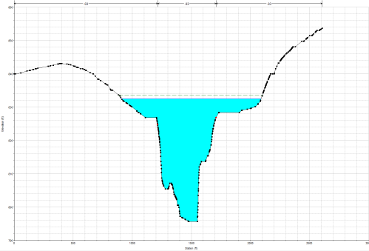
Representing River Geometry in HydroShare
LiDAR
Cross Sections Attached to River Network
Cross Sections
Hydraulic Calculations

Slide 15
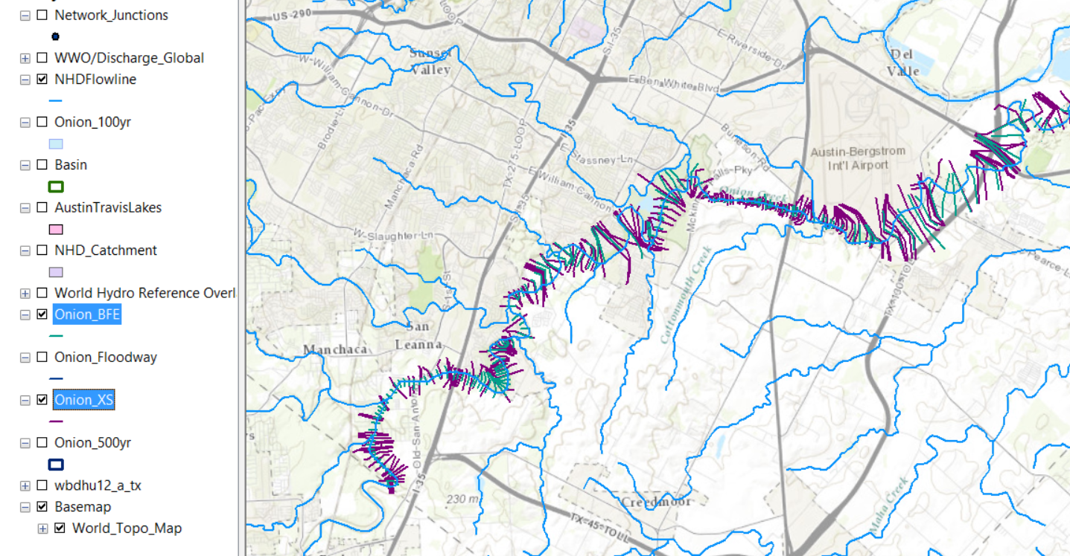
Cross-Sections and Base Flood Elevations

Slide 16
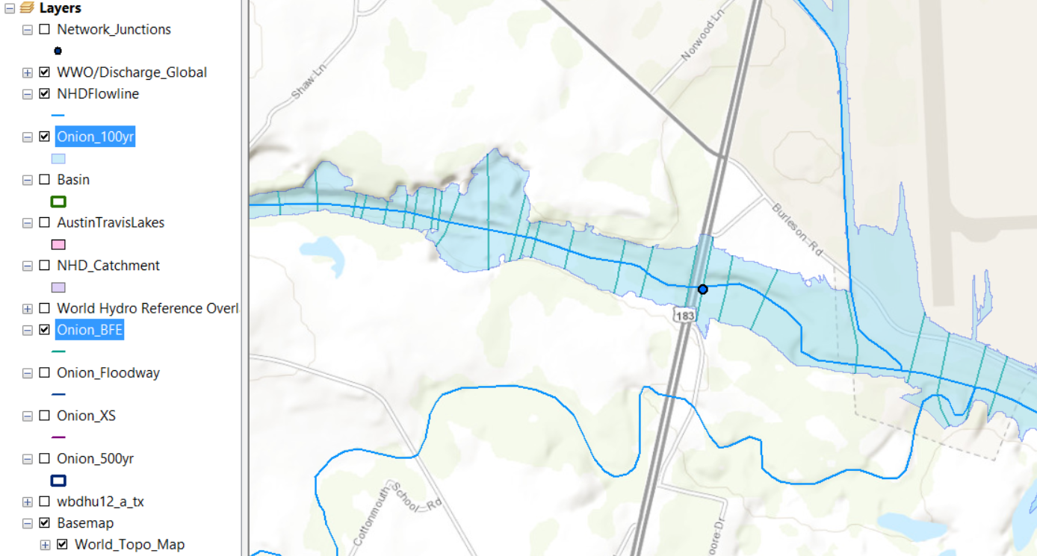
Base Flood Elevations (100 yr flood)
Highway 183
489’
485’
487’
483’
488’
484’

Slide 17
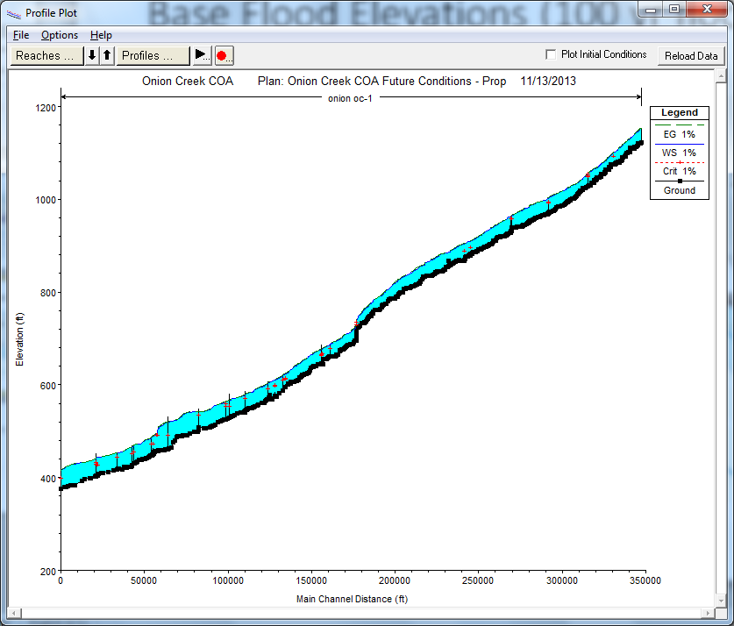
HEC-RAS Longitudinal Profile of Base Flood Elevation on Onion Ck
Elevation above datum
Distance from lower end of channel

Slide 18
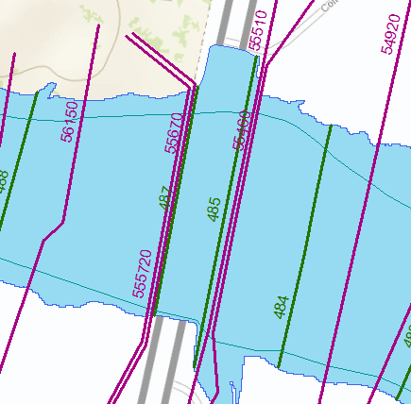
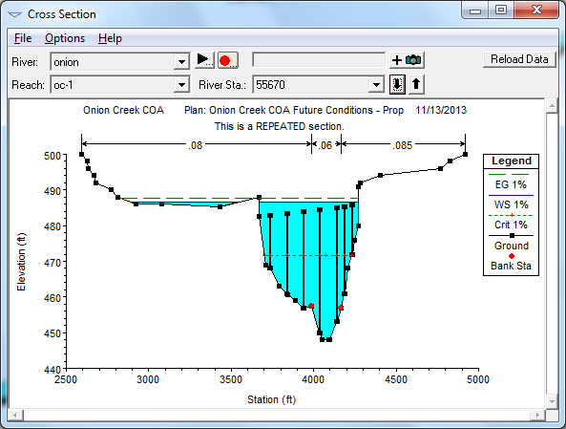
Cross-Section 55670 in HEC-RAS
Elevation of 100 year flood is 487 ft above datum
at cross-section 55670 ft from lower end of channel

Slide 19
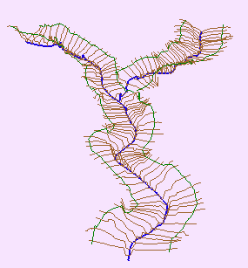
Channel Cross-Section
Direction of Flow
Channel
Cross-Section
Notes:
Before we get into detail let’s quickly define a channel and a cross-section. A river of stream Channel is a conduit or water course carrying water flow under gravity.
A Cross-Section refers to the section of a channel taken normal to the direction of the flow.

Slide 20
HydroShare: Channel Data
From the NSF project proposal: “As an exemplar for advancing data access, we will establish a national repository within HydroShare for river channel cross section data: a new data type not presently supported by CUAHSI HIS. Since 2003, the United States has spent more than $2 billion on digital flood map modernization. A great deal of river channel cross-section, morphology and hydraulic modeling data has been developed to support this mapping and some of that could be repurposed to advance water science. This repository will include a mechanism for voluntary submission of information and it will provide access to this data in a standard way such that it is easy to run hydraulic models that use this data on either local or HPC environments.”

Slide 21
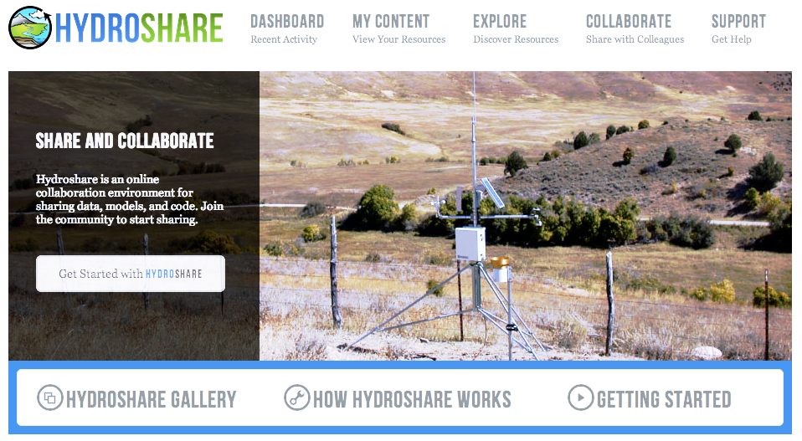
HydroShare.org: Web-based collaborative
environment for sharing data & models

Slide 22
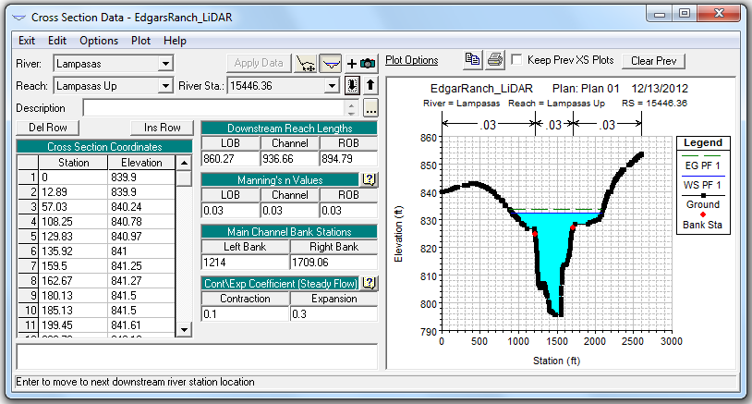
Sample Hydraulic Model: HEC-RAS
Calculated Water Surface Elevation
At present, river data formats are software-specific, and thus options for data sharing are limited.
Georeferenced Cross Sections

Slide 23
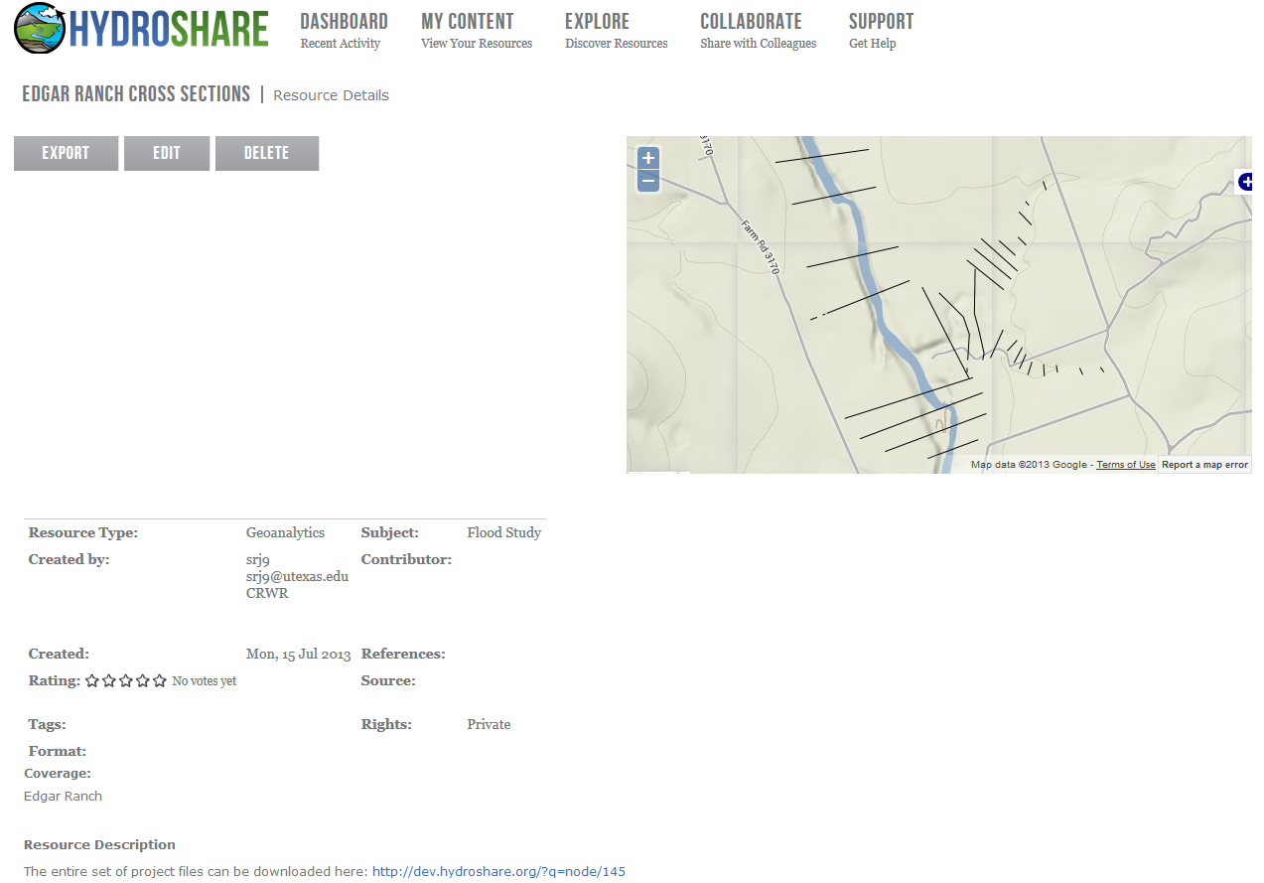
HydroShare: Resource Discovery
With a standardized exchange language, generalized tools can be developed to discover, view, and share river information independent of the software package which generated the data.

Slide 24
OGC HY_Features: General Semantic Structure
Hydraulic
Hydrologic
Based on International Glossary of Hydrology

Slide 25
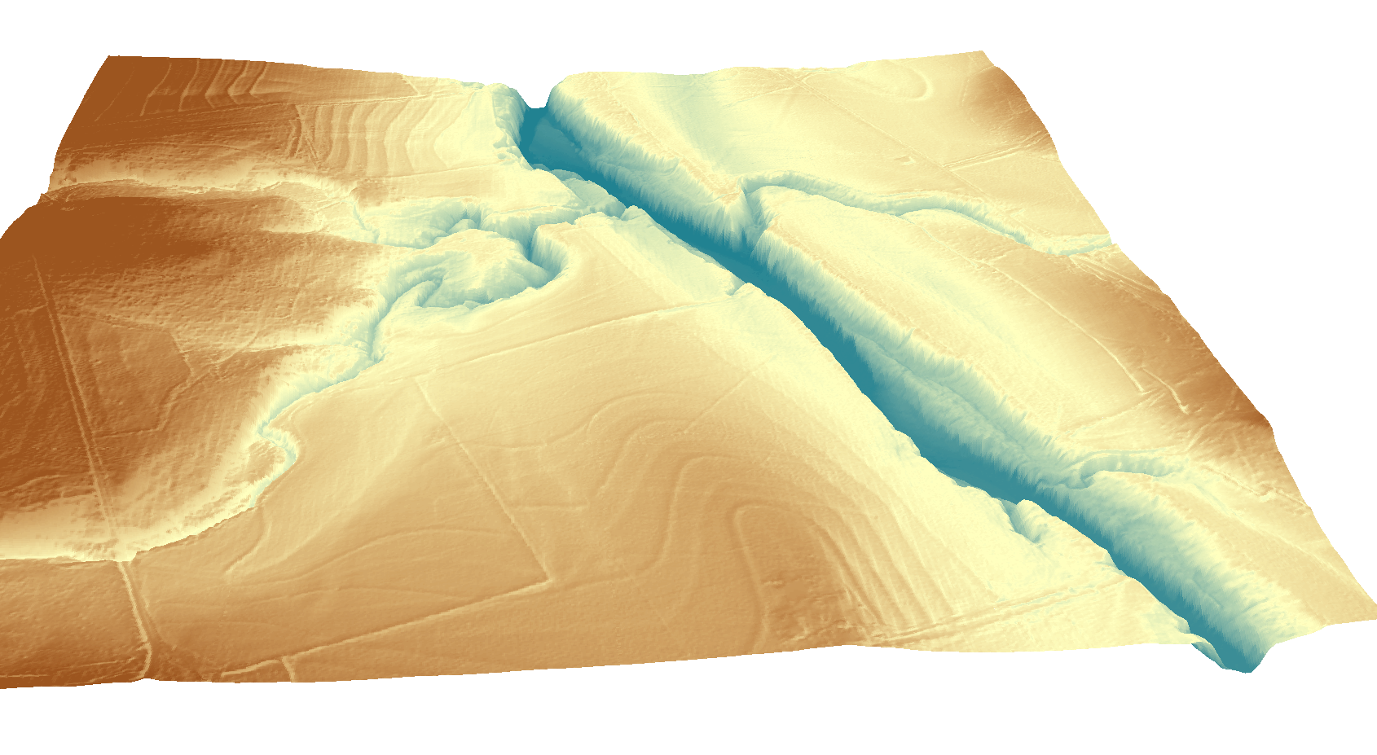
RiverML: Interoperability in River Modeling
RiverML
(Geometry, Catchment, River Network)
Terrain Processing Software
(ArcGIS, AutoCAD, etc.)
Hydrologic Calculation Software
(HEC-HMS, PondPack, etc.)
RiverML
(Water Surface
Elevation Observations)
RiverML
(Flow Rate Observations)
RiverML
(Geometry, River Network)
Hydraulic Calculation Software
(HEC-RAS, MIKE Flood HD, etc)

Slide 26
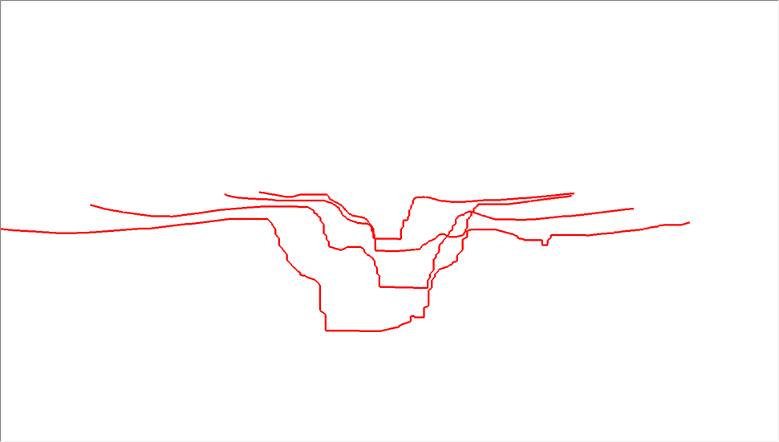
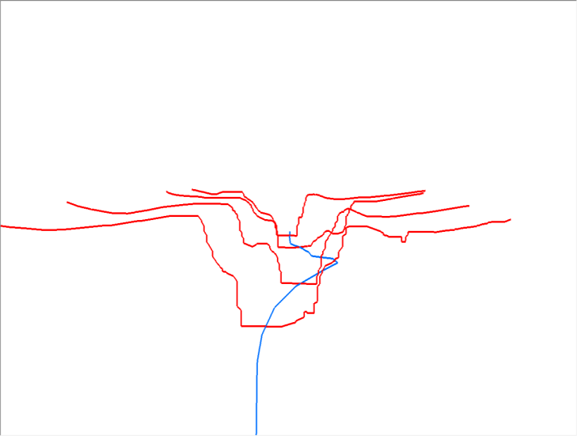

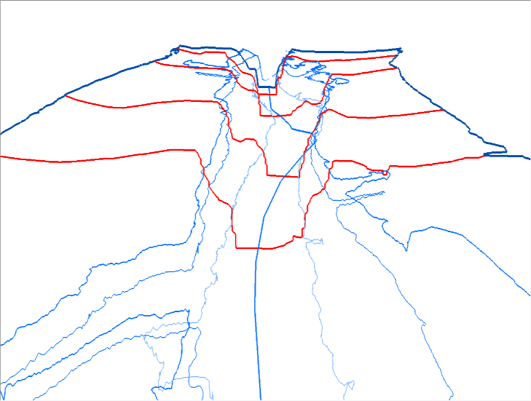
Geometry: Cross Sections and Flow Lines
Cross Sections
Center Flow Line
Overbank Flow Lines
Topological Flow Lines

Slide 27
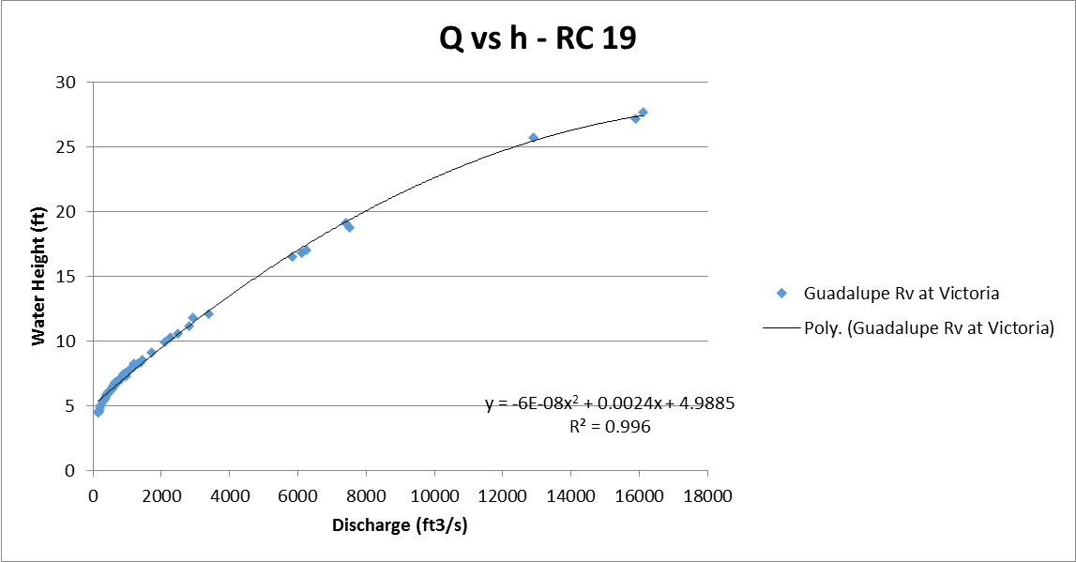
Relationship between “Q” and “h”

Slide 28
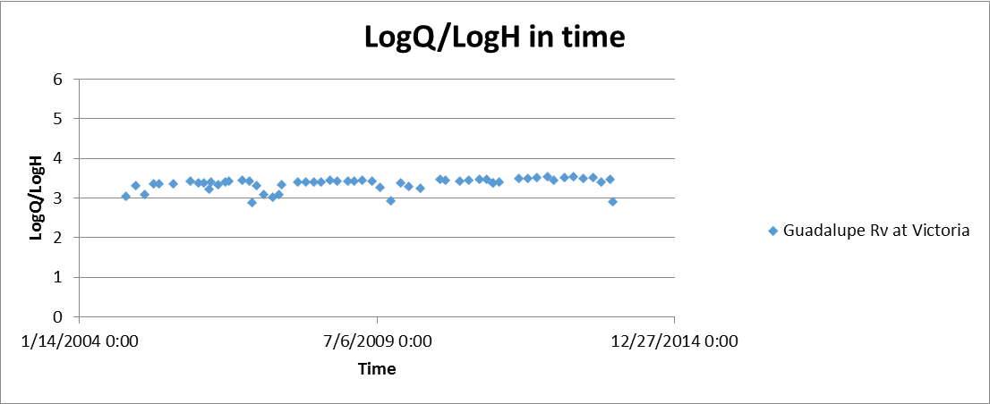
Relationship between “Q” and “h”

Slide 29
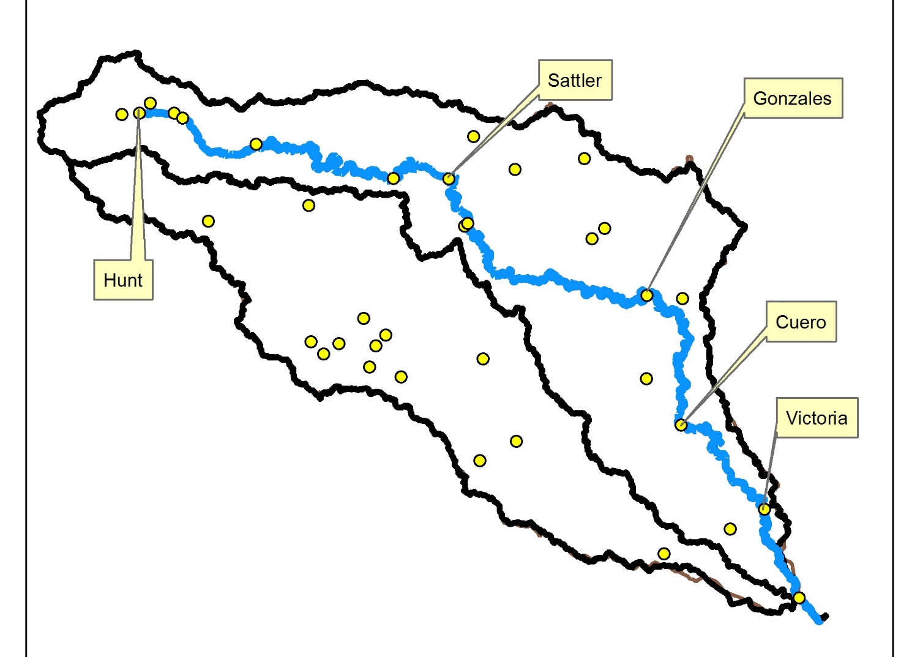
Relationship between “Q” and “h”

Slide 30
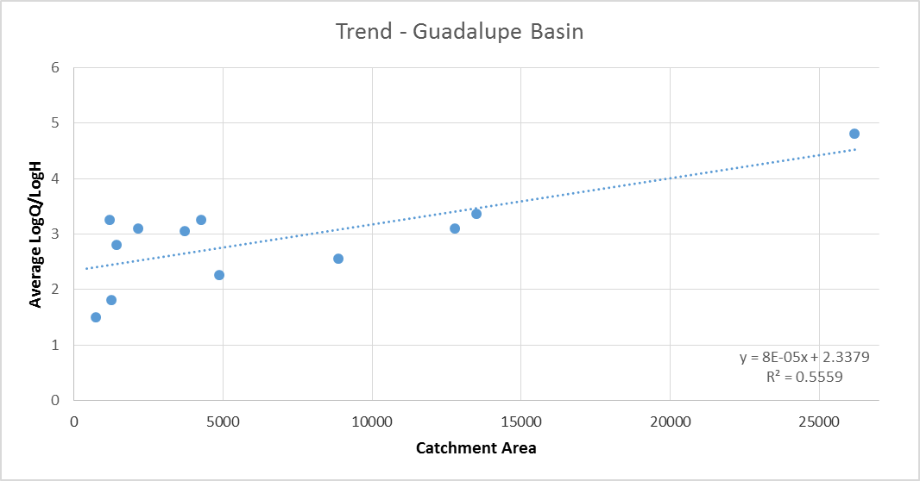
Relationship between “Q” and “h”

Slide 31
Conclusions
The OGC/WMO Hydrology Domain Working Group has effectively become the mechanism for international standards development for water
This group:
  Published in 2012 the WaterML2 standard for water time series (now endorsed by OSTP)
  Is working on a “ratings and gagings” standard for Q vs h
  Has endorsed the idea of developing RiverML
How can these developments be leveraged for formation of a 3DNHD?
How does the USGS function as an authoritative source of river channel information in the internet age?

