Slide 1
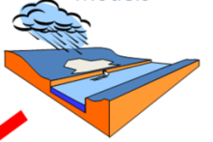
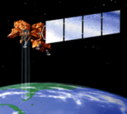
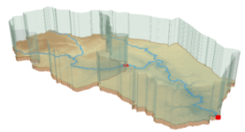
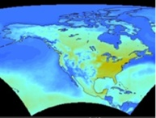
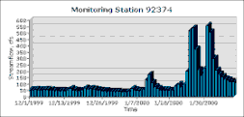
Water and Catchment Data Services
David R. Maidment
Center for Research in Water Resources
University of Texas at Austin
River Science Symposium
Swansea, Wales
April 18, 2011

Slide 2
Water and Catchment Data Services
Water Data Services
WaterML
Catchment Data Services
Watershed and River Data

Slide 3
Water and Catchment Data Services
Water Data Services
WaterML
Catchment Data Services
Watershed and River Data

Slide 4
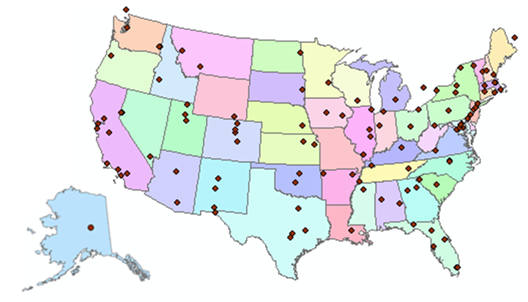
http://www.cuahsi.org
CUAHSI is a consortium representing 125 US universities
Supported by the National Science Foundation Earth Science Division
Advances hydrologic science in nation’s universities
Includes a Hydrologic Information System project

Slide 5
How the web works
Catalog (Google)
Catalog harvest
Search
Web Server
(CNN.com)
Access
Browser
(Firefox)
HTML – web language for text and pictures

Slide 6
Services-Oriented Architecture for Water Data
Catalog
Service registration
Search
Catalog harvest
Server
Data access
User
WaterML – web language for water data

Slide 7
Some terms and definitions
Web Service: A web service allows for information to be exchanged computer-to-computer over the internet
Portal: A one-stop shop that pulls together information from various sources and provides it to the user in a seamless fashion using a web site
Catalog: Like a library card-catalog, these provide summary level information on what data are available at the various sources
Exchange Schema: An agreed-upon data sharing format via which data owners publish data (e.g. WaterML)
Source: Dwane Young, Western States Water Council
Notes:
In order to understand what I’d talk about, these are some basic terms that need to be defined. The key term that needs to be understood is the idea of a web service. The best way to describe a web service is to relate it to something that they may already be familiar with. The best example I’ve been able to come up with is describing the ‘Weather Bug’ web service. A lot of people have interacted with this type of service. They have a little application that’s running on their computer that required a ‘Input parameter’, in this case a zip code. The application uses that to query another computer out on the internet. That computer returns to your computer a file that has all the information about the weather for your zip code. The application reads that file and turns it into a nice little icon that says that it’s raining and 42 degrees. The user never needs to know that this application is going out there and doing this, and doesn’t need to re-enter their information or interact with a web site or anything. It all happens in the back-ground as computer-to-computer communication.

Slide 8
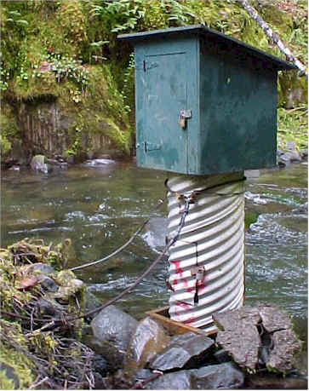
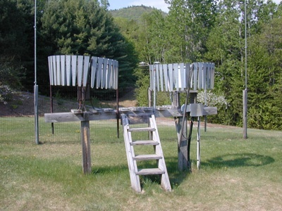
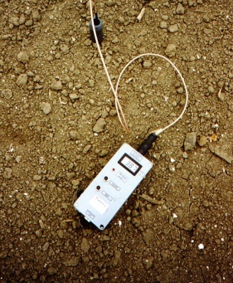
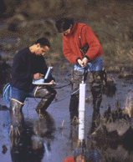
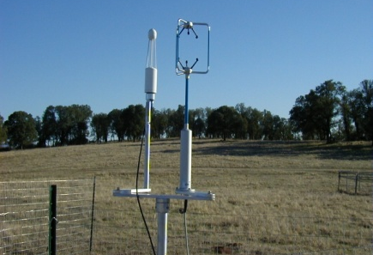
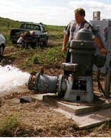
We Collect Lots of Water Data
Water quantity
Rainfall
Soil water
Water quality
Meteorology
Groundwater

Slide 9
The Data are Collected by Many Organizations
Water Districts
Federal Agencies
River Authorities
State Agencies
Cities
Universities
…. and the data are continuously accumulating

Slide 10
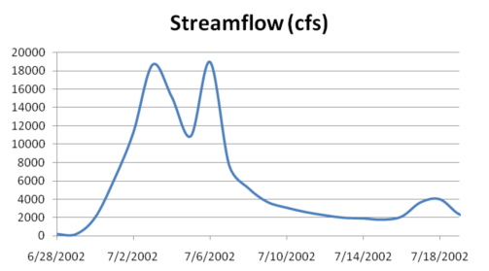
The Data have a Common Structure
A point location in space
A series of values in time
Gaging – regular time series
Sampling – irregular time series
Notes:
These data are recorded over time to monitor a hydrologic process or property.

Slide 11
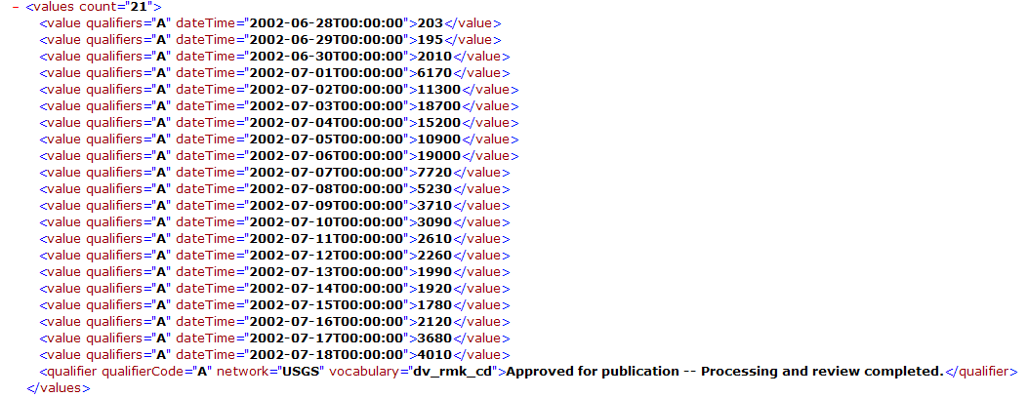
They can be expressed in WaterML
Discharge of the San Marcos River at Luling, TX June 28 - July 18, 2002
USGS Streamflow data in WaterML language
The USGS now publishes its time series data as WaterML web services

Slide 12
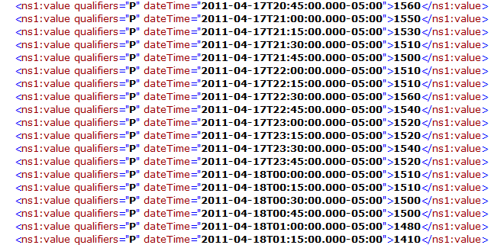
Colorado River at Austin
I accessed this WaterML service from my hotel in Swansea at 8:21AM this morning
(2:24AM Central Time)
http://waterservices.usgs.gov/nwis/iv?sites=08158000&period=P7D&parameterCd=00060
And got back these flow data from USGS which are up to 1:15AM Central time

Slide 13
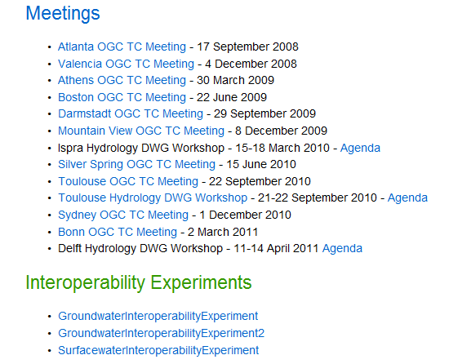
OGC/WMO Hydrology Domain Working Group
Design of WaterML 2.0 and testing in Interoperability Experiments

Slide 14
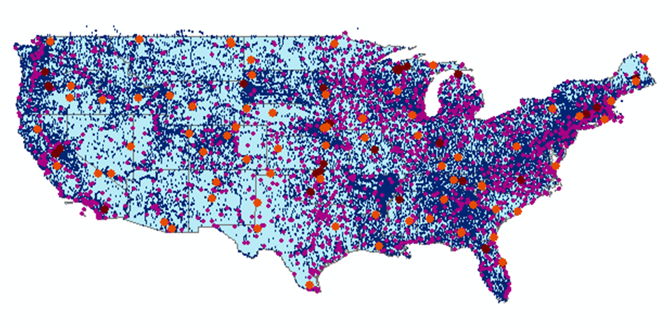
CUAHSI Water Data Services Catalog
69 public services
18,000 variables
1.9 million sites
23 million series
5.1 billion data values
And growing
The largest water data catalog in the world
maintained at the San Diego Supercomputer Center

Slide 15
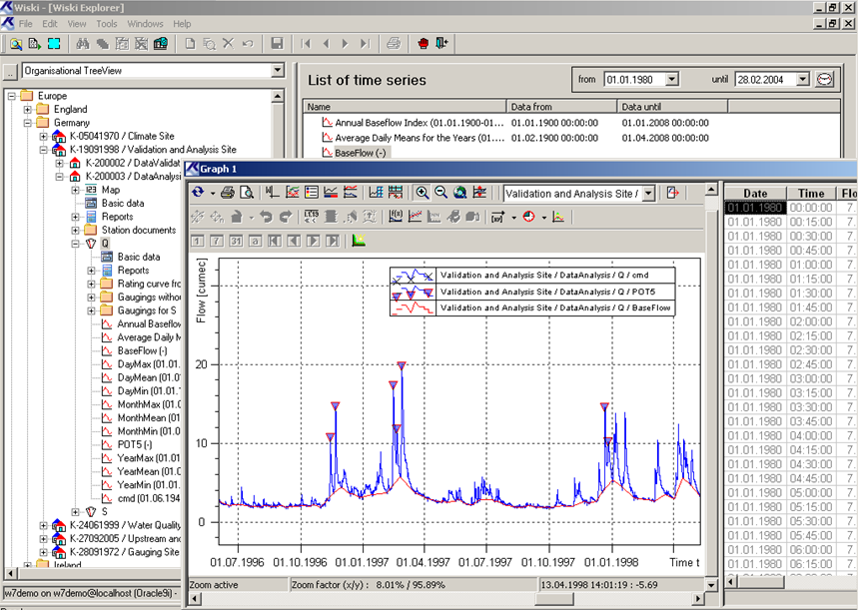
WISKI Water Data Management System from the Kisters company based in Aachen, Germany
Kisters has adopted the CUAHSI model for water data services

Slide 16
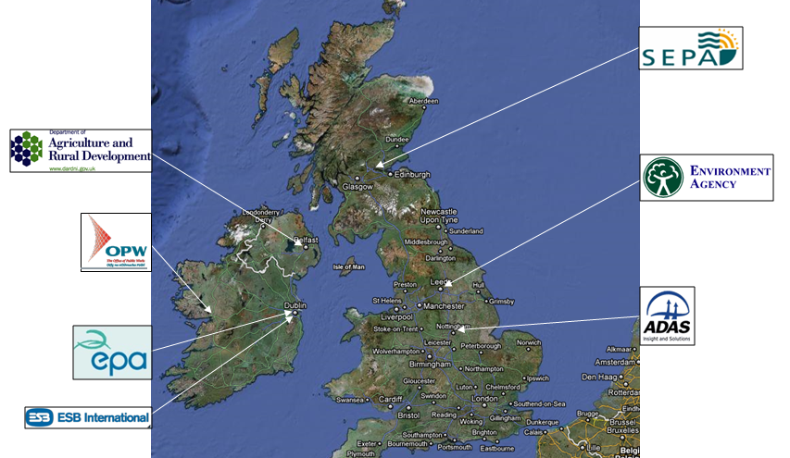
WISKI Data Systems in the UK and Ireland
The technology to implement CUAHSI water data services in the UK is already deployed….

Slide 17
WISKI Data Systems in the UK and Ireland
Surface water: 7696 Rainfall: 13236 Groundwater: 20184 Effluent sites: 3658 Water quality: 237 Areal: 257 (for calculation of areal rainfall) Secondary gauging sites: 43 (for summarizing gaugings) Reservoirs: 239
46,000 sites

Slide 18
Water and Catchment Data Services
Water Data Services
WaterML
Catchment Data Services
Watershed and River Data

Slide 19
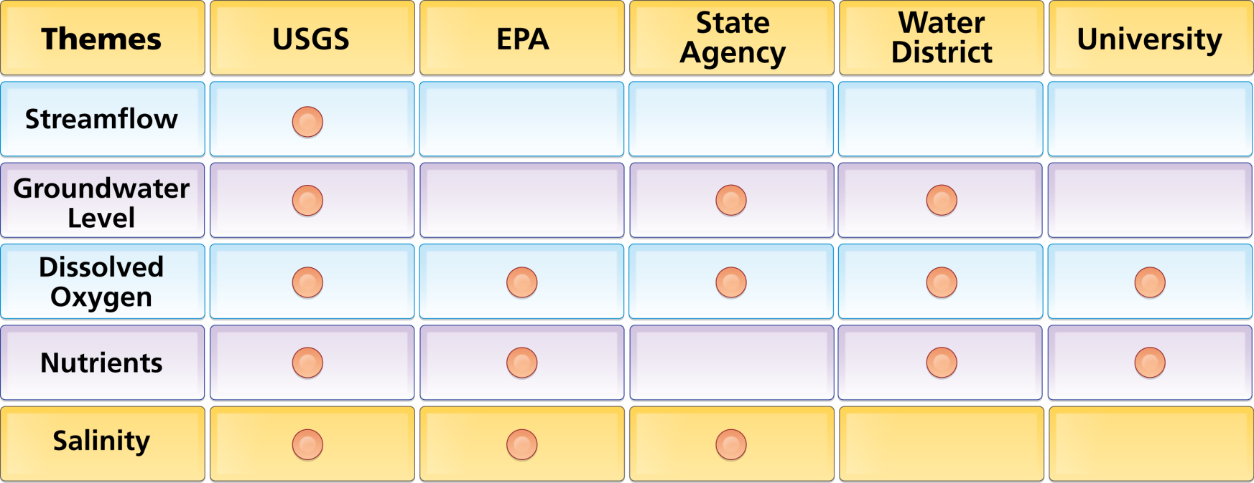
Organize Water Data Into “Themes”
Integrating Water Data Services From Multiple Sources
WaterML
WaterML
WaterML
WaterML
WaterML
. . . Across Groups of Organizations

Slide 20
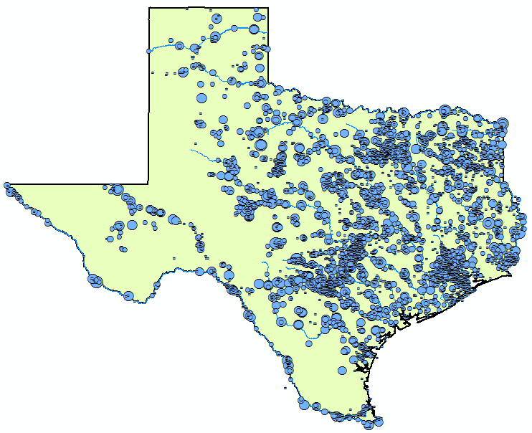
Streamflow Data Services
2 services
7 variables
4,363 sites
11,484 series
9,493,968 records
Notes:
Here’s an example showing where streamflow is measured in Texas from two different services (i.e., data providers).

Slide 21
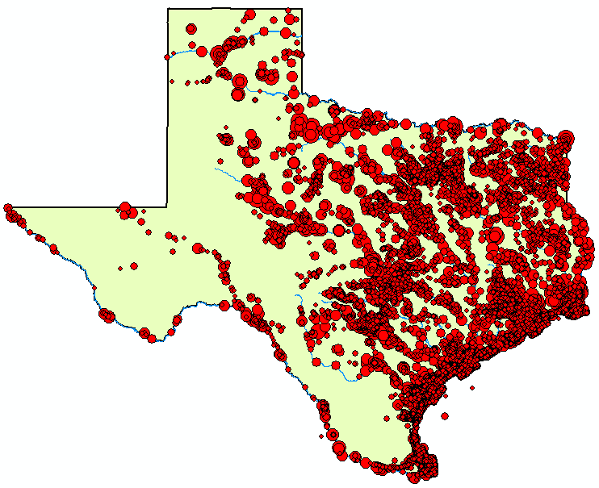
Water
Temperature Data Services
6 services
11 variables
11,158 sites
22,953 series
1,546,841 records

Slide 22
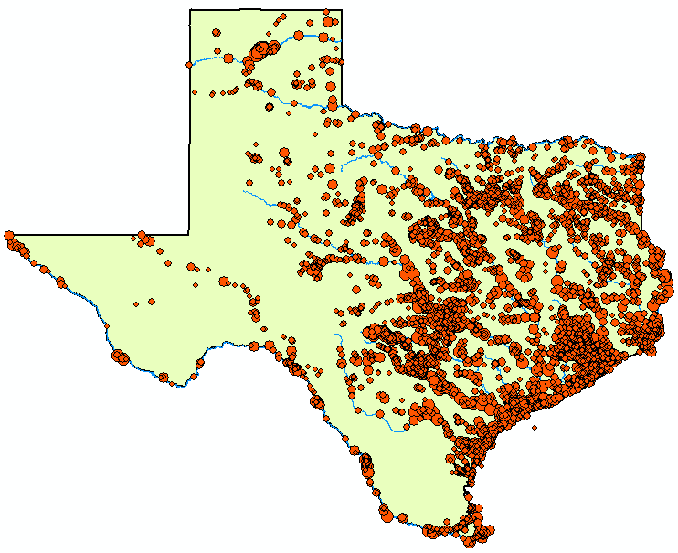
Bacteria Data Services
1 service
21 variables
4,801 sites
15,483 series
297,849 records

Slide 23
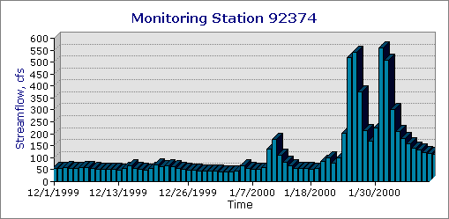
A Virtual Observatory for Catchments
Accessing and synthesizing data and models ……
Modeling
Remote Sensing
Weather and Climate
Monitoring
Catchment
…… doing this in “the cloud”

Slide 24
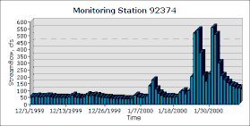
A Question…
Once you have a cloud…..
…..what is the telescope you use to view it?

Slide 25
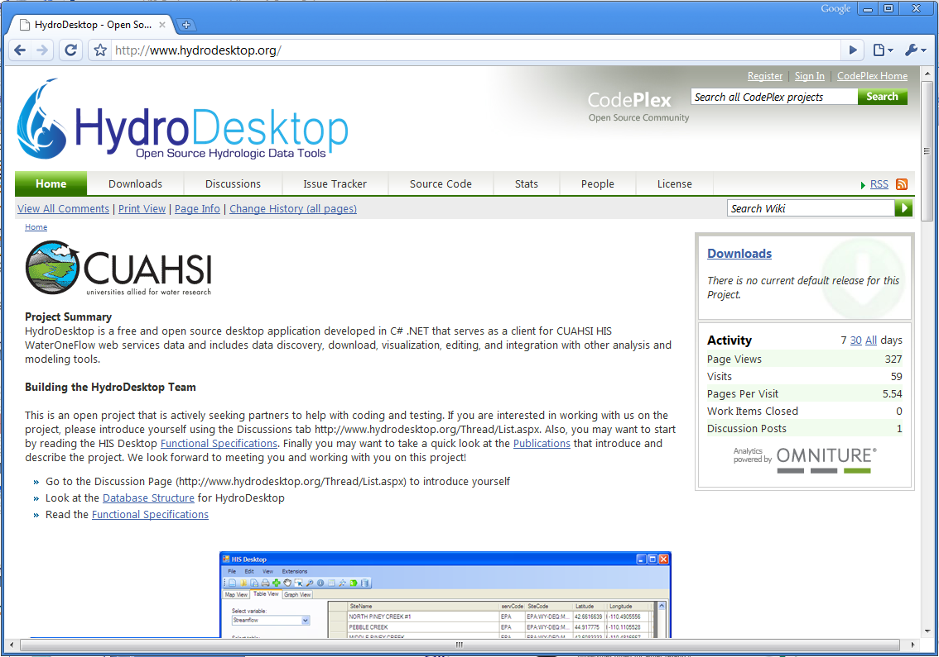
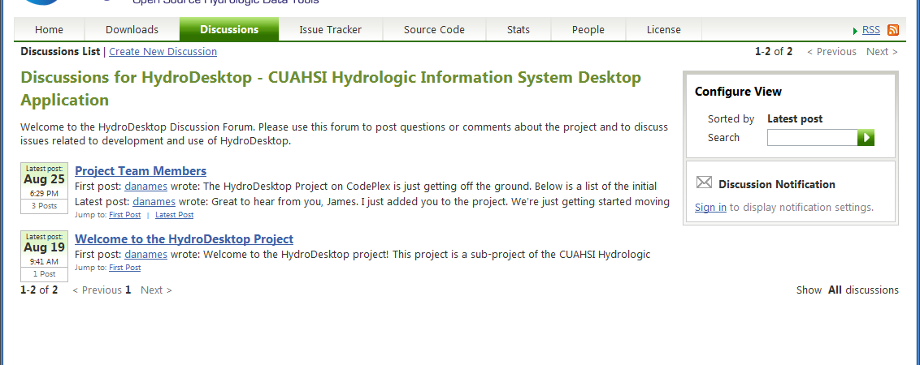
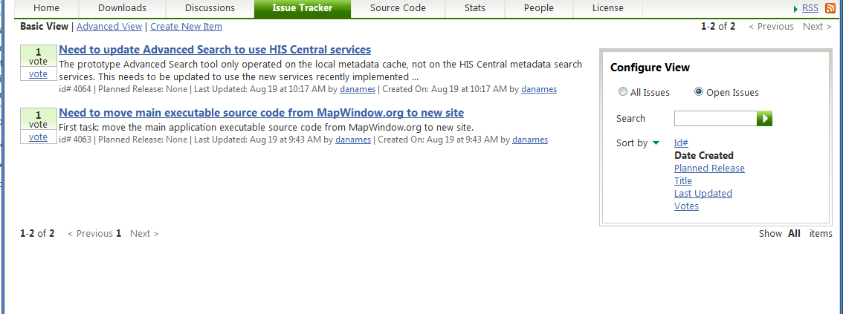
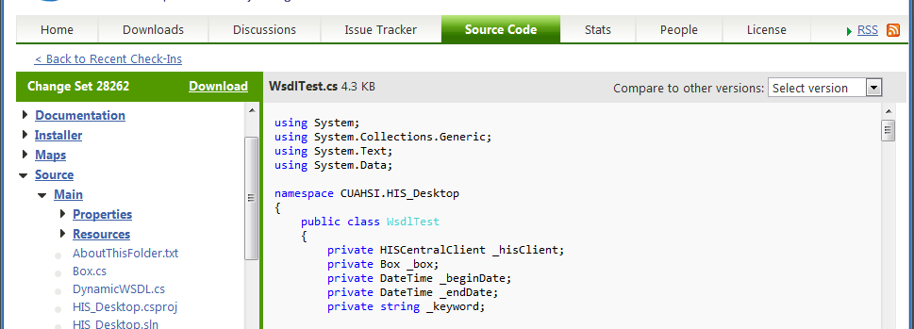
HydroDesktop – an Open Source HIS
A web-based collaborative software design and development environment was set up on CodePlex.com. This site includes a discussion forum, wiki, source code repository and versioning system, and bug/issue tracking system.
http://www.HydroDesktop.org
Notes:
HydroDesktop development is following the open source model and is housed at the Microsoft CodePlex web site. The project can be accessed through the link:www.hydrodesktop.org and is open for public participation in the project. The collaborative development portal includes a project WIKI with information about the project, a Downloads page for current installers and releases of the software, a Discussion Forum for open discussions and questions about the project, an Issue tracker for managing bugs, features, and issues. Also direct access to source code is available for anyone (authorized users are invited to contribute source code directly to the project). HydroDesktop is licensed under the BSD open source license which allows it to be used in commercial, non-commercial, academic, government or other settings as needed.

Slide 26
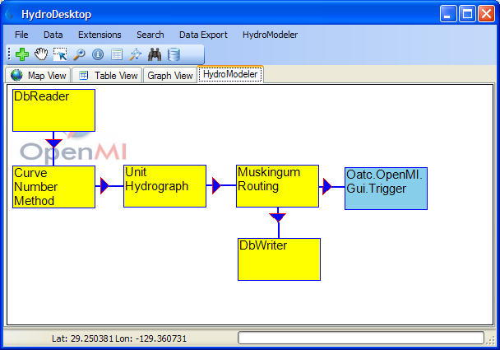
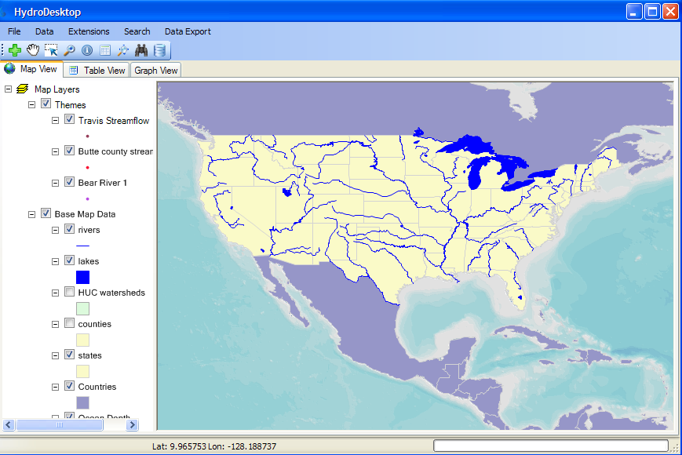
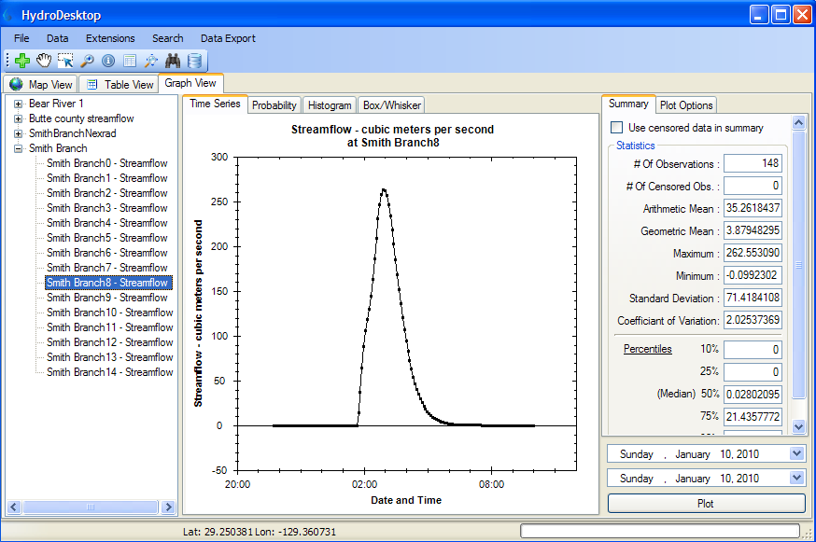
HydroDesktop A Hydrologic Information System integrates space, time and modeling
OpenMI
MapWindow
SQLite
http://www.hydrodesktop.org – an open source software development

Slide 27
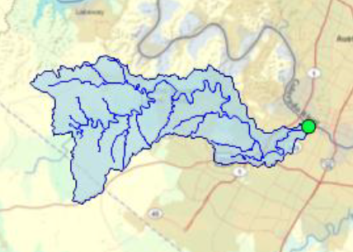
Watershed Delineation in HydroDesktop
Uses EPA Waters Web Services
See demo at:
http://data.crwr.utexas.edu/JacobsWellSpring/

Slide 28
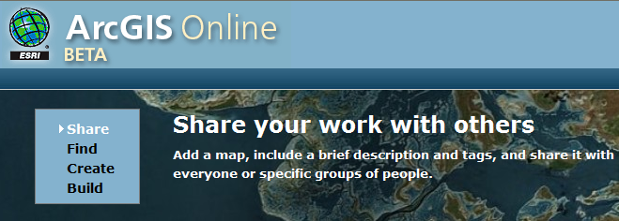
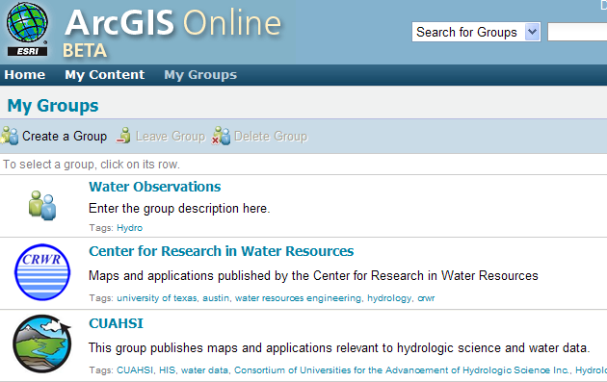
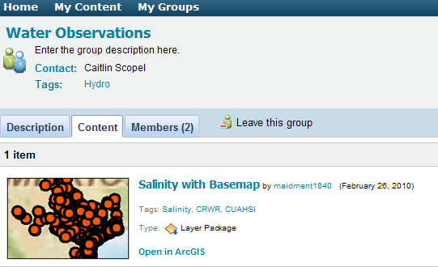
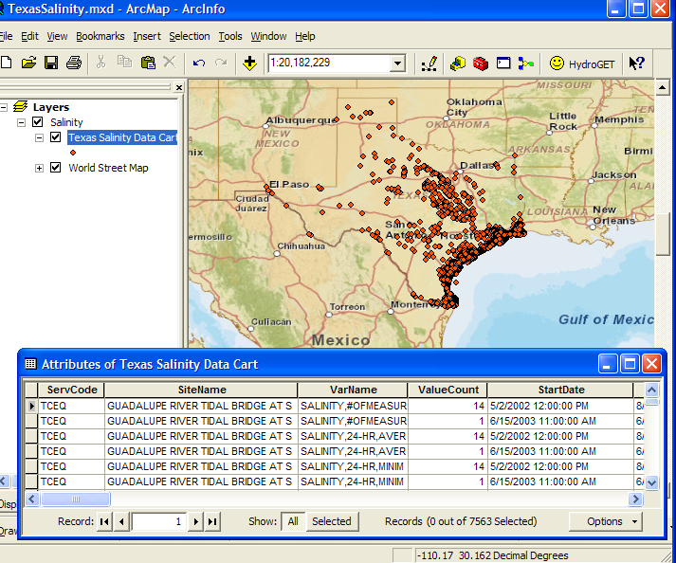
A Social Networking System for Sharing Geospatial Data

Slide 31
A new initiative – you are invited to participate
What Data Services are Needed to Support River Science?

