Slide 1
CE 311K
Introduction to Computer Methods
Daene McKinney
Introduction
www.ce.utexas.edu/prof/mckinney/ce311k/ce311k.html

Slide 2
Introduction
Course Introduction and Housekeeping
Computer Systems – Hardware and Software
The Internet
Program Planning

Slide 3
Course Objectives
Introduce computer methods for the solution of civil engineering problems, including:
  Intro to computer hardware and operating systems,
  Organization of engineering problems for computer solution,
  Selection of appropriate numerical solution software, methods, and algorithms,
  Elementary numerical analysis of selected algorithms,
  Writing, compiling, and executing Visual Basic programs
  Presentation of problems and their solution,
  Use of the WWW to communicate and retrieve information

Slide 4
Housekeeping
Prerequisites
  M408C, Calculus I, Co-requisite: M408D, Calculus II
Text
  Required:
    Schneider, D. I., An Introduction to Programming Using Visual Basic 2008, 2008, Prentice Hall
    Microsoft Visual Studio Express Edition with VB2008 (CD in back of the text or download from the web:
    http://www.microsoft.com/express/Downloads/#2010-Visual-Basic
  Strongly Suggested:
    Chapra, S. & R. Canale, Numerical Methods for Engineers
Homework
  Due at beginning of lecture, due date on web site
  Lab assignments due next lab period
  Late homework penalized 50% per day late

Slide 5
Housekeeping
Grading
  A >= 90, B >= 80, C >= 70, etc
  Exams: 50% (2 at 25% each; open book & notes)
  Project: 20%
  Laboratory: 20%
  Homework: 10%
Exams
  2 exams
  No makeups
  Dates: on web site
  No Final – Project Presentation and Report Instead

Slide 6
Projects
Enable you to explore in-depth some aspect of Civil, Architectural, or Environmental Engineering of interest to you
Provide experience in
  use of computer methods to solve engineering problems
  formulation, execution and presentation of an engineering investigation
  team effort to produce a project, report and presentation that is informative to you and your classmates

Slide 7
Project Steps
Students - sign up for an area of interest
  Architectural Engineering (ArE) – www.caee.utexas.edu/areareasofpractice/index.cfm
    Structural Engineering
    Building Energy and Environments
    Construction Materials Engineering
  Civil Engineering (CE) – www.caee.utexas.edu/ceareasofpractice/index.cfm
    Construction Engineering and Project Management (CEPM)
    Environmental Engineering (ENV)
    Geotechnical Engineering (GEO)
    Materials: Mechanics and Construction (MAT)
    Structures (STR)
    Transportation (TRAN)
    Water Resources Engineering (WR)

Slide 8
Project Steps
Instructor - prepares teams in areas of interest
Teams
  Select project topic in their area and prepare proposal
  Work on project in teams
  Present final project in class
  Submit final report

Slide 9
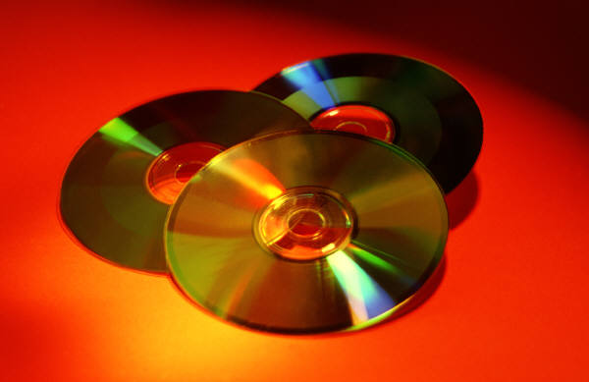
Computing Systems
A computer is a machine designed to perform operations specified with a set of instructions called a program.
Hardware refers to the computer equipment.
  keyboard, mouse, terminal, hard disk, printer
Software refers to the programs that describe the steps we want the computer to perform.

Slide 10
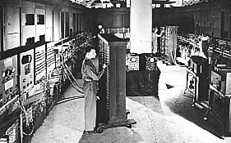
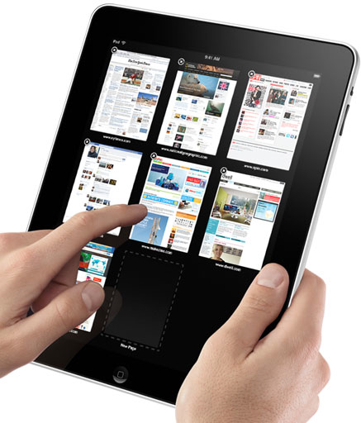
Computer Hardware
Display
Device
Memory
CPU
Storage
Device
RAM
Output
ALU
Input
CPU - Central processing unit
ROM - Read only memory
  Power off, data saved
RAM - Random access memory
  Power off, data lost
Computer

Slide 11
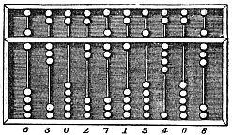


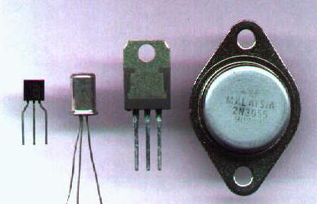
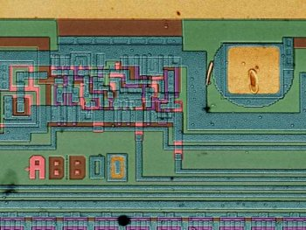
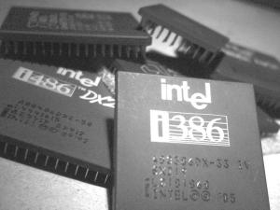
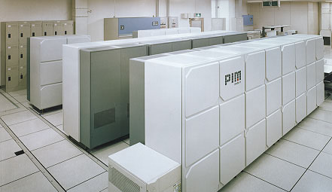
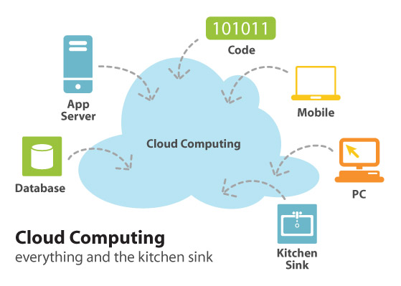
Computer Systems
First Generation
  1940-1950 Vacuum tubes
Second Generation
  1950-1964 Transistors
Third Generation
  1964-1971 Integrated Circuits
Fourth Generation
  1971-present Microprocessors
Fifth Generation
  Future Massively Parallel
Cloud
  Current Internet-based
www.wordiq.com/definition/History_of_computing_hardware

Slide 12
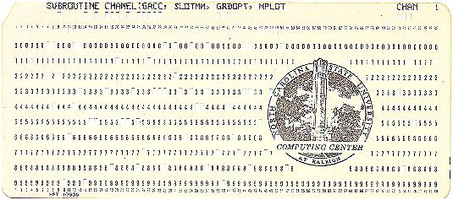



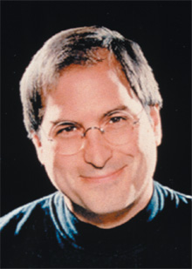
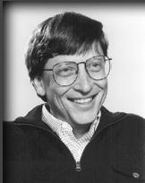
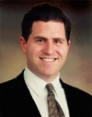
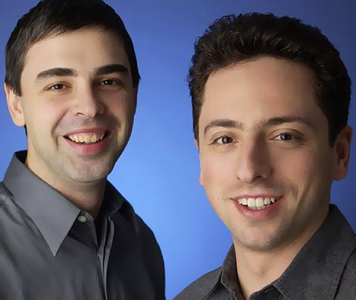
Computer Software
Operating System
  interface with the user
  unix, windows, linux, ...
Software Tools
  word processors (MicrosoftWord, WordPerfect, ...)
  spreadsheet programs (Excel, Lotus1-2-3, ...)
  mathematical computation tools (MATLAB, MathCAD, ...)
Computer Languages
  machine language
  assembly language
  binary language
  high level languages
  (C, C++, FORTRAN, VB, java)
Web Applications
  Search engines
  Online shopping
  VOIP
Reed
Harvard
UT
Stanford

Slide 13
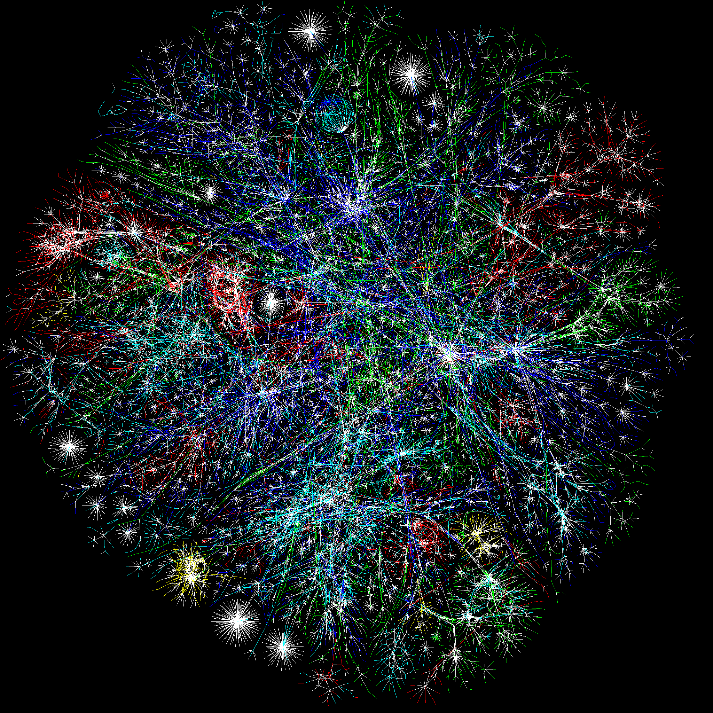
The Internet
International computer network connecting …everybody
Computer networking and communications technology
  i.e., wires and routers, those things that connect computers
  TCP/IP (Transmission Control Protocol/Internet Protocol) directs the flow of data between computers on the internet
The Internet allows you to communicate with computer users around town and around the world

Slide 14
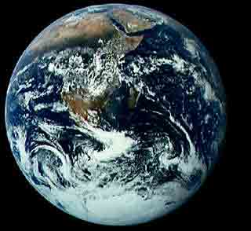
World Wide Web (WWW)
An open approach to information sharing
Providing a distributed “hyper”-media system to easily access information spread across the world
“Hyper”-text
  A way to link and access information of various kinds as a web of nodes in which a user can browse at will
  Operation of the Web relies on hypertext to interact with users
  Enables you to read and navigate information in a nonlinear way based on what you want to know
  Browser - programs which provide access to hypertext docs on the web
HTML (Hypertext Markup Language)
  Formatting standard for hypertext documents

Slide 15
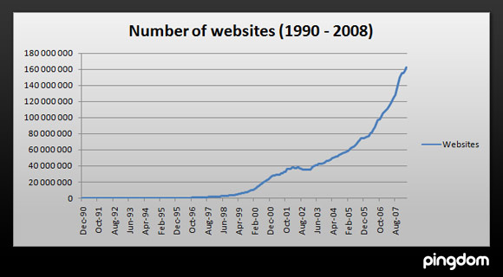
How big is the internet?
1830 million: individuals will use the Internet in 2010
> 1 trillion web pages
5 million Tera bytes of data
> 500 million use the Internet at least once a week
Google Zeitgeist Search Queries: 2009
  Fastest Rising (Global)
  michael jackson
  Facebook
  Tuenti
  Twitter
  Sanalika
  new moon
  lady gaga
  windows 7
  dantri.com.vn
  torpedo gratis

Slide 16
Model Building Process
Problem identification
  Important elements to be modeled
  Relations and interactions between them
  Degree of accuracy
Conceptualization and development
  Mathematical description
  Type of model
  Numerical method - computer code
  Grid, boundary & initial conditions
Calibration
  Estimate model parameters
  Model outputs compared with actual outputs
  Parameters adjusted until the values agree
Verification
  Independent set of input data used
  Results compared with measured outputs

Slide 17
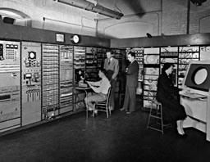

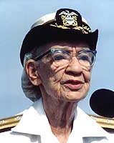
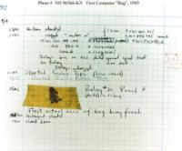
Programming Process
Algorithm Design
(underlying logic of program)
Program Composition
Debug & test
(error free & reliable)
Program Documentation
Program Maintenance
First “Bug”
Grace M. Hopper

Slide 18
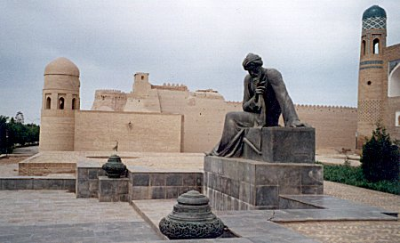
Algorithms
AL-KHOWARIZMI
Example:
  Write a letter.
  To mail it, you must decide how much postage to put on the envelop.
Rule of Thumb: One stamp for every 5 sheets of paper.
Algorithm: Step-by-Step procedure for solving a problem
  Input = Number of sheets of paper in the letter
  Divide Sheets by 5. Round up to the next highest whole number
  Output = Number of Stamps
INPUT
(16)
Processing
Output
(4)

Slide 19
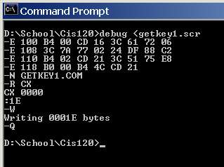
Composing a Computer Program
High-level
language
Low-level
Language
Input data
Source
code
Compiler
Machine
language
Link/load
Executable
module
Output
Programmer
  Writes program in source code (VB or other language)
Compiler
  Converts source code to machine language code
Linker
  Combines machine language with libraries & converts them to an executable module
Interpreter
  Converts source code to machine language and executes one line at a time

Slide 20
6 Elements of Programming
6 things you need to program in any language:
  Variables
  Input/Output
  Selection
  Subprograms
  Repetition
  Arrays
VB
C, C++, C#
FORTRAN
Pascal
Cobol
Java, J++
YouNameItLanguage

Slide 21
Summary
Course Introduction and Housekeeping
Computer Systems – Hardware and Software
The Internet
Program Planning

