Slide 1
Subprograms
CE 311 K - Introduction to Computer Methods
Daene C. McKinney

Slide 2
Introduction
Modularity
Sub Procedures
Arguments
  Pass By Value
  Pass By Reference

Slide 3
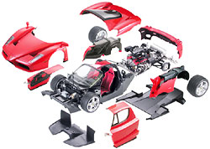
Modularity
Decompose problems into components
Model how components interact with each other
Subprograms are used for this decomposition
  Independent sections of code that performs specific tasks
  Written and tested separately
  Easier to maintain and modify
  Pre-defined libraries
  programmer defined libraries
www.tamiya.com

Slide 4
Sub & Functions Procedures
Sub Procedures
  Used to perform tasks
  Can return values in their arguments
  Used to receive or process input, display output or set properties
Function Procedures
  Return a value in the function name
  Used for calculations

Slide 5
Sub Procedures
A “Sub” procedure
  is part of a Program
  performs a task (or 2)
  has a name
  is invoked with a “Call” statement
A “Sub”
  has its own code
  Program
  …
  Call Name( )
  …
  End program
Program
  Sub Name( )
  statement(s)
  End Sub
Sub
procedure

Slide 6
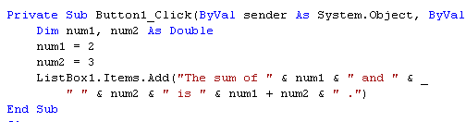
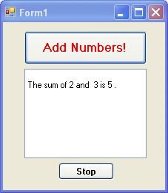
Example – w/o Sub
This version does NOT use a “sub”

Slide 7
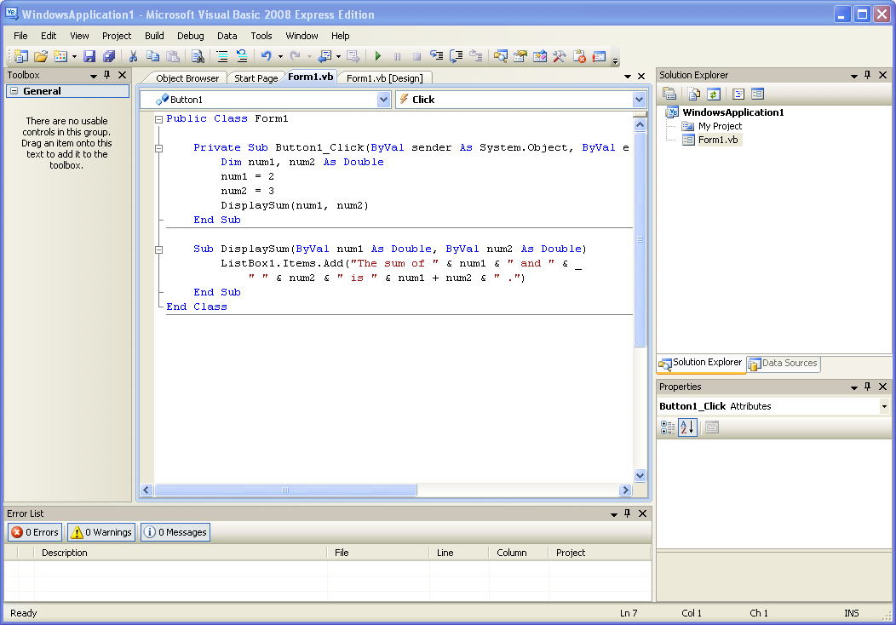
Example – w/Sub
This version does use a Sub

Slide 8
Example – w/Sub
Program “calls” Sub procedure
Sub
procedure
Sub receives the variable “value”
Sub declares the variables in title line

Slide 9
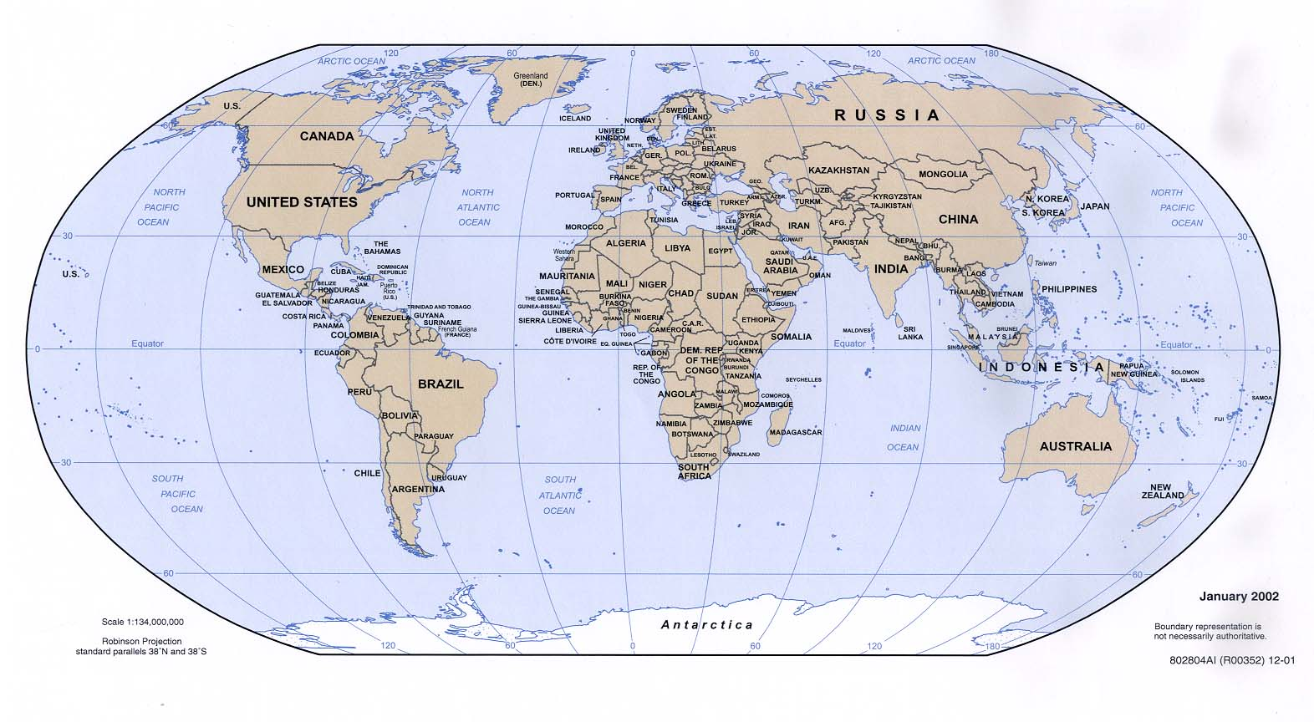
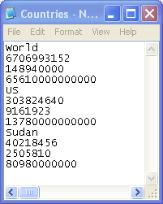
Example – w/ Sub & File I/O
Country
Population
Area (sq km)
GDP ($)

Slide 10
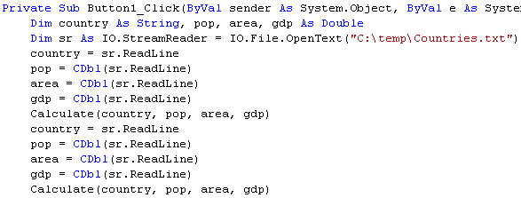
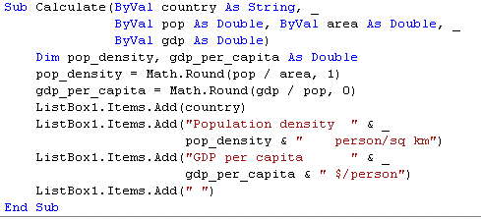
Example

Slide 11
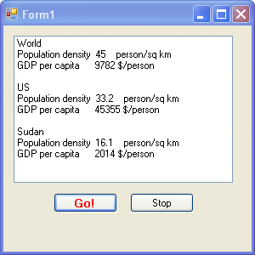
Example

Slide 12
Argument Passing By Value
Pass By Value
  Sends the value of the argument to the Subprogram
  Argument is evaluated and its value is passed and used locally in the Subprogram
  Subprogram can not change the value of the variable in the calling program
Arguments
Value
Value
Parameters
Sub uses value of parameters locally using values passed from calling program. We can use different names in the Sub.

Slide 13
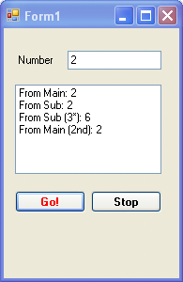
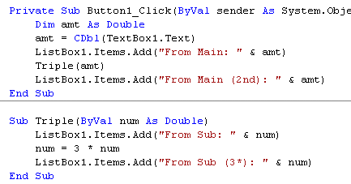
Example – Pass By Value

Slide 14
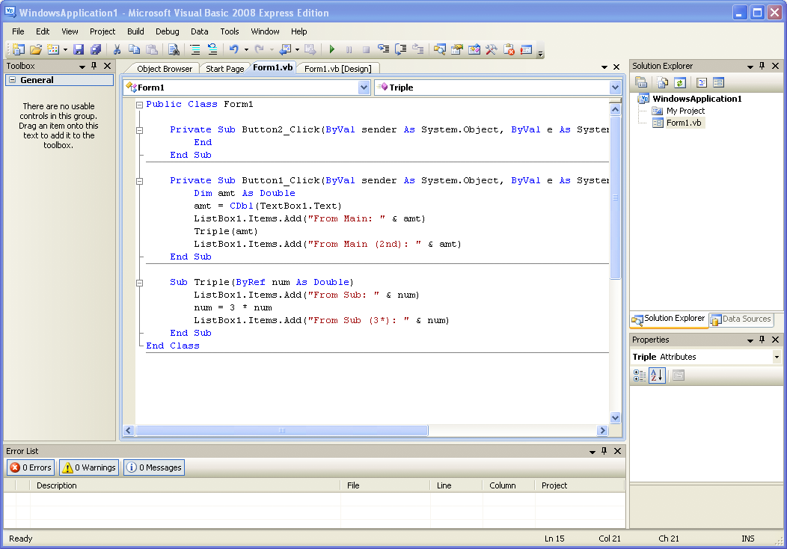
Argument Passing By Reference
Pass By Reference
  Memory address of argument passed
  Argument value can be changed in the Subprogram
  Value in the calling program is also changed
amt
Sub uses value of parameters locally using address passed from calling program. Sub changes value residing at the address of the argument. This also changes it in the calling program.
Memory
address
num

Slide 15
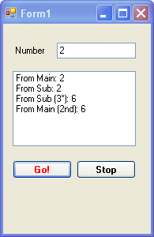
Example – Pass By Reference

Slide 16
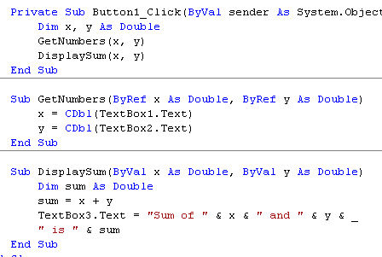
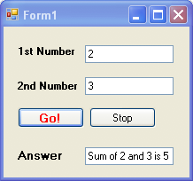
Example – Pass By Reference

Slide 17
Summary
Modularity
Sub Procedures
Arguments
  Pass By Value
  Pass By Reference

